Slide 1

Practical, Patient Report Measures for Primary Care: Progress on the My Own Health Report (MOHR) Project to Date
Russell E. Glasgow, Ph.D.
Suzanne Heurtin-Roberts, Ph.D., M.S.W.
Implementation Science Team, DCCPS
National Cancer Institute
Presented to NIDA, July 23, 2013

Slide 2

Overview
Rationale and Need for Practical Patient Report Measures
Implementation Science and Translational Perspective
Selecting Practical, Actionable Measures and Pragmatic Design for MOHR
MOHR Development, Current Status, Lessons Learned
Future Directions and Discussion

Slide 3
NCI Implementation Science Team Vision
To achieve the rapid integration of scientific evidence, practice, and policy, with the ultimate goal of improving the impact of research on cancer outcomes and promoting health across individual, organizational and community levels.
http://cancercontrol.cancer.gov/IS/

Slide 4
Translational Research: A T0- T4 Model
Promising
Application
(e.g. genetic test)
T2
Evidence-based
Guideline/
Policy
T1
Clinical
T0
T3
Basic
Knowledge
Integration
Discoveries
(e.g., genetic
risk factor)
Practice &
Control Programs
Population
T4
Reducing the
Burden of Disease
Focus of Implementation Science – T3 and T4
Modified from Khoury et al. Genetics in Medicine 2007;9(10):665-674
Glasgow RE, et al. Am J Public Health 2012;Jul;102(7):1274-1281
Notes:
Peyton, Russ said that you and he talked about adding Implementation Science to the T3-T4 area, so go for it.

Slide 5
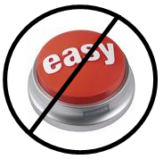
Key Issues in Integrating Research into Policy and Practice
Contextual
Complex
Multi-component programs and policies
Non-linear
Transdisciplinary
Multi-level
Addresses “wicked”, messy, important problems
Glasgow R & Steiner J. (2012). In Dissemination and Implementation Research. Brownson, R, Colditz, G, and Proctor, E (Eds.). Oxford University Press

Slide 6

Bench to Bookshelf

Slide 7
Implementation Science Models Key Common Points
Context is critical
Begin with stakeholders—take their perspective
Design for dissemination—from beginning—cannot wait until the end
Need balance between fidelity to evidence-based program and adaptation to local setting
Tabak RG, Khoong EC, Chambers DA, Brownson RC. Bridging research and practice: models for dissemination and implementation research. Am J Prev Med. 2012 Sep; 43(3):337-50.

Slide 8
Pragmatic Perspective / World View
“The importance of an idea or action lies in whether it makes a difference in everyday life. Ideas or actions that correspond to attractive explanations (e.g., metaphysical theories), but make no difference to outcomes, are problematic.”
~Charles Pierce

Slide 9
Basic Idea
A pragmatic trial is a real-world test in a real-world population, whereas an explanatory trial is a specialized experiment in a specialized population and often optimal setting*
Pragmatic does not mean being less rigorous
*Maclure, 2009 CMAJ

Slide 10
Designing a Pragmatic Trial: Consider the RE-AIM Framework
Reach: percent and representativeness of participants—getting those most in need?
Adoption: Settings and staff who can deliver
Effectiveness: for which groups on which outcomes; unanticipated results
Implementation: costs, fidelity and adaptation
Maintenance and sustainability
www.re-aim.org
Kessler RS, et al. What Does It Mean to ''Employ'' the RE-AIM Model? Eval Health Prof 2012;Mar;36(1):44-46.

Slide 11
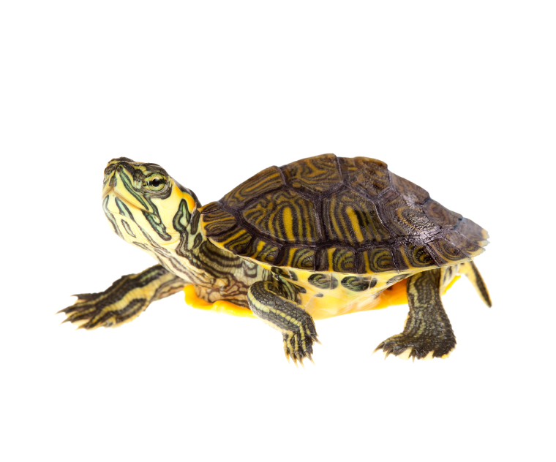
Challenge: Clinical Research is Slow, Expensive, and Often Does Not Translate
To most people, randomized controlled trials (RCTs) are the mainstay of clinical research.
But traditional RCTs are slow and expensive—and rarely produce findings that are easily put into practice.
In fact, it takes an average of 17 years before 14% of research findings lead to widespread changes in care.

Slide 12
Key Differences between Efficacy RCTs and Pragmatic Studies
 | A traditional RCT tests a hypothesis under ideal conditions | A PCT compares treatments under everyday clinical conditions
GOALS | To determine causes and effects of treatment | To improve practice and inform clinical & policy decisions
DESIGN | Tests the intervention against placebo using rigid study protocols & minimal variation | Tests two or more real-world treatments using flexible protocols & local customization
PARTICIPANTS | Highly defined & carefully selected | More representative because eligibility criteria are less strict
MEASURES | Require data collection outside routine clinical care | Brief and designed so data can be easily collected in clinical settings
RESULTS | Rarely relevant to everyday practice | Useful in everyday practice, especially clinical decision making

Slide 13
PCTs: Fewer Exclusions Allow for a Broader Subset of Settings, Staff, and Participants
Traditional RCT
Pragmatic Control Trial
Eligible population
Eligible population
Exclusions, non-response, etc.
Exclusions, non-response, etc.
Efficacy, among a defined subset
Effectiveness, in a broad subset
Figure provided by Gloria Coronado, PhD, Kaiser Permanente Center for Health Research

Slide 14
Pragmatic Study Methods: Key Characteristics
Questions from and important to stakeholders
Multiple, heterogeneous settings
Diverse populations
Comparison conditions are real-world alternatives
Multiple outcomes important to decision and policy makers
Thorpe KE et al., Can Med Assoc J, 2009;180:E47-57
Tunis SR et al. Practical clinical trials…JAMA 2003;290:1624-1632
Glasgow RE et al. Practical clinical trials…Med Care 2005;43(6):551-557

Slide 15
Take-Home Messages: Benefits of PCTs for Health Systems, Patients, and Providers
Actionable
Designed around application to practice, with an emphasis on successful implementation.
Patient Centered
Research questions and goals are strongly aligned with patient-centered research and care.
Relevant
Transparent reporting of results that are focused on issues and data that are relevant for making decisions and taking action.

Slide 16
Evidence Integration Triangle (EIT)
Intervention Program/Policy (Prevention or Treatment)
(e.g., key components; principles; guidebook; internal & external validity)
Feedback
Feedback
Evidence
Stakeholders
Participatory Implementation Process
(e.g., stakeholder engagement; CBPR; team-based science; patient centered)
Practical Progress Measures
(e.g., actionable & longitudinal measures)
Feedback
Multi-Level Context
Intrapersonal/Biological | Policy
Interpersonal/Family | Community/Economic
Organizational | Social/Environment/History
Glasgow RE, Green LW, Taylor MV, Stange KC. AJ Prev Med 2012;42(6):646-654

Slide 17
EIT Conclusions
The evidence-based movement is a good start, but only gets us so far
To make greater progress, two other elements also need attention:
Practical MEASURES to track progress and
Implementation PROCESSES that use partnership principles
These 3 legs of the “EIT” are each necessary but not sufficient by themselves
http://cancercontrol-dev.cancer.gov/IS/presentations

Slide 18
Practical Measures Criteria—For Use in Real-World Settings and Pragmatic Research
Required Criteria
Important to stakeholders
Burden is low to moderate
Sensitive to change
Actionable
2. Additional Criteria
Broadly applicable, has norms to interpret
Low probability of harm
Addresses public health goal(s)
Related to theory or model
“Maps” to “gold standard” metric or measure
Glasgow, R. E. & Riley, W. T. Pragmatic measures… Am J Prev Med 2013.

Slide 19
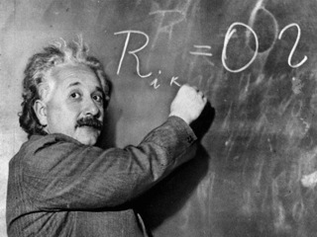
“The significant problems we face cannot be solved by the same level of thinking that created them.” ~A. Einstein

Slide 20
Pragmatic Example:
Using Practical Measures Based on a Pragmatic Model in a Pragmatic Trial— The My Own Health Report *
(MOHR Project)
* For general, adult primary care patients with or without disease(s)

Slide 21
Evidence Integration Triangle (EIT)—A Patient-Centered Care Example
Intervention Program/Policy Evidence-based decision aids to provide feedback to both patients and health care teams for action planning and health behavior counseling
Evidence:
US Preventive Services Task Force recommendations for health behavior change counseling; goal setting & shared decision making
Feedback
Feedback
Stakeholders:
Primary care (PC) staff, patients and consumer
groups; health care system decision makers; groups involved in meaningful use of EHRs
Practical Progress Measures
Brief, tested, standard patient reported data items on health behaviors & psychosocial issues—actionable and administered longitudinally to assess progress
Participatory Implementation Process
Iterative, wiki activities to engage stakeholder community, measurement experts and diverse perspectives
Feedback
Multi-Level Context
Dramatic increase in use of EHR | CMS funding for annual wellness exams
Primary Care Medical Home | Meaningful use of EHR requirements
Glasgow RE, Green LW, Taylor MV, Stange KC. AJ Prev Med 2012;42(6):646-654
Notes:
Note to self Context only a few of relevant domains listed

Slide 22
EHR Measures for Adult Primary Care
Advent of patient-centered medical home, CMS annual wellness exams, “meaningful use” of EHRs
In the billions of dollars spent on EHRs in last several years, one thing is missing: Patient-Reported Measures
Impossible to provide patient-centered care if no patient measures, goals, preferences, concerns collected
With recent advances in measurement, meaningful use incentives, time is right
Estabrooks PA, et al. Harmonized patient-reported data elements…J Am Med Inform Assoc 2012 Jul-Aug;19(4):575-82.

Slide 23
Vision for “Big Data” A Comprehensive Big Database to be Maximally Useful Should Contain:
Diagnostic and health care utilization data
Genomic and biomarker data
Patient-reported information, preferences, and patient-centered goals
Geospatial and social/physical/environmental data on fundamental determinants of health

Slide 24
MOHR Background, Phases 1 &2
SBM content experts identify 2-3 candidate measures in each of 13 key domains
Widespread web-based wiki activity: www.gem.beta.org
“Town Hall” Meeting at NIH: Day 1 town hall followed by Day 2 invited stakeholder decision makers
Post-Meeting and Beyond: Pilot study of “Patient Health Update” 2011-2012
Estabrooks PA, et al. Harmonized patient-reported data elements…J Am Med Inform Assoc 2012 Jul-Aug;19(4):575-82.

Slide 25
Identifying Patient-Report Measures Pre-MOHR Project Phase 1, 2
SBM content experts identify 2-3 candidate measures in each of 13 key domains
Widespread web-based wiki activity: www.gem.beta.org (go to “EHR Initiative”)
“Town Hall” Meeting at NIH: Day 1, town hall followed by Day 2, invited stakeholder decision makers
Post-Meeting and Beyond: Pilot study of “Patient Health Update” 2011-2012

Slide 26
EHR Measures for Primary Care
Domain | Final Measure (Source)
1. Overall Health Status | 1 item: BRFSS Questionnaire
2. Eating Patterns | 3 items: Modified from Starting the Conversation (STC) [Adapted from Paxton AE et al. Am J Prev Med 2011;40(1):67-71]
3. Physical Activity | 2 items: The Exercise Vital Sign [Sallis R. Br J Sports Med 2011;45(6):473-474]
4. Stress | 1 item: Distress Thermometer [Roth AJ, et al. Cancer 1998;15(82):1904-1908]
5. Anxiety and Depression | 4 items: Patient Health Questionnaire—Depression & Anxiety (PHQ-4) [Kroenke K, et al. Psychosomatics 2009;50(6):613-621]
6. Sleep | 2 items: a. Adapted from BRFSS b. Neuro-QOL [Item PQSLP04]
7. Smoking/Tobacco Use | 2 items: Tobacco Use Screener [Adapted from YRBSS Questionnaire]
8. Risky Drinking | 1 item: Alcohol Use Screener [Smith et al. J Gen Int Med 2009;24(7):783-788]
9. Substance Abuse | 1 item: NIDA Quick Screen [Smith PC et al. Arch Int Med 2010;170(13):1155-1160]
10. Demographics | 9 items: Sex, date of birth, race, ethnicity, English fluency, occupation, household income, marital status, education, address, insurance status, veteran’s status. Multiple sources including: Census Bureau, IOM, and National Health Interview Survey (NHIS)

Slide 27

Developing My Own Health Report
MOHR (patient-reported data tool) developed by a process of iterative crowd-sourcing:
Small group developed initial model for MOHR based on the Patient Health Update (included NIDA and SAMSHA reps)
Reviewed with changes recommended by all partners
Clinic stakeholders involved in process
Small group made recommended changes
Process repeated every 2-3 weeks over several months, Fall 2012

Slide 28
My Own Health Report (MOHR) Automated Assessment Tool
Patient Fills Out Tool
Summary display and printout for patient
Database of text messages
and triggers
Action Plan printout
Summary display and printout for health care team
Report data
stored in database
Research analysis
Krist A, et al. Designing a valid pragmatic primary care implementation trial…Implement Sci , 2013, 8:73

Slide 29
The MOHR Research Group
Funders:
National Cancer Institute
Office of Behavioral and Social Science Research
Agency for Health Research and Quality
Collaborating Research Teams
Texas A & M
University of California, Los Angeles
University of North Carolina, Chapel Hill
University of Vermont
University of Texas, Houston
Virginia Tech
Coordinating Center
Virginia Commonwealth University

Slide 30
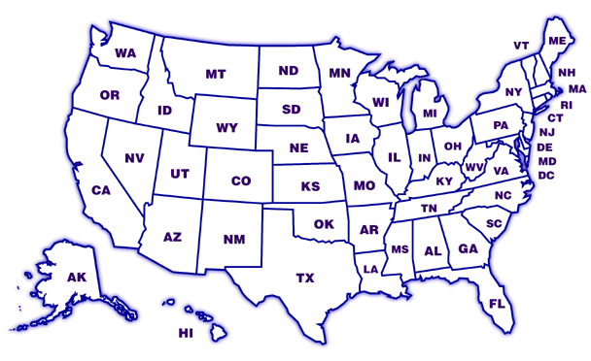
MOHR Project—Key Points
Cluster randomized trial of 9 clinic pairs, staggered early and late intervention
Approximately half of clinics community health centers; others AHRQ type PBRN clinics
Designing for flexibility and adoption—e.g., varying levels of clinic integration of EHRs, different levels and modalities of decision aids
WHAT is delivered—e.g., automated assessment tool, feedback, goal setting materials, follow-up are STANDARD
HOW this is delivered is customized to setting
Study goal = Sustainable, routine use of intervention
www.myownhealthreport.org
OR
VT
CA
VA
NC
TX

Slide 31
Other Data Collected in MOHR
Cost
Collected 2x in early intervention sites
Clinic Context
Collected 3x pre-, mid-, post-intervention, qualitative template
Project Context
Collected once, end of project, open-ended survey of key project stakeholders (e.g., researchers, funders)
Post-Implementation interview, sustainability discussion
Group interview, clinic staff

Slide 32
Key Outcomes in MOHR
Primary
Percent of patients who worked with provider to set an action plan for one or more health areas
Other
Reach: percent and representativeness of patients completing and benefitting from MOHR intervention

Slide 33
Context Assessment
(Both EIS & DIS)
Context Update- EIS
Contextual
Changes
Update- EIS & DIS
Pilot in EIS
Intervention EIS
Long-term Implementation & Adaptation Check - EIS
Cost of Intervention Collection-EIS
Cost of Intervention Collection- EIS
Implementation Data Collected-EIS
IRB Approval
Patient Experience
Survey—EIS &DIS
Post-Intervention Staff Interview—EIS
Optional MOHR Patient Reported Outcomes Follow-up--EIS
Intervention--DIS
Implementation Data Collected-DIS
Post –Intervention Staff Interviews—DIS
Pre-Implementation
1
2
3
4
5
6
7
8
9
After 9/30/13
Months
Approx. January 2013
*EIS=Early Interventions Site DIS=Later Intervention Sites MOHR= My Own Health Report

Slide 34
Pragmatic Features of MOHR
Relevant | Diverse, real-world primary care settings; and staff who do all the intervention
Rigorous | Cluster randomized, delayed intervention design
Rapid | One year from concept, planning, and execution, low cost, and cost informative
Resource Informative | Low cost; studying costs and cost-effectiveness under different delivery conditions
Transparent | Report on adaptations, failures, variation across sites and implementation models, lessons learned
Notes:
Russ made a few edits

Slide 35
Transparent Reporting on…..
Info needed to replicate or implement
Resources required—costs for patients and delivery setting perspectives
How were settings, clinicians, and patients selected—(who was excluded and why)
Adaptation—changes made to protocol, to intervention, to recruitment, etc.
Differences across settings

Slide 36
Current Status
Completing Early Intervention Phase
Different cultures in PBRNs and community health centers
This trial will be fast, inexpensive, implementation informative…and not definitive
Key focus is implementation; reach and equity are central

Slide 37
MOHR Lessons Learned to Date
Each clinic, population, and IRB is different
Key to pragmatic study success is balancing fidelity (to EB principles not static protocol) with context-sensitive adaptation
Context Changes—and needs repeated, multi-method assessment
Cost, resource, and time issues are central
Importance of flexibility for researchers and clinics

Slide 38
The Future: Pragmatic Needs and Opportunities for MOHR and in General
Health equity impacts—along multiple dimensions of RE-AIM
Context—key factors that may moderate results, measurement
Scalability—potential to impact large numbers
Sustainability after official study period
Patient/citizen/consumer and community perspective and engagement throughout
Multi-level interactions, especially between policy and practice

Slide 39

Take-Home Points
There is a pressing need for a DIFFERENT type of research: PRAGMATIC models, measures, and methods— that translate more rapidly, and are more relevant to stakeholders
There is great opportunity to learn from the convergence of results from different study methods—clinical trials, pragmatic research, observational data, simulation modeling, patient-reported data
There are many opportunities for this type of research, especially among research networks and for coalitions to study context (e.g., the HCS Collaboratory; Ca Centers, VA centers, FQHCs, HMORN, extension, PBRNs, the Y, Livestrong Centers, MOHR, etc.)

Slide 40
All Models (and Methods) are Wrong… ….Some are useful.
“To every complex question,
there is a simple answer…
and it is wrong.”
~H. L. Mencken

Slide 41

Contact us: glasgowre@mail.nih.gov
sheurtin@mail.nih.gov
IS Team Website: http://dccps.cancer.gov/is/
IS Team Email: NCIdccpsISteam@mail.nih.gov

Slide 42
Why Not Just Use PROMIS Measures?
No measures for several behaviors and issues central to this project
Most primary care, especially low-resource settings not using computer adaptive testing
Many of the issues (e.g., healthy eating, substance use are not uni-dimensional)
Short, fixed PROMIS measures generally too long

Slide 43
“Meaningful Use and EHRs”
American Recovery and Reinvestment Act (ARRA)—2009
(included HITECH Act)
Called for meaningful use:
Use of a certified EHR in a meaningful manner
Electronic exchange of health information to improve quality of health care
Use of certified EHR technology to submit clinical quality and other measures
Centers for Medicare and Medicaid Services (CMS)
2010 final rule to implement and use EHRs in a meaningful way to help improve the quality and safety of the U.S. healthcare system

Slide 44
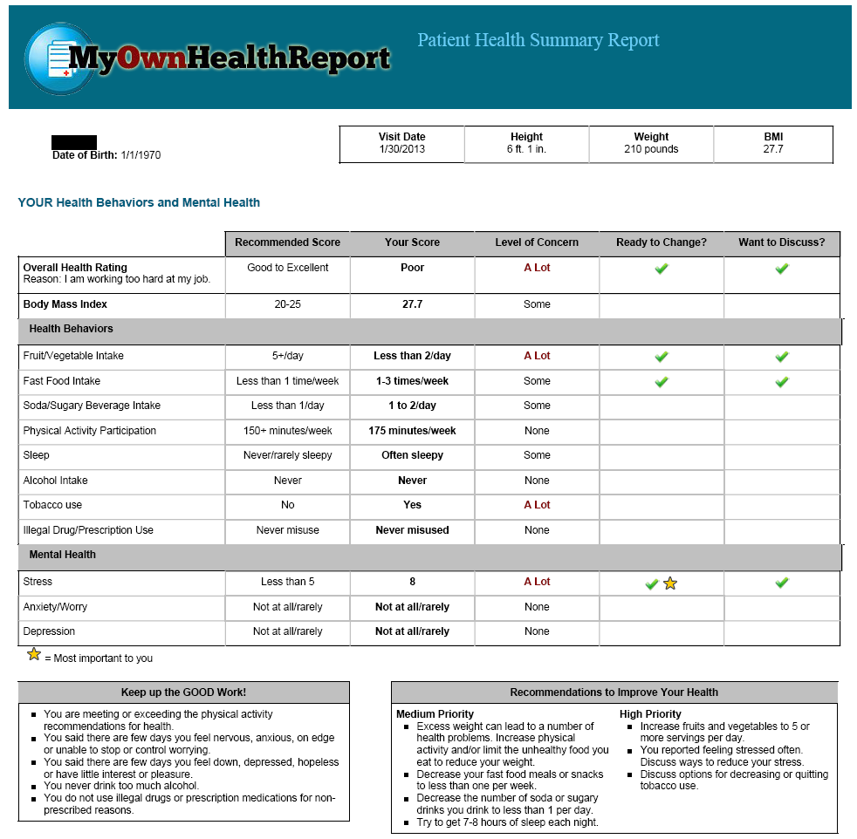
Basic patient and clinician goal advice (electronic) and goal setting (paper)

