Slide 1
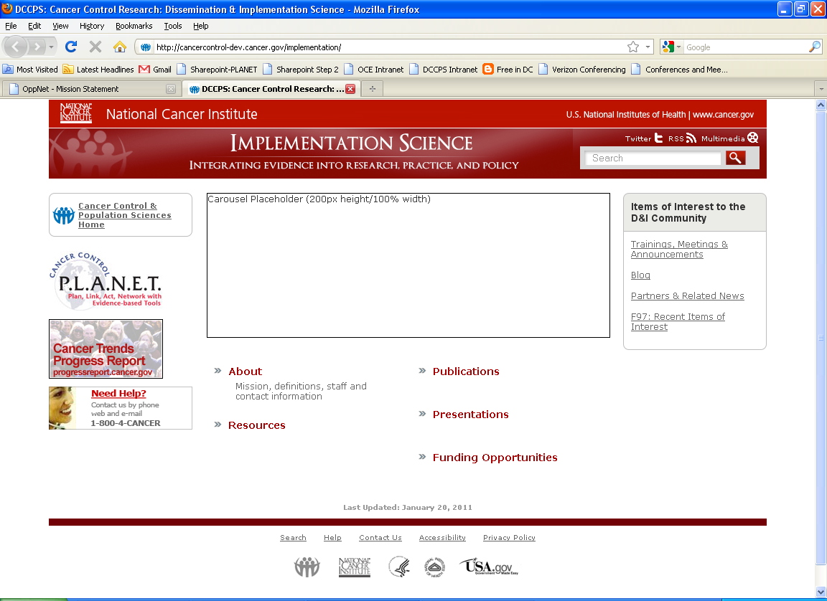
Implementation Science (IS) Team:
New Name, New Direction, & New Website
Russell E. Glasgow, Ph.D.
Deputy Director, Implementation Science
Division of Cancer Control and Population Sciences (DCCPS),
National Cancer Institute

Slide 2

Implementation Science Team:
Vision and Mission
Priorities and Goals
New/Revised Resources
To achieve the rapid integration of scientific evidence, practice, and policy, with the ultimate goal of improving the impact of research on cancer outcomes and promoting health across individual, organizational and community levels.

Slide 3
Implementation Science Team Mission
Implementation Science Team:
Vision and Mission
Priorities and Goals
New/Revised Resources
The mission of the Implementation Science (IS) Team is to build and advance the field of Implementation Science by:
Integrating new knowledge across clinical and public health research, practice and policy;
Stimulating an increasing number of competitive grant submissions on cancer implementation science that contribute to the development of innovative IS methods and study designs;
Developing a robust and supportive network of trained, interdisciplinary implementation scientists;

Slide 4
Implementation Science Team Mission Cont.
Implementation Science Team:
Vision and Mission
Priorities and Goals
New/Revised Resources
The mission of the Implementation Science (IS) Team is to build and advance the field of Implementation Science by:
Promoting science that is rigorous, transparent and relevant in the real world;
Fostering rapid learning strategies for improving individual and population health; and
Building partnerships for the development, dissemination and implementation of evidence-based measures, initiatives and programs.

Slide 5
Implementation Science Team Priority Areas
Implementation Science Team:
Vision and Mission
Priorities and Goals
New/Revised Resources
BUILD:
  Build the Science of Implementation Science (IS)
PARTNER:
  Establish Robust Partnerships
TRAIN:
  Develop Ongoing Training Networks

Slide 6


BUILD
Goal: Change the Research Paradigm (shift from efficacy to systems approaches)
Implementation Science Team:
Vision and Mission
Priorities and Goals
New/Revised Resources
Short Term Objectives:
Publish ≥5 articles in leading journals and present at ≥10 major national meetings on new IS concepts
Continue to be a key planner and supporter of NIH D&I Meeting and related initiatives to increase attention to and support of IS by NIH leaders, researchers, and the public
Long Term (2015) Objectives:
Increase # of cancer-relevant IS submissions by 33%
Increase # of funded cancer-relevant grants proposals to D&I PAR (and other mechanisms) by 25%
Increase # of accepted cancer-relevant abstracts for presentation at D&I conference by 25%

Slide 7

The Major Trans-NIH D&I Funding Announcement
Implementation Science Team:
Vision and Mission
Priorities and Goals
New/Revised Resources
R01 - PAR 10-038 ($500k per annum up to five years)
R03 - PAR 10-039 ($50K per annum up to two years)
R21 - PAR 10-040 ($275K up to two years)
Participating Institutes: NIMH, NCI, NIDA,
NIAAA, NIAID*, NHLBI, NINR, NIDDK*, NINDS*,
NIDCD, NIDCR, & Office of Behavioral &
Social Sciences Research
Starting October 2010, new standing review
committee, Dissemination and Implementation
Health Research
Three submission dates per year: February, June, October
* New Participating Institutes
http://cancercontrol.cancer.gov/funding_apply.html#is

Slide 8
Annual D&I Science Conference
March 19-20, 2012 (Bethesda MD)
Implementation Science Team:
Vision and Mission
Priorities and Goals
New/Revised Resources
Annual meetings held since 2007 - “State of the D&I Science” Venue
  Participation increased from 350 registrants in 2007 to over 1200 in 2011
  Past themes have included: “Building Capacity” and “Methods and Measures”.
    This year’s theme: “Research at the Crossroads”
  Abstracts for 2012 conference due: November 10, 2011
Meeting to be held in Bethesda on March 19-20, 2012
Registration and Call for Abstracts: http://conferences.thehillgroup.com/obssr/di2012/index.html
There is no fee to register for this conference.

Slide 9

Partner
GOAL: Assist other projects to be more likely to improve health outcomes, succeed in reducing health disparities, and be sustainable
Implementation Science Team:
Vision and Mission
Priorities and Goals
New/Revised Resources
Short Term Objectives:
Be a key contributor on two trans-HHS efforts related to IS
Support Cancer Prevention Control Research Network (CPCRN) to make identified contributions to local communities in 5 states
Have at least one trans-NIH meeting or funding initiative on Comparative Effectiveness Research –Translation (CER-T) linking primary care and public health approved (e.g. a PAR or RFA)
Long Term (2015) Objectives:
Establish and maintain 1 new national partnership per year involving multiple Division of Cancer Control and Population Sciences branches and other institutes to support innovative IS initiatives (w/ HRSA, VA, CMS, and ACS) as well as continued partnership with CDC
Collaborate

Slide 10
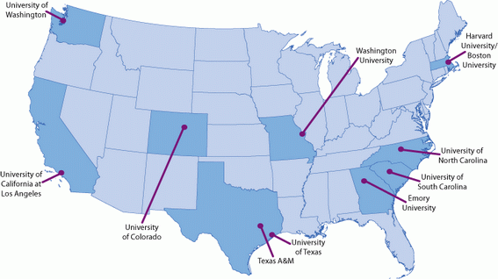

Cancer Prevention & Control Research Network
Accelerate the adoption of evidence-based cancer prevention and control in communities
Implementation Science Team:
Vision and Mission
Priorities and Goals
New/Revised Resources
Enhancing large-scale efforts and deepening understanding
Infrastructure for applying relevant research to local cancer prevention and control needs.
Subgroup of the CDC's Prevention Research Centers (PRCs) – 10 centers
http://www.cpcrn.org

Slide 11
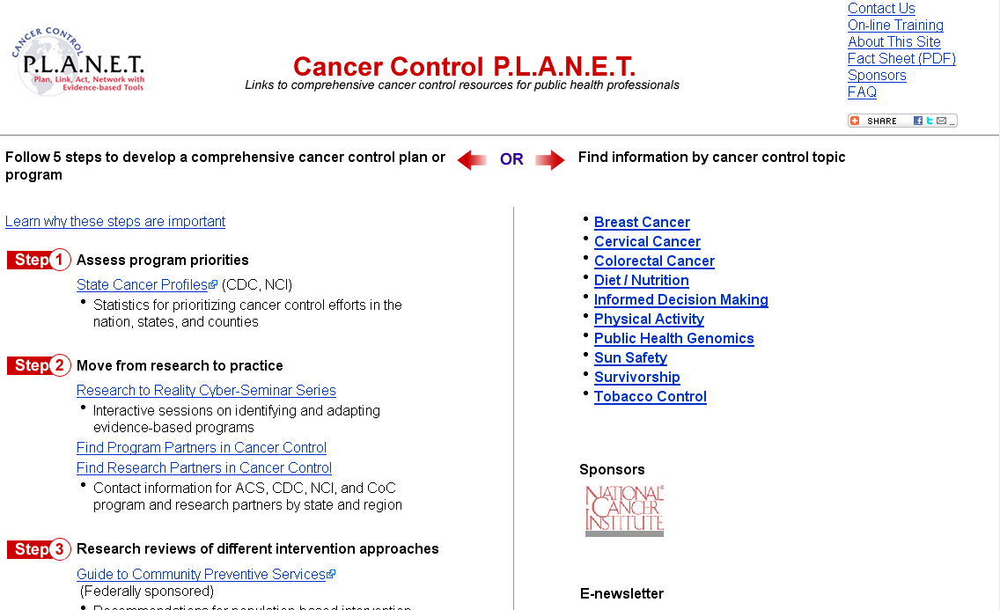
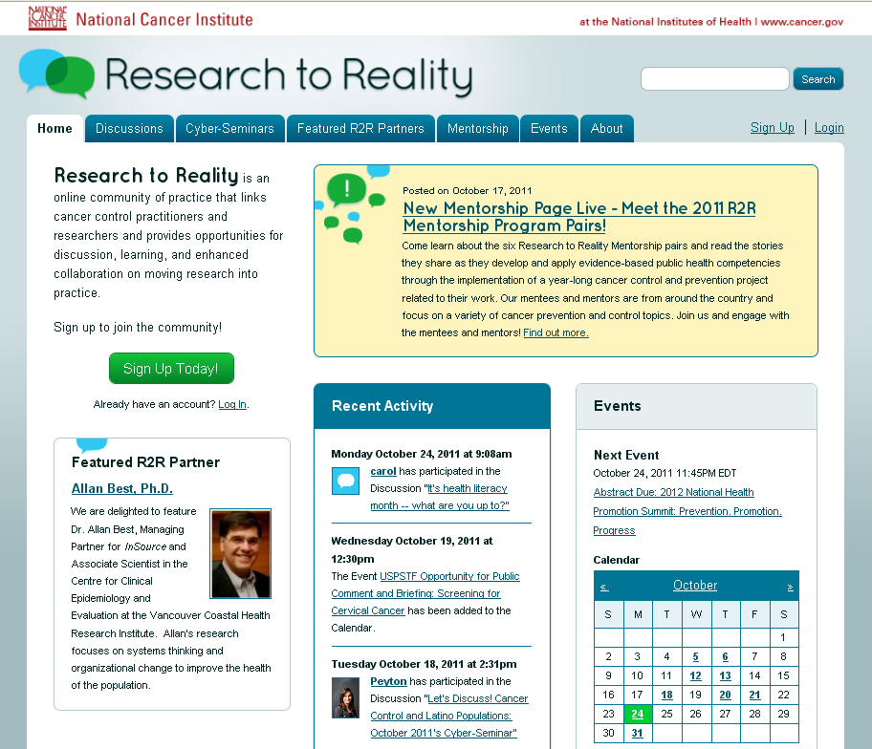

Train
Goal: Establish a strong, supportive, evolving, virtual IS community
Implementation Science Team:
Vision and Mission
Priorities and Goals
New/Revised Resources
Short Term Objectives:
Have two successful years of the NIH Summer Training Institute for D&I Research in Health
Continue NIH D&I Annual technical assistance workshop; and improve evaluation ratings
Provide training and networking for an increased # of researchers, public health practitioners, and community members via Research to Reality (R2R), Cancer Control P.L.A.N.E.T., IS Team website and other vehicles
Organize and evaluate pilot mentorship program for 6 mentee-mentor pairs on evidence-based public health
Long Term (2015) Objectives:
Train at least 140 promising new investigators and 40 established cancer-relevant investigators in IS
Train 1,000 public health practitioners in IS knowledge and skills

Slide 12
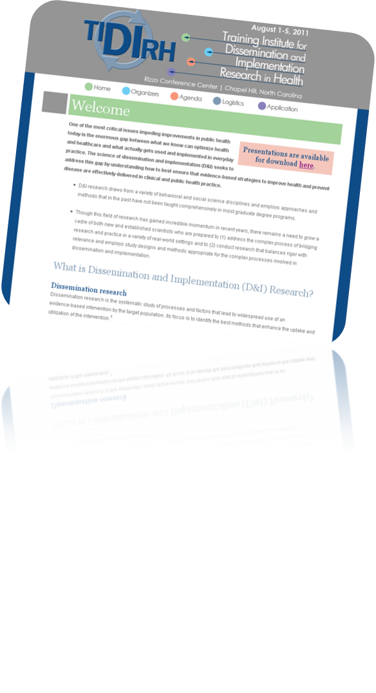
Training Institute for D&I
Research in Health
Implementation Science Team:
Vision and Mission
Priorities and Goals
New/Revised Resources
Organizers:
  Office of Behavioral and Social Sciences Research (OBSSR)
  National Cancer Institute (NCI)
  National Institute of Mental Health (NIMH)
  U.S. Department of Veterans Affairs (VA)
First Annual Training Institute – August 2011 (Chapel Hill, NC)
  35 participants
  Training Materials available online.
Applications for 2012 Institute
coming soon!
http://conferences.thehillgroup.com/OBSSRinstitutes/TIDIRH2011/index.html

Slide 13

Research to Reality (R2R):
A Virtual Community of Practice
Implementation Science Team:
Vision and Mission
Priorities and Goals
New/Revised Resources
A dialogue between practitioners and researchers on how to move evidence-based programs into practice
Launched February, 2011 (NCI) – STEP 2 of Cancer Control P.L.A.N.E.T.
  Over 600 members
Site Features:
  Monthly cyber-seminars
  Discussion forums
  Featured partners
  An events calendar
  Community profiles
  Mentorship Program
https://ResearchtoReality.cancer.gov

Slide 14
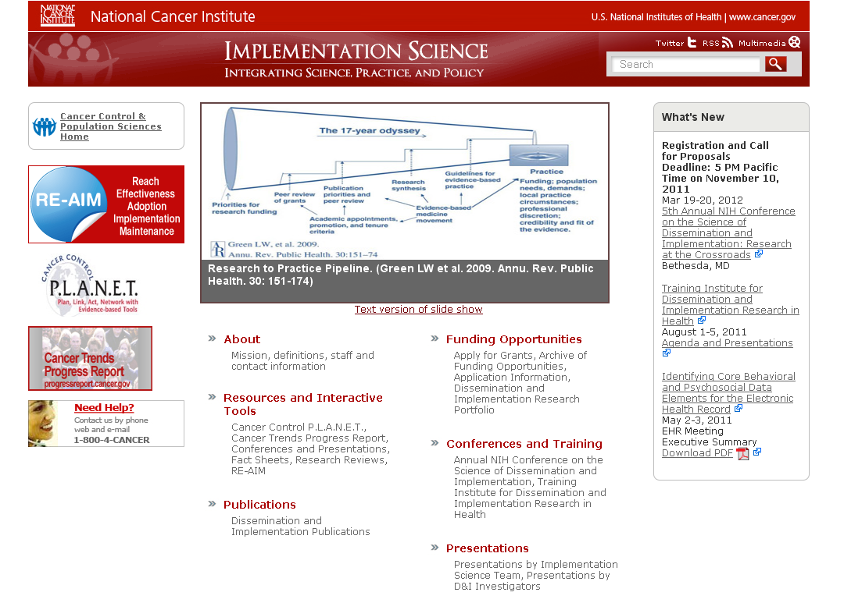
Implementation Science Team:
Vision and Mission
Priorities and Goals
New/Revised Resources
http://cancercontrol.cancer.gov/IS/index.html

Slide 15
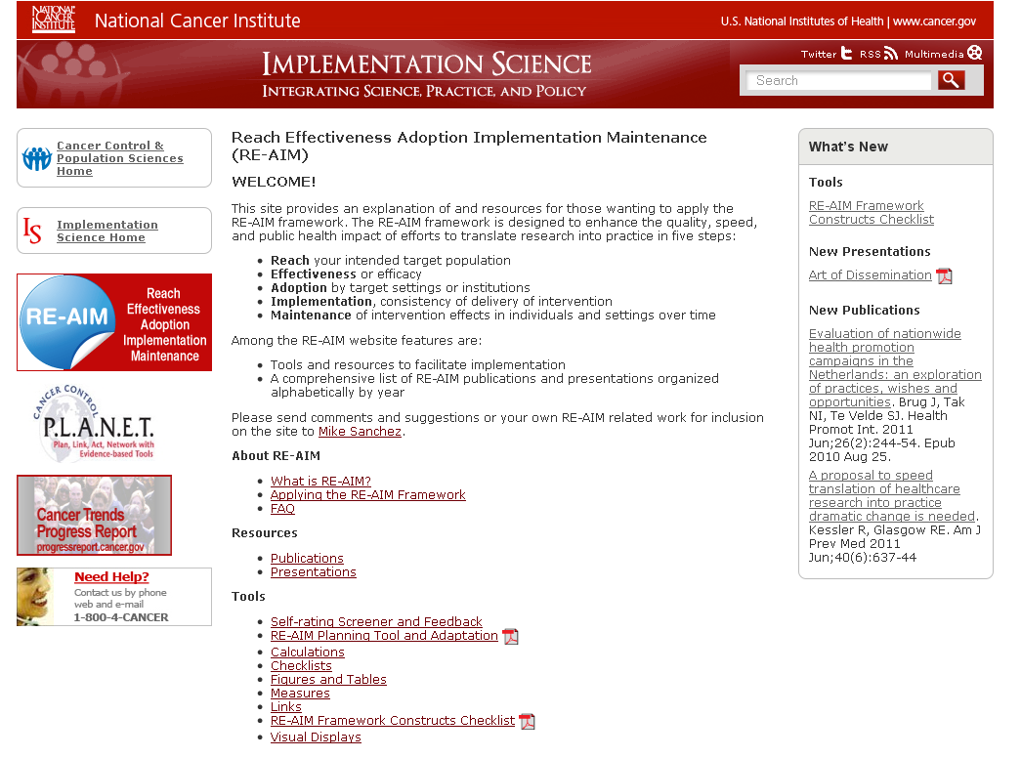
Implementation Science Team:
Vision and Mission
Priorities and Goals
New/Revised Resources
http://cancercontrol.cancer.gov/IS/reaim/index.html

Slide 16
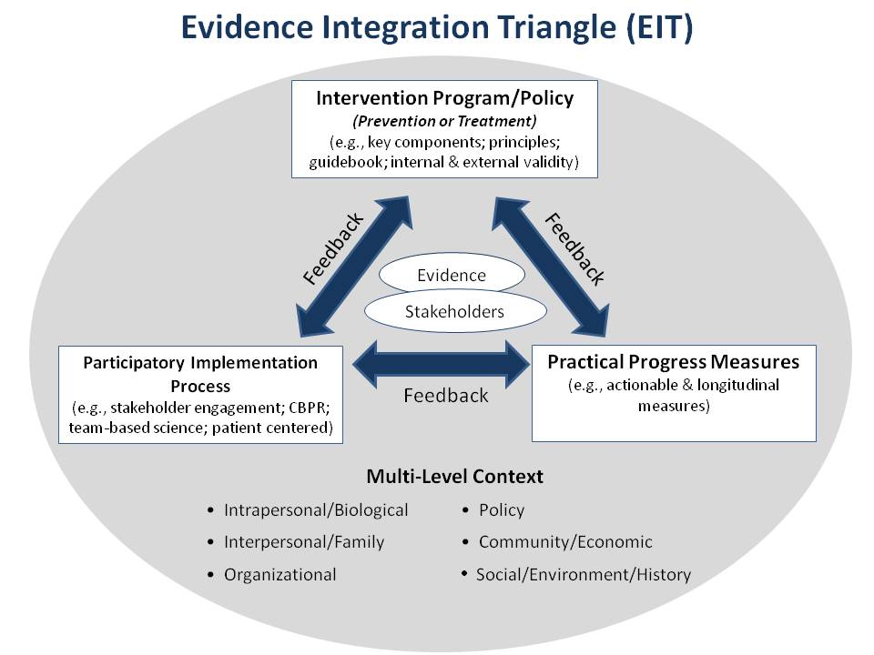
Implementation Science Team:
Vision and Mission
Priorities and Goals
New/Revised Resources

Slide 17

Coming Soon!
Implementation Science Team:
Vision and Mission
Priorities and Goals
New/Revised Resources
Redesign of Cancer Control P.L.A.N.E.T. homepage (2012)
Incorporation of external validity measures and RE-AIM tools on Research-tested Intervention Programs website (Spring 2012)
RSS Feeds and Social Media outlets on R2R
Patient-reported Outcomes for Electronic Health Records

Slide 18
Contact Us
http://cancercontrol.cancer.gov/IS/index.html
Name | Title
Laurie Cynkin, MHS | Program Analyst, Communication Specialist
Russell Glasgow, PhD | Deputy Director for IS
Arshon Parker | Contractor
Peyton Purcell, MPH, CPH | Program Coordinator/CRTA
Michael Sanchez, MPH, CHES | Public Health Advisor
Kurt Stange, MD, MPH | “Boundary Spanner” and Sabbatical IPA
Martina Taylor, MT (ASCP) | Senior Advisor
Annabelle Uy, MS | Program Analyst
Cynthia Vinson, MPA | Public Health Advisor
Office of the Director, Division of Cancer Control and Population Sciences
6130 Executive Blvd. MSC 7339
Bethesda, MD 20892-7339
Phone: 301-594-5906

