Slide 1
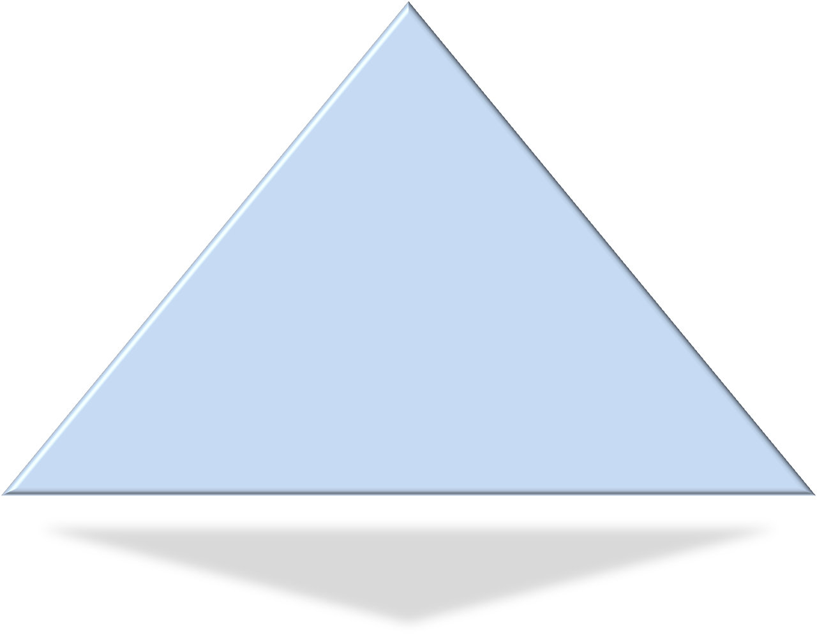
Evidence Integration Triangle
Implementation Science Team
Division of Cancer Control and Population Sciences National Cancer Institute
August 2011

Slide 2

Rationale – Square Peg, Round Hole
Majority of research tested programs do not translate into real world settings
Those that do, often take an inordinately long period of time to so so
Glasgow 2011

Slide 3

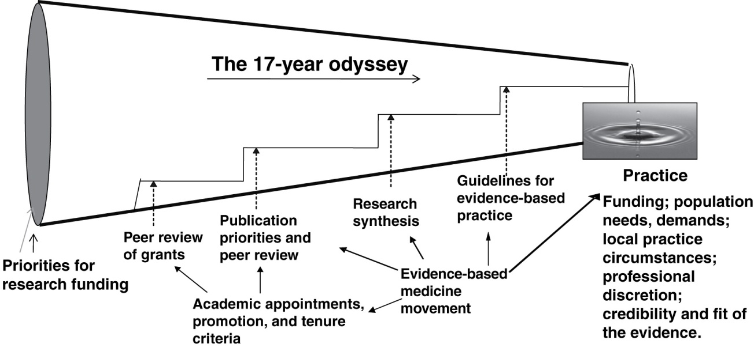
Research to Practice Pipeline
Green, LW et al. 2009. Annual Rev. Public Health. 30: 151-174
Balas EA, Boren SA. 2000. Managing clinical knowledge for health care improvement. In: Yearbook of Medical Informatics.
Notes:
‘research to practice pipeline’… illustrated here that shows the various steps in the ‘research funnel’ and implies’ leakage between the various steps.
The common thought is that there is some ‘leakage’ in going from one step of this linear pipeline to the next…. And which assumes that the optimal solution is ‘discovered’ early on and frozen in time. Some of us, in contrast, think that this model is broken and that a better representation would be a huge oil spill as shown in the background. Rather than ‘a little leak here and there- so much leaks, that most of the valuable commodity- like the water in the Colorado River, never makes it to its destination at all. Additionally, it is not just about “leakage” but often a failure of asking the right questions about context.

Slide 4
Evidence Integration Triangle
Intervention Program/Policy
(Prevention or Treatment)
(e.g. design; key components; principles; external validity)
Evidence
Stakeholders
Multi-Level Context
Intrapersonal/Biological | Policy
Interpersonal | Community/Economic
Organizational | Social/Environment
Glasgow 2011
Notes:
Let’s take look at what is needed to close this gap or chasm, and why the ‘evidence-based’ movement has not been sufficient to foster such dissemination.
It is all about context. And context is multi-level and all these levels need to be considered when thinking about a problem and developing or implementing an intervention.
Unfortunately, context and setting factors- although critically important, are often not considered part of the ‘evidence’ that is reported.
(After first click): Next, we have to consider the stakeholders and stakeholder engagement. The stakeholders could be a community group, clinicians, political leaders, community members, program staff, etc. With this group, the goal(s) and objectives are defined and consider the evidence.
(After click 2): The first component of the evidence-based triangle we need to consider is the program or policy intervention. There are a number of reviews that exist (Cochrane, Community Guide, AHRQ guidelines, etc) that outline the evidence of intervention design, key components and principles. What has, in the past, been lacking is a focus on external validity. There is still work do be done so that intervention designs include factors that make research both “rigorous and relevant” and thus far we have ignored the relevance.
We consider this evidence to be NECESSARY BUT NOT SUFFICIENT to produce wide scale uptake and successful implementation

Slide 5
Evidence Integration Triangle
Intervention Program/Policy
(Prevention or Treatment)
(e.g. design; key components; principles; external validity)
Evidence
Stakeholders
Practical Progress Measures
(e.g. actionable & longitudinal measures)
Multi-Level Context
Intrapersonal/Biological | Policy
Interpersonal | Community/Economic
Organizational | Social/Environment
Glasgow 2011
Notes:
Leg two is the practical progress measures. This is how we know how well we are doing and needs to be done iteratively throughout development and implementation. But to do so, these measure must be practical so they can, like an intervention, be appropriate and relevant to the setting in which they are used.
These measures are often part of CQI programs, but often those measures do not have established reliability or validity.
In contrast, most of the research tools to evaluate progress are so lengthy or burdensome as to not be practical for use in applied settings.
Like Evidence-based interventions, practical measure of progress are also NECESSARY BUT NOT SUFFICIENT

Slide 6
Evidence Integration Triangle
Intervention Program/Policy
(Prevention or Treatment)
(e.g., design; key components; principles; external validity)
Evidence
Stakeholders
Implementation Process
(e.g., stakeholder engagement team-based science; CBPR; patient centered care)
Practical Progress Measures
(e.g., practical, actionable & longitudinal measures)
Multi-Level Context
Intrapersonal/Biological | Policy
Interpersonal | Community/Economic
Organizational | Social/Environment
Glasgow 2011
Notes:
The third leg of the triangle is the implementation process. This is really how one implements things and the evidence around the process. This has for the most part be excluded from the evidence-based focus thus far (this will be covered more in a couple of slides).
This is the HOW part of the triangle.
Now lets look in more detail at each of these aspects of the triangle

Slide 7
Intervention Program/Policy – The “What”
Evidence Integration Triangle
Identify key components or theoretical principles
Need for detailed implementation guides,
lessons learned manuals
Need to focus and report on both internal
and external validity (need to add relevance to
rigor)
Current focus mostly on treatment, more is needed on prevention, and even more on policy
“If we want more evidence-based practice,
we need more practice-based evidence.”
Green LW & Glasgow R. Eval Health Profess. 2006, 29: 126-53.
Rothwell, PM. Lancet. 2006, 365:82-93.
Glasgow 2011
Notes:
This is the “what” - it is the theoretical principles and the key components of the intervention. Like context, these interventions are most often multi-level.
Researchers and practitioners need to provide detailed implementation guides and lessons learned – show what can and cannot be modified (key components)
Reiterate that we must focus on evidence that is both internally and externally valid (for researchers, this means developing interventions that are relevant and realistic and for practitioners, this may refer more to evaluating an intervention on both the internal and external validity before selecting and implementing it and if it is relevant for their setting).
In terms of relevance, we need to consider the cost, value, the settings, etc. in which this intervention will be ultimately delivered.

Slide 8

Practical Measures of Progress – the “So What”
Evidence Integration Triangle
Measures need to be:
Brief and practical
Collected longitudinally to assess progress
Reliable and valid
Sensitive to change
Have national norms, easily understood and ACTIONABLE
Culturally appropriate across groups
Reflect multiple stakeholder perspectives
Society of Behavioral Medicine Health Policy Statement on Public Health Need for Patient Reported Measures. http://www.sbm.org/policy/patient-reported_measures.pdf
Glasgow 2011
Notes:
More specifically, measures need to be designed and selected with evidence in mind. Measures to track progress and provide feedback on progress toward goals should be… brief and practical enough to be able to be collected over time and sensitive enough to assess change
(ex. Some of the best measures such as quality of life are not all that sensitive on a short term basis).

Slide 9
Implementation Process – The “How”
Evidence Integration Triangle
Partnership and Community Based Participatory Research (CBPR) approaches¹
Patient-centered Care Approach
Team science in action^{2,3}
Iterative, self-correcting
¹ Guidelines and Categories for Classifying Participatory Research Projects in Health: http://lgreen.net/guidelines.html
²Gray, D. O. (2008). In C. L. S. Coryn& M. Scriven (Eds.), Reforming the evaluation of research. New Directions for Evaluation, 118, 73–87.
³Mâsse, LC, et al. Am J Prev Med. 2008; 35 (2S): S151-S160.
Glasgow 2011
Notes:
What do we mean by this? For example, if we are talking about a primary care setting, we are talking about how patient-centered is your care. If we are talking about a community program, are you really using CBPR and partnership approaches. If we are talking about a research collaboration center, CTSI, are we really using team science principles. Or are we just paying lip service to these principles, but not actually implementing them in action.
The process needs to be iterative and self-correcting. The participants need to feel they have the permission to fail and they are not on the line. It is often through failure that we learn and correct ourselves, which, again, incorporates the need for an iterative process. And, as with the other components of the triangle, stakeholder engagement and buy-in is critical.

Slide 10


Evidence Integration Triangle
Intervention Program/Policy
(Prevention or Treatment)
(e.g., design; key components; principles; external validity)
Evidence
Stakeholders
Implementation Process
(e.g., stakeholder engagement; team-based science; CBPR; patient centered care)
Practical Progress Measures
(e.g., actionable & longitudinal measures)
Multi-Level Context
Intrapersonal/Biological | Policy
Interpersonal | Community/Economic
Organizational | Social/Environment
Glasgow 2011
Notes:
Currently almost all our D and I efforts are focused on the top point in the triangle- established evidence….and then often assuming that ‘magic will happen’ and this evidence-based intervention will somehow automatically diffuse.
This is to demonstrates there, currently, is too much focus on just evidence-based interventions and little attention paid to incorporating evidence into the implementation process and measurement.
(click): Ideally, we need to balance out these three components more and focus our time and efforts on establishing and integrating evidence into and from each of these when designing and implementing solutions to public health problems. This is the second take home message. First is context is king, second is we need to address all three of these legs of the triangle and not only integrate the evidence into each leg but also integrate the legs with one another.

Slide 11
Evidence Integration Triangle
Intervention Program/Policy
(Prevention or Treatment)
(e.g., design; key components; principles; external validity)
Feedback
Feedback
Evidence
Stakeholders
Implementation Process
(e.g., stakeholder engagement; team-based science; CBPR; patient centered care)
Practical Progress Measures
(e.g., actionable & longitudinal measures)
Feedback
Multi-Level Context
Intrapersonal/Biological | Policy
Interpersonal | Community/Economic
Organizational | Social/Environment
Glasgow 2011
Notes:
Like the Chronic Care Model and most models, the key is not just that this components exist and are done, but it is how they are connected that is important. Do the activities interact with one another or do they conflict? Continual feedback and two-way connection is needed.

Slide 12
Conclusions
The evidence-based movement was a good start, but only gets us so far
To make greater progress, two other elements also need attention:
    Practical MEASURES to track PROGRESS, and
    Implementation PROCESSES that use partnership principles
    The 3 legs of the ‘EIT” are each necessary but not sufficient by themselves

