Slide 1

Using RE-AIM to Address Health Impact Evaluation Issues
Cynthia A. Vinson, MPA
Implementation Science Team
Division of Cancer Control and Population Sciences
American Evaluation Association Annual Conference
October 26, 2012

Slide 2


Outline of Talk
Background and Definitions
Comprehensive use of RE-AIM framework
Adaptation of RE-AIM for rating evidence-based interventions
Creation of new RE-AIM tool for practitioners

Slide 3
Definitions
Internal Validity – identifies causal relationships … in this study, the intervention made a difference in the outcome.
External Validity – findings are true beyond the controlled limits of the study. “To what populations, settings, treatment variables and measurement variables can this effect be generalized?” (Campbell & Stanley, 1963)
Campbell DT, Stanley JC. Experimental and quasi-experimental designs for Research. Chicago, IL: Rand McNally. 1966.
Notes:
We’re here from different disciplines, but we are assuming that most are familiar with Campbell and Stanley’s seminal work on experimental and quasi-experimental research designs. That work presented over 40 years ago described two principal types of validity – one that addresses whether or not we can infer a causal relationship between our intervention/experiment and the observed outcome (internal validity) and one that addresses whether these causal relationships can be generalized to different persons, settings, treatments and outcomes (external validity).

Slide 4
Internal vs. External Validity
What are the trade-offs of in maximizing internal or external validity?
Notes:
Ask participants and list their answers.
A focus on internal validity does not address stakeholders’ needs, abilities and concerns. Relevant or generalizable only to artificial situation.
A focus on external validity increases chance of working in the real-world.

Slide 5
Gold Standard≠ Translation
“Where did the field get the idea that evidence of an intervention’s efficacy from carefully controlled trials could be generalized as THE best practice for widely varied populations and settings?”
L.W. Green
Green LW. From research to "best practices" in other settings and populations
Am J Health Behav 2001; 25:165-78

Slide 6
External Validity
A framework for closing the gap between research and practice/policy
Notes:
Flip side of external validity:
Local applicability and realist question of which intervention components are most effective (or which outcomes) for which persons in what settings delivered under what conditions

Slide 7
Purposes of RE-AIM
To broaden the criteria used to evaluate programs to include elements of external validity
To evaluate issues relevant to program adoption, implementation, and sustainability
To help close the gap between research studies and practice by:
Suggesting standard reporting criteria
Informing design of interventions
Providing guides for program planners and potential adopters
www.re-aim.org
Notes:
For first bullet note that this is not intended to kill internal validity but to achieve balance.
Comment for third bullet; Can be used: 1) before evaluability; 2) during for adjustment and 3) after the program for reporting or review of literature.

Slide 8
Goal of RE-AIM Evaluation
Determine characteristics of interventions that can:
Reach large numbers of people, especially those who can most benefit
Be widely adopted by different settings
Be consistently implemented by staff members with moderate levels of training and expertise
Produce replicable and long-lasting effects (and minimal negative impacts) at reasonable cost
Glasgow, Vogt, Boles, Am J Public Health, 89, 1999
Glasgow RE, Linnan L. Evaluation of theory-based interventions. In: Health Education: Theory, Research, and Practice, 4th Ed., 2007.

Slide 9
Example of Applying RE-AIM
Ultimate Impact of ‘The Magic Pill’
Dissemination | Concept | % Impacted
50% of Federally Qualified Health Centers Use | Adoption | 50%
50% of Clinicians Prescribe | Adoption | 25%
50% of Patients Accept Medication | Reach | 12.5%
50% Follow Regimen Correctly | Implementation | 6.2 %
50% of Those Taking Correctly Benefit | Effectiveness | 3.1%
50% Continue to Benefit After 6 Months | Maintenance | 1.6%
Notes:
‘Suppose you read headline in tomorrow morning’s paper that had just had conclusive evidence that a NEW MAGIC PILL …(FILL IN BLANK- CURED CANCER; PRODUCED MAJOR WEIGHT LOSS IN 50% MOE OF SAMPLE THAN STRONG CONTROL)….
….. IN A TRIPLE BLIND MULTI-SITE RCT EFFICACY STUDY….. SO SUCCESSFUL, THEY STOPPED THE TRIAL EARLY AND SUGGESTED THAT HHS DISSEMINATE THIS TO ENTIRE COUNTRY.
LETS LOOK AT STEPS THAT MIGHT BE INVOLVED- USING re-aim TERMS… AND WATCH THE NUMBERS ON RIGHT HAND SIDE WHICH REFER TO PERCENT OF POPULATION (E.G. OVERWIEGHT) THAT WOULD BENEFIT FROM THIS INCREDILE BREAKTHROUGH…

Slide 10
The Moral of the Story?
“Focus on the Denominator”(not just the numerator)
Each step of the dissemination sequence, or each “RE-AIM” dimension is important
Notes:
Have them answer before revealing the other text

Slide 11
RE-AIM Guidelines for Developing, Selecting, and Evaluating Programs and Policies Intended to Have a Public Health Impact
RE-AIM ELEMENT | GUIDELINES AND QUESTIONS TO ASK
REACH Percent and representativeness of participants | Can the program attract large and representative percent of target population? Can the program reach those most in need and most often left out (i.e., the poor, low literacy and numeracy, complex patients)?
EFFECTIVENESS Impact on key outcomes, quality of life, unanticipated outcomes and subgroups | Does the program produce robust effects across sub-populations? Does the program produce minimal negative side effects and increase quality of life or broader outcomes (i.e., social capital)?

Slide 12
RE-AIM Guidelines for Developing, Selecting, and Evaluating Programs and Policies Intended to Have a Public Health Impact (Cont)
RE-AIM ELEMENT | GUIDELINES AND QUESTIONS TO ASK
ADOPTION Percent and representativeness of settings and staff that participate | Is the program feasible for majority of real-world settings (costs, expertise, time, resources, etc.)? Can it be adopted by low resource settings and typical staff serving high-risk populations?
IMPLEMENTATION Consistency and cost of delivering program and adaptations made | Can the program be consistently implemented across program elements, different staff, time, etc.? Are the costs—personnel, up front, marginal, scale up, equipment costs—reasonable to match effectiveness?
Notes:
Adoption is multi-level dimension- setting (can be levels of settings) and staff within a setting.
For example:
state health department
county level health department
staff within local health department

Slide 13
RE-AIM Guidelines for Developing, Selecting, and Evaluating Programs and Policies Intended to Have a Public Health Impact (Cont)
RE-AIM ELEMENT | GUIDELINES AND QUESTIONS TO ASK
MAINTENANCE Long-term effects at individual and setting levels, modifications made | Does the program include principles to enhance long-term improvements (i.e., follow-up contact, community resources, peer support, ongoing feedback)? Can the settings sustain the program over time without added resources and leadership?

Slide 14
What
Evidence is Needed?
Notes:
Currently internal validity classifies EBB and thereby promotes interventions that have little chance of success in real world. Need to expand scope of reporting quality.
Evidence can be strengthened by reporting on reach, adoption, implementation and maintenance.
Why is reporting on this important?
So practitioners can determine if a study applies to their situation.
So policy makers can determine the applicability of research findings.
So we can draw conclusions with systematic reviews and meta-analyses

Slide 15
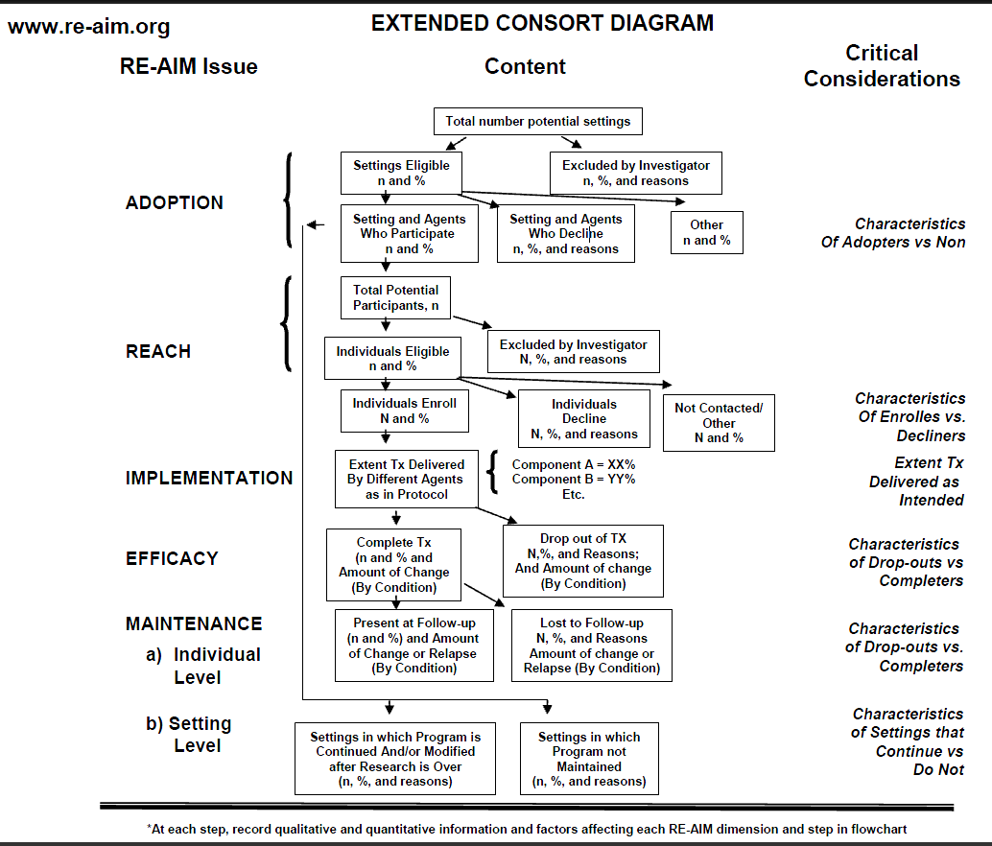
Notes:
Consolidated Standards of Reporting Trials (CONSORT) criteria, National Guidelines, etc. focus on internal validity – minimal attention to external validity and no attention to viability validity. Likewise, transparent reporting of evaluation with non-randomized designs (TREND) – also little attention to external validity.
Extended Consort starts before and goes beyond traditional consort

Slide 16
External Validity Checklist for Researchers (from meeting of 13 journal editors)
1. _____ Record recruitment and/or selection procedures, participation rate, and representativeness at each of the following levels:
a. Individuals, patients, citizens, or clients
b. Intervention staff, or program delivery agents
c. Delivery settings, work sites, health care clinics, schools
2. _____ Take note of any differences in delivery across:
a. Settings, populations, and/or staff
b. Program components
c. Time, taking special care to note any modifications over time
3. _____ Record all impacts of intervention, including:
a. Quality of life, or unintended adverse consequences
b. Costs of implementation and/or program replication
c. Moderator variables, especially those related to health disparities
4. _____ When conducting long-term follow-up report, pay attention to:
a. Long-term effects on item #3 above
b. Attrition at all levels in #1 above
c. Institutionalization, modification, or discontinuance of the program
Glasgow, R. E., Green, L. W., and Ammerman, A. (2007). A focus on external validity. Evaluation & the Health Professions 30(2): 115-117.
Notes:
Quality Rating Criteria for External Validity.
Not saying that all articles have to be strong on EV criteria, but we need more reporting than currently occurs.

Slide 17
Reporting External Validity Future Directions
Document reliability of EV coding criteria
Consider summary metrics, composite or overall EV quality scores
Report on impact on health equity for all RE-AIM levels
Assistance to practitioners on how to combine with theory and local experience
Evaluate which criteria most strongly related to long-term dissemination success
Revise criteria based on lessons learned
Notes:
Note: RE-AIM or other impact models may best be used to compare strengths and limitations of different programs

Slide 18
Assistance to practitioners on how to combine with theory and local experience
NCI has revised the Research-tested Interventions Program (RTIPs) review process and website to incorporate RE-AIM
April 2012 began scoring new RTIPs programs on RE-AIM criteria
October 2012 launched “RE-AIM notes” on all program summary pages
http://rtips.cancer.gov/rtips/index.do

Slide 19
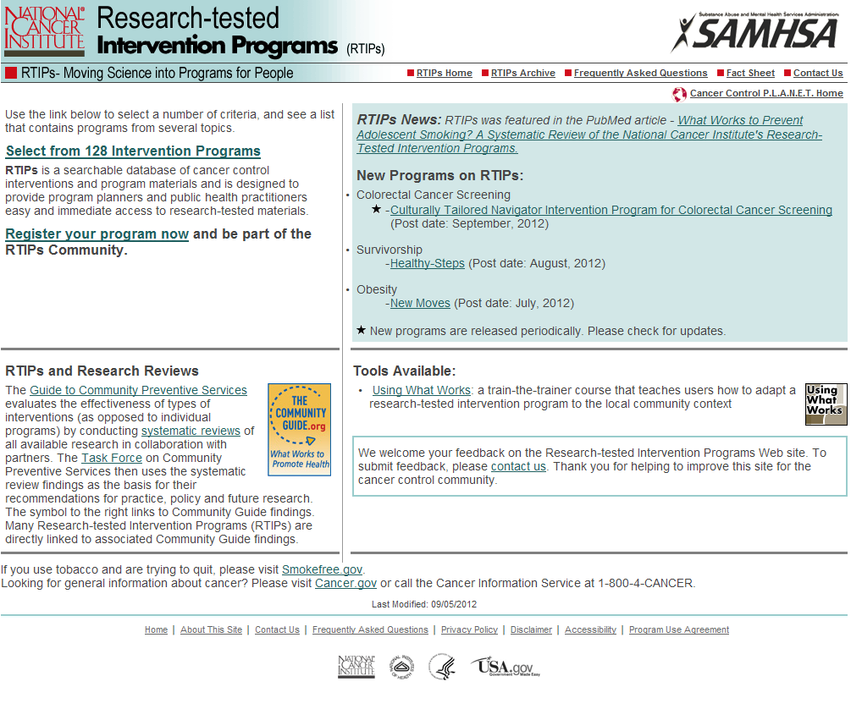
http://rtips.cancer.gov/rtips/index.do
Notes:
Note that many of the programs as not cancer specific (physical activity, diet/nutrition, tobacco control, obesity)

Slide 20
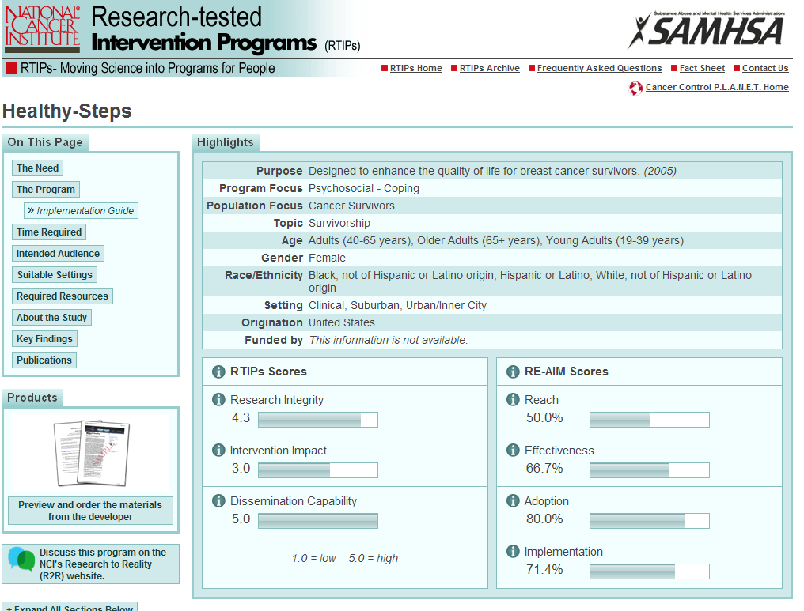

Slide 21
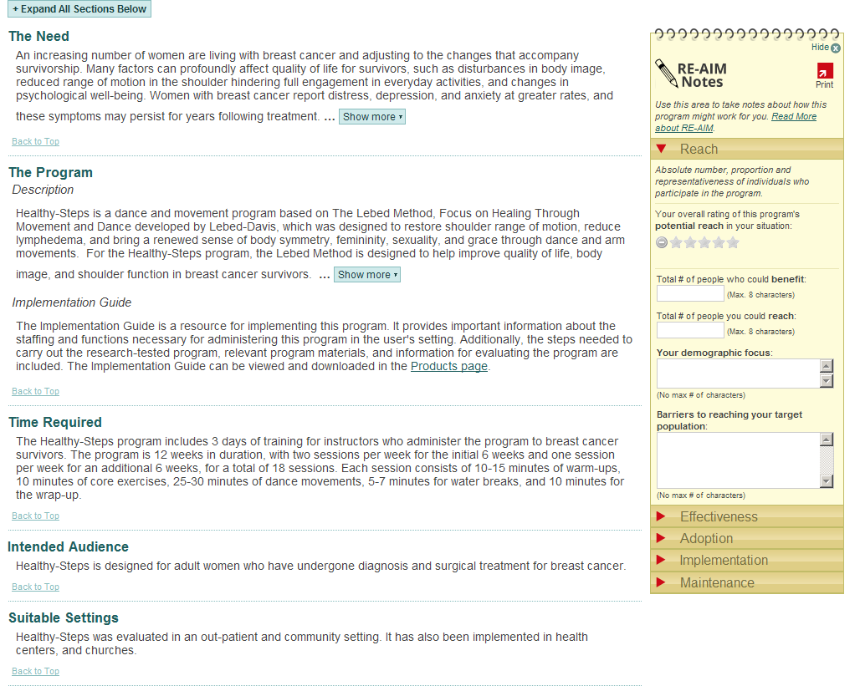
Notes:
RE-AIM also has a self-rating quiz on the RE-AIM site.

Slide 22
Take Home Points
Failure to focus on external validity is a major contributor to the disconnect between research and practice
Need a broader approach to evaluating interventions that places appropriate focus on dimensions of external validity
Reporting on external validity issues is needed to facilitate moving research into practice
RE-AIM is continuing to evolve and welcomes your input

Slide 23
Resources
www.re-aim.org
http://rtips.cancer.gor/rtips/index.do
Gaglio B, Glasgow RE. Evaluation approaches for dissemination and implementation research. In R Brownson, G Colditz, E Proctor (Eds.). Dissemination and implementation research in health: Translating science to practice. New York: Oxford Univ. Press, 2012, pages 327-356.
Kessler RS, Purcell EP, Glasgow RE, Klesges LM, Benkeser RM, Peek CJ. What Does It Mean to ''Employ'' the RE-AIM Model? Eval Health Prof. 2012
Klesges, L.M., Estabrooks, P.A., Glasgow, R.E., Dzewaltowski, D.A. Beginning with the Application in Mind: Designing and Planning Health Behavior Change Interventions to Enhance Dissemination. Ann Behav Med 2005; 29:66-75.

Slide 24
Questions?

