Slide 1
In Search of Synergy:
Strategies for Combining Interventions at Multiple Levels
Bryan J. Weiner, Ph.D.
Megan A. Lewis, Ph.D.
Steven B. Clauser, Ph.D.
Karyn Stitzenberg, MD
Notes:
You think that because you understand “one” that you must therefore understand “two” because one and one make two. But you forget that you must also understand “and.” – Sufi teaching story
The social ecological perspective provides a powerful conceptual basis for multilevel intervention.
Its fundamental insight is that determinants at multiple levels interact to influence human behavior and health outcomes. The immediate implication of this insight is that interventions that target determinants at multiple levels and mutually reinforce each other are likely to produce larger and longer lasting effects than interventions that target determinants at only one level.
Although the SE perspective offers a compelling justification for developing multilevel interventions, it provides surprisingly little practical guidance for designing them.
We use a causal modeling approach to describe five strategies for combining interventions at different levels to produce complementary or synergistic effects. We illustrate these strategies with examples of multilevel interventions to improve the quality of cancer treatment.

Slide 2









The Social Ecological Perspective
Human health results from the complex interaction of personal factors and multiple aspects of physical and social environments.
Notes:
Although there are many variants of the SE perspective, there are two principles that unite them.
The first principle is that human health results from the complex interaction of personal factors and multiple aspects of physical and social environments.
These include
BIOLOGICAL, PSYCHOLOGICAL, AND BEHAVIORAL FACTORS
GEOGRAPHY
ARCHITECTURE
CULTURE
ECONOMICS
POLITICS
SOCIAL RELATIONSHIPS

Slide 3
The Social Ecological Perspective
Macro-Policy
Community
“Levels of
Influence”
Organizational
Interpersonal
Intra-personal
Notes:
In the SE perspective, these multiple factors are described as “levels of influence” and are depicted as nested concentric circles representing contextual layers of increasing scope.

Slide 4
The Social Ecological Perspective
The multiple factors influencing health are interdependent.
Three implications:
  Causal influence does not flow in one direction.
  Determinants at one level of influence can modify the effects of determinants at another level.
  Changes at one level of influence can bring about changes at another level.
Notes:
The second principle is that these multiple factors are interdependent—that is, they mutually influence each other. Interdependence holds 3 important implications for multilevel interventions.
The first implication is that causal influence does not flow in only one direction. Physical and social features of the environment influence people’s behavior and therefore their health; at the same time, people can influence their health by modifying physical and social features of their surroundings.
The second implication is that determinants at one level of influence can modify the effects of determinants at another level. Dan Stokols notes, for example, that “the same environmental conditions…may affect people’s health differently, depending on their personalities, perceptions of environmental controllability, health practices, and financial resources.”
The third implication is that changes at one level of influence can bring about changes at another level of influence. For example, changes in Medicare reimbursement could encourage health care organizations to offer patient navigation which, in turn, could encourage patients to follow-up on abnormal screening results which, in turn, could improve breast cancer outcomes.

Slide 5


The Social Ecological Perspective
Multi-level interventions should be more effective than single-level interventions at changing health behavior and outcomes.
+
Notes:
On the basis of these two principles, proponents of the SE perspective contend that multilevel interventions should be more effective than single-level interventions.
Smoking, for example, is influenced by multiple, interdependent factors operating at different levels of influence.
Thus, a multilevel intervention that combines smoking cessation counseling and workplace smoking bans should be more effective than either intervention alone.
However, both proponents and critics of the SE perspective acknowledge that more interventions do not necessarily translate into more effect.
The key to designing effective multilevel interventions is to select and combine interventions that work together in complementary or synergistic ways.

Slide 6

The Problem
Little discussion about how, when, or why interventions at different levels of influence produce (or could produce) complementary or synergistic effects.
How should I design my
multi-level intervention?
Notes:
Despite widespread agreement on this point, little discussion has occured about how, when, or why interventions at different levels of influence produce (or could produce) complementary or synergistic effects.
Consequently, multilevel intervention designers can find little practical advice for deciding which interventions to combine, and why.
To address this issue, we employ a causal modeling framework to explore five strategies for combining interventions at multiple levels that help describe when synergy and complementarity may be produced.

Slide 7
A Causal Modeling Approach
Mediation
The process or pathway through which a cause is linked to an effect
Physician
motivation
Audit and feedback
Behavior
change
Notes:
By causal models, I mean abstract, visual representations that use cause-and-effect logic to describe the behavior of a system.
These models can be used to design interventions to clarify the causal relationships between (1) determinants and outcomes and between (2) determinants and determinants.
Given the importance of interdependence in the SE perspective, we focus on two types of causal relationships: mediation and moderation.
Mediation refers to the process or pathway through which a cause is linked to an effect. In intervention research, the issue of mediation concerns how a particular intervention produces a desired outcome.
Some suggest, for example, that audit and feedback interventions influence physician behavior by triggering self-directed motivation to reduce discrepancies between desired and actual performance.
In general, interventions are more effective when the mediating process or pathway is strongly related to the desired outcome.

Slide 8
A Causal Modeling Approach
Moderation
Individual differences or contextual factors that influence the relationship between cause and effect
Audit and feedback
Behavior
change
Physician
type
Notes:
Moderation refers to the individual differences or contextual conditions that influence the strength or direction of the relationship between cause and effect.
In intervention research, the issue of moderation concerns how such factors intensify or attenuate the intervention effect.
For example, it might be that audit and feedback influences physician behavior more strongly for physicians in training than for physicians in practice.
Alternatively, the effect of audit and feedback might be stronger in some contexts (e.g., cancer screening) than in others (e.g., cancer treatment).
In general, interventions are more effective when they exhibit a good fit, or high degree of compatibility, with other personal and environmental factors that define a context.

Slide 9
A Causal Modeling Approach
Mediated Moderation
Moderating effect of individual difference or contextual condition results from differences in mediating process or pathway
Physicians in Training
Self-directed
motivation
Audit and feedback
Behavior
change
Physicians in Practice
Peer-induced
motivation
Audit and feedback
Behavior
change
Notes:
Mediation and moderation can combine in various ways.
Mediated moderation occurs if the moderating effect of some individual difference or contextual condition results from differences in the mediating process or pathway.
For example, audit and feedback could have differential effects on physician behavior because it triggers self-directed motivation to improve for physicians in training, but not for physicians in practice.
Alternatively, audit and feedback could have differential effects because it triggers self-directed motivation for physicians in training (one pathway) and peer-induced motivation for physicians in practice (a different but perhaps less potent pathway).

Slide 10
A Causal Modeling Approach
Moderated Mediation
The mediating process or pathway is intensified or attenuated by an individual difference or contextual condition
Physician
motivation
Audit and feedback
Behavior
change
Physician
type
Notes:
Moderated mediation occurs if the meditating process or pathway is intensified or attenuated by an individual difference or contextual condition.
For example, audit and feedback might trigger self-directed motivation to improve among all physicians, but its effects on self-directed motivation (and, hence, on physician behavior) is intensified by the social norms and practices of residency training programs.

Slide 11

Aspirin, anyone?
Notes:
To review, in mediated moderation, the causal pathway varies for different groups or in different contexts.
In moderated mediation, the causal pathway does not differ but the magnitude of the transmitted effect varies for different groups or in different contexts.
Moderated mediation can occur in many ways, suggesting several strategies for combining interventions at different levels to produce complementary or synergistic effects.

Slide 12
Some Orienting Points
Intervention: a strategy for changing a given state of affairs.
Intervention target: the level of influence of the determinant (or causal factor) that an intervention attempts to modify.
Intervention setting: the social system in which the intervention target (i.e., determinant) is reached.
Notes:
Let me take a moment to clarify my use of certain terms.
An intervention is a strategy for changing a given state of affairs.
An intervention target refers to the level of influence of the determinant (or causal factor) that an intervention attempts to modify.
For example, an organization-level intervention is one that attempts to change an organization-level determinant of behavior (e.g., organizational policy, procedures, staffing, or resource allocation).
Although the intervention’s ultimate goal might be to change physician behavior, its proximal goal of changing an organizational determinant of physician behavior makes it an organization-level intervention.
An organization-level intervention can occur in a variety of settings, including multiple organizations of the same type (e.g., physician practices) or different types (e.g., physician practices and hospitals).
An intervention setting refers to the social system in which the intervention target (i.e., determinant) is reached.
Intervention settings can range in scope from individuals, to dyads, to groups, to organizations, to communities, to societies.

Slide 13
Some Orienting Points
Intervention level = intervention target
Intervention level ≠ intervention setting
Audit and feedback is an intra-personal intervention, even when it’s implemented in an organizational setting.
Why? It targets intrapersonal determinants of behavior (i.e., knowledge of performance discrepancy and motivation to reduce discrepancy)
Notes:
Following Lucie Richard and her colleagues, what defines the level of an intervention is the level of influence of the determinant that the intervention attempt to modify, not the social unit to which an intervention is directed or in which an intervention is implemented. In other words, the level is defined by the target not the setting. This distinction is subtle, but important.
Audit and feedback provides a useful illustration. Although scientific knowledge of how audit and feedback works is limited, control theory suggests that the presentation of information indicating that a discrepancy exists between actual performance and desired or expected performance motivates a behavioral response to reduce the discrepancy.
Thus, from a control theory perspective, audit and feedback represents an intrapersonal-level intervention.
Although often implemented in organizational settings, audit and feedback directed toward physician targets intrapersonal determinants of physician behavior: knowledge of a performance discrepancy and motivation to reduce that discrepancy.

Slide 14
Our Example
Improving the quality of rectal cancer treatment
1990 NIH Consensus Statement: Stage II and III rectal cancer patients should get chemo-radiation therapy (CRT)
20-25 percent of rectal cancer patients don’t get CRT.
Disparities exist by geography, stage, physician specialty, patient age and gender, and patient race/ethnicity.
Treatment variation likely due to causal factors (determinants) at multiple levels of influence.
Notes:
In 1990, the National Institutes of Health (NIH) issued a consensus statement recommending chemo-radiation therapy (CRT) as adjuvant treatment for Stage II and Stage III rectal cancer patients.
Although CRT is now accepted as the standard of care for Stage II and Stage III rectal cancer, evidence suggests that at least 20% to 25% of Stage II and Stage III rectal cancer patients still do not receive any CRT.
Moreover, studies have documented significant variation in the receipt of CRT by geographic region, stage (II vs. III), surgeon specialty, patient age and gender, and patient race/ethnicity.
Although the causal factors giving rise to variation in patterns of care for rectal cancer treatment are not well understood, extrapolation from studies of practice patterns in breast cancer treatment suggests several possible determinants at various levels of influence, such as provider knowledge or distance to a radiation facility.

Slide 15
Accumulation Strategy
Public reporting*
(organizational)
Opinion leader
(interpersonal)
Physician
motivation
Chemoradiation
therapy
Outreach visit
(intrapersonal)
Legend:
Box: intervention and level of influence (in parentheses)
Diamond: mediator
Oval: outcome
* For expositional purposes, the diagram depicts interventions rather than determinants as causes. Public reporting in this instance refers to the publication of practice-level CRT rates. To keep the presentation simple, a single mediating pathway is presented.
Notes:
In the accumulation strategy, interventions at different levels produce a cumulative impact on a common mediating pathway. The effect of each intervention is not conditional on the other interventions. Rather, the interventions exhibit what scholars call pooled interdependence, meaning that each intervention makes a discrete contribution to the outcome through the mediating pathway, without being dependent on each other.
To illustrate, this figure depicts a multi-level intervention focused on increasing surgeons’ motivation to ensure that rectal cancer patients receive appropriate CRT following surgery. In this example, surgical practices’ CRT rates are publicly reported to provide the practices an incentive for coordinated multidisciplinary care, opinion leaders are used to alter local norms about CRT appropriateness for older patients, and outreach visits targeted at physicians whose patients are less likely to receive CRT are employed to change surgeons’ attitudes and beliefs. This approach would be warranted if theory or research indicated that (1) all 3 interventions produce their effects through a common pathway and (2) this mediating pathway is the principal determinant of the outcome.
The interventions must converge upon the same intended audience. Otherwise, scattered, non-cumulative effects. If the relationship between mediating pathway and outcome is subject to threshold or ceiling effects, the cumulative strategy could produce large effects, small effects, or no effect at all.

Slide 16
Amplification Strategy
Public reporting*
(organizational)
Physician
motivation
Chemoradiation
therapy
Opinion leader
(interpersonal)
Reimbursement
(intrapersonal)
Notes:
In the amplification strategy, the effect of one or more interventions is conditional on another intervention. One intervention increases the target audience’s sensitivity or receptivity to the other intervention(s). In ways analogous to moderated mediation, one intervention amplifies the magnitude of the effect of the other intervention(s) on the mediating process or pathway.
This figure presents an example in which audit and feedback is added in order to boost the signal of public reporting and opinion leaders.
This combination would be warranted if theory and/or research indicated that physicians are more responsive to practice-level public reporting or peers’ opinions if they have credible, individually tailored information that signals a discrepancy between desired and actual performance. In other words, the effects of these interventions depend on contextual factors (i.e., a visible performance gap).
Amplification strategies could be used to create tailored multilevel interventions that equalize contextual conditions for different groups. It could be that, when it comes to improving CRT rates, urban surgeons are more sensitive than rural surgeons to public reporting and peers’ opinions. Targeting audit and feedback toward rural surgeons could equalize the sensitivity of these two groups to these other interventions. Analogous to improving person-environment fit.

Slide 17
Facilitation Strategy
Public reporting*
(organizational)
Physician
motivation
Chemoradiation
therapy
Opinion leader
(interpersonal)
Clinical Reminder
(intrapersonal)
Notes:
As in the case of the amplification strategy, in the facilitation strategy, the effect of one or more interventions is conditional on another intervention. However, instead of boosting the signal, the conditional intervention clears the mediating pathway for the other intervention(s) to produce the desired outcome. As another form of moderated mediation, one intervention removes the barriers or facilitates the effect of the other interventions.
To continue the example, this figure depicts a multilevel intervention in which a clinical reminder is added in order to facilitate the motivating effect produced by public reporting and opinion leaders.
This approach would be warranted if theory or research indicated that public reporting and peers’ opinions increase surgeons’ motivation to ensure that their rectal cancer patients get appropriate CRT, but, in order to translate their increased motivation into action, they need a cue or reminder.
The facilitation strategy is especially useful when the interdependence of multiple determinants is defined by necessary but not sufficient relationships. In this example, the increased motivation that public reporting and opinion leaders stimulate might be necessary, but not sufficient to improve rates of CRT absent some action cue or reminder.

Slide 18
Cascade Strategy
Physician / Manager
motivation
Advocacy
(policy)
Tumor Board
(organizational)
Multi-Disciplinary Planning
Physician
motivation
Outreach visits
(intrapersonal)
Chemoradiation
therapy
Chemoradiation
therapy
Notes:
In the cascade strategy, an intervention at one level affects the desired outcome in and through one or more interventions at other levels of influence. The interventions demonstrate what scholars refer to as sequential interdependence, meaning that the outputs of an intervention at one level become the inputs of an intervention at another level.
To illustrate, this figure depicts a multilevel intervention in which advocacy prompts a change in accreditation standards, which, in turn, stimulates hospital managers’ and physicians’ motivation to initiate tumor board meetings in order to promote multidisciplinary care planning. Tumor board meetings reveal that physicians have varying degrees of knowledge of and comfort with current guidelines for rectal cancer treatment. Thus, tumor board meetings prompt outreach visits wherein trained professionals meet face-to-face with physicians in order to provide information about current guidelines, feedback on current performance, and tailored suggestions for overcoming barriers to practice change.
The cascade approach would be warranted if theory and/or research indicated that determinants at different levels of influence interrelate primarily through mediation rather than moderation. By linking multiple mediating processes into an integrated causal pathway, cascading interventions create a “circuit” through which the effects of interventions combine and flow. Although “cascade” implies a flow from higher levels of influence to lower ones, this approach can be applied in reverse. Often interventions at one level run up against technical, resource, authority, or other constraints that can only be addressed at higher levels of influence. Community development and community empowerment models of intervention often work in a bottom-up fashion.

Slide 19
Convergence Strategy
Public reporting*
(organizational)
Physician
motivation
Opinion leader
(interpersonal)
Physician - Patient
Interaction
Patient Education
(intrapersonal)
Patient
motivation
Chemoradiation
therapy
Notes:
In the convergence strategy, interventions at different levels mutually reinforce each other by altering patterns of interaction among two or more target audiences. The interventions exhibit what scholars call reciprocal interdependence, meaning the outputs of some interventions become the inputs of other interventions and vice versa.
For example, the multilevel intervention depicted in this figure combines public reporting and opinion leaders to increase surgeons’ motivation to ensure that rectal cancer patients receive appropriate CRT. It adds patient education and counseling component to increase patients’ knowledge and motivation to seek appropriate CRT.
The physician-directed and patient-directed interventions mutually reinforce each other to promote a different kind of physician-patient interaction, the result of which is increased appropriate receipt of CRT.
The convergence strategy would be warranted if research showed that coordinated behavior change by different, interdependent parties is necessary to produce a desired outcome. The Chronic Care Model, for example, posits that high-quality chronic disease care depends on supportive, evidence-based interactions between an informed, activated patient and a prepared, proactive practice team.
Although these examples focus on altering the patterns of interaction among individuals, the convergence strategy can be used to alter the patterns of interaction among groups (e.g., provider teams), organizations (e.g., hospitals and physician practices), and communities (e.g., neighborhoods, cities, and states).

Slide 20
Take Aways
Multi-level interventions hold promise, but are expensive, time-consuming, and difficult.
Combining interventions at multiple levels only makes sense if they produce 2+2=4 or 2+2=5 effects.
Complementary or synergistic effects should be planned for, not hoped for.
Causal modeling can help investigators think through the logic of the design of multi-level interventions.
The five strategies identified here are not exhaustive; moreover the strategies themselves can be combined.
Notes:
The essential point, in our view, is that multilevel interventions should be designed based on sound causal reasoning about the likely interactions among the combined interventions and not simply on the merits of the individual interventions themselves

Slide 21
Discussion Questions
Do we have theories that explain how determinants at multiple levels interact to produce health and other outcomes?
Do we have enough cross-level research that examines the interdependence of variables (determinants) at multiple levels of influence?
Do we have sufficient grasp of the causal mechanisms that through which commonly employed interventions produce their effects?

Slide 22
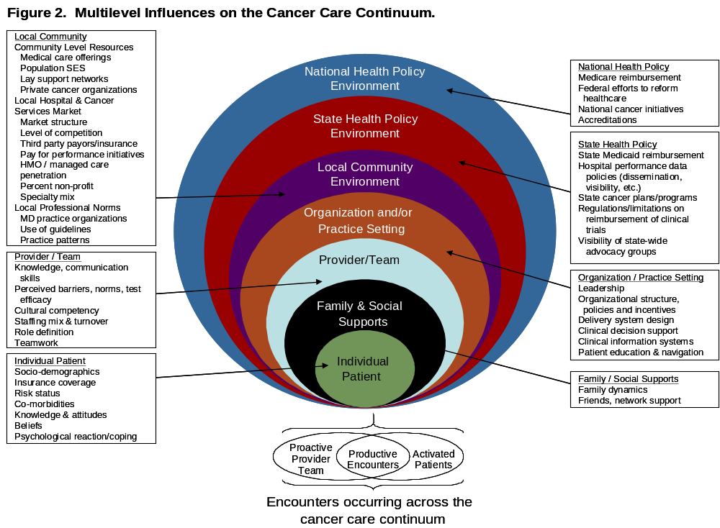
Alternative Conception of Levels

