Slide 1
How to Respond to the NIH Summary Statement
Veronica Y. Chollette, MS, RN
Program Director, Division of Cancer Control and Population Sciences, NCI
A presentation to
The American Society of Preventive Oncology
March 13, 2005

Slide 2
Today’s Talk
Overview of the Summary Statement
Reviewer Critiques
  Summary of the discussion
  Score
  Priority score
  Percentile
  Administrative comments
  Codes
  Roster
  Revise and Resubmit
    Number of Resubmissions
  Letter of Rebuttal
    Formal Appeal
Common Flaws
  Recommendations

Slide 3
Summary Statement Overview
Official document of initial peer review
Prepared by a NIH Scientific Review Administrator (SRA)

Slide 4
Reviewer Critiques
Six to eight weeks after peer review
Highlights review discussion
Provides general feedback
Use to guide revision
Limitations

Slide 5
Reviewer Critiques
Six to eight weeks after peer review
Highlights review discussion
Provides general feedback
Use to guide revision
Limitations

Slide 6
Reviewer Critiques
Six to eight weeks after peer review
Highlights review discussion
Provides general feedback
Use to guide revision
Limitations

Slide 7
Other Information
Priority score
Percentile
Recommended budget
Human and animal subjects codes
Administrative comments
Study section roster

Slide 8
Other Information
Priority score
Percentile
Recommended budget
Human and animal subjects codes
Administrative comments
Study section roster

Slide 9
Other Information
Priority score
Percentile
Recommended budget
Human and animal subjects codes
Administrative comments
Study section roster

Slide 10
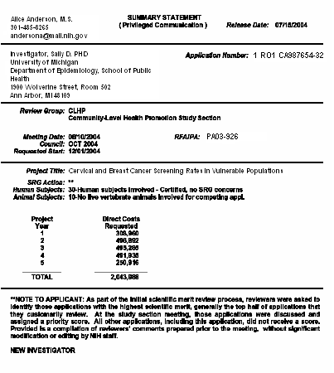



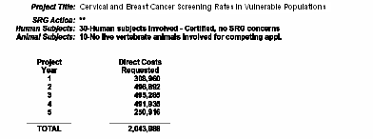


Slide 11
Unfundable Application
You’re in good company
Three submissions maximum
How serious are the problems?
Re-read carefully and analytically
Contact NCI Program Director

Slide 12
Unfundable Application
You’re in good company
Three submissions maximum
How serious are the problems?
Re-read carefully and analytically
Contact NCI Program Director

Slide 13
Unfundable Application
You’re in good company
Three submissions maximum
How serious are the problems?
Re-read carefully and analytically
Contact NCI Program Director

Slide 14
Unfundable Application, Cont’d
Address each criticism
Agree or disagree?

Slide 15
Options
Rebuttal Letter
  Formal Appeal
Revise and Resubmit

Slide 16
Summary
Two to three pages is sufficient for Introduction.
Responds to every criticism in the Summary Statement.
Provide the detail reviewers need to understand every aspect of your study.

Slide 17
Resources for New Investigators
http://grants.nih.gov/grants/new_investigators/index.htm
Check it out!

