Slide 1

Secondary Data Analysis of National and State Health Survey Data: Access and Analysis
Second AACR Conference on The Science of Cancer Health Disparities in Racial/Ethnic Minorities and the Medically Underserved
February 5, 2009
Richard P. Moser, Ph.D.
Behavioral Research Program
Division of Cancer Control and Population Sciences
National Cancer Institute

Slide 2

Using Secondary Data
Pilot data for grant (e.g., R01) proposals
Hypothesis generation/testing
Publications
Strengths:
  Large samples
  Population estimates
  Can test trends over time
Limitations:
  Non-experimental
  Constructs measured by fewer items (no scales)
  Oftentimes require special statistical techniques
  Most are cross-sectional

Slide 3


Federal Surveys

Slide 4



http://hints.cancer.gov
Population
  Adults (18+)
Method
  Random digit dial (RDD)
  Conducted Biennially
Content
  Communications trends and practices
  Cancer information access and usage
  Cancer risk perception
  Mental models of cancer
  Health behaviors
Data
  2003 (n= 6,469); 2005 (n= 5,586)
  HINTS 2007 data available to public February 16, 2009

Slide 5


National Health and Nutrition Examination Survey (NHANES)
http://www.cdc.gov/nchs/nhanes.htm
Population
  Children and Adults
Method
  Face to face interview
  Physical exams
Content
Chronic and Infectious Disease
  Mental health and cognitive functioning
  Energy Balance
  Reproductive history and sexual behavior
  Respiratory disease
Data
  N~5000/Year
  Initiated in 1960’s; Annual since 1999
  On-line tutorial

Slide 6


National Health Interview Survey
(NHIS)
http://www.cdc.gov/nchs/nhis.htm
Population
  Households, families, adults and children
Method
  Face to face interview
Content
  Health conditions and behaviors, access to and use of health services
  Cancer Control Module (1987, 1992, 2000, 2003, and 2005)
    Energy Balance
    Cancer Screening
    Sun Avoidance
    Tobacco Use and Control
    Genetic Testing
Data
  n~40,000 households (~87,000 individuals)
  Initiated in 1957

Slide 7


http://www.bls.census.gov/cps/cpsmain.htm
Population
  Part of the Current Population Survey
Method
  75% telephone
  25% in-home
Content:
  Cigarette smoking prevalence
  Current and past cigarette consumption
  Cigarette smoking quit attempts and intentions to quit
  Cigar, pipe, chewing tobacco, and snuff use
  Degree of youth access to tobacco in the community
  Attitudes toward advertising and promotion of tobacco
Data
  Sample of ~240,000 respondents in a given survey period
  Part of CPS since 1992

Slide 8

American Time Use Survey
http://www.bls.gov/tus/
Population
Adolescents/adults 15 and older
Method
  Self report telephone interview using 24 hour recall
Content
  Estimates of activities people do (work, childcare, socializing, exercising, eating), whom they were with, and the time spent doing them by sex, age, educational attainment, labor force status, and other characteristics, as well as by weekday and weekend day.
Data
  n ~ 13,000 per year
Note
  Cross-sectional data available currently: 2003-2007

Slide 9

National Longitudinal Survey of Adolescent Health (Add Health)
http://www.cpc.unc.edu/addhealth
Population
Adolescents (grades 7 thru 12) from 80 High Schools and 52 Middle Schools; started in 1994-05 and latest follow-up in 2008 (ages: 24-32)
Method
  In-school questionnaire and in-person interview
Content
  Health conditions and behaviors; access to and use of health services; social, psychological and physical well- being; risk behaviors
Data
  n~6,504
Note
  Follow-up data available at 1, 2, and 6 year intervals
  No fee for public data; $750 fee for restricted data

Slide 10




Surveillance Epidemiology and End Results (SEER)
http://seer.cancer.gov/
Population
Children to adults
Method
  Data collected from cancer registries that cover ~26% of the US population; follow-up with individual cases until death
Content
  Cancer incidence, prevalence, and survival data; limited demographics (age, race/ethnicity, region)
Data
  100% of cancer cases in registries; Six million cases with 350,000 added each year; 1973 to 2006
Note
  Need specialized software to analyze (SEER*Stat or SEER*Prep) downloaded from website;
  Must sign user agreement to obtain; limited to research purposes;
  Can be linked to Medicare data
Notes:
SEER-Medicare Linked Database
The SEER-Medicare data are the result of linking Medicare-eligible persons with cancer in the SEER data with their Medicare claims. The resulting files provide a unique population-based source of information about health care that spans the continuum of care from the period of initial diagnosis and treatment to long-term followup and care. Investigators using this combined dataset have conducted studies on patterns of care for persons with cancer as well as studies focused on disparities in cancer-related care, use of cancer tests, and the costs of cancer treatment.
As of April 2003, more than 100 peer-reviewed publications have used SEER-Medicare data. In the quality-of-care arena, one study examined the use of mammography following a diagnosis of breast cancer and found that, among women treated with breast-conserving surgery without radiation therapy (those most likely to have a recurrence), more than 20 percent had no mammogram in the 2 years following their initial diagnosis. Another analysis demonstrated that men who had radical prostatectomy by surgeons who performed fewer of these procedures were more likely to have late urinary complications than men treated by surgeons who performed the surgery frequently.
The SEER-Medicare database also is a source of data that allows derivation of estimates of cancer-related medical costs by site and stage of disease, by treatment approach, and for each gender in 65 and older age groups. These estimates can be incidence-based, meaning they provide the average cost per patient, or prevalence-based, which provides aggregate expenditures by cancer type.
The SEER-Medicare Data
The SEER-Medicare data are a unique resource that can be used for research related to the healthcare provided to persons with cancer. The database results from the linkage of two large population-based data sources: the Surveillance, Epidemiology, and End Results (SEER) cancer registries data and the Medicare enrollment and claims files. The SEER program collects information about cancer site, stage, and histology for persons newly diagnosed with cancer who reside in one of the SEER geographic areas. Medicare’s master enrollment file is used to identify which persons in the SEER data are Medicare beneficiaries. For people who are Medicare eligible, the SEERMedicare data include claims for covered health care services, including hospital, physician, outpatient, home health, and hospice bills. The SEER-Medicare data include over 2.4 million persons with cancer -- its linkage being a collaborative effort of the National Cancer Institute (NCI), the SEER registries, and the Centers for Medicare and Medicaid Services (CMS).

Slide 11

Other Federal Surveys
National Longitudinal Mortality Study
  http://www.census.gov/nlms/
National Health Care Survey
  http://www.cdc.gov/nchs/nhcs.htm
National Ambulatory Medical Care Survey
  http://www.cdc.gov/nchs/about/major/ahcd/ahcd1.htm
Medical Expenditure Panel Survey
  http://www.meps.ahrq.gov/
Medicare Current Beneficiary Survey
  http://www.cms.hhs.gov/MCBS/
Medicare Health Outcomes Survey
http://www.hosonline.org/
National Survey on Drug Use and Health
http://www.oas.samhsa.gov/nhsda.htm
National Survey of Family Growth
http://www.cdc.gov/nchs/about/major/nsfg/nsfgbiblio.htm

Slide 12










State Surveys

Slide 13


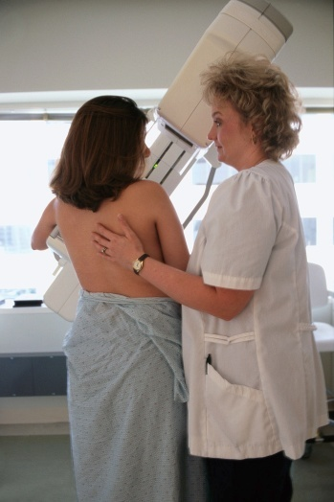

Behavioral Risk Factor
Surveillance System (BRFSS)
http://www.cdc.gov/brfss/
Population
  Adults
Method
  Random Digit Dial telephone survey
  State Administration
Content
  Behaviors associated with chronic diseases, injuries, and
  infectious diseases
Sexual behavior
  Smoking
  Cancer screening
  Diet and exercise
Data
  >150,000 subjects/year
  Core questions asked of everyone and state-specific modules
  Data can be combined across states to get national estimates

Slide 14

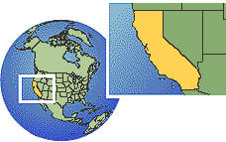
California Health Interview Survey
http://www.chis.ucla.edu
Population
  Adult, adolescent and child questionnaires
  Very diverse racial/ethnic population
Method
Telephone survey of all California counties
Content
  Physical activity
  Health status
  Health conditions
  Cancer screening
  Diet
  Sociodemographic information
Data
  2001, 2003, 2005, and 2007 data available (2009 underway)
  ~40-50,000 respondents/survey
Note
Many latino and asian groups represented

Slide 15
Summary
Subsample of all publicly available datasets
Most are cross-sectional
All employ a complex sampling design
  Many use multi-stage sampling
  Requires special software to analyze (e.g., SUDAAN)
  Use of weighting, clustering, and stratification
  Differences in variance estimation methods
  See documentation from sites for analytic recommendations

Slide 16
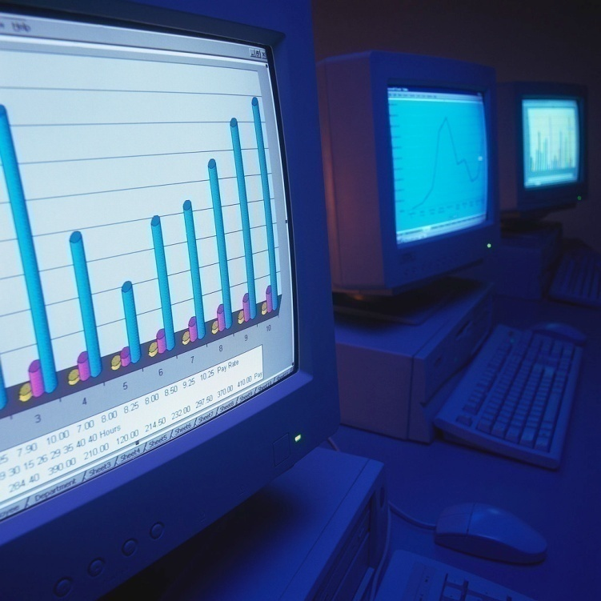


Statistical Issues

Slide 17

Statistical Weight
The statistical weight of a sampled person is the number of people in the population that the person represents.
If sampling rate is 1/1000
  Each sampled person represents 1000 people
  Each sampled person would have a sample weight of 1000
Weights derived from
  selection probabilities,
  response rates,
  post-stratification adjustment (e.g., gender, education, income, region).

Slide 18
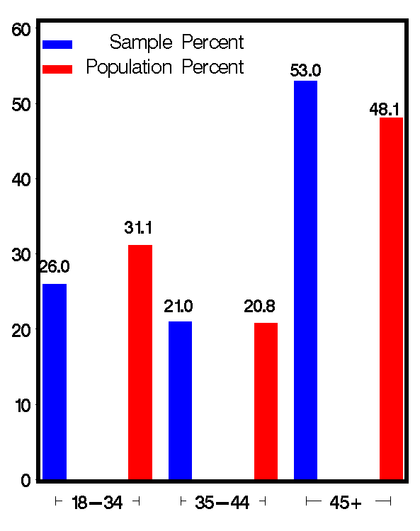
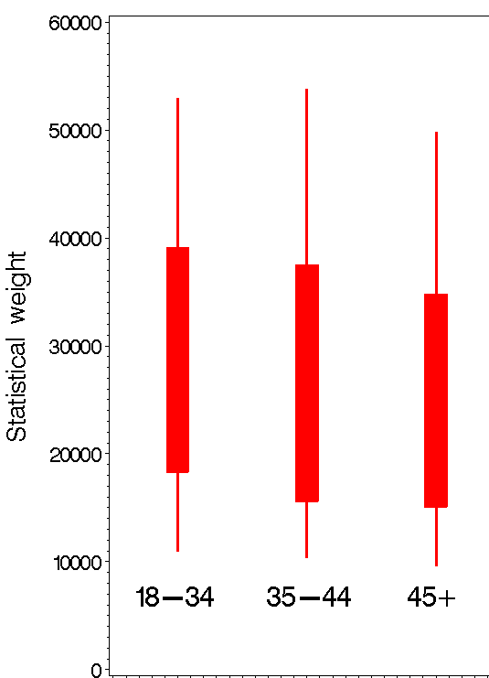
HINTS (2003): Older Folks Participated at a Higher Rate

Slide 19



To Weight or Not to Weight: The Variance/Bias Tradeoff for the Mean
Estimate | Mean | Confidence Interval
Unweighted
Weighted
The unweighted mean is biased
The weighted mean has a larger variance and confidence interval

Slide 20

Stratification
Population divided before sampling into disjoint, exhaustive groups (strata)
  Members termed primary sampling units (PSUs)
  Independent samples are taken in each strata
Strata formed by similar geographic areas
  E.g.,NHANES: partition US counties into 49 strata based on region and economic/racial characteristics
  Sample 2 counties (PSUs) from each strata

Slide 21

Clustering
Persons residing in a small area may have similar characteristics
Thus, responses of subjects in small area (or within an exchange) may be correlated
Dependence between subjects leads to inflated variance
Correlation must be accounted for in the analysis
  Survey analysis programs do this through strata/PSU
Area samples may have more clustering than telephone samples

Slide 22
Variance Estimation for Surveys
Linearization: Uses a Taylor series expansion to estimate variance of non-linear estimators
  Default method for most stats programs
  Requires stratification and PSU information
Replication methods: Calculates different parameter estimates for each replicate and combines these to estimate variance.
  Jackknife with replicate weights available for a number of SUDAAN, STATA, SAS and WesVAR procedures

Slide 23
Replication vs. Linearization
If the survey doesn’t have replicate weights use the full sample weights and linearization
If the survey has replicate weights use them with the jackknife procedure
Most software can use linearization method
Only SUDAAN, STATA, SAS, and WesVAR can incorporate replicate weights

Slide 24


Statistical Software for Analyzing Health Surveys
Specifically designed for analyzing data utilizing complex sampling designs:
  SUDAAN
  WesVar
Others that can be used:
  STATA
  SAS
  SPSS
  Mplus

Slide 25

How Do I Decide Which
Software to Use?
Will get same point estimates with any of them
  Means, proportions
  Unweighted or weighted
For correct variance estimates need program that can incorporate complex sampling design
  Needed when doing statistical testing
  Standard errors will tend to be larger
  Less likely to make Type I error

Slide 26
Data/Research Resources
Univ. of Michigan Consortium for social research: http://www.icpsr.umich.edu/
UCLA Statistical Computing: http://www.ats.ucla.edu/stat/
BRFSS Maps
http://apps.nccd.cdc.gov/gisbrfss/default.aspx
State Cancer Profiles
http://statecancerprofiles.cancer.gov/

Slide 27
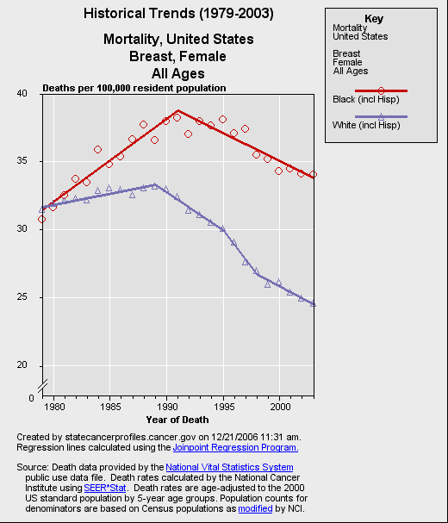
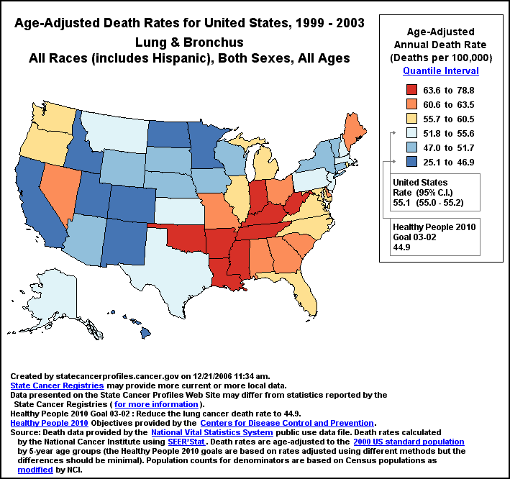
NCI State Cancer Profiles Website

Slide 28
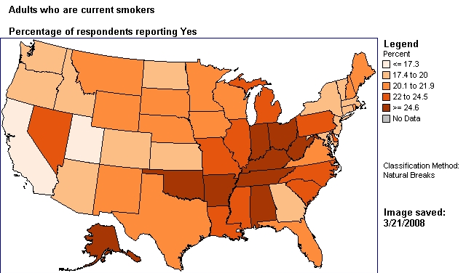
BRFSS Maps
Can map several risk factors from multiple years
http://apps.nccd.cdc.gov/gisbrfss/default.aspx

Slide 29
References
Korn, E.L. and Graubard, B.I. (1999). Analysis of
Health Surveys. New York: John Wiley. (Must read)
State Cancer Profiles: http://statecancerprofiles.cancer.gov/
SUDAAN: http://www.rti.org/SUDAAN/
SAS: http://www.sas.com/
SPSS: http://www.spss.com/
STATA: http://www.stata.com/
WesVar: http://www.westat.com/wesvar/
Mplus: http://www.statmodel.com/

