Slide 1
Self-Affirmation and the Processing of Health Risk Information
Bill Klein
University of Pittsburgh
Presentation at 2005 meeting of the Society for Personality and Social Psychology

Slide 2
Self-Affirmation & Dissonance
Aronson, Steele: cognitive dissonance challenges one’s integrity and self-worth

Slide 3
Self-Affirmation & Dissonance
Aronson, Steele: cognitive dissonance challenges one’s integrity and self-worth
If threat to self can be minimized, no need to resolve dissonance

Slide 4
Self-Affirmation & Dissonance
Aronson, Steele: cognitive dissonance challenges one’s integrity and self-worth
If threat to self can be minimized, no need to resolve dissonance
Steele and Liu (1983): focusing on important value reduces attitude change in induced compliance paradigm

Slide 5
Self-Affirmation & Dissonance
Aronson, Steele: cognitive dissonance challenges one’s integrity and self-worth
If threat to self can be minimized, no need to resolve dissonance
Steele and Liu (1983): focusing on important value reduces attitude change in induced compliance paradigm
Tesser (2000): self-protection strategies are substitutable

Slide 6
Self-Affirmation & Dissonance
Aronson, Steele: cognitive dissonance challenges one’s integrity and self-worth
If threat to self can be minimized, no need to resolve dissonance
Steele and Liu (1983): focusing on important value reduces attitude change in induced compliance paradigm
Tesser (2000): self-protection strategies are substitutable
Fein & Spencer (1997): self-affirmation reduces prejudice following negative feedback

Slide 7
Self-Affirmation → Processing Health Information
Reed & Aspinwall (1998):
  Consumers of caffeine presented with risk-confirming and risk-disconfirming information linking fibrocystic disease to caffeine consumption

Slide 8
Self-Affirmation → Processing Health Information
Reed & Aspinwall (1998):
  Consumers of caffeine presented with risk-confirming and risk-disconfirming information linking fibrocystic disease to caffeine consumption
  Half self-affirmed by writing about kindness

Slide 9
Self-Affirmation → Processing Health Information
Reed & Aspinwall (1998):
  Consumers of caffeine presented with risk-confirming and risk-disconfirming information linking fibrocystic disease to caffeine consumption
  Half self-affirmed by writing about kindness
  Mood also measured to ensure that self-affirmation was not simply a proxy for good mood (and it wasn’t)

Slide 10
Self-Affirmation → Processing Health Information
Self-affirmation/high use participants:
  oriented more quickly to risk-confirming information

Slide 11
Self-Affirmation → Processing Health Information
Self-affirmation/high use participants:
  oriented more quickly to risk-confirming information
  found risk-confirming information more convincing

Slide 12
Self-Affirmation → Processing Health Information
Self-affirmation/high use participants:
  oriented more quickly to risk-confirming information
  found risk-confirming information more convincing
  recalled less risk-disconfirming info. at follow-up, and the same amount of risk-confirming info.

Slide 13
Self-Affirmation → Processing Health Information
Sherman, Nelson, & Steele (2000):
  Caffeine paradigm (Study 1): Self-affirmation led participants to be more accepting of threatening health information, and to intend behavioral changes
  HIV paradigm (Study 2): Self-affirmation increased HIV risk perceptions and led to purchase of more condoms

Slide 14
Deductive Risk Perceptions
Klein, Blier, & Janze (2001):
  217 Maine high school students rated their risk of alcohol poisoning as well as their standing on several risk factors (e.g., number of drinks consumed in one sitting)

Slide 15
Deductive Risk Perceptions
Klein, Blier, & Janze (2001):
  217 Maine high school students rated their risk of alcohol poisoning as well as their standing on several risk factors (e.g., number of drinks consumed in one sitting)
  Independent variables: Social comparison feedback (X’s on risk factor scales), Self-affirmation (essay about some event that made them feel proud)

Slide 16
Social Comparison Feedback
    In general, how many drinks do you typically consume in one sitting?
    1 2 3 4 5 6 7
    2 or fewer 3-4 5-6 7-8 9-10 11-12 13 or more
    drinks drinks drinks drinks drinks drinks drinks

Slide 17
Results
Correlation between risk factor ratings and risk perceptions was highly significant in all conditions except in comparison information/affirmation condition
 | Comparison Information | No Comparison Information
Self-affirmation |  | X
Control | X | X
(Klein, Blier, & Janze, 2001)

Slide 18
Results
Correlation between risk factor ratings and risk perceptions was highly significant in all conditions except in comparison information/affirmation condition
Self-esteem was a better predictor of risk perceptions in this condition than in any of the others
(Klein, Blier, & Janze, 2001)

Slide 19
Follow-ups
Deductive risk perceptions only emerge when self-affirmation is in unrelated domain
Deductive risk perceptions can happen when threat and attention to self are paired via “self-repudiation”

Slide 20
Reed & Aspinwall (1998)
Self-affirmation/high use participants:
  oriented more quickly to risk-confirming information, but:
    spent less time reading information

Slide 21
Reed & Aspinwall (1998)
Self-affirmation/high use participants:
  oriented more quickly to risk-confirming information, but:
    spent less time reading information
  found risk-confirming information more convincing, but:
    didn’t remember any more of it at follow-up, and remembered less of disconfirming information

Slide 22
Reed & Aspinwall (1998)
Self-affirmation/high use participants:
  oriented more quickly to risk-confirming information, but:
    spent less time reading information
  found risk-confirming information more convincing, but:
    didn’t remember any more of it at follow-up, and remembered less of disconfirming information
    intended to consume more caffeine (though did not by follow-up)

Slide 23
Reed & Aspinwall (1998)
Self-affirmation/high use participants:
  oriented more quickly to risk-confirming information, but:
    spent less time reading information
  found risk-confirming information more convincing, but:
    didn’t remember any more of it at follow-up, and remembered less of disconfirming information
    intended to consume more caffeine (though did not by follow-up)
    memory for confirmatory information was uncorrelated with belief change (as opposed to no affirmation/low use participants; rs = .25 and .55, respectively)

Slide 24
Sherman et al. (2000)
HIV paradigm (Study 2): Self-affirmation increased HIV risk perceptions and led to purchase of more condoms, but:
 | Perceived risk/similarity to people in video | Perceived risk/intentions to use condoms
Affirmation Condition | .24 | .04
No Affirmation Condition | .51* | .26
*p < .01.

Slide 25
Critical Variables
Relationship between cognitions and behavior (as in previous studies)
Intentions and behavior
Processing, memory
Moderators

Slide 26
Colorectal Cancer Study
143 adults between 50-75 years old who were off-schedule for colorectal cancer screening
Tailored feedback about CRC risk
IVs:
  Self-affirmed or not before feedback
  Unrealistically optimistic (UO) or not about CRC risk
DV: Memory for feedback

Slide 27
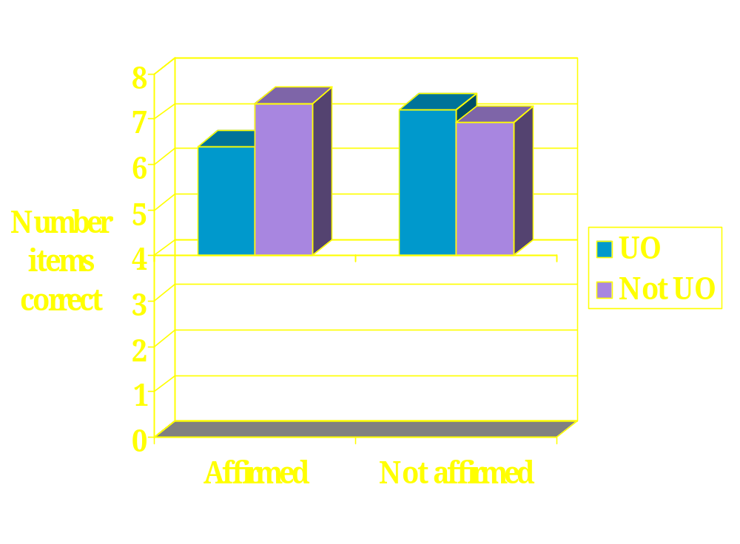
Colorectal Cancer Study

Slide 28
Caffeine Study
 | Self-affirmed | Control
Worry | 2.85 | 3.59
Intentions | 4.11 | 5.19
Information | 4.07 | 5.52
Should cut down | 5.22 | 6.56

Slide 29
Conclusions
Self-affirmation may reduce defensiveness when processing threatening health messages

Slide 30
Conclusions
Self-affirmation may reduce defensiveness when processing threatening health messages
However, it may also reduce memory for those messages, and may disassociate health cognitions from behavior

Slide 31
Conclusions
Self-affirmation may reduce defensiveness when processing threatening health messages
However, it may also reduce memory for those messages, and may disassociate health cognitions from behavior
Effects of self-affirmation may be moderated by unrealistic optimism and other individual differences

Slide 32
Conclusions
Self-affirmation may reduce defensiveness when processing threatening health messages
However, it may also reduce memory for those messages, and may disassociate health cognitions from behavior
Effects of self-affirmation may be moderated by unrealistic optimism and other individual differences
Need more research to understand underlying processes (e.g., Correll et al., 2004)

