Slide 1
Of Health and Death:
Health Behavior Implications of a Dual Defense Model of Terror Management
Jamie Arndt
University of Missouri-Columbia

Slide 2
Some background ideas:
terror management theory (TMT):
awareness of mortality potential for anxiety managed via investment in cultural worldview and self-esteem
Recent focus on distinctions between managing conscious concerns with death (via proximal defenses) and unconscious concerns (via distal defenses)
TMT and health psych literatures have not really considered implications of deeply rooted fears about death for understanding health relevant behavior

Slide 3
HEALTH APPLICATION OF DUAL DEFENSE TERROR MANAGEMENT MODEL
Conscious death thought activation
Proximal Defenses: health responses to remove death thoughts from focal attention/ reduce perceived vulnerability
Health promoting responses
Health risk responses
Non-conscious death thought activation
Distal Defenses: health responses influenced by motivation to maintain self-esteem and symbolic sense of self

Slide 4
Death can be good for your health: Application of dual defense model to exercise intentions (Arndt, Schimel, & Goldenberg, 2003)
HEALTH APPLICATION
EXERCISE INTENTION APPLICATION
Conscious death thought activation
Conscious death thought activation
Proximal Defenses: health responses that minimize perceived vulnerability
Proximal Defenses: increased exercise intentions (regardless of fitness relevance to self-esteem)
Non-conscious death thought activation
Distal Defenses: health behaviors influenced by motivation to maintain self-esteem and symbolic sense of self

Slide 5
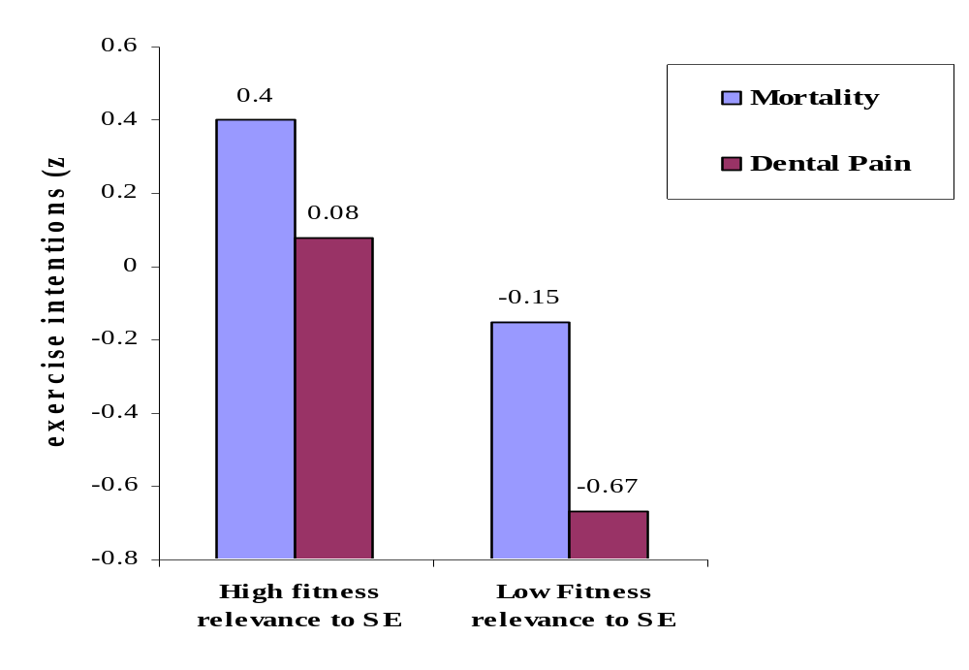
Immediate exercise intentions as a function of mortality salience
Note: High Scores indicate greater exercise intentions

Slide 6
Death can be good for your health: Application of dual defense model to exercise intentions (Arndt, Schimel, & Goldenberg, 2003)
HEALTH APPLICATION
EXERCISE INTENTION APPLICATION
Conscious death thought activation
Conscious death thought activation
Proximal Defenses: health responses that minimize perceived vulnerability
Proximal Defenses: increased exercise intentions (regardless of fitness relevance to self-esteem)
Non-conscious death thought activation
Non-conscious death thought activation
Distal Defenses: health behaviors influenced by motivation to maintain self-esteem and symbolic sense of self
Distal Defenses: increased exercise intentions when fitness is contingency of self-esteem

Slide 7
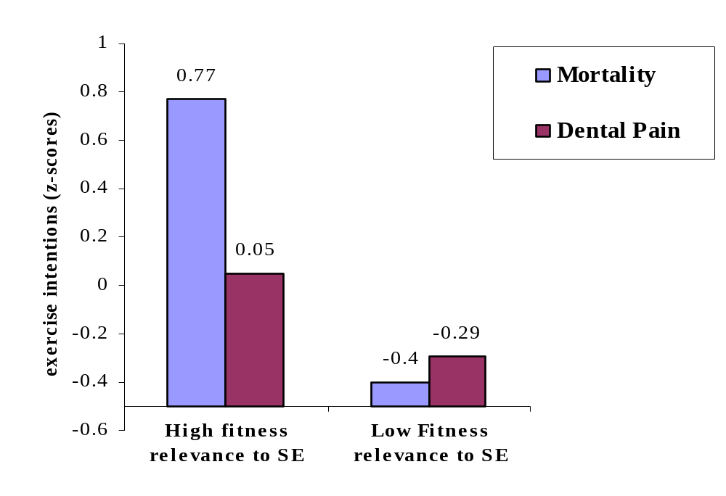
Delayed exercise intentions as a function of mortality salience and relevance of fitness to self-esteem
Note: High Scores indicate greater exercise intentions

Slide 8
A time to tan: Application of dual defense model to safe sun behavior intentions (Routledge, Arndt, & Goldenberg, 2004)
HEALTH/CANCER APPLICATION
SUN-TAN INTENTION APPLICATION
Conscious death thought activation
Conscious death thought activation
Proximal Defenses: health responses that minimize perceived vulnerability
Proximal Defenses: increased interest in sun protection (products)
Non-conscious death thought activation
Distal Defenses: health behaviors influenced by motivation to maintain self-esteem and symbolic sense of self

Slide 9
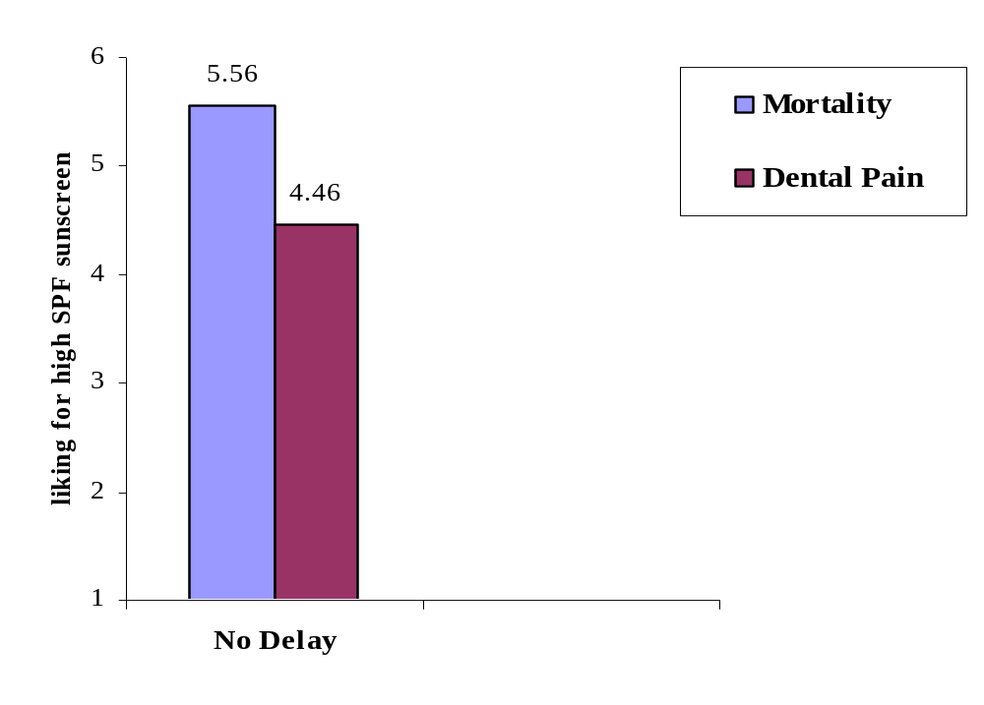
Interest in buying high SPF sunscreen as a function of mortality salience and delay
Note: High Scores indicate more interest in high SPF sunscreen

Slide 10
A time to tan: Application of dual defense model to safe sun behavior intentions (Routledge, Arndt, & Goldenberg, 2004)
HEALTH/CANCER APPLICATION
SUN-TAN INTENTION APPLICATION
Conscious death thought activation
Conscious death thought activation
Proximal Defenses: health responses that minimize perceived vulnerability
Proximal Defenses: increased interest in sun protection (products)
Non-conscious death thought activation
Non-conscious death thought activation
Distal Defenses: health behaviors influenced by motivation to maintain self-esteem and symbolic sense of self
Distal Defenses: decreased interest in sun productive (products); increased interest in tanning

Slide 11
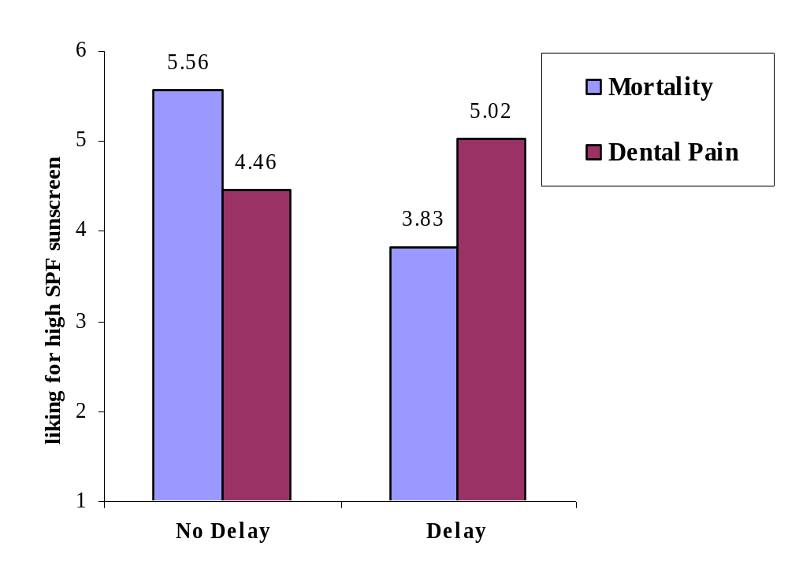
Interest in buying high SPF sunscreen as a function of mortality salience and delay
Note: High Scores indicate more interest in high SPF sunscreen

Slide 12
ADAPTIVE AND MALADATPVIE DEFENSES
Conscious death thought activation
Health Relevant Proximal Defenses
Suppression of death-thoughts (Arndt et al., 1997b)
Denial of vulnerability to risk factors (Greenberg, Arndt et al., 2000)
Exercise intentions (Arndt et al. 2003)
Safe sun behavior (Routledge, Arndt, & Goldenberg., 2004)
Unconscious death thought activation
Health Relevant Distal Defenses
Exercise intentions (Arndt et al. 2003)
Risky sun behavior (Routledge, Arndt, & Goldenberg., 2004)
Risky driving behavior (Taubman et al., 1999)
Dieting and body identification (e.g., Goldenberg, Arndt et al., in press)
GUIDING QUESTION:
What are the personality and situational factors that promote
adaptive vs. maladaptive health behaviors as people try to
manage conscious and unconscious concerns with death?

Slide 13
Initial directions to explore factors affecting selection of health-relevant proximal defense routes
Effects of salience and perceived vulnerability to cancer on suppression of death-related cognitions (Arndt, Cook, & Goldenberg, in prep)
Study 1&3 : whereas explicit simple cancer salience induction does not increase death thought accessibility (relative to control condition), subliminal cancer primes do.
Study 2: cognitive load + explicit cancer salience does lead to increased death accessibility
Study 4: exposure to low vulnerability to cancer information leads to higher death accessibility than exposure to high vulnerability to cancer information.

Slide 14
Initial directions to explore factors affecting selection of health-relevant proximal defense routes (cont.)
The influence of coping strategies and health optimism on proximal health defenses (Arndt, Routledge, & Goldenberg, in prep)
Study 1: higher adaptive coping is associated with greater interest in taking active responsibility for health behavior immediately (vs. delay) after MS (vs. control topic).
Study 2: women higher in health optimism respond to conscious death thoughts (vs. control topic) with greater interest in FBD screening when learn may be at risk
Study 3: middle-aged women higher in health optimism respond to conscious death thoughts (vs. control topic) by increasing intentions to conduct BSEs.

Slide 15
Exploring factors that can affect the adoption of healthy vs. unhealthy distal defenses
self-esteem contingencies (e.g., tanning, fitness)
2. Existential concerns with the physicality of the body…aka creatureliness
  The body is a problem for humans because it reminds us of our sheer physicality and our similarity to other animals, which is threatening because it makes apparent our vulnerability to death

Slide 16
Creatureliness and Breast Self Exams (BSEs)
Goldenberg, Arndt, Hart, & Turrisi (under review)
activation of death-related thought
+
reminder of creatureliness
increased existential discomfort
distancing from physicality of the body
Reduced breast exam
intentions and behavior

Slide 17
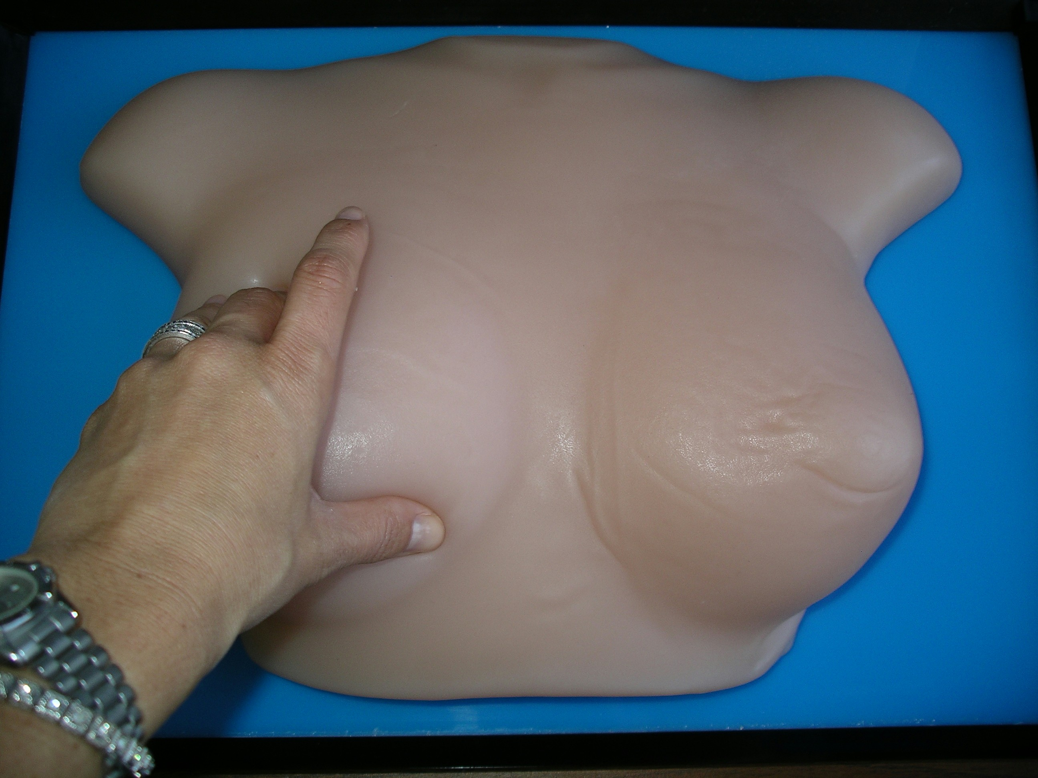

Slide 18
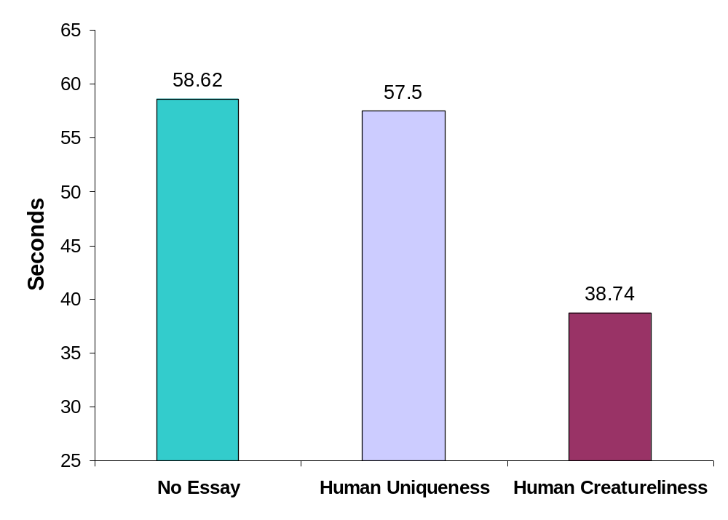
Study 2: Seconds Conducting Exam on Breast Model

Slide 19
SUMMARY OF TMT DUAL DEFENSE MODEL OF HEALTH DECISIONS
Conscious death thought activation
Health optimism
& adaptive coping
High perceived
vulnerability
Health promoting Proximal Defenses
Health risk proximal defenses
Non-conscious death thought activation
Self-esteem
contingencies
creatureliness
Health promoting/risky Distal Defenses
Health risk distal defenses

Slide 20
Some contributions :
provide insight into how conscious and unconscious fears about mortality motivate different classes of psychological defense in ways that connect to risk enhancing & reducing health judgments.
reveal the differential influence of factors affecting proximal health defenses (e.g., optimism) and distal health defenses (e.g., self-esteem contingencies).
consideration of creatureliness introduces novel mechanism by which existential concerns can influence health relevant domains and implicates the influence of malleable and non-conscious emotional discomfort in health behavior
Generally: suggest ways of broadening health theory to incorporate motivational sources of non-rational influence

Slide 21
The key here, I think, is not to think of death as an end, but rather, as a very effective way of cutting down on your expenses.
-Woody Allen

Slide 22
A special thanks to the contributions of:
Jamie L. Goldenberg, Clay Routledge, Alison Cook, Cathy Cox, Jeff Schimel, Josh Hart, Rob Turrisi
National Cancer Institute (R01 CA96581)

