Slide 1
Is There Nothing So Practical as a Good Theory?:
Why Interventions are Needed to Promote Innovations in Social Psychological Theory
Alex Rothman
University of Minnesota

Slide 2
“…Many psychologists working today in an applied area are keenly aware of the need for close cooperation between theoretical and applied psychology. This can be accomplished in psychology, as it has been accomplished in physics, if the theorist does not look toward applied problems with highbrow aversion or with a fear of social problems, and if the applied psychologist realizes that there is nothing so practical as a good theory.”
--Kurt Lewin (1943-44), “Problems of research in social psychology”

Slide 3
Overview
There are numerous social psychological theories of health behavior (e.g., Health belief model; Theory of reasoned action/planned behavior; Transtheoretical model; Social cognitive theory) and they have stimulated an tremendous amount of research.

Slide 4
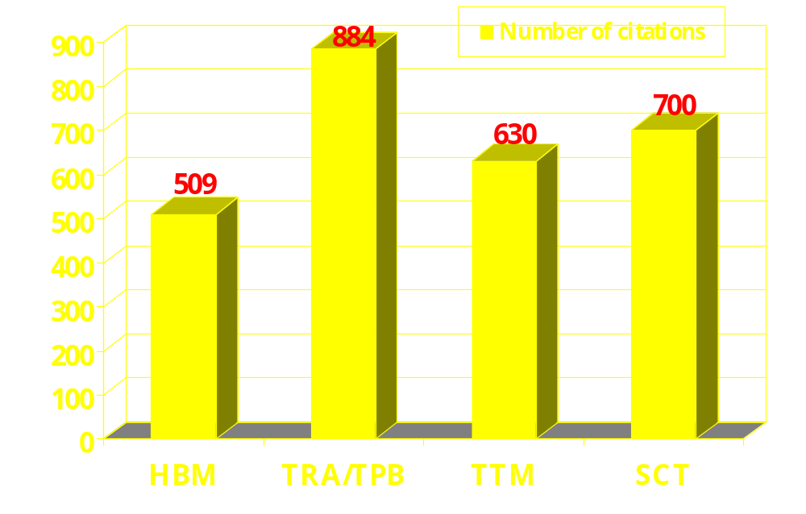
[Adapted from Noar and Zimmerman (in press)]

Slide 5
Overview
There are numerous social psychological theories of health behavior and they have stimulated a tremendous amount of research
Yet, over time there have been strikingly few modifications to our theories (e.g., specification of parameters; delineation of mediators and moderators)
The process by which we refine, revise, or refute our theories is not working as well as it could (Noar & Zimmerman, in press; Rothman, 2004; Weinstein & Rothman, in press).

Slide 6
Overview
We need to do a better job of challenging our theories. Practical problems afford a valuable opportunity to clarify the strengths and weakness of our theories, but only if we take advantage of it (Rothman, 2004).
Example: Why do people who successfully
change their behavior have difficulty
maintaining it over time?

Slide 7
Model of Behavioral Initiation and Maintenance
(Rothman, 2000; Rothman, Baldwin, & Hertel, 2004)
Behavioral Initiation
Guided by expectations about change
Optimistic expectations predict interest and initial success
Motivated by desire to approach favorable goal (i.e., to be thin)
Progress is marked by a change in discrepancy between current state and a goal state
Behavioral Maintenance
Guided by satisfaction with outcomes
Satisfaction predicts long-term success
Satisfaction based on comparison of outcomes to expectations
Motivated by a desire to avoid unfavorable goal (i.e., not be a smoker)
Progress is marked by a sustained discrepancy between current state and a prior state

Slide 8
Specifying the Determinants of the Initiation and Maintenance of Behavior Change
Series of interventions to promote smoking cessation (Hertel et al., in preparation) and to promote weight loss (Finch et al., in press)

Slide 9
Specifying the Determinants of the Initiation and Maintenance of Behavior Change
Series of interventions to promote smoking cessation (Hertel et al., in preparation) and to promote weight loss (Finch et al., in press)
Examine the challenge posed by trying to specify the factors that uniquely contribute to decisions to initiate and decisions to maintain a pattern of behavior.

Slide 10
Disentangling Predictors of Sustained Behavior Change
Satisfaction with quit at Session 10
β =1.32
Smoke Free at Session 10
(p < .01)
Smoke Free at 12 months
Self-efficacy at Session 10
(Baldwin et al., under review)
Note: Session 10 is 3 months after quit date; 4 months into program

Slide 11
Disentangling Predictors of Sustained Behavior Change
Satisfaction with quit at Session 10
=.21
(p<.03)
β =1.32
Smoke Free at Session 10
(p < .01)
Smoke Free at 12 months
Self-efficacy at Session 10
=.36
(p<.01)
(Baldwin et al., under review)
Note: Session 10 is 3 months after quit date; 4 months into program

Slide 12
Disentangling Predictors of Sustained Behavior Change
Satisfaction with quit at Session 10
=.07
(ns)
Smoke Free at 12 months
Self-efficacy at Session 10
=.76
(p < .01)
Analysis includes People who were Smoking or quit less than a month at Session 10
(Baldwin et al., under review)

Slide 13
Disentangling Predictors of Sustained Behavior Change
Satisfaction with quit at Session 10
=.35
(p<.01)
Smoke Free at 12 months
Self-efficacy at Session 10
=.16
(ns)
Analysis includes People who were Smoke Free for 3 months at Session 10
(Baldwin et al., under review)

Slide 14
Observations
Practical problems can shed light on important theoretical issues.
Efforts to test predictions regarding determinants of behavior need to be guided by theory (e.g., where people are in the behavior change process) and not necessarily by the intervention (e.g., time in the intervention schedule)

Slide 15
Does the Analysis Test the Theory?

Slide 16
Does the Analysis Test the Theory?
Behavioral maintenance can be thought of as attempt to minimize deviations from a current state and prevent the return to a prior undesired state.
Higgins (1998) has proposed that prevention-oriented people might be particularly good at persisting at a task. Some supporting evidence from laboratory tasks, but all have involved a limited time frame.

Slide 17
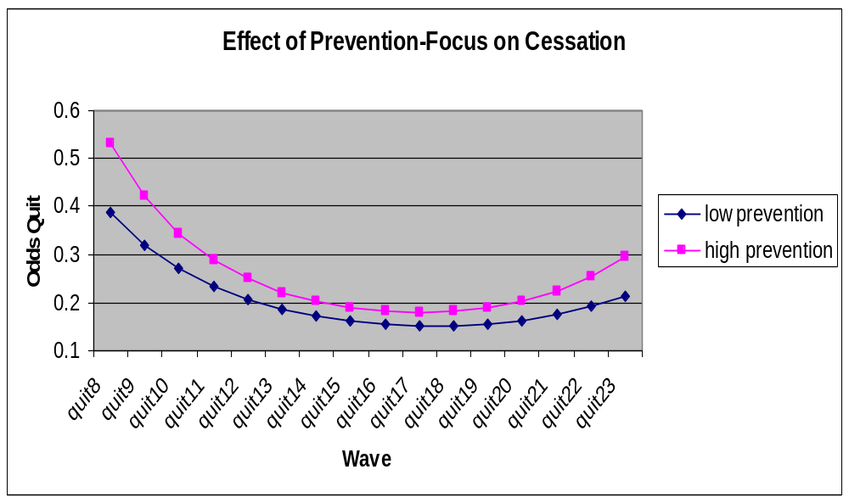
Does the Analysis Test the Theory?

Slide 18
Does the Analysis Test the Theory?
Initial analysis did NOT test our hypothesis
We wanted to test whether smokers who are high in prevention-focus would have a greater chance of maintaining a successful quit.

Slide 19
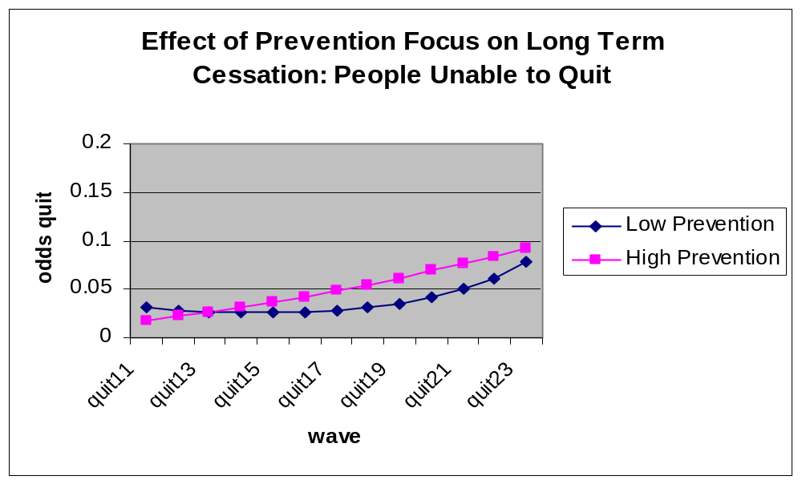
Does the Analysis Test the Theory?

Slide 20
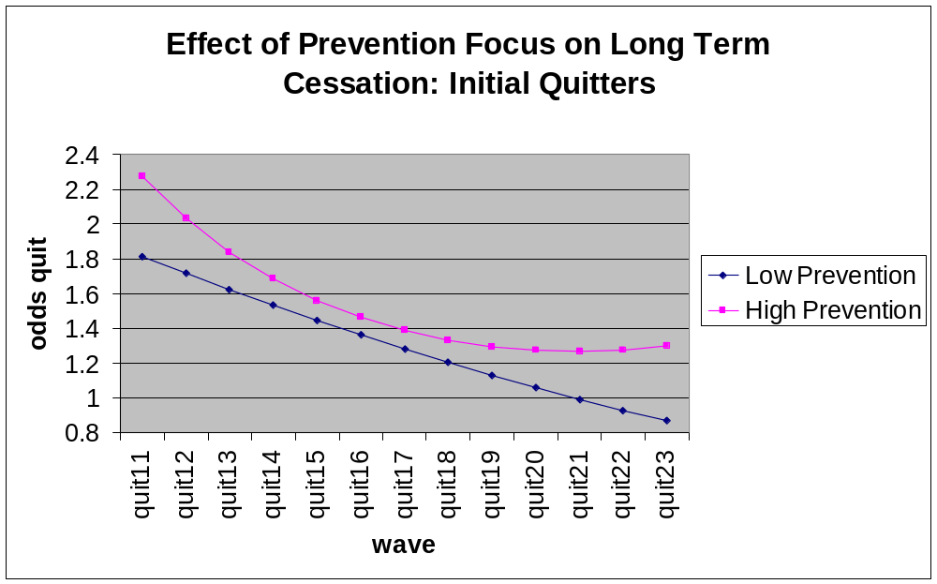
Does the Analysis Test the Theory?

Slide 21
Final Thoughts
We need to reinvigorate the reciprocal relation between theory and practice
Applying our theories to practical problems will stimulate innovations in our models by helping to clarify what we can and cannot explain
As we refine our theories, their impact on practice will increase. This will, in turn, generate a richer base of evidence which can guide further refinements and revisions.

Slide 22
Research Team
Psychology: Andy Hertel, Kristi Kelly, Emily Finch, Steven Martino, Loran Nordgren, Helen Sullivan, Keilah Worth, Marc Kiviniemi, Austin Baldwin, Paul Fuglestad
Epidemiology: Bob Jeffery, Harry Lando, Jennifer Linde, Christie King, Debbie Ng, Kerrin Brelje
Research supported by NINDS Grant NS38441

Slide 23
Mean Ratings of Self-Efficacy and Satisfaction at Session 10 by Smoking Status at 12 months
Smoking at Session 10 Quit at Session 10
Smoking at Quit at Smoking at Quit at
12 months 12 months 12 months 12 months
Self-Efficacy 3.04 4.40 6.04 6.76
(at session 10)
Satisfaction -1.25 0.50 1.49 2.91
(at session 10)
Self-efficacy assessed on scale from 0 to 8; higher numbers indicate greater confidence
Satisfaction assessed on scale from –4 to +4; higher numbers indicate greater satisfaction

