Slide 1
Multilevel Interventions: Measurement and Measures
Martin P. Charns
Mary K. Foster
Elaine C. Alligood
Justin K. Benzer
James F. Burgess
Allison Burness
Donna Li
Nathalie M. Mcintosh
Melissa R. Partin
Steven B. Clauser

Slide 2
Context
The “call to action”
Multilevel intervention research requires multilevel theory, design, measures
Measurement and analysis approach flows from
Intervention objectives
Theoretical model
Notes:
The introductory paper by Taplin and colleagues has provided a “call to action” – highlighting the critical role that multilevel intervention studies will play in making future quality improvements across the cancer care continuum.
As detailed in this introductory paper, as well as many other papers in the supplement, multilevel intervention research requires the development and application of multilevel theory, design, and measures.
As with any intervention research, the measurement and analysis approach employed for a multilevel intervention study should flow from the intervention objectives (i.e., the levels and predictors targeted) and the theoretical model explicating the hypothesized relationships between potential predictors, mediators, moderators, and outcomes, (both within and across targeted levels).

Slide 3
Objective
Provide practical guidance on measurement issues in multilevel intervention research in order to advance the state of the science in this area
Identify gaps in the literature
Recommend how to address those gaps
Notes:
The paper by Cleary and colleagues in this issue deals with study design and analysis issues involved in conducting multilevel intervention research.
The purpose of the current paper is to provide practical guidance on measurement issues in multilevel intervention research.

Slide 4
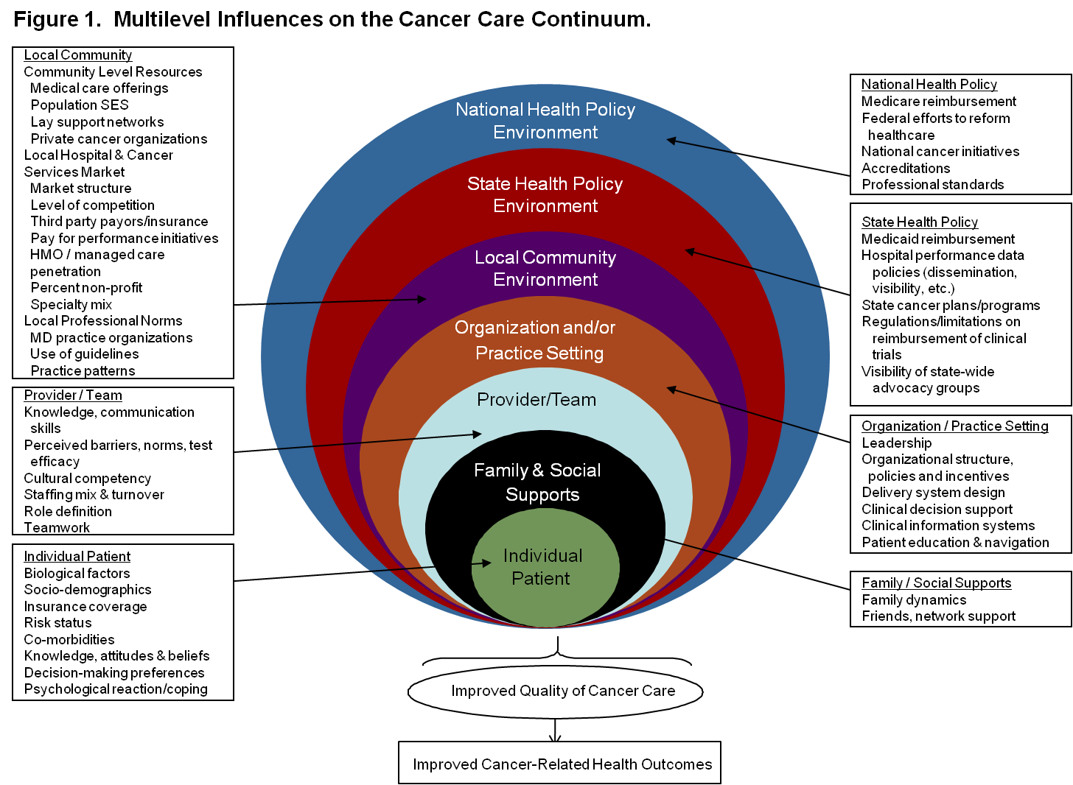
Socio-Ecological Model
Notes:
Because we’ve asserted above that the measurement approach used in a study should flow in part from the theoretical model, we will begin with a few details about the theoretical model guiding our work.
The Socio-ecological model used as a common framework for the papers assembled for this supplement acknowledges that health outcomes result from complex relationships between the characteristics of patients, families, care teams, practice settings, community environments, and both state and national health policy environments.
Description of example measures at each/some levels?
Developing and evaluating interventions that attempt to manipulate and measure the complex interplay between three or more of these various levels, (which is how this group of papers has defined “multilevel intervention”), is complex work.
The complexity of multilevel intervention research is magnified in a decentralized healthcare system such as the United States’, where many individuals receive care from multiple health care organizations, each with different local policies, resources, practice standards, and cultural norms.
Perhaps in part due to this complexity, there is a striking paucity of research evaluating interventions targeting more than one level across the cancer care continuum.
Further, even the few prior studies that have evaluated multilevel interventions have not all employed multilevel measurement approaches.
Given the dearth of prior research on multilevel interventions generally, and the use of multilevel measures specifically, our paper focuses more on what should be than has been done in this area.

Slide 5
Systems Approach To Interventions
Intervention Targets
Individual
Group
Organization
Inter-organizational
Processes
Outcomes
Processes
Outcomes
Processes
Outcomes
Processes
Context
Outcomes
Context
Emergent States
Context
Emergent States
Context
Emergent States
Emergent States
Individual
Group
Organization
Inter-organizational
Units of Measure
Notes:
Possible visual to use when explaining different types of models (homologous vs. cross-level, vs. single level)

Slide 6
Notes:
One of the things that is important to appreciate and understand in conducting multilevel intervention research is the fact that there can be multiple levels of interventions (in terms of targets) as well as measures (in terms of outcomes, mediators, moderators, and confounders).
The vast majority of prior cancer care interventions target the single level of the patient and only include measures at that same level. A few target a single intervention level but include measures at multiple levels, and some target multiple levels but only examine measures at a single level. However, very few include both multilevel intervention targets and measures.
This table illustrates some of these distinctions, using screening promotion as a hypothetical example.
An example of a single level screening promotion intervention based on single level measures would be a patient directed reminder intervention implemented in a single practice setting examining screening adherence as the dependent variable and patient demographics, attitudes, and behaviors (such as scheduling an appointment for a screening procedure) as independent measures.
If this same study design was modified so that the intervention was implemented in multiple practice settings and measures of practice setting characteristics (such as baseline screening rates and organizational complexity) were added as stratifying variables or confounders, this would be a single level intervention study using multilevel measures.
If you changed the intervention to target multiple levels by adding a provider education piece and a clinical reminder, but only examined patient level outcomes and independent measures, this would be a multilevel intervention with single level measures.
The most complex design would be a multilevel intervention with multilevel measures that explored the associations within and across levels. For example, in addition to an intervention targeting the patient, provider, and organizational level, you could have dependent and independent measures at the patient, provider, and organizational level, and explore the extent to which the intervention effect on patient and provider behaviors varied across practice characteristics such as baseline screening rates and organizational complexity.

Slide 7
Articles Reviewed
1,781
Minus 137 duplicates, conference papers, & letters/editorials/comments/ errata
1,644
Minus 449 biomedical effects/ treatments/ techniques
Minus 123 not related to cancer care
1,072
Related to cancer care interventions, measures

Slide 8
Level by Type of Care

Slide 9
Level by Intervention Target

Slide 10
Level by Unit of Measure

Slide 11
Recap
Of 1,152 articles reviewed, fewer than 25% were multilevel (intervention studies, essays, review, models, qualitative, measures development, etc.)
Of 356 intervention studies reviewed, fewer than 20% were multilevel
The most common type of multilevel study:
Whether considering intervention target or unit of analysis
Involves patient and caregiver (both at the individual level of analysis)
Caution:
Don’t mistake a multi-component intervention or multi-arm trial for a multilevel intervention
Don’t mistake setting for an intervention target
Notes:
Possible visual for discussion of examples of how studies may have multilevel intervention targets and /or multilevel units of measures

Slide 12
Discussion
More multilevel model investigation is needed, and structured literature reviews are an important tool
Focus on existing measures and gaps to be filled in further research
Focus on multilevel investigation offers opportunities to extend levels considered
Importance of detailed and well-developed theory as a basis for careful analysis

Slide 13
Organizational Level Measures
In health care systems, particular organizational level measures may be especially important in effectiveness, implementation and sustainability
Leadership, culture, quality, non-financial incentives are important examples
Interactions across levels may be especially important in the continuum of cancer care to extend multilevel modeling beyond provider/patient interactions into organizations

Slide 14
Methods for Extending Studies Toward True Multilevel Analysis
Team-level models: specifying global, shared, or configurations of team constructs or to other higher aggregations (e.g., networks or systems)
Cross-level models: specifying how interventions (typically at higher levels) affect outcomes (e.g., at individual levels)
Homologous multilevel models: specifying how relationships between interventions and outcomes might hold at multiple levels of analysis (e.g., for interventions at both provider and team levels)
Notes:
Klein and Kozlowski emphasize that team based studies alone can still just be single level studies.
Team models are where “leadership” is important, and we may want to put more emphasis on that than I have in the slides so far.
I think these Klein/Kozlowski ideas are good at this point on models unless they appear earlier somewhere.
We may need more examples and more slides (e.g. one for each of the three K/K proposals).

Slide 15
Questions
What are barriers to developing ML interventions and measures?
Can ML models be used in the context of RCTs to address measurement issues?
Can ML models be used with research designs other than RCTs to address measurement issues?
What theoretical/conceptual frameworks are helpful for conceptualizing ML research and developing appropriate measures?
What models/measures include focus on groups or organizations?
What models/measures address interactions across levels?
What models/measures address sustainability of interventions?

