Slide 1
Overview Multilevel Interventions Across the Health Care Continuum
Arnold D. Kaluzny, Ph. D
Professor Emeritus of Health Policy & Management
Gillings School of Global Public Health, &
Senior Research Fellow
The Cecil G. Sheps Center for Health Services Research
University of North Carolina at Chapel Hill

Slide 2


Within healthcare an array of interventions
Checklists
VBI
JCAHO
“AGENDA FOR
CHANGE”
Guidelines
CQI
EMR
DRGs
TQM
EBM
Outcomes
HEDIS
SUPPLE CHAIN
MANAGEMENT
COMMIT
CCOP
Benchmarking
CHOPs
Breakthrough
Improvement
Disease Management
ASSIST

Slide 3
Interventions targeting quality, cost & health
National Health
Policy Environment
Emerging
Science
State Health
Policy Environment
QUALITY
Local
Community
HEALTH
COST
Providers
Organization/
Management
Patients/Family

Slide 4
How well are we doing?
Quality/Safety
Despite efforts – Quality remains variable
“little evidence of improvement in safety “
EX- Recent Study NC Hospitals (Landrigan et.al., NEJM,Nov,2010)
Cost
Ranked #1 in cost/capita
Health (Despite Claims-Evidence)
World Health Report 2000 ranked
U.S health care system 37th in the world
Life expectancy 36 in the world
-Evidence of a declining trend each year
Murry&Frank, NEJM,2010
Notes:
Quality/Safety remain a challenge
10 years after the IOM “To Err is Human”
Recent NEJM study 2002-2007 MR audit study of 10 NC hospitals
Why NC--- NC highly engaged in efforts to improve patient safety ..96% hospitals enrolled in program
compared to other states av 78% enrolled

Slide 5
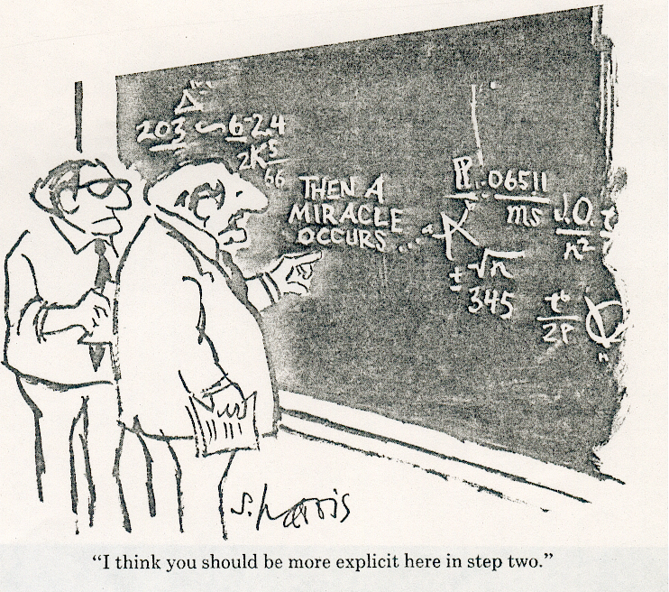
Bottom Line: “We Have Run Out of Miracles”

Slide 6
“You can always count on Americans to do the right thing - after they've tried everything else”...
Winston Churchill

Slide 7
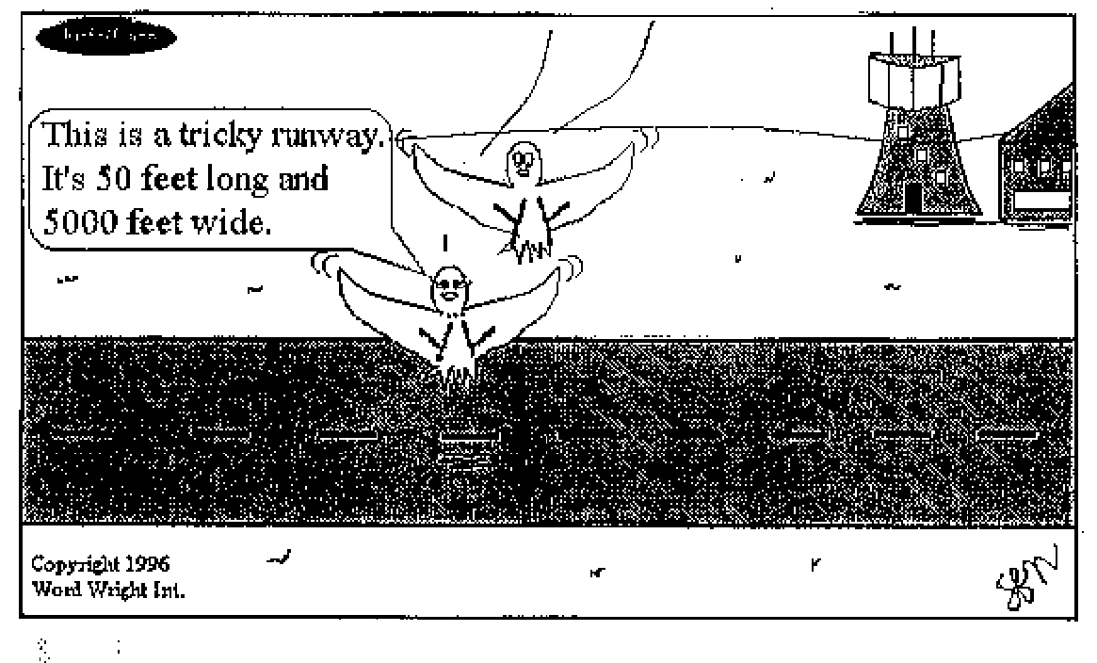
How we define the problem is important!!
This is a tricky runway. It’s 50 feet long and 5000 feet wide.
”

Slide 8
Opportunities are at the Intersection
“ The US will not achieve high value health care unless improvement initiatives (interventions) pursue a broader system of linked goals.---The Triple Aim”
Improving the individual experience of care
Improving the health of the population
Reducing the per capita cost of care for populations
Berwick,Nolan,Whittington, 2008
Notes:
As Don Berwick ( Director of CMS)….has said … and if he were at this meeting …
would say ………………..” “

Slide 9
“Triple Aim” Requires Some Re-thinking

Slide 10
Requiring the recognition that:
Health care is a complex/interactive/non-recursive process
multi points of intervention
From risk assessment–end of life
Intervention involves multiple levels
- Federal/State/Local/Organizational
Provider/Family/ Individual
Interventions involve a translational process…
aka …one of the “T” formulations
Notes:
Let me just say a word about each of these …since these are pervasive themes of the papers /// and will be central to our discussion and comments ……..

Slide 11
“Translational research transforms scientific/programmatic discoveries arising from laboratory, clinical or populations studies into clinical applications to improve care & reduce cancer incidence, morbidity and mortality” (TRWG, NCI,2009)
Interventions Involve a
“Translational Process”

Slide 12
We need to accelerate research translation
Discoveries
(e.g. genetic
risk factors/
T1: Epi, Cohorts, Biobanks
Candidate
Application
(e.g. test)
T2: Clinical studies, Randomized Clinical Trials
Checklists
Evidence based
Guideline/
Policy
T3: Implementation Research
Trials
Phase I
Phase II
Phase III
Phase IV
Practice &
Control
Programs in
Communities
T4: Outcomes
Research
Reducing the
Burden of
Disease in
Communities
Adapted from Khoury et al; Gen Med 2007
Notes:
Implementing interventions is a process at whatever level
The concept of “Translational Research”… so well captured by words
(Bench to Bedside)
equally appropiate when thinking about “programmatic interventions”
eg CHECKLIST

Slide 13
Our Mission—Focus of the MLI Papers/MLI Discussion
WHAT WE KNOW-ABOUT MLIs–“Consensus”
WHAT WE THINK WE KNOW–Hypothesis testing
WHAT WE NEED TO KNOW
Identify CROSS CUTTING ISSUES
ACROSS THE CONTINUUM
ACROSS THE LEVELS
WITHIN A TRANSLATIONAL FRAMEWORK
Basic–Applied–Improved Performance/Health

Slide 14
Agenda for MLI
Introduction: Conceptualization
Issues of Levels/Continuum/SOA
Challenges/Opportunities
Issues of /Synergy/Timing/Design
Applications/Future Directions
Within Context HCR/Org Reality/ Science
Notes:
Our two days are partitioned into 3 major segments
paper presentations
pane discussion
table discussion
feed back and commentary

Slide 15
This is not going to be easy!!
“There is nothing more difficult to take in hand, more perilous to conduct, or more uncertain in its success, than to take the lead in the introduction of a new order of things, because the innovator has for enemies all those who have done well under the old conditions, and luke warm defenders in those who may do well under the new” Machiavelli, The Prince

Slide 16
MLI Challenges
Conceptualization of the problem/link to appropriate theory/competing theories
Adequacy of research designs/approaches
Sample Size/Qualitative Methods/Simulations
Identifying appropriate metrics at
Various levels
Various phases of the care process
Notes:
Within the spirit of “FULL DISCLOSURE”… SOME MAJOR CHALLENGES

Slide 17
MLI Challenges (cont.)
Risk of “politicization” as interventions move to National/State/Community level
EG, Fluoridation/HCR
EG, Wendell Potter .. Deadly Spin
Involving the relevant stakeholders
Managing partnerships–research/practice
Communication: research/practice/disciplines

Slide 18
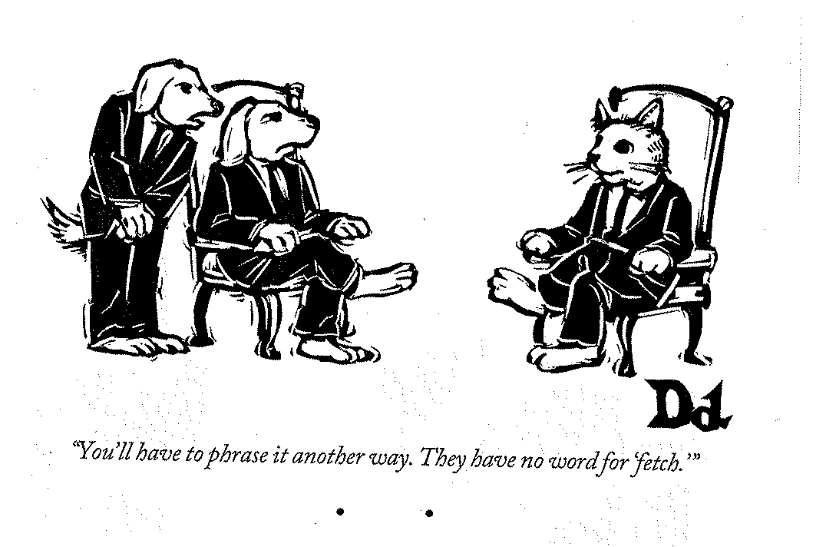
The communication challenge is paramount
“You’ll have to phrase it another way. They have no word for ‘fetch.’”
“You’ll have to phrase it another way. They have no word for ‘fetch.’”
(We don’t have a lot of practice)

Slide 19
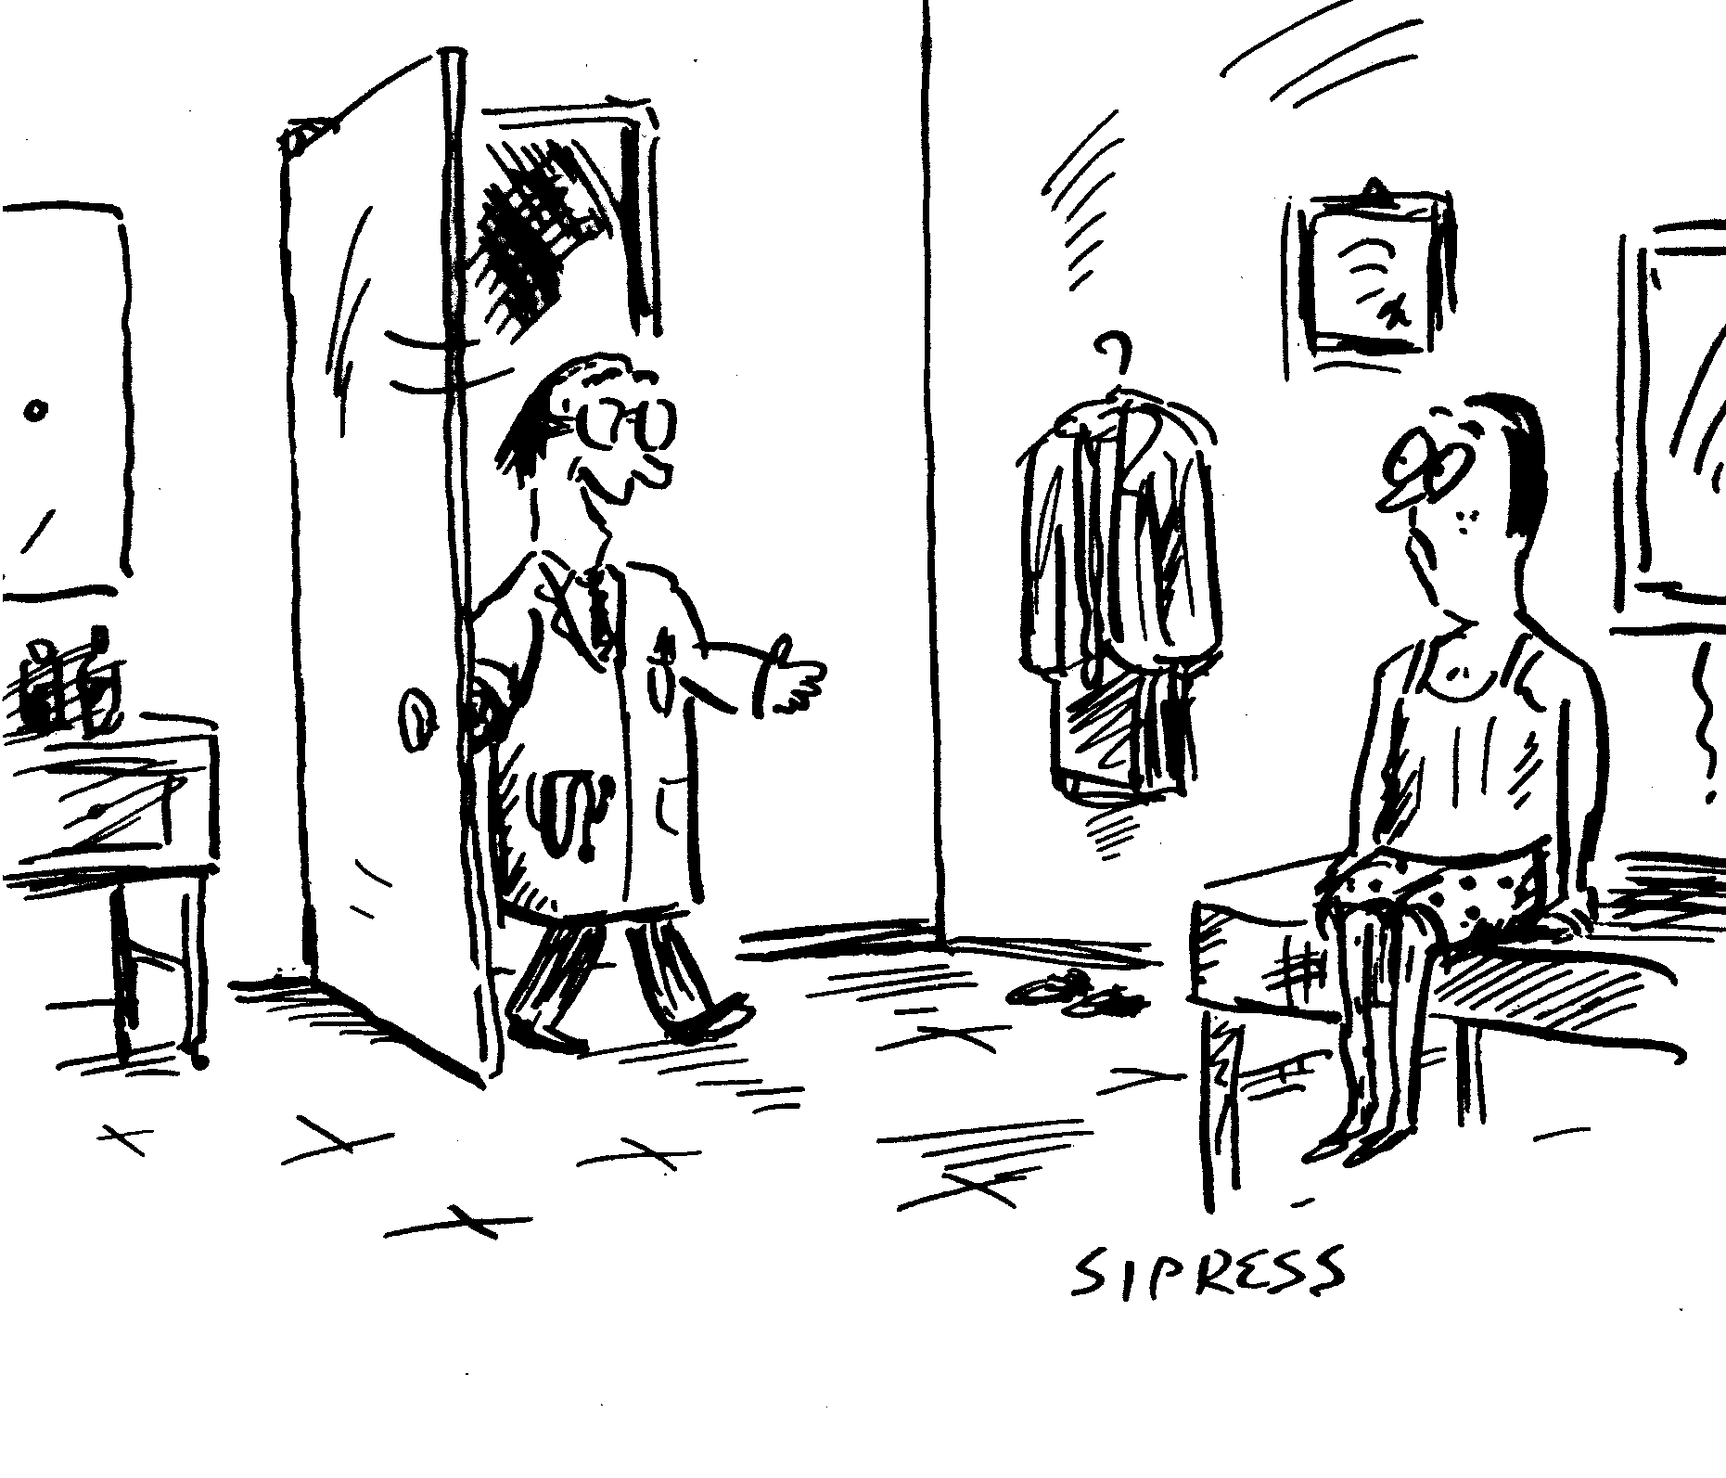
“Let the dialogue begin!”
Notes:
With that as an overview and context …………………...

Slide 20
THANK YOU !

