Slide 1
Multilevel Interventions in Health Care: Building the Foundation for Future Research
March 4, 2011
Stephen Taplin, MD MPH | Steven Clauser PhD
Rebecca Anhang Price PhD | Erica Breslau PhD | Veronica Chollette MS RN Heather Edwards PhD | Pebbles Fagan PhD | Mary Fennell PhD
Mary Foster PhD | Irene Prabhu Das PhD | Jane Zapka ScD
Notes:
Thank you Dr. Kaluzny for setting the stage, and for your wisdom during the development of this conference. One of the privileges of working at the National Cancer Institute is the chance to collaborate with luminaries from across the country like Dr. Kaluzny, Dr. Richard Scott, whom you will hear from later today, and Dr. Otis Brawley who have been leading the research and cancer care field for years.
It is also a privilege to have work with fine people like these who have contributed to developing the ntellectual base for this meeting and many of the details that make this meeting possible; People like Veronica, Heather, and Rebecca who made sure we stayed on track, on task, and on time. Thank you to them as well.
But let’s start. You’ve heard the plan, you’ve heard some of the problem. Let’s elaborate, and lets get to the discussion.

Slide 2
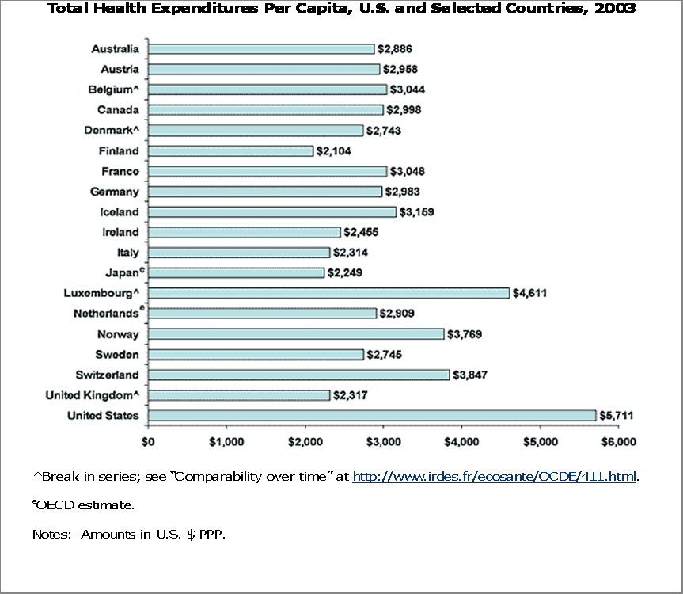
Background
US health care over spends
US health care underachieves
Costs for cancer care are large and growing
    $124.6 billion – 2010
    27% increase anticipated for 2020
  54.9% with chronic illness get recommended care
  19th in reducing avoidable mortality
  13th in infant mortality
Notes:
Among people audited, 54.9% of people with chronic illness receive recommended care.
Asch, et al. (2006). Who is at greatest risk for receiving poor-quality health care?” NEJM, 354: 1147-1156.
So Dra. Kaluzny has noted that we have a problem, but let me just reinforce that a bit…
We over spend
We under achieve
And the only thing that is clear is that our spending is going to increase…
Our underchievement and over spending is at the heart of the problem. The intellectual challenge, and the opporutnity to make a difference in the care provided to Americans requires careful thought.

Slide 3
Assumptions
We need to do better
Reductionist approaches have limitations
  New technologies take 17 years to be widely adopted
  Evidence based innovations are not adopted
  Practices inconsistent with evidence persist.
We can learn from other research fields
We can do better
  In pursuit of health
  Rethinking our questions about delivering care
  Considering multilevel interventions
Notes:
So I do make some explicit assumptions;
Read
Finish with
And we can do better etc.
We wanted to consider multi level intervetions…
Because they have been called for in the literature,
In 2004 Dr. Breslau and Meissner called for them when it became apparent that after 20 years of screening intervention research there were still many unadopted improvements, and there many vulnerable populations not being screened; not because they had the wrong attitude, but because they did not have insurance, or were not given the choice. There also are multilevel analyses like the one by Stone et al that show that system changes have the most lasting effects.

Slide 4
Multilevel Interventions defined…
Address the health outcomes for patients
  Patient-Centered Care
Target at least 2 other levels in a multilevel model of improving health status
Measure effects at each level
Notes:
But what is a multilevel intervention? The term is used quite a bit now.
Our team started into this work with an explicit definition that we used to look for published research on multilevel interventions.
The definition began with the patient and then addresses 2 other levels in a multilayered contextual model I will explain more fully in little bit: We were therefore looking for interventions that addressed three levels of our model.
We also set out to find work that measured effects of the interventions at each of the three levels.

Slide 5
Sparse MLI Intervention
Literature
Commit – individuals, orgs, community
  Smoking cessation in community
Assist – individuals (+), groups, orgs.
  RCT Smoking cessation among heavy smokers
Catch – students, families, schools
  RCT of 4 communities to reduce cholesterol and BMI
Notes:
We did not find much… And I won’t go into them I detail but they are classics whose work is often cited but in fact they barely met our definitions.
Stanford:
COMMIT: This community intervention trial for smoking cessation randomly assigned one of each of 11 matched pairs of cities to either intervention or control status.
ASSIST: This randomized trial was conducted in 7 intervention and 7 control communities in Minnesota to test a community organizing approach to reducing smoking among school-age children who were in grades 8 through 10 at initiation of the study.
CATCH: This randomized trial in four communities tested interventions at three levels (schools, students and families). They encouraged schools to: 1) reduce the fat content of food service, 2) increase the amount of time devoted to physical exercise, and 3) implement classroom curricula addressing healthy eating.
Measured effects at individual level (smoking yes/no), or community
Little examination of interactions among contextual influences
Little examination of interventions that affect multiple levels (e.g. 3 or more)
Did not measure effects at all levels
While the evidence of system and environmental effects is growing its connection to indvidual level health outcomes is not necssarily strong, and the four studies cited earlier are not compelling evidence of benefit. So we wanted to more closely examine multilevel effects, not because there was a strong evidence base that said this was the way to go but because there was a strong evidence base that individually focused innovations and improvements were not addressing the problems, were not being adopted, were deveoped in an acontextual way that limited their adoption.

Slide 6
Project Background
June 2009 workshop with experts
  Generated issues and recommendations
  Resulted in this conference & JNCI supplement with focus on critical topics and considerations
  Jeff Alexander John Ayanian
  Allen Dietrich
  Mary Fennell
  Ann B Flood
Arnold Kaluzny
Joe Morrisey
Electra Paskett
David Murray
Mario Schootman
Stephen Shortell
Kurt Stange
Sally Vernon
Notes:
As I noted in my opening , one of the great privieges of working at NCI is the ability to convene leaders and luminaries. So we did that in June of 2009, to discuss MLI and to consider how we could expand the foundation for research in this area.
This meeting generated issues and recommendations and the development of a series of papers that will be presented today. They are the focus of this meeting and they will benefit from the discussion here and they are intended to expand the foundation of work; a foundation that benefits from work by many of you and a foundation that we hope will contribute to a growing body of work .

Slide 7
Conference Topics
Section I: multilevel influences and interventions across the cancer care continuum
    Taxonomy and operational definitions (Stephen Taplin)
    Multilevel issues impacting care (Jane Zapka)
    State of the science for MLI interventions in health and health care (Kurt Stange)

Slide 8
Conference Topics
Section II: challenging conceptual issues and opportunities for research on multilevel interventions
  Intervention development (Brian Weiner)
  Time as a factor in analyses (Jeff Alexander)
  Research design (Paul Cleary)
  Modeling as an analytic tool (Joe Morrissey)
  Measures in MLI research (Martin Charns)

Slide 9
Conference Topics
Section III: Current reality and future directions for multilevel interventions and research
  Linking multilevel approaches in healthcare reform (Kelly Devers and Richard Warnecke)
  Applications of interventions in a multilevel context (Elizabeth Yano)
  Genomic medicine in a multilevel context (Muin Khoury)
  Synthesis & emerging themes (Steve Clauser)

Slide 10
We look forward to your comments
This conference is designed to seek your input
  See the summaries in your folder
Participate in the discussions
  We expect lively critical feed back

Slide 11
Session I
Multilevel influences and interventions across the cancer care continuum

Slide 12
Levels Definitions vary
Ecological/Psychological model
  Intrapersonal
  Interpersonal
  Policy
“Systems” model
  Individuals/groups
  organizations
  economic & social systems (community, state, nation)
Units of human organization- Biopsychosocial model
  Individuals
  Groups (family, health care team)
  Organizations
  Community
  Nation
Notes:
Biopsych – Engel
Systems models – Molloy
Ecological/Pschological – Sallis
The definitions of what constitutes a level vary by discipline but they are all getting at the same issue …stuff happens. We live in this world. It was very clear to me that no matter how long we had worked on this meeting, if the government shut down tonight, our best laid plans were going to be affected.

Slide 13
The Layered Context of Care
National Health Policy Environment
State Health Policy Environment
Local Community Environment
Organization and/or
Practice Setting
Provider/Team
Family & Social
Supports
Individual
Patient
Improved Quality of Cancer Care
Improved Cancer-Related Health Outcomes
Notes:
So our model is close to Engel’s biopsycho social model. There are multiple layers that affect patient and health care team interactions and therefore affect quality and health outcomes.
But recognize this is a complex but limited view.

Slide 14
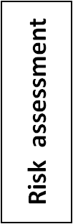
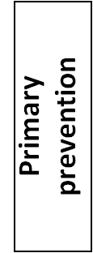
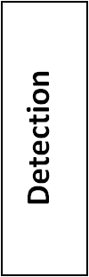
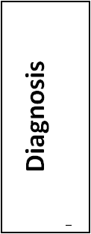
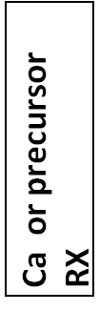
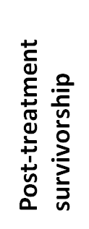
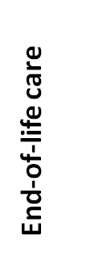
Progression across the continuum affects quality & outcomes
The Care Process(es)
Impact
Outcomes
Types of Care
Risk status
Biologic outcomes
Health related quality of life & well- being
Quality of death
Financial burden
Patient experience
Patient
Quality measures
PopulationMorbidity
Mortality &
Cost-effectiveness
Transitions in Care
Notes:
Cancer care is a process that involves multiple subprocesses.
Efficiency
Equity
Effectiveness
Safety
Timeliness
Patient-centeredness

Slide 15
Figure 1. Steps and Interfaces from Diagnosis to Treatment.
Intersections of Levels & Process
SCREENING
DIAGNOSIS
TREATMENT
DETECTION
(Dx)
(Rx)
Performance
Results
Referral for
Appointment
Performance
Results
Referral
of the Test
Reporting
diagnostic
Scheduling
of Follow
-
Up
Reporting
evaluation
Testing
•
Patient
•
Accessibility
•
Administration
•
Patient
understanding
•
Convenience
•
Interpretation by specialist /
understanding
•
To referring provider
•
Counseling re: fears
•
Availability
laboratory
•
Fears
•
To primary care provider
•
Patient compliance
•
Patient understanding
•
To patient
•
Counseling re fear
Type of Care
Type of Care
: The care delivered to
: The care delivered to
accomplish a specific goal such as
accomplish a specific goal such as
detection, diagnosis, treatment.
detection, diagnosis, treatment.
Transition
Transition
: The set of steps and
: The set of steps and
interfaces necessary to go from
interfaces necessary to go from
one type of care to another.
one type of care to another.
Step
Step
: The medical encounters or
: The medical encounters or
actions that compose a type or
actions that compose a type or
transition in care.
transition in care.
Interface
Interface
: Interactions between
: Interactions between
Follow
-
Up Figure (JZ)
provider types and/or organizations
provider types and/or organizations
and organizational units.
and organizational units.
2/5/2009
Notes:
The connections between steps in the care process can be elaborated even further. In fact the more you dig into all the things that occur during care the more it becomes clear there are many steps and interfaces between people and organizations that are affecte
But think about it. These steps are not just about cancer care. They capture a number of processes that affect care in any system. We have learned a lot about organized approaches to screening, from Europeans because our details are different but our processes are the same; The results of a test need to be reported to the patient in some way, referrals and connections to the next step in care need to be made in some way.
And the way that we deal with these connections is affected by the context of care; national policy regarding reimbursement , relationships between organizations, how information and responsibility are passed from one set of providers to the next in a way that serves the care of the patient. Finding these general process es and the influences upon them is part of multilevel analysis. It is helped by talking about this process with others like Europeans who operate in other systems and contexts, but must address the same processes

Slide 16

Levels Affect Individual’s Care Across the Cancer Continuum
Community
Organization
Providers
Family & Social Support
Assess Risk
°1 Prev
Detect
Dx
Survivor-ship
End
of life
Treat
Notes:
But of course it is more complicated because as I noted at the time of showing you the first onion figure, care occurs across a continuum, and of course people enter and leave that continuum at different points in a recursive process.
But more importantly, when they enter that process is affected by context all the way along.

Slide 17
The Effect May Vary
Across the Cancer Continuum
Organization
Providers
Family & Social Support
Family & Social Support
Family & Social Support
Providers
Providers
Assess Risk
°1 Prev
Detect
Dx
Survivor-ship
End
of life
Treat
Notes:
And if we think about it a bit, it is clear that the effects are not monotonoic. Family may play a stronger role than providers n the early phase of the continuum. And providers may plan a more important role than family in the treatment phase, but that role could drop off again at the end.
So it is easy to make this all very complicated. And the question in the meeting today is can we simplify, can we begin to find underlying principles while still considering these complex effects.

Slide 18
But how do levels affect each other
Structure
Policy
Incentives
Interpersonal interaction to affect
  Education
  Attitudes (e.g. perceptions of social norms)
  Skills
  Behavior
Notes:
But I think it is important conceptually to separate the concept of levels of influence from the concept of mechanisms of influence. That is one simplification I would like to propose today.
While some disciplines consider policy as a level, I think it may be conceptually appealing to separate levels from mechanisms of influence. Policy can be set at national or state levels; it is a mechanism of influence.
So is physical structure and interpersonal interactions.

Slide 19
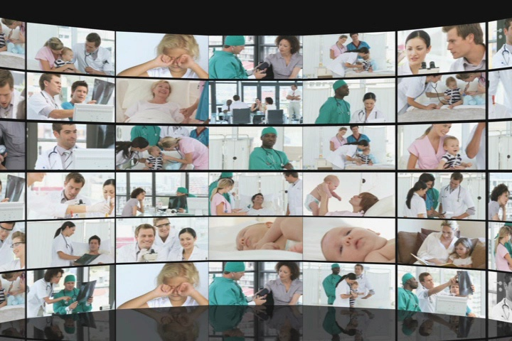
Care occurs in context
National Health Policy Environment
State Health Policy Environment
Local Community Environment
Organization and/or
Practice Setting
Provider/Team
Family & Social
Supports
Individual
Patient
Improved Quality of Cancer Care
Improved Cancer-Related Health Outcomes
Notes:
Yes it is complicated. Yes it requires careful thought, but it also reflects the reality of the world in which we live and practice.
As I noted in the beginning; we have approched interventions as single small steps and individually focused, but this approach results in changes that occur very slowly.
We live in a more complicated world and our interventions should begin to at least measure if not intervene in that layered context .

Slide 20
Discussion Question
What is a level?
How is level distinguished from a mechanism of influence?
  Eg. “Is policy a contextual level or a mechanism of effect?”
    Policy’s effect can be tested
What difference does it make?
  This work is about intervention design and testing
Notes:
Levels are there, they are characteristics of the environment, they may change but they won’t/can’t go away.
I’m clear that I have a perspective, and I want to hear yours. Later this morning you will have a chance to talk at your tables. I suggest you take on at least these three questions, not to see if you were awake during this lecture, but to hear your perspective.
What do you mean when you say or consider multilevel effects? What is a level?
How is level distinguished from mechanism of effect?
Does it make any difference how we define levels? …but also remember, this conference is about intervention design, not multilevel analysis.
The bottom line for me is developing interventions that can be tested to improve health care delivery, that have measurable affects at 3 levels of the system but that ultimately improve patient outcomes and get us closer to achiveing the potential of our knowledge.
Thank you.

