Slide 1

State of the Art and Future Directions in Multilevel Interventions across the Cancer Control Continuum
Erica Breslau, PhD, MPH
Allen Dietrich, MD
Russell Glasgow, PhD
Kurt Stange, MD, PhD

Slide 2
Methods
Multidisciplinary team
Multiple iterations of literature searches
Designed to include the breadth of the field
Concentrated on cancer control continuum
Included other fields (particular cardiovascular disease studies)
Developed a matrix of article types
Immersion at O’Hare Airport hotel
Characterize how multilevel research currently is conceptualized and implemented
Described illustrative examples
Identified opportunities for MLI to advance cancer control
2

Slide 3
Threads of Shared Thinking & Research
Contextualized single-level studies intervene at the person/patient or provider/practice, but consider other contextually-important levels
Health care systems research includes individual, practice & system levels, and sometimes considers community or policy factors
Community-wide studies public health perspective, often including nested health care system, practice, family, person levels
Community heart studies
Community cancer control studies
3

Slide 4
Observations from the Literature
Multilevel interventions are context-dependent, but context is reported inadequately in most reports
Typically, less than 3 levels are reported
Theory, models and interventions are not well integrated in reports/studies
Most focused on prevention and screening; seldom on diagnosis, treatment, survivorship
Reporting of temporal issues is limited
Many glimmers of potential of MLI
Thought pieces
Theory
Empirical
4

Slide 5
Opportunities
Design
Analysis
Dissemination
5

Slide 6
Design Greater attention to:
Contextual factors across
Levels
Time
Rapid learning designs that evolve over time
Dynamic
Adaptive
Emergent
Interfaces across and within levels
Specifying levels affecting the phenomena under study (even if they are not the focus of the study)
6

Slide 7
Analysis Greater attention to:
Evaluate both process and outcomes
Capture, but move beyond measures of central tendency
Use multi-method approaches that
Integrate quantitative modeling across multiple levels where relevant quantitative data can be generated, and
Qualitative methods to evaluate levels with small numbers, and to identify key inter-level processes
Complex systems and dynamic simulation modeling may provide additional insights where data are sparse
7

Slide 8
Translation Greater attention to:
Transparent reporting of contextual factors
Moving beyond fidelity to
Local adaptation / reinvention / evolution
Participatory approaches
How multiple levels interact in context, (vs. in isolation)
Move beyond sustainable to evolvable interventions
8

Slide 9
An Example
Design: Observational / intervention
Focus: Preventive services & health behavior
Level | Who/What
Individual and Family | Low income, pregnant mothers, and their children <2
Practice | Primary care and home visits
Healthcare System | Multilevel advisory committee included Medicaid representatives
Community | Community organization and town and state government
Margolis PA, Stevens R, Bordley WC, et al. From concept to application: the impact of a community-wide intervention to improve the delivery of preventive services to children. Pediatrics. 2001;108(3):E42.
9

Slide 10
Challenges
The future is multiple (conditions, behaviors, interactive modalities)
The future is complex (and we ignore complexity at our peril)¹
“All models (and designs) are wrong” ² – tolerance, respect, & creativity are needed
We may need to UN-learn much of what we have been taught to answer the tough questions
10
¹Glasgow RE, Emmons KM. Annual Review of Public Health , 2007
²StermanJD. Syst Dynam Rev 2002;18:501-531

Slide 11
Discussion Questions
How do we develop MLI that
Create synergy across multiple levels?
Continually pay attention to context?
Adapt and learn over time?
How do we develop designs and analytic techniques that reflect the complexity of the phenomena we are studying?
How do we disseminate to foster
Informed adaptation or re-invention?
Continued evolution and learning?
11

Slide 13
Extra Slides
Not for handout
May be used for discussion

Slide 14

Integrated Dynamic, Multilevel Research-Practice Partnerships Systems Approach
Evidence-Tested Program
Health Care System
Program
as Tested
Clinic(s)
Fit
Program
Delivery
Staff
Critical
Elements
Non-critical Packaging
Delivery Site(s)
Program as Marketed
Organization
Design
Appropriate
for Question
Partnership
Research Design Team
And Adaptive Design
Broader Health Policy and
Cultural Context
14
Adapted from Estabrooks et. al. AJPM, 2005, 31: S45

Slide 15
Opportunities for Integrating Across Levels
Cultural, Historical, Social-Environmental Factors (Fundamental “distal” Determinants)
Incentives, Coverage
Community Building Infrastructure;
Health Care System
Priorities, Resources, Guidelines, etc.
Patient-Provider Encounters
Shared Decision-making
Monopolies vs. Open Access
Regulations, resources on food, tobacco, transportation
Interoperable EMRs and PHRs
Feedback, Monitoring
Public Reporting
Breadth of Impact
Social-Community Context
Work, built environment, environmental exposures, family, friends
Ubiquitous Media and Technology Work, built environment, environmental exposures, family, friends
Tracking, Monitoring Progress
Action Plans
Malleability in Short Timeframe
Community programs
Individual Level
Malleable Factors:
Self-efficacy, activation, problem-solving, etc.
“Trait” Factors: Preferences, illness Representations, emotions
mHealth (mobile) devices
Social Norms Transportation Programs
Personal Health Records (PHR)
Personal Health Records (PHR); Social Media
Genetic Counseling
Sub-personal/Biological
Genomics
15

Slide 16
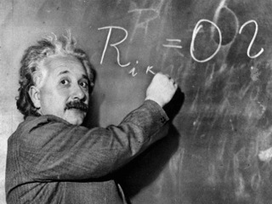
“The significant problems we face cannot be solved by the same level of thinking that created them.”
A. Einstein
16

Slide 17
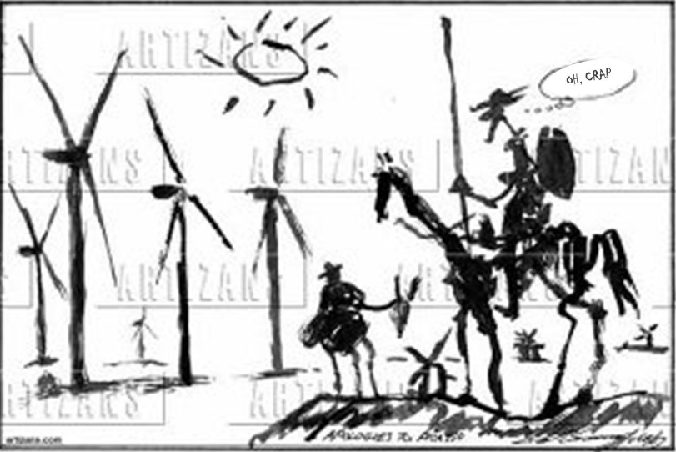

Slide 18
Implementation and Dissemination Research Characteristics
Contextual
Complex
Multi-component programs and policies
Non-linear
Transdisciplinary
Multi-level

Slide 19
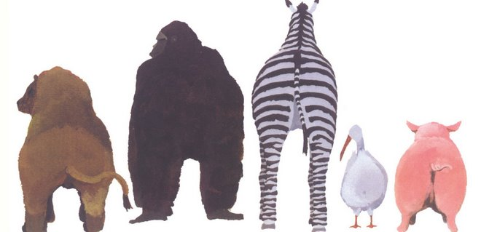
THE END
19

