Slide 1
Healthcare Reform and Multilevel Interventions
and Research:
Big Changes Go Hand-in-Hand with Big Science
Presented by Kelly J. Devers
Prepared for the NCI Conference on Multilevel Interventions in Health Care: Building
a Foundation for Future Research
March 4-5, 2011
Las Vegas

Slide 2
Purpose
To identify, describe, and discuss:
  Some key provisions of the Affordable Care Act (ACA) and federal stimulus bill (ARRA HITECH)
    New care delivery models
    New provider payment models
    Health information technology
  Their impact on cancer care
  Their implications for research

Slide 3
Major Themes and Take-Aways
Big changes are underway
  Influencing multiple levels of the health system
  In fundamental areas
They will impact cancer care in significant but unpredictable ways
  Health system is particularly complex and dynamic
  Unintended responses and consequences likely
These times, and changes, require “big science”
  Innovative approaches to and investment in:
    Multi-level theory, data, methods, and measures
    Larger, longitudinal studies
    Mixed methods, not quantitative or qualitative alone
    Multi-disciplinary research teams
Notes:
Historic passage of national health reform—Affordable Care Act. Although very early on in implementation, and clearly subject to some change as political, legal, and economic debates and decisions play out, ACA is already resulting in:
major changes at the federal and state levels, through Medicare and Medicaid, as well as pockets of the private sector.
These major changes are in two fundamental areas
Coverage (i.e., how many people have insurance, who their insurer is) and coverage decisions (i.e., what drugs, treatments, or other technology) . The later is where comparative effectiveness research (CER) comes in.
The organization and delivery of care, and related provider payment changes.
My talk focuses on the later, but it’s clear that changes in coverage and coverage decisions will effect the organization and delivery of care as well.
This brings me to theme 2: These major policy changes will influence cancer care in significant and highly unpredictable ways. Talk further about some concrete examples throughout the rest of the talk.
Theme three 3—Big Science . Big Science is a term used by scientists and historians of science to describe a series of changes in science which occurred in industrial nations during and after World War II, as scientific progress increasingly came to rely on large-scale projects usually funded by national governments or groups of governments.^{[1]} Individual or small group efforts, or Small Science, is still relevant today as theoretical results by individual authors may have a significant impact. But very often the empirical verification requires experiments using constructions, such as the Large Hadron Collider costing between $5 and $10 billion.
We are not without recent example of “Big Science” in Health—Best example is the Human Genome Project. Big staffs, budgets, laboratories/machines and related data and data exchange. All of this helped create an infrastructure and public-private partnership to achieve an amazing goal…sequencing the human genome in about 13 years.
We argue that we need more of a “big science” mentality and infrastructure in the cancer care services area, to answer the pressing questions of the day about how changes in provider payment and the organization and delivery of cancer care effects access, quality, and cost. This “big science” approach would complement, not replace, our small science approach. But, it would require….(go to points on the slide).

Slide 4
What is a PCMH?
Purpose is to support and improve primary care, particularly access, patient-centeredness, care coordination and management
Dozens of specific PCMH definitions and numerous assessment instruments, such as NCQA’s
But, share seven common principles
  Personal relationships; whole person orientation; team delivery of care; care coordination across specialties, care settings, and time; quality and safety improvement; enhanced access; and, adequate and/or new payment models.
Notes:
Experts in this topic in the room, like Kurt Stange and others…

Slide 5
PCMH Activity
CMS recently announced its support for the Advanced Primary Care demonstration
  Medicare is joining multi-payer medical home efforts in eight states
Multi-stakeholder pilots are already underway
  27 initiatives in 18 states
Currently 39 Medicaid-associated PCMH initiatives underway
  Some Medicaid only and others part of multi-payer efforts

Slide 6
Impact on Cancer Care
Are primary care providers well suited to serve as a medical home for cancer patients and to coordinate cancer care?
Can oncology practices and oncologists be a medical home?
  How do we encourage and support positive aspects of medical homes in oncology practice?
    E.g., Patient-centered, shared decision-making, care integration and coordination
How might medical homes effect multi-disciplinary care (MDC) cancer teams?

Slide 7
What is an ACO?
Couples provider payment and delivery system reforms
  Attempt to solve “chicken and egg problem”
  Form of direct contracting between Medicare (or purchasers) and providers, cutting out Medicare plans!
Purposely designed to be flexible, recognizing:
  Variation in local markets, such as provider organization and willingness and ability to accept non-FFS payment arrangements
  Need to experiment with new payment methods
Broadly defined as a group of providers—primary care, specialists, hospital--that can be jointly held accountable for the quality and cost of care for a defined population
  E.g., Traditional Medicare beneficiaries (Parts A and B)
Notes:
Bear with me here….still vague and conceptual….
Some just think of them ACO’s as HMO’s in drag, but there are some important differences..

Slide 8
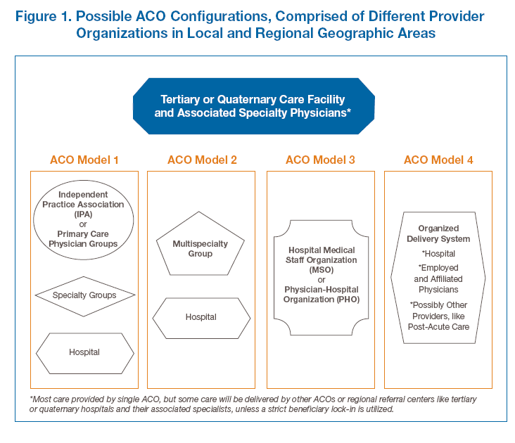
Notes:
Key points:
In theory, ACO’s require a strong primary care base. In this way, some see PCMHs as the foundation of an ACO and/or part of a “medical neighborhood” with specialists and hospitals.
In some cases, primary care physicians could be leading an ACO, as in model 1.
In other cases, more specialist and hospital dominated organizations may lead the ACO, as in models 2-4.
People have hypotheses regarding which one of these models would add the most value—that is maintain or improve quality while reducing total costs.
Finally, no one expects all care to be provided by the ACO and policymakers don’t want to prevent Medicare beneficiaries from going to regional tertiary or quatenary facilities, like AMCs or NCI-designated centers. But, if the ACO is being held accountable for the cost and quality of care, they may not want to refer when necessary.
In theory, in the ACO program, patient can go to any facility they want. But, is that as likely if their primary care physicians and specialists have incentives not to do so.

Slide 9
ACO Activity
First key step for ACO pilot is well underway
  Notice of Proposed Rule Making (NPRM) for the ACO pilot will be released soon
  NPRM describes decisions about all aspects of the ACO pilot program, including areas where CMS is still seeking public input
Great interest in ACO pilot from providers, as well as public and private purchasers
Notes:
(Section 3022- Shared Savings Program)

Slide 10
Impact on Cancer Care
More incentive to reduce total cost of care
  Strength of incentive varies with specific payment model
  May alter referral patterns within local areas from community hospitals to academic medical centers (AMCs) and NCI- designated cancer centers
More incentive to meet quality targets
  Greater need for, and emphasis on risk-adjusted quality measures, to protect against stinting on care
To what extent will AMCs and NCI-designated cancer centers lead or participate in ACOs?
Where and how do hospice, nursing homes, and other services and providers fit in?

Slide 11
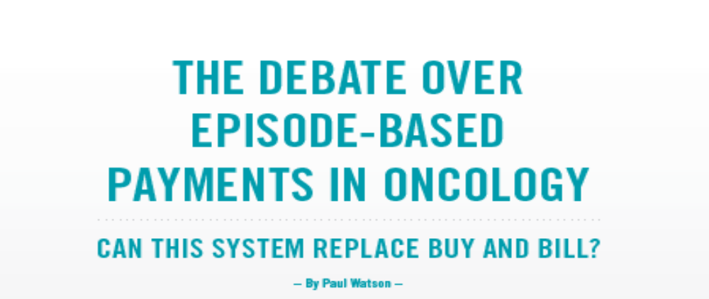
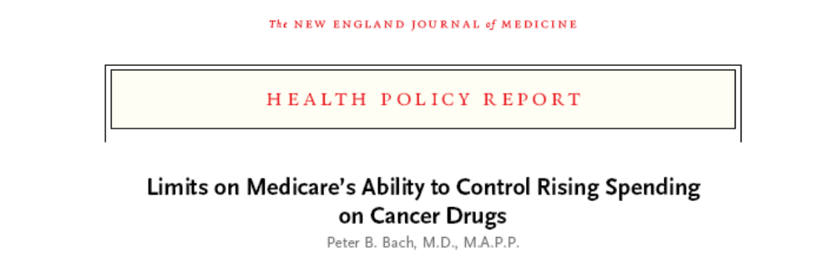

Slide 12
Electronic Health Records (EHRs) and Health Information Exchange (HIE)
Largest investment by federal government in history--approximately $30 billion--to facilitate:
  EHR adoption, upgrade, and meaningful use (MU) by Medicare and Medicaid providers
  HIE among providers, patients, and other groups
  Ultimately aims to increase quality, efficiency, and patient-centered care in a secure environment

Slide 13
Impact on Cancer Care
Many oncology practices will be implementing, upgrading, and trying to meet MU requirements
  Very challenging and in the short term may be disruptive to practices or have unintended impacts on quality, safety, and efficiency
HIE provides new opportunities to share information among oncologists, hospitals, and researchers
  But, also many technical challenges and concerns about security, privacy, and related legal matters

Slide 14
Implications for Research
Are PCMH’s and ACO’s complementary or conflicting? What is their impact on integration, care coordination across the continuum, and outcomes?
  Patient and community centeredness and engagement
  Primary care—oncologist—hospital relationships
    Multi-disciplinary care teams
  Cancer programs, including linkages between community hospital based programs and AMCs and NCI-designated cancer centers
  Access, quality, and cost of cancer care
How do EHRs and HIE fit into PCMHs and ACOs?
  How important are these component for achieving the aims of PCMHs /ACOs or can their contributions even be separated out?

Slide 15
Implications for Research
Major delivery system and payment reforms underway are complex, multi-component, multi-level interventions!
  Methods must match the times
  Current multi-component, multi-level research tool-kit
    Some areas of strength and progress, but also serious gaps
  Need a comprehensive approach
    Work in one area, or incremental change, is not likely to meet the needs of the field and researchers, OR
    Diverse policymakers, payers, providers, patients, and the local communities in which they live

Slide 16
Big Changes Go Hand-in-Hand with the Need for Big Science!!

