Slide 1

Implementation and Spread of Multilevel Interventions in Practice: Implications for the Cancer Care Continuum
Elizabeth M. Yano, PhD, MSPH
VA Greater Los Angeles HSR&D Center of Excellence
UCLA School of Public Health
Center for the Study of
Healthcare Provider Behavior

Slide 2
Co-Authors
Lawrence W. Green, DrPH (UCSF)
Karen Glanz, PhD, MPH (U Penn)
John Z. Ayanian, MD, MPP (Harvard Med)
Brian S. Mittman, PhD (VA CIPRS)
Veronica Chollette, RN, MS (NCI)
Lisa V. Rubenstein, MD, MSPH (VA, UCLA, RAND)

Slide 3
Introduction
Scientific evidence about what works in health care takes decades to move to routine care
Evidence is flawed → tested under highly controlled and homogenized circumstances
Applied to real world settings → “voltage drop”
Greater recognition of contextual influences underlying intervention success (or failure)
Motivated interventions that target context levels (patients, providers, practices, communities, policy)
Few multilevel interventions (MLIs) conducted along cancer continuum → fewer implemented

Slide 4
Implementation and Spread
How is implementation different?
Not testing the original efficacious intervention
Testing a set of strategies for deploying the MLI
Adapted to different contexts (settings, levels)
Focused on activities that facilitate uptake of MLI
Requires engagement/involvement of wide range of stakeholders
Partners in implementation at each level
Researchers’ capacity to influence determined by handoffs and support constructed through partners
Creating new ways of “doing business”

Slide 5
Approach
Identified cancer and non-cancer MLI exemplars
Span different levels and different stages of care continuum
Pool Cool Diffusion Trial
Improving Systems for CRC Screening
Depression Collaborative Care Models
CHOICE
(Cancer Education)
Comprehensive Tobacco Control Programs
VHA Colorectal Cancer Care Collaborative

Slide 6
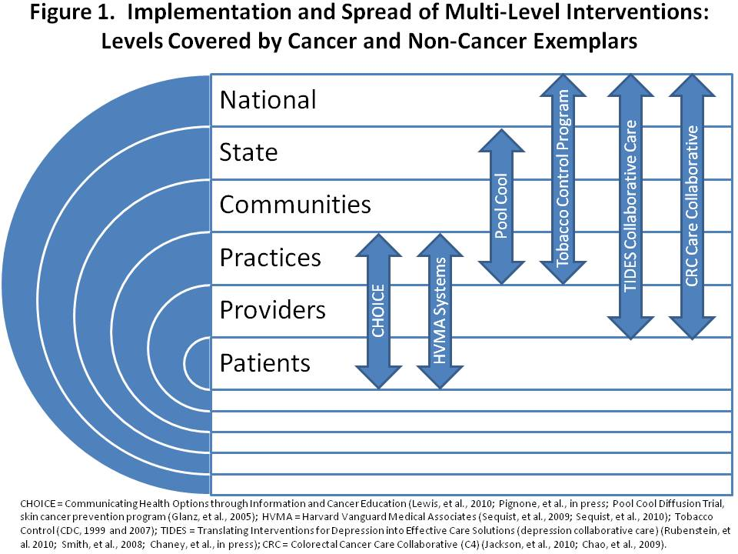

Slide 7
Implementation and Spread of MLIs
Combinations, phases of MLI implementation
Attend to stakeholders at each level
Understand how levels may interact
Create inter-dependencies (e.g., local funding based on mapping to state-level program activities)
Determine quality of evidence for interventions at each level (in lieu of evidence, blend experience)
Use social marketing for interventional messaging
Use PDSA pilots to test within/across levels
Consider staged approaches, give adequate time
Top-down and bottom-up implementation

Slide 8
Implementation and Spread of MLIs
Partnerships within and across levels
Research-clinical partnerships essential
Reduced researcher control over implementation
Shared knowledge, trust, role specification
Team building before, during, after MLI implementation
Continual identification of stakeholders in network
Strong leadership support at each level, over time
Help elucidate other key players
Accountable
Role in coalition building
Partnerships with health IT staff (e.g., in EMR sites)

Slide 9
Implementation and Spread of MLIs
Implementation facilitators
Organizational supports (e.g., direct grants, special funding allocations, protected time for QI)
May be centralized (e.g., state media campaign for tobacco control) or shared (e.g., EMR support)
Implementation barriers
Implementation requiring interdisciplinary cooperation may be met with resistance
“Turf” (especially if competition for resources exists)
“Silos” (must create communication/coordination mechanisms)
Perceived value of MLI balanced with competing demands among busy members at each level

Slide 10
Implementation and Spread of MLIs
Policy context, fiscal climate, performance incentives
Critical to understand contextual influences surrounding players at each implementation level
Ex: Harvard Vanguard “perfect storm”
Ex: Master Settlement Agreement with tobacco industry
Determinants of spread
Timing/applicability of available evidence
Champions can support spread; tools important
Explication of handoffs
Quality monitoring programs

Slide 11
Conclusions
Implementation and spread of MLIs into routine practice and policy feasible and effective
Attention needed within and across levels
Partnerships, relationships, teams, coalitions
Facilitators and barriers (resources, perspectives)
Contextual factors
Current mismatch between review and reality
Sustainability a myth → evidence, stakeholders, context all continually changing
But investment will pay important dividends

Slide 12
Questions
What does implementation mean…
in the context of your intervention(s)?
in the context of the best available evidence?
What kinds of implementation strategies should be deployed and tested for each level?

