Slide 1
Multilevel Research and the Challenges in Implementing Genomic Medicine
Muin Khoury on behalf of
Ralph Coates
Mary Fennell
Russ Glasgow
Maren Scheuner
Sheri Schully
Marc Williams
Steven Clauser

Slide 2
Outline
The Promise and Challenge of Implementing Genomic Medicine
A Translational Research Agenda for Genomic Medicine
Multilevel Intervention Research in Implementing Genomic Medicine
Example of Lynch Syndrome
Issues for Discussion

Slide 3
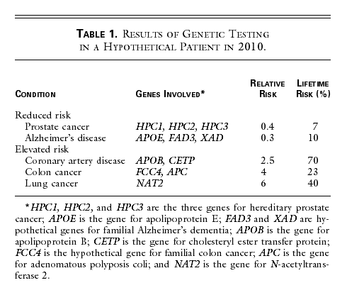
The Vision of “Personalized Medicine” Based on Genomics
A 23 year old man named John
Collins FC, NEJM 1999
Primary Prevention Smoking Cessation
Secondary Prevention Colon Ca Screening
Tertiary Prevention Pharmacogenomics
New Drugs, Interventions & Diagnostics

Slide 4
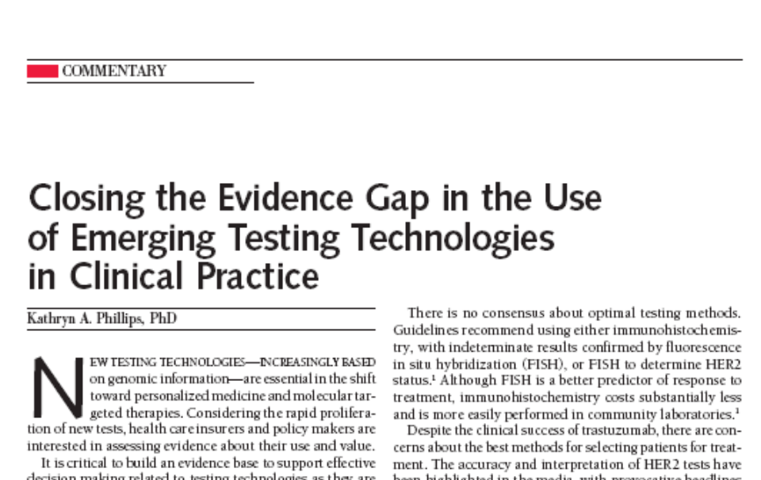
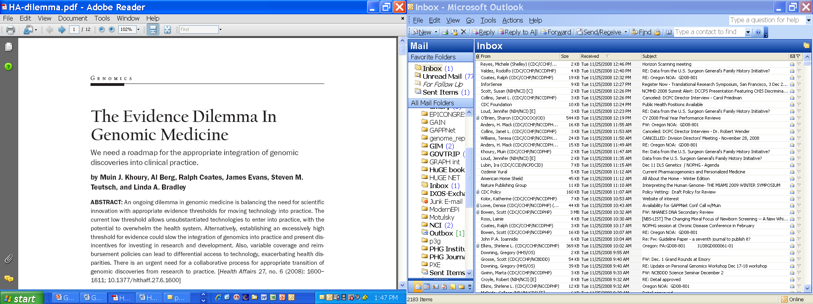
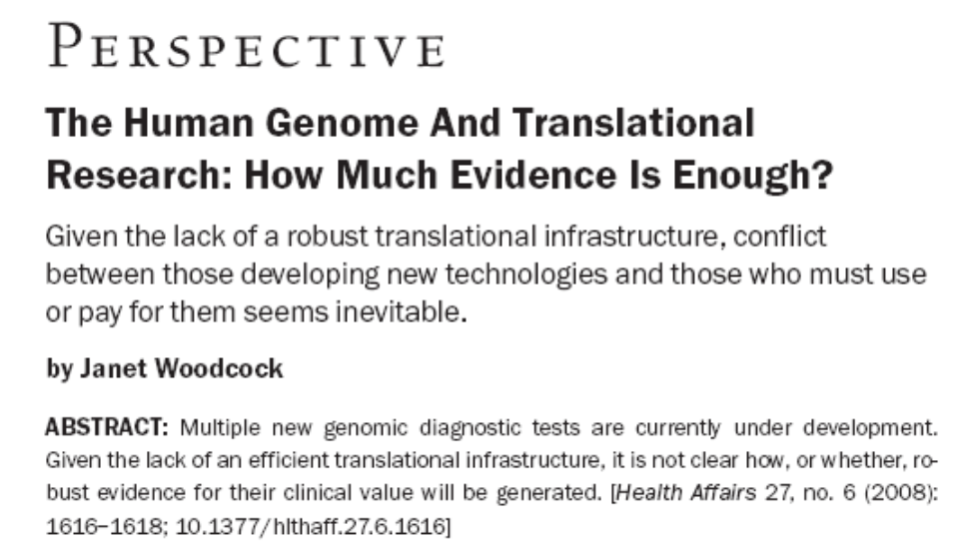

The Evidence Gap in Genomic Medicine

Slide 5
The Challenges of Genomic Medicine
Getting to the Center of the Onion….
An increasing number of genomic applications
Incomplete information on genotype-outcomes relationships
Incomplete information on gene-environment and gene-drug interactions in relation to cancer occurrence and outcomes
Incomplete evidence on clinical utility that may or may not be amenable to randomized clinical trials
Health technology assessment slow to adapt
Uneven coverage and reimbursement
Little or no oversight or regulation of genomic applications
Uneven, spotty implementation , and potential for disparities
Direct to consumer advertisement of personal genomic tests
Unknown outcomes of testing in practice
Uncertain quality of testing and follow up
And a few more

Slide 6
The Genomics Translation Highway from Discovery to Health Impact
BASIC
SCIENCES
Promising
Application
(e.g., genetic test)
T2
Evidence-based
Guideline/
Policy
CLINICAL
SCIENCES
T1
T3
Knowledge
Synthesis
Discoveries
(e.g., genetic
risk factor)
Practice &
Control
Programs
POPULATION SCIENCES
T0
Reducing the
Burden of
Disease
T4
Modified from Khoury et al
Am J Epidemiol 2010

Slide 7

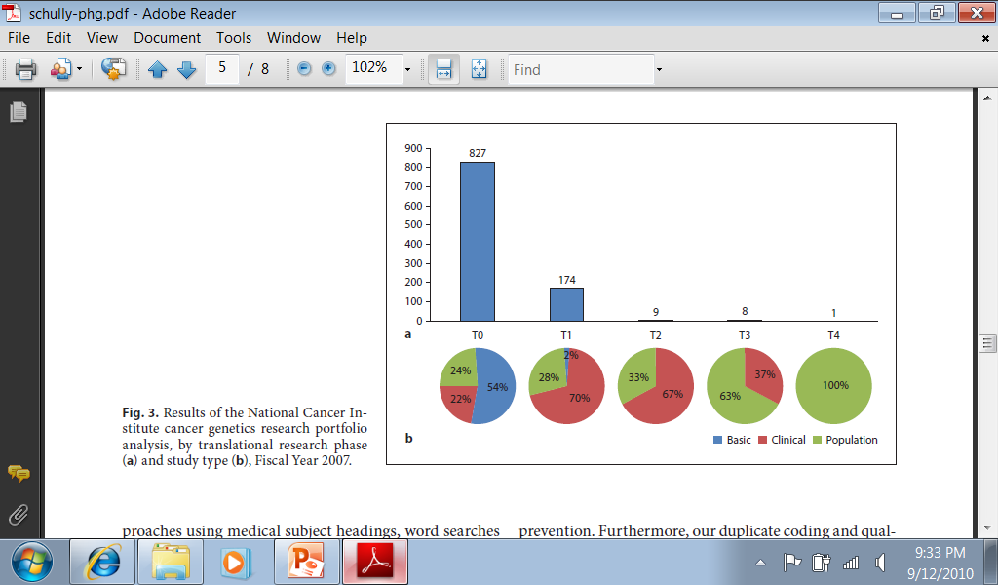
Genomics Translation Highway:
The Road Less Traveled
Public Health Genomics 2010

Slide 8
Multilevel Factors in Implementing Genomic Medicine
Clinical and laboratory (pre-analytic, analytic, post-analytic)
Behavioral, social, and communication issues
Health care organizations
Public health system
Regulatory oversight

Slide 9


EGAPP Lynch Summary Statement
Genetics in Medicine - Jan 2009
“The Evaluation of Genomic Applications in Practice and Prevention (EGAPP) Working Group found sufficient evidence to recommend offering genetic testing for Lynch syndrome to individuals with newly diagnosed colorectal cancer (CRC) to reduce morbidity and mortality in relatives.

Slide 10
Potential Impact of Lynch Syndrome (LS)
Cascade Screening in the US
Newly diagnosed colorectal cancer
146,970 new cases of CRC in the US in 2009
4,115 have Lynch syndrome (2.8%)
12,345 of their relatives have LS

Slide 11
Challenges to Implementation
Lack of provider knowledge of Lynch syndrome and testing issues
Question of informed consent
Availability of genetic services
Cost and coverage
Psychosocial impact
Informing relatives – who is responsible?
Patient and provider compliance
Infrastructure needs
Testing limitations (e.g., IHC accuracy by site)

Slide 12
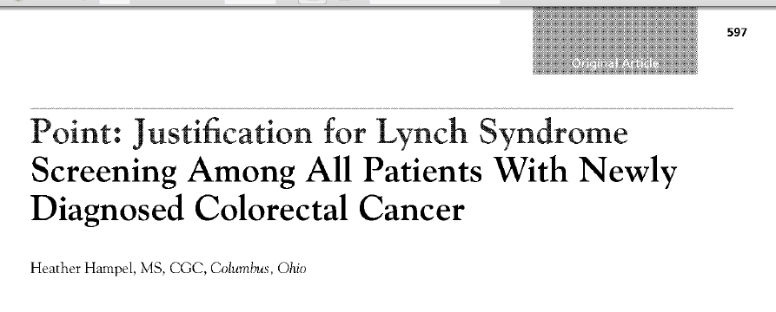
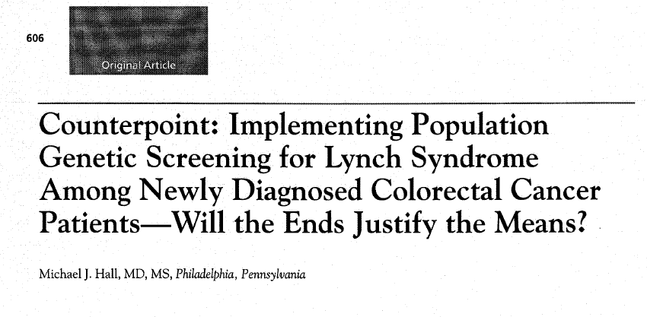
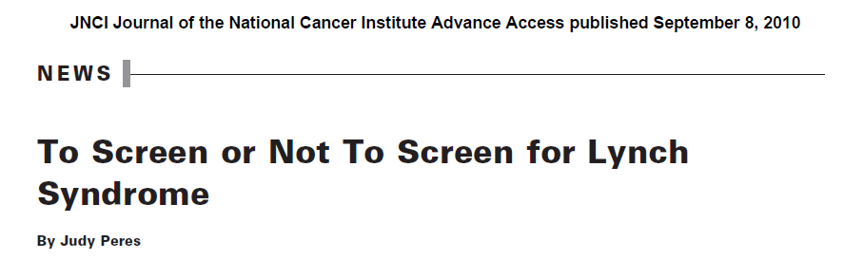
Debate About Implementation
JNCCN May 2010

Slide 13
Issues for Discussion
Is there anything unique about genomics?
What do we do with lack of evidence to inform intervention science in genomic medicine?
How do we manage the push and pull forces of translation?
Can we develop a robust multilevel research agenda for genomic medicine that is informed by other fields?

