Slide 1
Multilevel Interventions in Policy & Genomic Medicine
NCI Multilevel Interventions in Health Care:
Building the Foundation for Future Research
Las Vegas, Nevada
March 4-5, 2011
E. Hawk, MD, MPH
UT MD Anderson Cancer Center
Duncan Family Institute

Slide 2
2011 - A Time of Incredible Change in Magnitude, Breadth, Depth, & Pace of American Health Care
Poor public understanding of
Cancer and its causes – Risk & risk:benefit balance
Poor public tolerance of
Complexity – Personal risk
Explosive technologic advances that pressure deliberative decision-making
IT (EMRs) – Communications
Imaging – Social connections
Molecular tools
Transitioning of medical care system
Guidelines – Reimbursement reforms
Checklists – Specialization vs generalization
Health care systems – Need to demonstrate value = Quality/cost
Universal cost-cutting
2010 Health care reform = “I pay less/they pay more”
Rising public expectations

Slide 3
Linking Multilevel Approaches to Issues in Health Policy – Warnecke, et al.
Policies – tools often conceived at the national or state level to address a population concern
Always, well-intended
Hopefully, linked to evidence
Usually represent a compromise between science, fiscal concerns, and political maneuvering, and therefore, rarely the best of any of these
Administration & implementation of policies can influence their ultimate impact on cancer incidence and outcomes at the local and individual levels
Access
Quality
Environmental stress
The trans-level process of implementation (i.e., “signal transduction”) is critical to effectively link
Good intentions
Effective & efficient actions
Improved outcomes

Slide 4
Rising Disparities in Breast Cancer Mortality – What’s the Cause?
Four possibilities:
Poor/limited access to screening mammography
Poor quality of screening
Poor quality of treatment
Biologic differences

Slide 5
A Remarkable Communal Approach to the Problem
March 2006 – 102 individuals from 74 organizations form the Metro Chicago Breast Cancer Task Force
Health care providers
Administrators of safety net health care centers
Community leaders
Cancer survivors
Cancer organizations
Researchers
How did this form? Key champions? Aligned motives?
October 2006 – task force report identifies 37 specific, pragmatic, evidence-based recommendations for policy changes to address local factors contributing to disparities
How were these identified, agreed upon?
Criteria? Roles/responsibilities?
Was this a MLI? Would it have been better if it was?

Slide 6
A Remarkable Communal Approach to the Problem
March 2008 – Illinois General Assembly passes ground breaking legislation to reduce disparities
Elimination of co-pays and deductibles for mammograms
Patient navigation system
Were all TF recommendations incorporated? If not all, which?
Based on evidence that was generated and mentioned in the report, or independent of it?
Follow-up
Was breast cancer mortality reduced? If not yet, when will we know?
Which elements of the intervention were most critical to success?
What, if anything, wasn’t done as a result? Were the trade-offs worth it?
Childhood vaccination or obesity program
Tobacco cessation/quitline program
HPV vaccination
Prostate cancer screening
How should we think about prioritization of opportunities?

Slide 7
Multilevel Approaches and Challenges of Implementing Genomic Medicine – Khoury, et al.
Rapid pace of discovery
Long and complex translational paths to establish validity, especially against “hard” outcomes of greatest interest…those representing “clinical benefit”
Even in phases T0 & T1 alone
Later phases remain largely unexplored, but critical to success
Opportunities far exceed investments
Fundamentally, a problem of biomarkers

Slide 8
Possible Clinical Applications of Biomarkers
TYPE | APPLICATION | EXAMPLE
RISK or SCREENING | INDICATOR OF RISK OF DEVELOPING DISEASE | Cholesterol for CVD risk; PSA for prostate cancer
DIAGNOSIS | ONE MEASURABLE ELEMENT OF A PATHOLOGIC EVALUATION | c-kit for gastrointestinal stromal tumors¹
PROGNOSIS | INDICATOR CORRELATED W/ OUTCOME IN UNTREATED PATIENTS OR W/ SURVIVAL OF HETEROGENEOUSLY TREATED PATIENTS | CA125 for overall survival and progression-free survival in ovarian cancer²
PREDICTION | MARKER THAT PREDICTS OUTCOME TO SPECIFIC TREATMENT | KRAS as predictor of efficacy of panitumumab/cetuximab in advanced CRC³; Oncotype DX in ER+/N- breast cancer
MONITORING/ SURVEILLANCE | MARKER TO ESTIMATE DISEASE STATUS FOLLOWING INTERVENTION | CEA in resected CRC
SURROGATE ENDPOINT | MARKER INTENDED TO SUBSTITUTE FOR A “CLINICAL BENEFIT” ENDPOINT | BP for CV mortality & morbidity; ⁴ tumor response
¹ Anticancer Res 30:2407-2414, 2010
² http://www.ovarianresearch.com/content/2/1/13
³ J Clin Oncol 27:4027-4034, 2009
⁴ The National Academies Press http://www.nap.edu/catalog.php?record_id=12869

Slide 9
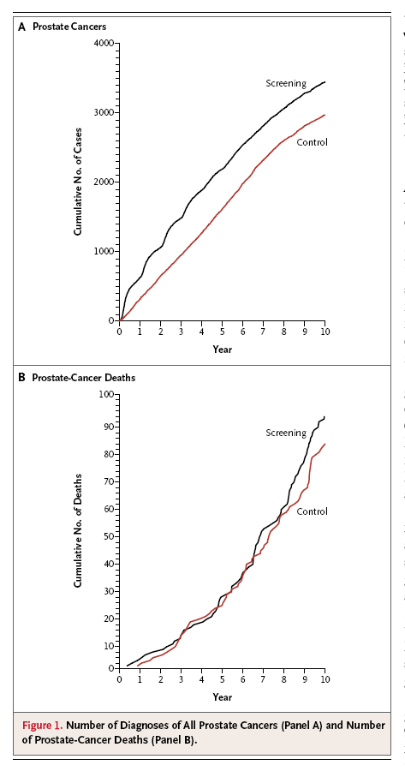
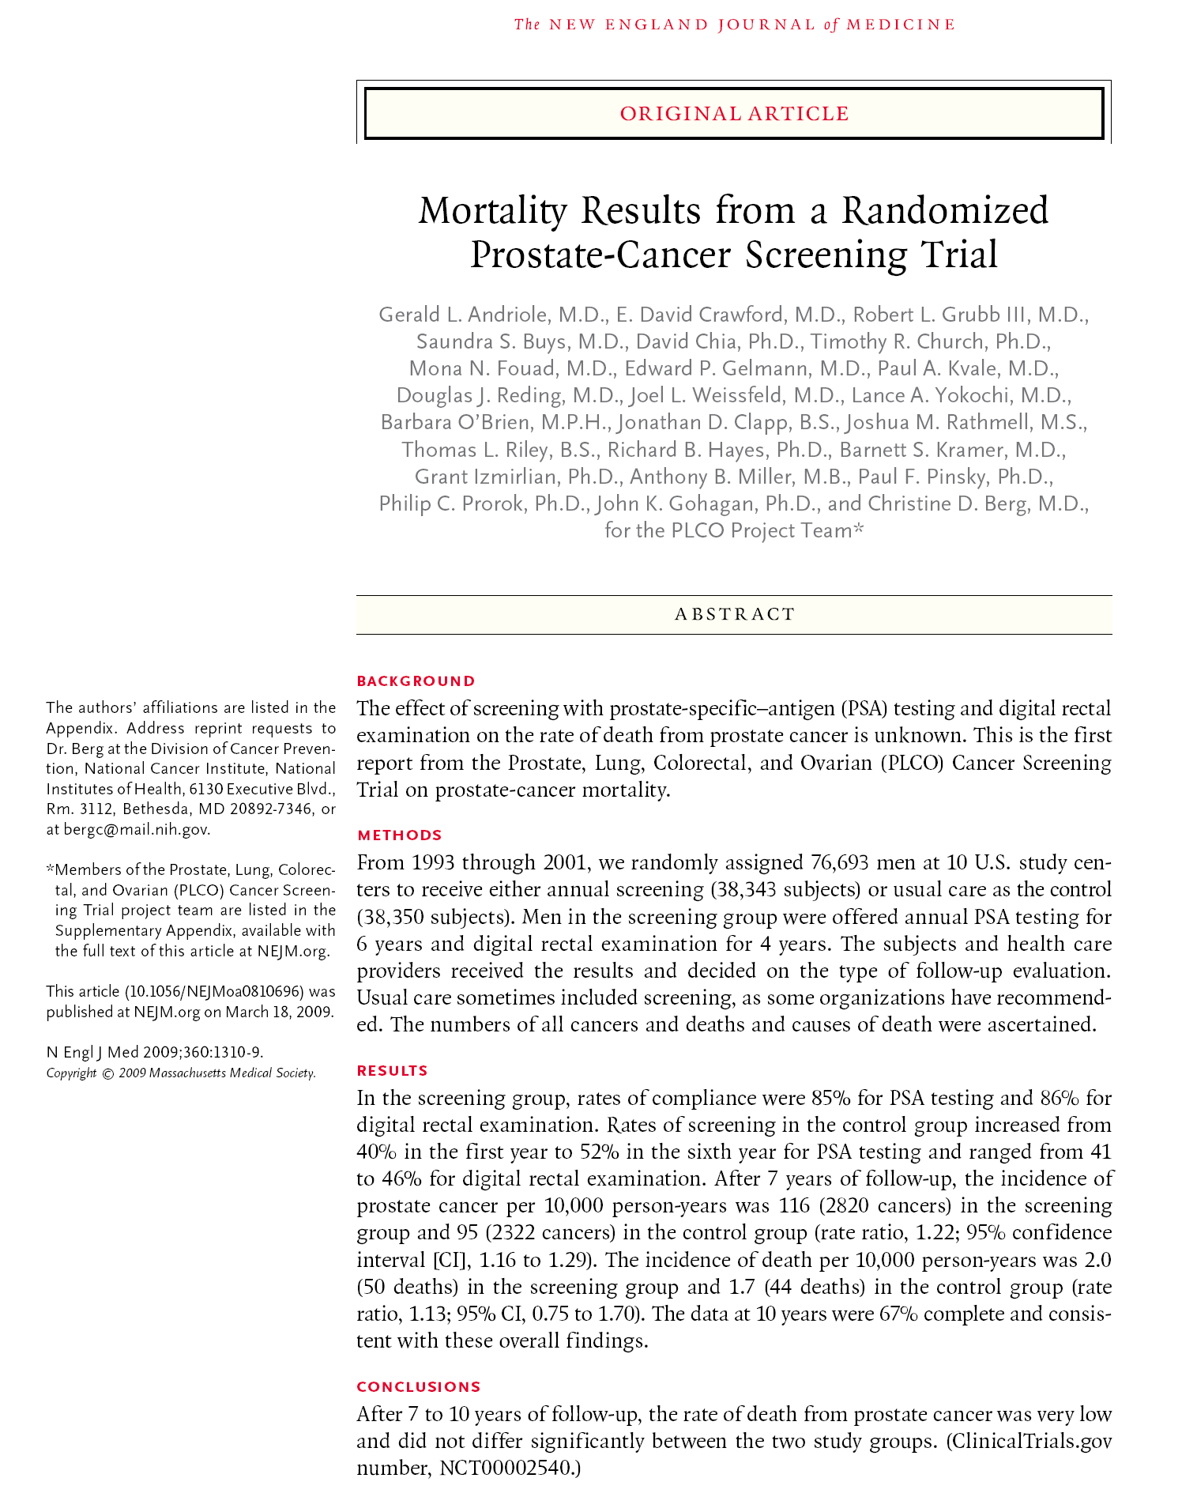
Biomarkers in Cancer Screening

Slide 10
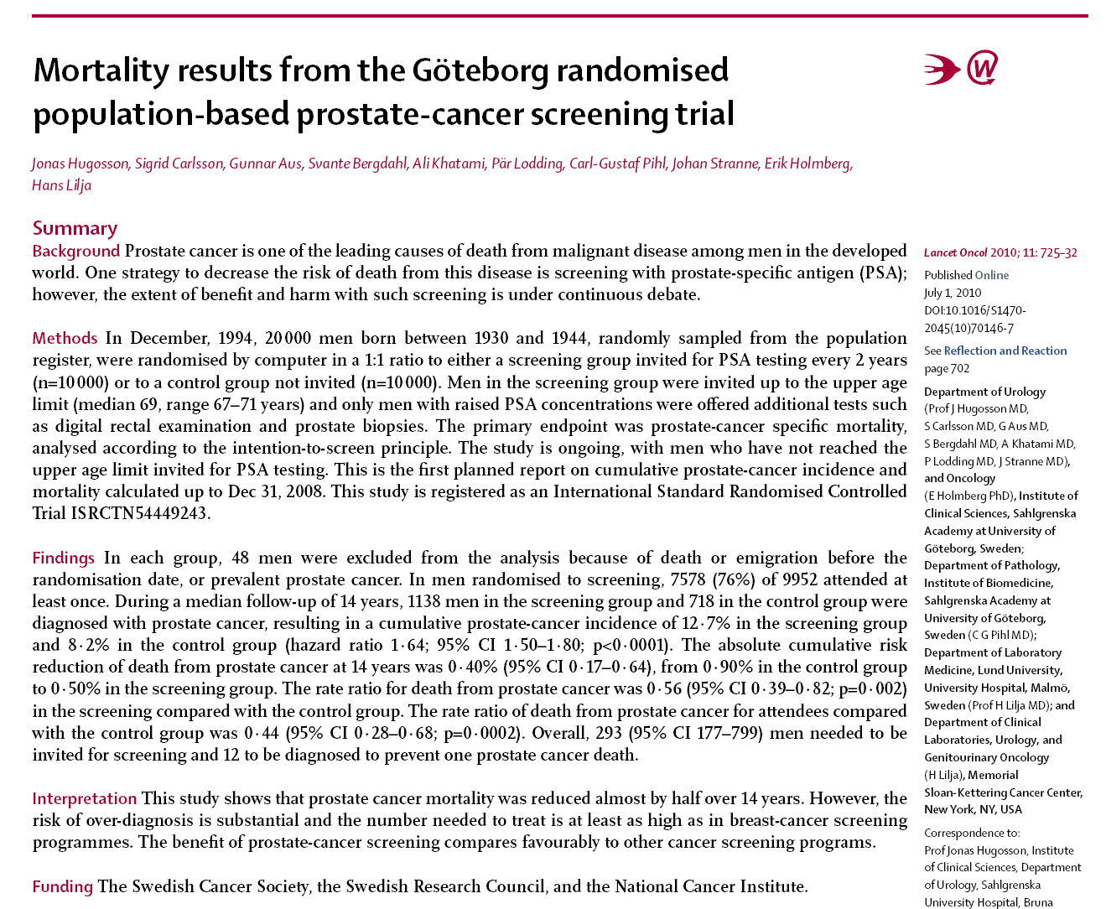
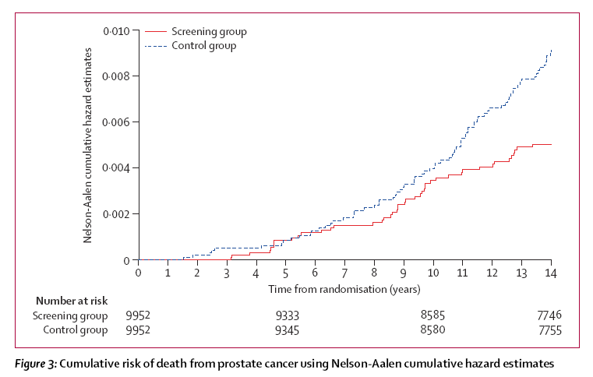

Slide 11
Levels of Evidence Guiding Biomarker Utility – The Path to Validity
Level | Type of Evidence
I | Single, adequately powered prospective study designed to test the marker; Randomized controlled trial guided by the biomarker; Meta-analysis or overview of LOE II/III studies; Prospective trial with a primary objective of associating a marker and one or more clinical outcomes
II | Prospective therapeutic trial involving markers as a secondary objective
III | Large, retrospective studies evaluating associations in post-hoc analyses
IV | Small retrospective studies; may be matched, case-control
V | Small pilot studies designed to estimate distribution of markers in a sample population; not designed to determine clinical utility
Hayes DF: Biomarkers in DeVita, Hellman & Rosenberg’s Cancer: Principles & Practice of Oncology, 8th ed.; Lippincott Williams & Wilkins, 2008

Slide 12
Necessary Criteria for a Biomarker to Be Incorporated into Routine Clinical Use
Intended use clearly delineated
Magnitude of clinical outcomes associated with marker status sufficient to affect a clinical decision
Estimate of magnitude accurate, reliable, & validated
Assay technically stable, accurate, and reproducible
Clinical study appropriately designed & powered to address the intended use and externally validated
Analysis statistically rigorous
Hayes DF: Biomarkers in DeVita, Hellman & Rosenberg’s Cancer: Principles & Practice of Oncology, 8th ed.; Lippincott Williams & Wilkins, 2008

Slide 13
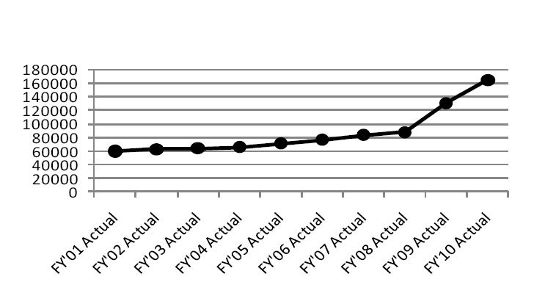
Clinical Activity in Biomarker Requests at MD Anderson Cancer Center FY01 to FY10

Slide 14
Four Elements of Personalized Cancer Care Potentially Improved By Genomic Assessments
Patient selection
Germline genetics & pharmacogenetics
Target identification
Somatic genomics
Environmental assessment
Lifestyle choices & exposures
Agent(s) selection

Slide 15
“Infrastructures” Needed To Transform New Scientific Discoveries into Clinical Advances
Internationally standardized, harmonized electronic medical records
Incorporating baseline/follow-up data on patients, treatments, outcomes
Modernized clinical care guidelines incorporating standardized, serial sampling of patients and tumors with accommodation for fresh/frozen tissues
Large, well-annotated repositories of blood, tissues, biospecimens
“Hyper-specialization”
Multi-institutional biospecimen-focused research consortia
Innovative trial designs, including elements of adaptive randomization, biomarker-based eligibility, nested biomolecular analyses
Recognition of time as one of the most critical and valuable components of medical research/care
More inclusive, critical, and routine evaluations of risk/benefit and risk/risk
Approaches to monitor and address the real possibility of increasing disparities in care as medicine incorporates more high-tech risk assessments and interventions

Slide 16
Multilevel Approaches and Challenges of Implementing Genomic Medicine – Khoury, et al.
Because of the complexity, speed, potential for misunderstandings and miscommunications, as well as insufficient regulatory oversight involved in developing and applying genomic technologies in a world insufficiently prepared, there is the very real potential for INCREASED
Harms,
Worries,
Litigation,
Costs, and
Disparities
…without improving outcomes, at least uniformly.
No clear or easy path forward

Slide 17
Tremendous Opportunities to Model the Necessary Connections to Facilitate Translational Progress Within Government
NCI DCB
NCI DCDT/DCP
NCI DCCPS
NIH
FDA
CDC
AHRQ
CMS

Slide 18
Genomic Medicine & Multi-level Research - Great Challenges, Incredible Opportunities
“Nature is probabilistic
and information incomplete,
Outcomes are valued,
Resources limited,
…decisions unavoidable”
Weinstein MC & Fineberg HV
Clinical Decision Analysis. Saunders, London, 1980

