Slide 1
Synthesis and Emerging Issues
Steven Clauser, PhD, Stephen Taplin, MD, MPH
Mary Foster, PhD, MBA, Pebbles Fagan, PhD,
Arnold Kaluzny, PhD
Presented at the National Cancer Institute’s Conference on Multilevel Intervention Research, Las Vegas, NV, March 5, 2011

Slide 2
Why are We Here?
Goal: Improve cancer care delivery throughout the continuum of care
Right service is provided to the right person at the right time in the right place
Achieve this result at each phase of care
Considerable progress exists in building an intervention science
Smoking rates are declining
Screening rates are increasing
For many cancers, survival is improving
Yet for many, progress is slow
Results often mixed
Sustained improvement a challenge

Slide 3
MLIs broaden and deepen the view of Intervention Science
Often, more than just the provider and patient influence outcomes
Context matters
Some experience with community-level mechanisms
Two levels often underrepresented in studies
Organizational change mechanisms
National and state level policy mechanisms
We need to broaden our menu of intervention mechanisms beyond the patient and the provider

Slide 4
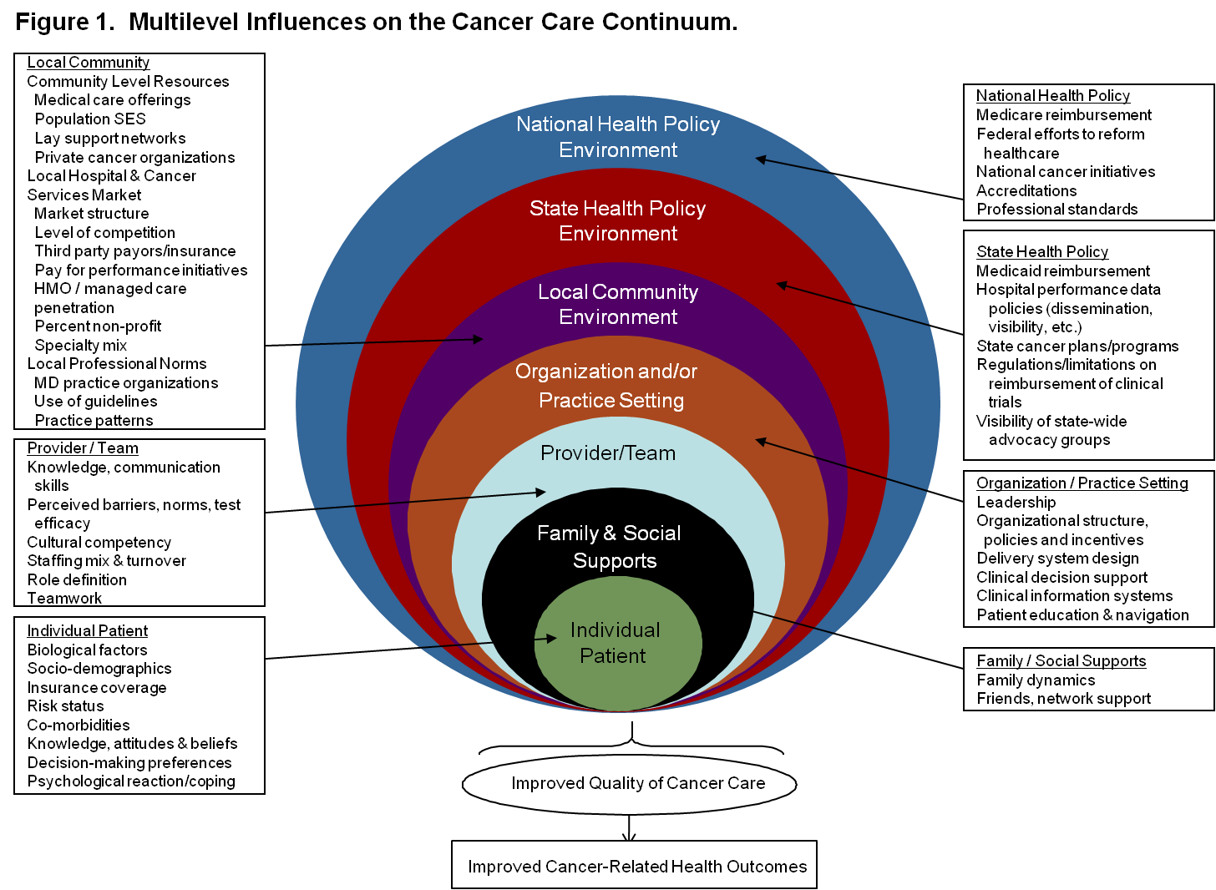
Multilevel Research Provides That Opportunity

Slide 5
New Health Environment Amplifies the Importance of MLI Research
Health Reform
Coverage expansions
Health IT acceleration
New delivery entities (medical homes, accountable care organizations)
Performance measurement/payment reform
Ehealth technology creates new connections for consumers, patients, health practitioners
Genomic medicine holds potential for major changes in cancer care delivery
Health consumers and purchasers demand for greater value for the dollar

Slide 6
What We Have Learned? Few MLI Studies
Intervention Target
Unit of Analysis
Most intervention studies are single level (~80%)
Most multilevel studies look at the patient and caregiver (~25%) or the patient and some other unit of analysis
Notes:
Small reservoir of MLI research experience in cancer
Most quality of care studies in cancer are analytical, not interventional
Interventional studies tend to be single intervention, single target
MLI cancer studies are primarily in prevention (tobacco) or in screening (breast cancer)
Few studies examine diagnosis, treatment, surveillance, and survivorship phases of care
Study settings have been limited to community-based or VA practice based networks

Slide 7
MLI Conference Posters Reflect Research Literature
Few abstracts were actually MLI studies (according to our definition)
Use of the terms “levels” and “interventions” differ across abstracts
Yet, potential to build MLI studies from some of these studies appear promising
So, go visit the Poster Session!

Slide 8
MLI Research is Challenging
Authors noted challenges with MLI research:
Conceptual difficulties with study designs
Examining intervention effects within and across mechanisms and levels
Timing, both within the intervention context, and in patient disease states
Measurement, especially related to organizational factors and federal/state policy
Communication across disciplines and levels
New models and methods for researchers to work directly with intervention study groups
Yet, cross-cutting issues emerged

Slide 9
Cross-Cutting Conceptual Issues
Question: How can we use theory to guide the assessment and selection of interventions?
Theory should drive design; but rarely used to guide intervention strategies
Theories differ between levels (e.g., psychological theory for individuals; economic theory for policy)
We tend to focus on what is familiar
Cancer researchers more familiar with biology and psychology; less familiar with management, organization, and implementation sciences
No unified theory or conceptual framework exists that includes all facets of MLI

Slide 10
Conceptual Challenges, cont.
Weiner suggests taking a practical approach
Think how interventions interrelate
Identify possible mediators/moderators
Alexander adds timing as a consideration
Disease trajectory/status of cancer patients
Duration, frequency, sequencing of interventions
Cautionary advice!
Don’t let a single discipline/stakeholder drive decisions
Researchers need to engage intervention stakeholders with research design process

Slide 11
Cross-Cutting Issues – Methods
Question: How do we measure the relative influence/interaction of interventions when used as an MLI package?
Reductionist approach may not work here
Systems thinking may be more fruitful
Implications for Research Design
Randomization may not always be feasible or best
Consider use of structural equation models
Simulation modeling may be promising, either as complement or preliminary step to larger study
Still, context of intervention matters

Slide 12
Methods Challenges, cont.
Question: What are the relevant methods for monitoring fidelity and sustainability in MLI studies?
MLIs emphasize effectiveness and scalability over efficacy and internal validity
Require flexible designs that evolve as interventions evolve (e.g., PDSA)
Address implementation as much as execution of interventions
Requires longitudinal design, multiple measurement points, including endpoints after study is completed

Slide 13
Cross-Cutting Challenge: Applications
Question: Why do interventions fail, or if initially successful, become unsustainable?
Fail to follow the evidence
Fail to consider context (e.g., primary care practice resistance to only focus on cancer screening)
Fail to consider benefits and costs
Fail to align incentives for patients, providers and organizations

Slide 14
Applications Challenges, cont.
Question: What types of research platforms are best for supporting MLI studies in cancer control?
Should we build these platforms one study at a time?
Or, do we also build from existing resources?
Research Platform
Research Platform (Examples) | Research Partner
CISNET Cancer Research Network NCI Comprehensive Cancer Centers NCI Community Cancer Centers CanCORS, PROSPER, CECCRS NCI Quality of Cancer Care Committee | Modelers, Statisticians Integrated Health Systems Academic Cancer Centers Community Cancer Centers Population-based Researchers Federal Research/Delivery Agencies

Slide 15
Building Capacity to Move the Field Forward
Working synergistically to build MLI capacity
Team-based science research
guidance on facilitating large collaborations, training, and translation
Systems science/
methodologies
guidance on addressing complex problems within interrelated dynamic systems
Transdiciplinary science research and evaluation of large initiatives
insight on facilitating integration of disciplines/stakeholders; methods and metrics for evaluation; theoretical frameworks and systems for evaluation
Participatory research
direction on approaches and processes that equitably involve partners‘ unique strengths and talents to achieve desired outcomes
Identification of key stakeholders/partners to create learning communities
Shifting organizational culture, norms and values for sustainability
Training and infrastructure
Research skills training
Study section experts
Study partners
Journals
Policy makers
Social marketing, diffusion, and dissemination of MLI concept
NIH and DHHS
Peer review journals
Consumers and Practitioners
Health care systems
Health policy makers
Resource allocation and facilitative policy
NIH and DHHS
Policy makers
Health care systems
Insurers
Notes:
We have tools that help us to move this field forward expeditiously. Building capacity of the field to move forward with MLI requires integration and team-based approaches within DHHS/NIH/NCI since the expertise, disciplines, and stakeholders needed to make these come together are in different areas
15

Slide 16
More Questions than Answers?
“When you are through learning… you are through”
John Wooden

