Slide 1

A Great Meeting…..BUT: so ‘It does NOT stay in Vegas’
Interventions across the Cancer Control Continuum:
State of the Art and Future Directions in Multilevel
Q and A Session 3- and Overall
Russ Glasgow, NCI Moderator
and
YOUR TABLE (briefly and succinctly)
Mulitlevel Interventions in Health Care
March 4-5, 2011, Las Vegas NV

Slide 2
Discussion Questions
Did we resolve the Level- Mechanism conundrum?
Did we underemphasize Policy influences- leveraging where the power is (from Field theory and analyses of power)
Have we adequately address the Consumer- Citizen-Patient level issues- especially as citizens use HIT, PHRs, and social media; as they impact other levels?
How and what can we learn from International colleagues about MLI?
How do we define “and’; and alignment?
  l

Slide 3
Discussion Questions
How do we prepare to study unanticipated, unpredictable outcomes?
Should we devote greater attention to health communication science, advertising and framing issues, health literacy and numeracy issues?
How can we learn more from important major MLI implementation successes- and failures?
What specifically can we recommend re: integrating time and planning for sustainability?
What do we need to do to overcome the dominance of old, tired, limited, linear, reductionistic models of science that have not worked?
How do we encourage discussion of MLI that are not discussed as such?

Slide 4
Call Outs: What can you do to advance the state of MLI?
What can journals do: Brian M?
What can the NCI do?
What can and will YOU do? (Ask not what NCI can do for you…but…..…
What should be done about MLI conceptualizations of genomics for public health impact: Muin K?
What can the VA (Becky and Martin and ?) and HMOs (Tom V and Borsika R and ?) do?
What can your organization do….by next Tuesday?
YOUR TABLE- let’s hear (once) from each table

Slide 5

Opportunities for Integrating Across Levels
Cultural, Historical, Social-Environmental Factors
(Fundamental “distal” Determinants)
Health Care System
Priorities, Resources, Guidelines, etc.
Patient-Provider Encounters
Shared Decision-making
Breadth of Impact
Individual Level
Malleable Factors:
Self-efficacy, activation, problem-solving, etc.
“Trait” Factors: Preferences, illness Representations, emotions
Malleability in Short Timeframe
Sub-personal/Biological
Genomics

Slide 6
Opportunities for Integrating Across Levels
Cultural, Historical, Social-Environmental Factors
(Fundamental “distal” Determinants)
Health Care System
Priorities, Resources, Guidelines, etc.
Patient-Provider Encounters
Shared Decision-making
Breadth of Impact
Social-Community Context
Work, built environment, environmental exposures, family, friends
Ubiquitous Media and Technology
Work, built environment, environmental exposures, family, friends
Individual Level
Malleable Factors:
Self-efficacy, activation, problem-solving, etc.
“Trait” Factors: Preferences, illness Representations, emotions
Malleability in Short Timeframe
Sub-personal/Biological
Genomics

Slide 7
Opportunities for Integrating Across Levels
Cultural, Historical, Social-Environmental Factors
(Fundamental “distal” Determinants)
Health Care System
Priorities, Resources, Guidelines, etc.
Patient-Provider Encounters
Shared Decision-making
Breadth of Impact
Social-Community Context
Work, built environment, environmental exposures, family, friends
Ubiquitous Media and Technology
Work, built environment, environmental exposures, family, friends
Individual Level
Malleable Factors:
Self-efficacy, activation, problem-solving, etc.
“Trait” Factors: Preferences, illness Representations, emotions
Malleability in Short Timeframe
Sub-personal/Biological
Genomics

Slide 8
Opportunities for Integrating Across Levels
Cultural, Historical, Social-Environmental Factors
(Fundamental “distal” Determinants)
Incentives, Coverage
Community Building Infrastructure;
Health Care System
Priorities, Resources, Guidelines, etc.
Patient-Provider Encounters
Shared Decision-making
Monopolies
vs.
Open Access
Regulations, resources on food, tobacco, transportation
Interoperable EMRs and PHRs
Feedback, Monitoring
Public Reporting
Breadth of Impact
Social-Community Context
Work, built environment, environmental exposures, family, friends
Ubiquitous Media and Technology
Work, built environment, environmental exposures, family, friends
Tracking, Monitoring Progress
Action Plans
Community programs
Individual Level
Malleable Factors:
Self-efficacy, activation, problem-solving, etc.
“Trait” Factors: Preferences, illness Representations, emotions
mHealth (mobile) devices
Malleability in Short Timeframe
Social Norms
Transportation Programs
Personal Health Records (PHR)
Personal Health Records (PHR);
Social Media
Genetic Counseling
Sub-personal/Biological
Genomics

Slide 9
Challenges
The future is multiple (LEVELS, conditions, behaviors, interactive modalities)
The future is complex (and we ignore complexity at our peril)¹
“All models (and designs) are wrong” ² – tolerance, respect, and creativity are needed
We may need to UN-learn much of what we have been taught to answer the tough questions
¹Glasgow RE, Emmons KM. Annual Review of Public Health , 2007
²StermanJD. Syst Dynam Rev 2002;18:501-531

Slide 10
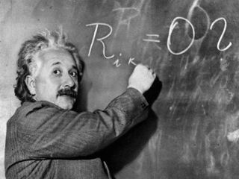
“The significant problems we face cannot be solved by the same level of thinking that created them.”
A. Einstein

Slide 11
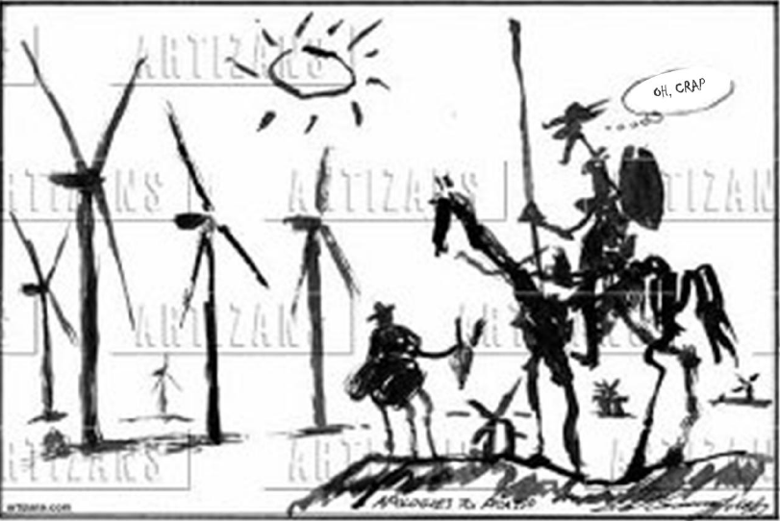

Slide 12
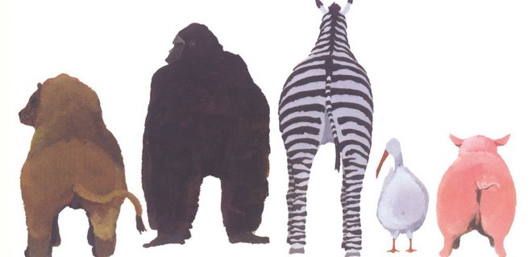
THE END

