Slide 1
The Transformation of American Medicine
(A Cancer Prospective)
Otis W. Brawley, MD, FACP
Chief Medical and Scientific Officer
American Cancer Society
Professor of Hematology, Medical Oncology,
Medicine and Epidemiology
Emory University
©2010, American Cancer Society, Inc.
Notes:
The American Cancer Society presents Cancer Statistics 2010.

Slide 2
Healthcare Reform
The internet as a source of information (mentioned?)
EMR, much vested in it as the salvation of healthcare, increase efficiency, etc.
Effectiveness vs Efficacy
Rational use vs rationing use

Slide 3
Healthcare Reform
The ACS as a player in this area
Overview of the situation
  The economy
  Poor health IQ
  The urgency of the situation
The need to focus on Prevention
  (transform from a treatment and consumption based economy to one that values prevention)

Slide 4
ACS Leadership Roles
Information
Research
Quality of Life
Prevention and Early Detection

Slide 5
The American Cancer Society
We are dedicated to helping People:
Get Well
Stay Well
Find Cures
Fight Back

Slide 6
Guiding Principles
Cancer prevention and treatment is an issue that must be approached ethically, logically and rationally
We must realize:
        What we know.
        What we do not know.
        What we believe.

Slide 7
Three great threats to America’s Future
Apathy
Ignorance
Greed

Slide 8
Reforming how healthcare is paid for
Vs.
Transforming how we view and consume it
(“We” is at multiple levels)

Slide 9
Transforming American Healthcare
Decrease Costs
Decrease Disparities
Improve Quality

Slide 10
True Healthcare Reform
Requires:
Broad critical thinking
An understanding of the scientific method
The use of “Evidence Based Care and Prevention”
That is:
        the rational use of medicine
        not the rationing of medicine

Slide 11
Transforming American Healthcare
Goal
  Good outcomes, “Saving Lives”
We could do better!!!!!

Slide 12
Factor Increasing Cancer Risk in U.S.
Issues:
- Irrational patterns of consumption
- A lack of education (MD’s and Patients)
- A lack of basic prevention (obesity, lack of exercise, high caloric intake, smoking)

Slide 13
Factor Increasing Cancer Risk in U.S.
The Aging of the population
  30 million over age 65 in 2000
  71 million over age 65 in 2030

Slide 14
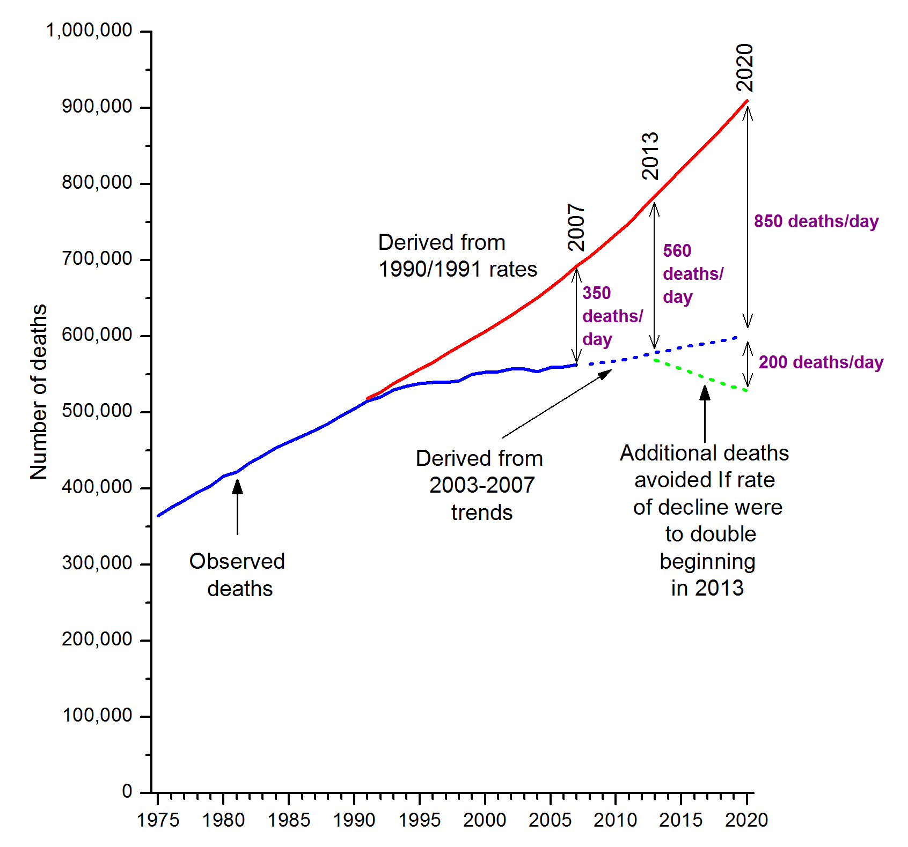
Deaths averted from 1991-2020
The blue solid line represents the actual number of cancer deaths recorded and the blue dashed line represents projected cancer deaths based on decreasing trends in cancer death rates during 2003-2007. The green dashed line represents the projected number of cancer deaths if rates continue to decline at twice the current rate (2003-2007) beginning in 2013. The red line represents the expected number of cancer deaths if cancer death rates had remained the same since 1990 (males) and 1991(females).

Slide 15
Disparities in Health
The concept that some populations (however defined) do worse than others.
Populations can be defined or categorized by:
  Race
  Ethnicity and Culture
  Area of geographic origin
  Socioeconomic Status

Slide 16
How Can We Provide Adequate High Quality Care (to Include Preventive Care) to a Population That Has So Often Not Received It?

Slide 17
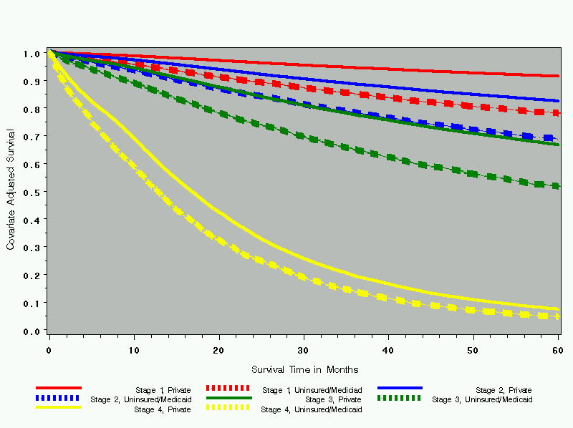
Adjusted Colorectal Cancer Survival by Stages and Insurance Status, among Patients Diagnosed in 1999-2000 and Reported to the NCDB

Slide 18
Toward an Efficient Healthcare System
Some consume too much
    (Unnecessary care given)
Some consume too little
    (Necessary care not given)
We could decrease the waste and improve overall health!
Evidence Based Medicine

Slide 19
U.S. Health Care Spending
In 2009, the U.S. spent
$2.53 TRILLION
on Health Care

Slide 20
U.S. Health Care Spending
How Big is a Trillion?
1 million seconds Last week
1 billion seconds Richard Nixon’s Resignation
1 trillion seconds 30,000 BCE

Slide 21
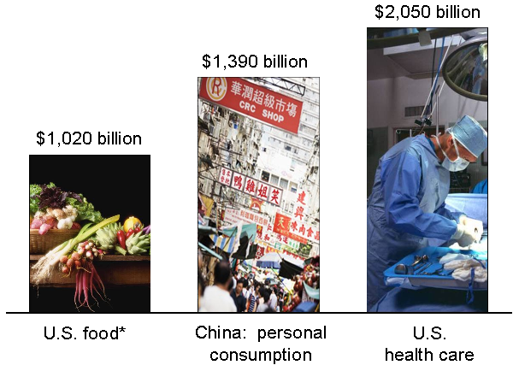
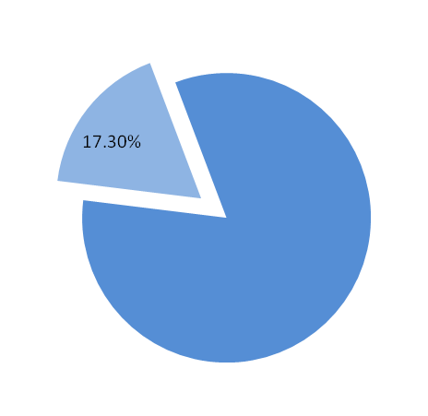
Spending in Context
2009
$2.53 trillion
$1.4 trillion
$1.1 trillion
Gross Domestic Product
* Excludes alcoholic beverages ($150 billion) and tobacco products ($92 billion)
Source: Bureau of Economic Analysis; National Bureau of Statistics of China, MGI analysis

Slide 22
American Healthcare
16.2% of GDP in 2008
17.3% of GDP in 2009
19.3% of GDP by 2019 (projected)
25% of GDP by 2025 (projected)

Slide 23
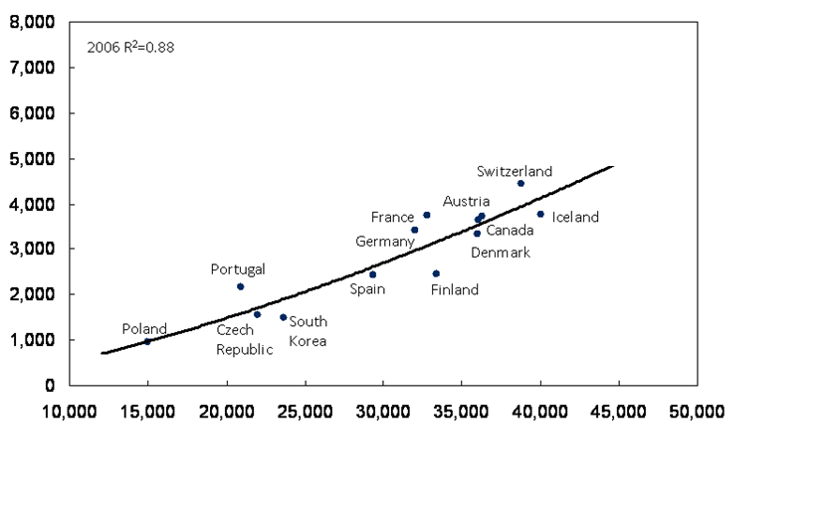
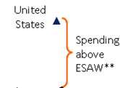
Spending: US vs. Other Countries
Per capita health care spending, 2006
$ at PPP*
Per capita GDP ($)
* Purchasing power parity.
** Estimated Spending According to Wealth.
Source: Organization for Economic Co-operation and Development (OECD)

Slide 24
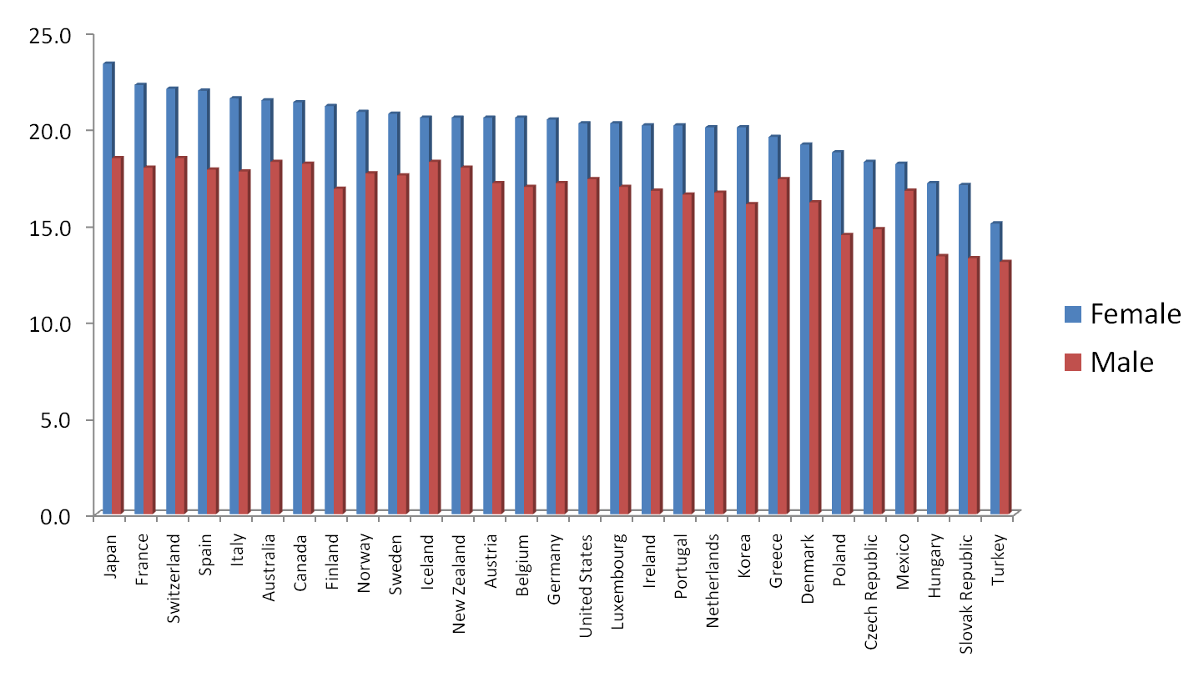

Overall Quality: Life Expectancy at 65
The US is ranked 12th for Males and 16th for Females
Source: OECD, 2006 data

Slide 25
Healthcare in Three Countries (2009)
Canada Switzerland U.S.
Infant Mortality 5.04 4.53 6.22 per 1000 live births
White Male Life Exp 78.0 79.7 76.8 years
Per Capita Costs 3173 4011 6096 US Dollars
Proportion of GDP 9.6% 11.2% 17.3%

Slide 26
At the Level of the Employer
Heath insurance costs:
Year 2000
  $2,471 for an individual
  $6,438 for a family
Year 2009
  $4,824 for an individual
  $13,375 for a family

Slide 27
Why the Overutilization
(A Multi-level Problem)
Americans have been conditioned “me” and not “us”
Individualism

Slide 28
Why the Overutilization
(A Multi-level Problem)
Patients who believe in cost containment until you are talking about them as the patient
Doctors are paid to treat
Hospitals and Clinics are paid to treat
Insurance is big business

Slide 29
Medical Gluttony
Screening tests of no proven value
Treatments of no proven value
Laboratory and radiologic imaging done for convenience.
-Cannot find original.
-Legal defense (real or imagined).
-Tradition.

Slide 30
U.S. vs. Canada
CT Scanners per million population. U.S. dominates by 3 to 1 ratio
MRI Scanner per million population. U.S. dominates by 5 to 1 ratio

Slide 31
Reforming how healthcare is paid for
Vs.
Transforming how we view and consume it

Slide 32
Treatment vs Prevention
Our healthcare system is heavilly focused on addressing illness.
The system needs to transform to one that values prevention of disease!

Slide 33
Poor Nutrition and
Lack of Physical Activity
Obesity, high caloric intake, and lack of physical activity is increasing rates of:
Diabetes
Cardiovascular Disease
Orthopedic Injury
Cancer

Slide 34
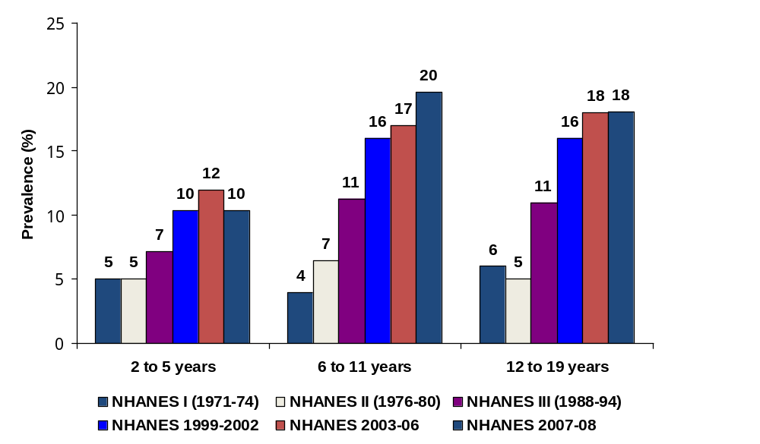
Trends in Obesity* Prevalence (%), Children and Adolescents, by Age Group, US, 1971-2008
*Body mass index (BMI) at or above the sex-and age-specific 95th percentile BMI cutoff points from the 2000 sex-specific BMI-for-age CDC Growth Charts. Note: Previous editions of Cancer Statistics used the term “overweight” to describe youth in this BMI category.
Source: National Health and Nutrition Examination Survey, 1971-1974, 1976-1980, 1988-1994, 1999-2002, National Center for Health Statistics, Centers for Disease Control and Prevention, 2002, 2004. 2003-06: Ogden CL, et al. High Body Mass Index for Age among US Children and Adolescents, 2003-2006. JAMA 2008; 299 (20): 2401-05. 2007-08: Ogden CL, et al. Prevalence of High Body Mass Index in US Children and Adolescents, 2007-2008. JAMA 2010; 303 (3): 242-249.
Notes:
People who become overweight in childhood and adolescence are more likely to be overweight or obese as adults. With at least half of the overweight children becoming overweight adults, future adult populations are at increased risk for developing cancer and other serious chronic diseases.
The prevalence of obese children and adolescents has increased since the 1970s, with the most dramatic increases occurring in the late 1980s and 1990s. In fact, over the past three decades the proportion of obese children has more than doubled among children 2-5 years and 6-11 years, and tripled among adolescents 12-19 years. More recently, however, no changes in obesity prevalence was observed between 1999-2000 and 2007-2008.

Slide 35
How Can We Provide Adequate High Quality Care (to Include Preventive Care) to a Population That Has So Often Not Received It?

Slide 36
How do we increase the Health IQ of Americans?
How do we increase America’s interest in health?
How do we create healthy skepticism of American Medicine?

Slide 37
The Transformation of American Medicine
(A Cancer Prospective)
Otis W. Brawley, MD, FACP
Chief Medical and Scientific Officer
American Cancer Society
Professor of Hematology, Medical Oncology,
Medicine and Epidemiology
Emory University
©2010, American Cancer Society, Inc.
Notes:
The American Cancer Society presents Cancer Statistics 2010.

