Slide 1
Small Area Estimation for the Tobacco Use Supplement to the Current Population Survey
Benmei Liu
Statistical Research and Applications Branch/
SRP/DCCPS
May 10 2018
TCRB Scientific Staff Meeting
Notes:
1

Slide 2
Outline
Overview of Small Area Estimation (SAE)
Research goals
SAE models and implementation
Model-based estimates – for maps
Summary and discussion

Slide 3
Why Small-Area Estimation?
The TUS-CPS is designed to produce reliable estimates at the national and state levels.
Policy makers, cancer control planners and researchers often need county level data for tobacco related measures in order to better evaluate tobacco control programs, monitor progress, and conduct tobacco-related research.
The standard direct estimation (design-based) methods for TUS data cannot provide reliable estimates at county level due to small (or zero) sample size
Model-based methods that combine information from multiple related sources are needed to increase precision

Slide 4
Overview of the Model-based SAE Techniques
Borrowing strength from relevant sources (Census/ Administrative information, related surveys)
Borrowed strength comes from covariates, and from other counties with similar characteristics
Methods of combining Information
Choose good small area model
Use good statistical methodology
Mixed models (fixed effects + random effects) at area level or unit level have been popularly used in the small area estimation literature (Rao 2003, Jiang and Lahiri 2006).
Among the many models developed in the SAE literature, the most prominent approach is the Fay-Herriot area- level model, originally developed to estimate per-capita income for U.S. areas with populations of less than 1,000.
Notes:
The key idea of model-based small area technique is to borrow strength from relevant sources (for example, Census or Administrative records) and other areas with similar characteristics to increase the precision of small area estimates. Choosing a good model is the key because the inferences mainly rely on the assumed model. One also needs a good statistical methodology to make inferences.
Mixed models have been popularly used in the small area estimation because of its flexibility in combining information from different sources and taking account of different sources of error.
For example, a commonly used well-known mixed model is the Fay-Herriot model which consists two levels of models:
The sampling model and the linking model.

Slide 5
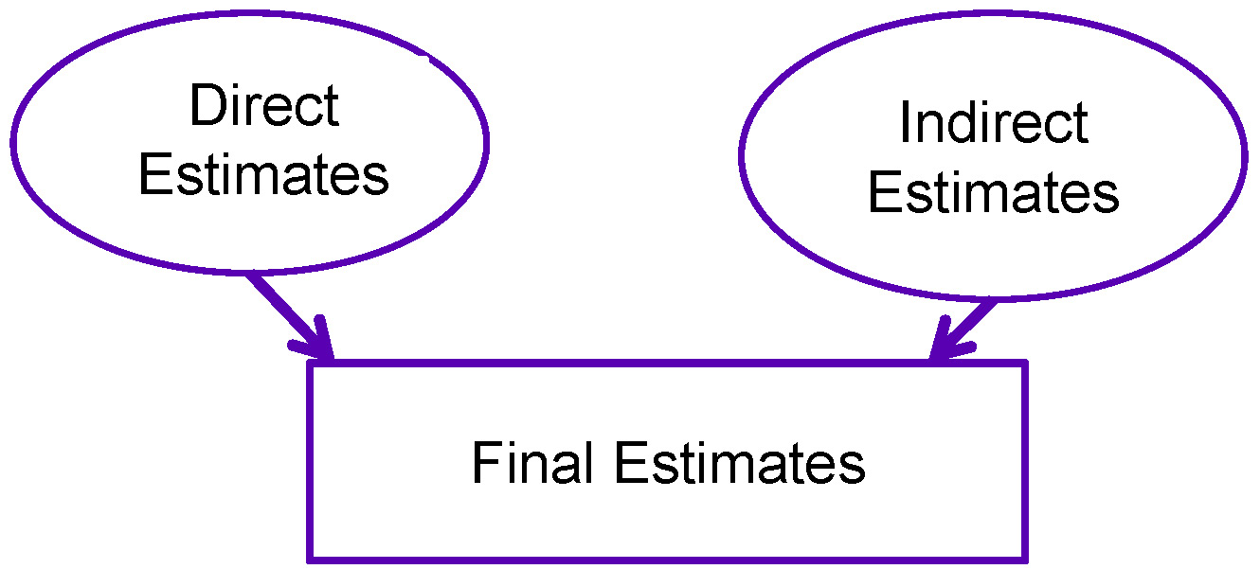
Statistical Inferences Using Mixed Models
The final estimates are combinations of the direct estimates with the synthetic estimates.
Fully Bayesian approach or empirical best prediction approach (analytic formulas) can be used for the estimation.
Notes:
In theory, the final estimates are combinations of the direct estimates and synthetic estimates. The sliding scale between the direct and synthetic estimates usually depends on the sample size.
When there is sufficient survey data for a small area: the combined estimates depend largely on the direct estimates computed that area.
When there are little or no local data available for a small area: the combined estimates increasingly depend on the assumed model to produce estimates for areas with similar characteristics.

Slide 6
Application of SAE Techniques in Estimating Proportions
Estimate cancer risk factors & screening behaviors for states and counties by combining data from Behavior Risk factor Surveillance System (BRFSS) and National Health Interview Survey (NHIS) (http://sae.cancer.gov/)
Estimate poverty rates for states, counties, and school districts in the Census Bureau’s Small Area Income and Poverty (SAIPE) program (http://www.census.gov/did/www/saipe/)
Estimate substance rates for states with data from the National Survey on Drug Use and Health (NSDUH) (http://www.samhsa.gov/data/NSDUH/2k11State/NSDUHsae2011/index.aspx)
Estimate proportions at the lowest level of literacy for states and counties with data from the National Assessment of Adult Literacy (NAAL) (http://nces.ed.gov/naal/estimates/overview.aspx)

Slide 7
Research Goals
Produce model-based, county level estimates (n=3,137) for the following key measures (2010/2011 TUS, age 18+):
Percent of population currently smoking
Percent of population that has ever smoked
Percent of population that has quit for 24+ hours, among those who have smoked within the past year
Percent of population governed by a smoke-free workplace policy
Percent of population governed by a smoke–free home rule
Involved collaboration among NCI, the Census Bureau, and the University of Maryland
Notes:
The denominator for the smoking cessation variable includes recent former smokers who quit less than 365 days ago and those current every day or someday smokers.

Slide 8
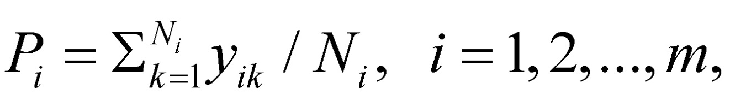
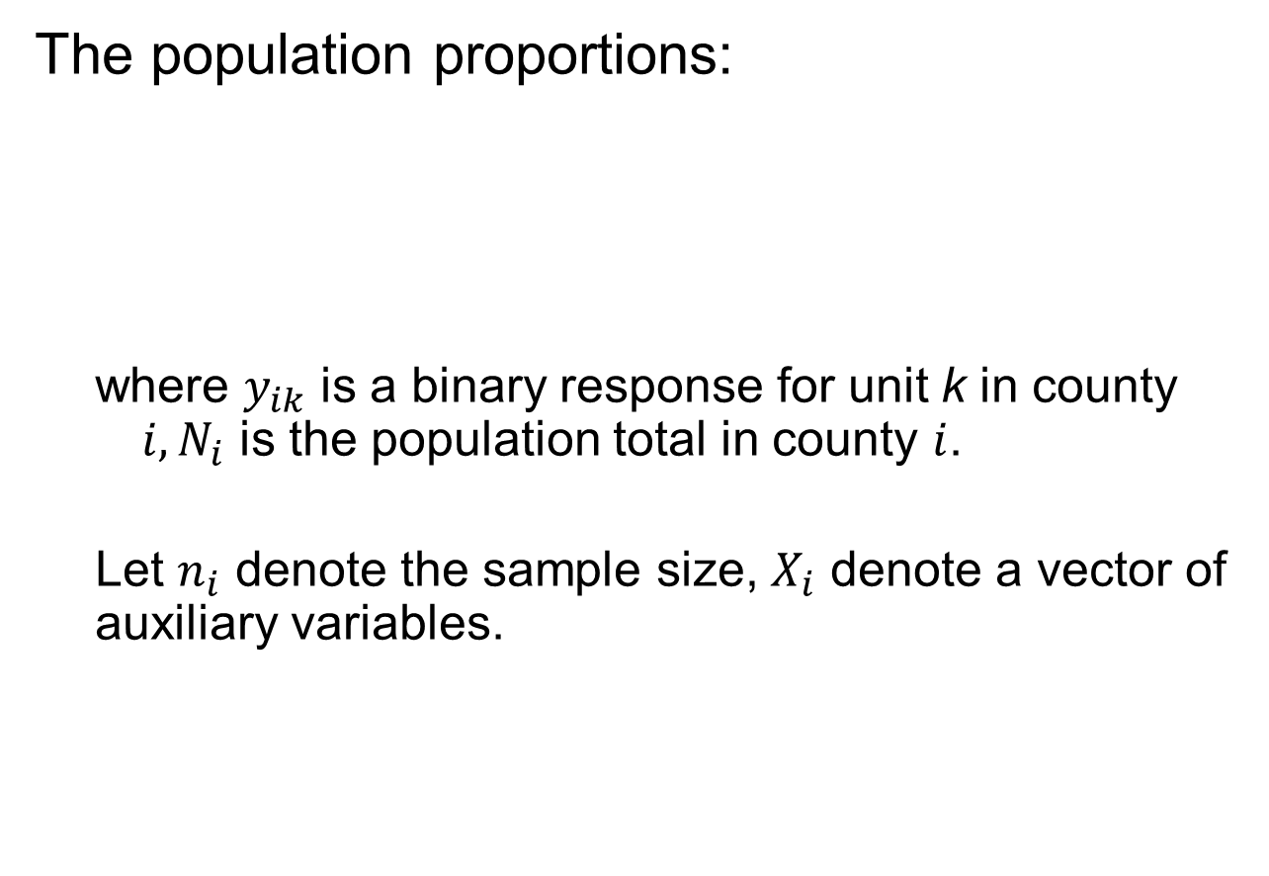
Parameters of interest
The population proportions:
where $y_{ik}$ is a binary response for unit k in county $i, N_{i}$ is the population total in county $i$.
Let $n_{i}$ denote the sample size, $X_{i}$ denote a vector of auxiliary variables.

Slide 9

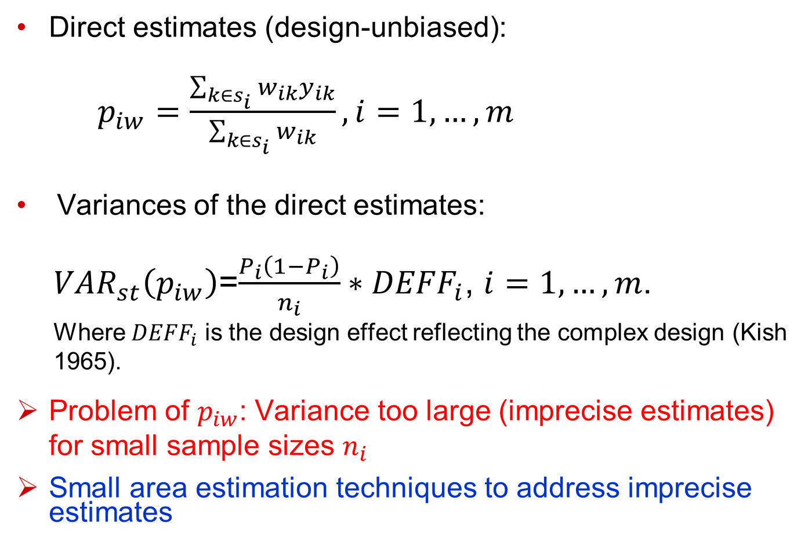
Direct Estimates of $P_{i}$ and Associated Variances
Direct estimates (design-unbiased):
$p_{iw}=\frac{\sum_{k∈s_{i}}{w_{ik}y_{ik}}}{\sum_{k∈s_{i}}{w_{ik}}}, i=1,…,m$
Variances of the direct estimates:
${VAR}_{st}\left(p_{iw}\right)$=$\frac{P_{i}\left(1−P_{i}\right)}{n_{i}}∗{DEFF}_{i}$, $i=1,…,m$.
Where ${DEFF}_{i}$ is the design effect reflecting the complex design (Kish 1965).
Problem of $p_{iw}$: Variance too large (imprecise estimates) for small sample sizes $n_{i}$
Small area estimation techniques to address imprecise estimates

Slide 10
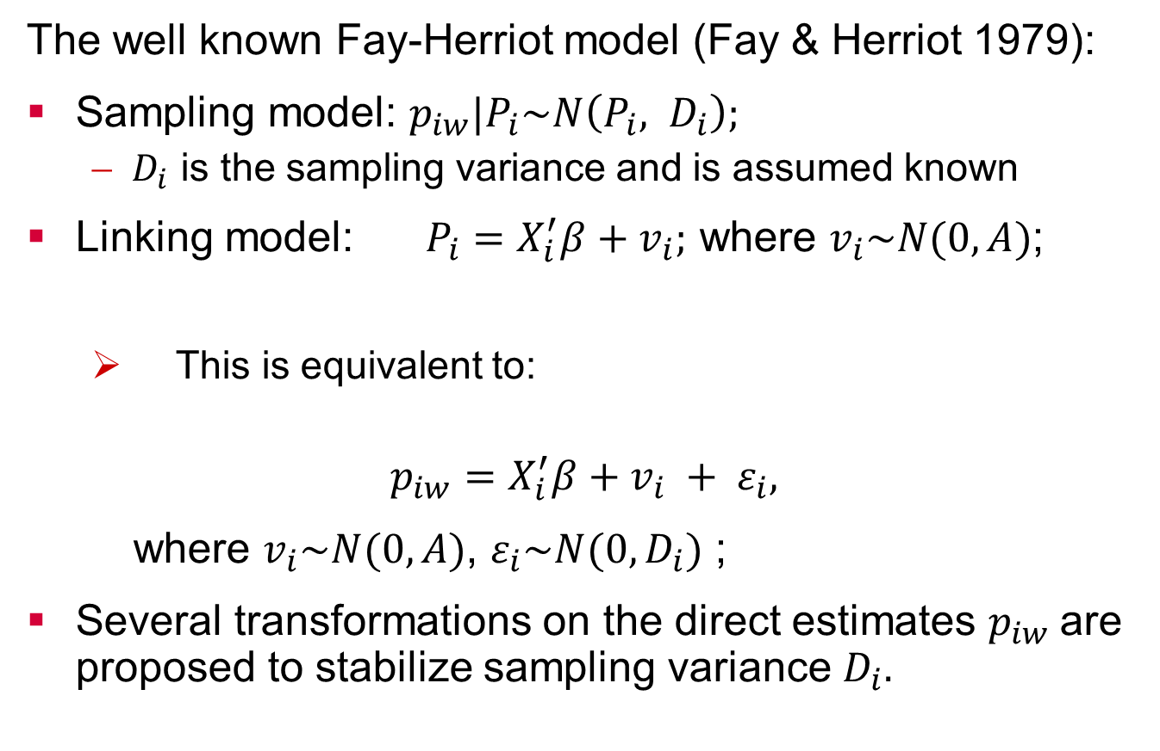
Commonly Used Area Level Model: Fay-Herriot Model
The well known Fay-Herriot model (Fay & Herriot 1979):
Sampling model: $p_{iw}|P_{i}\sim N\left(P_{i}, D_{i}\right);$
$D_{i}$ is the sampling variance and is assumed known
Linking model: $P_{i}=X_{i}^{′}β+v_{i};$ where $v_{i}\sim N(0, A)$;
This is equivalent to:
$$p_{iw}=X_{i}^{′}β+v_{i} + ε_{i},$$
where $v_{i}\sim N(0, A)$, $ε_{i}\sim N(0,D_{i})$ ;
Several transformations on the direct estimates $p_{iw}$are proposed to stabilize sampling variance $D_{i}.$

Slide 11
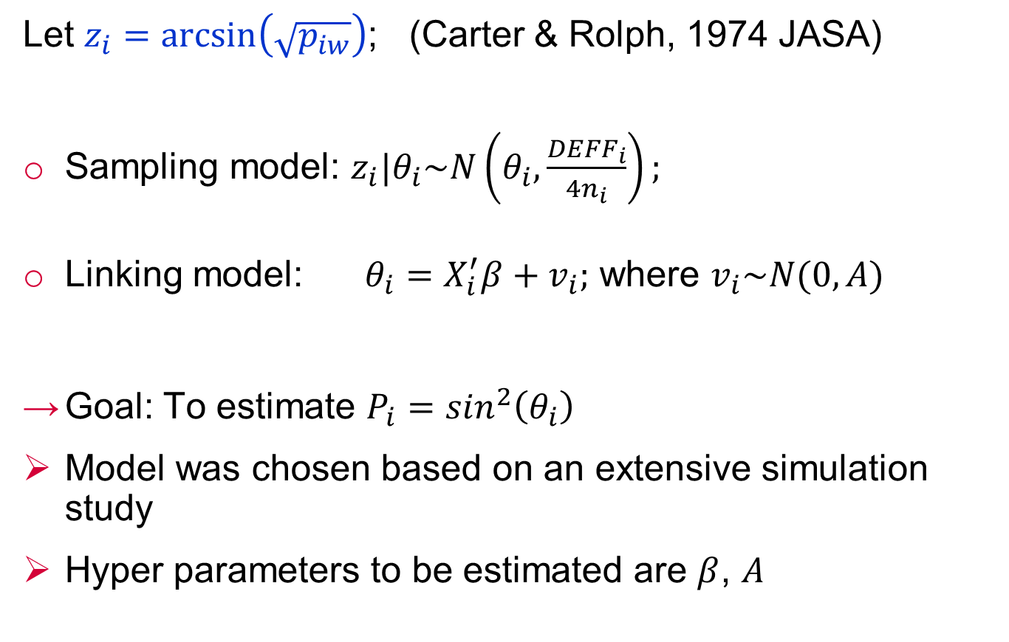
Fay-Herriot Model with C&R Arcsin Transformation
Let $z_{i}=\arcsin\left(\sqrt{p_{iw}}\right)$; (Carter & Rolph, 1974 JASA)
Sampling model: $z_{i}|θ_{i}\sim N\left(θ_{i},\frac{{DEFF}_{i}}{4n_{i}}\right);$
Linking model: $θ_{i}=X_{i}^{′}β+v_{i};$ where $v_{i}\sim N(0, A)$
Goal: To estimate $P_{i}=\sin^{2}\left(θ_{i}\right)$
Model was chosen based on an extensive simulation study
Hyper parameters to be estimated are $β$, $A$

Slide 12
Estimate the Design Effects
The design effect (or DEFF) is the ratio of the actual variance of a sample to the variance of a simple random sample of the same number of elements
Multiple ways can be used to estimate DEFF.
We used Kish’s traditional design effect formula given the clustering design of TUS-CPS, and estimated the state level design effects. We then used the state level DEFF to estimate the county level DEFF.

Slide 13
Auxiliary Variables
The pool of auxiliary variables include:
30 county-level demographic & socio-economic variables obtained from ACS 2005-2009, 2008-2012, Census 2000 & 2010, and other administrative records;
5 state level tobacco policy data (cigarette taxes, clean air laws, tobacco control funding, Medicaid Coverage for Tobacco-Related Treatment, year in which Quitline service was established)
Classical model selection procedures are applied to reduce the number of auxiliary variables for each outcome
Tested forcing in several strong unit level covariates: only worked for current smoking and smoking cessation.

Slide 14
Statistical Inference and Model Diagnosis
Hiearchical Bayesian approach through Markov Chain Monte Carlo (MCMC) methods were used to estimate the parameters of the statistical models.
Extensive model selection and model diagnosis procedures are used to select the final models and assess the goodness of fit for each model.
Modeled estimates were compared to the available direct estimates. The ratio of the two is expected to converge to 1 as the sample size gets larger.

Slide 15
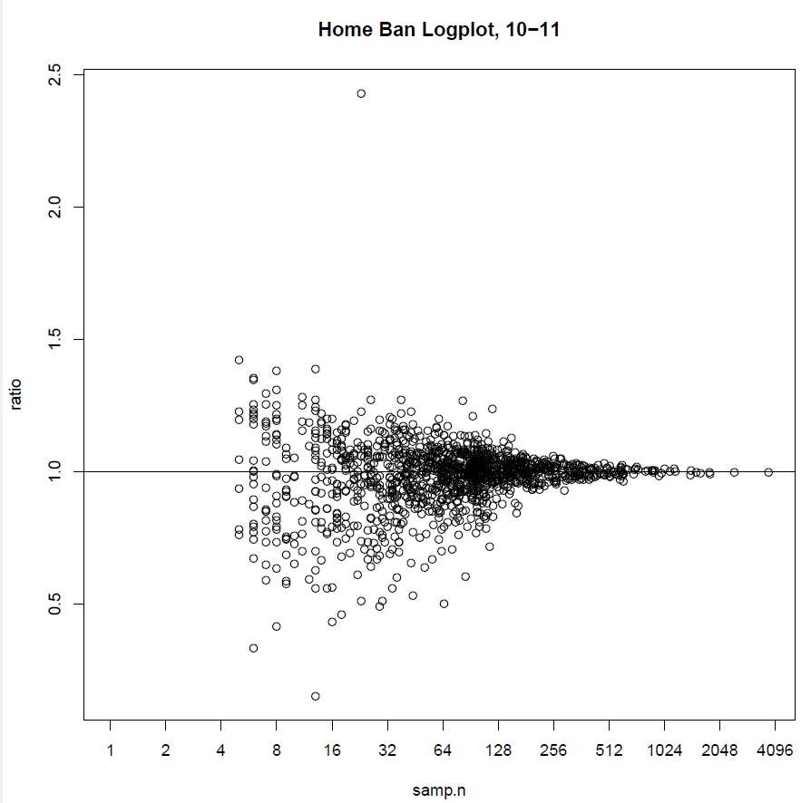
Ratio of the Direct Over the Modeled Estimates for the Current Smoking Prevalence

Slide 16
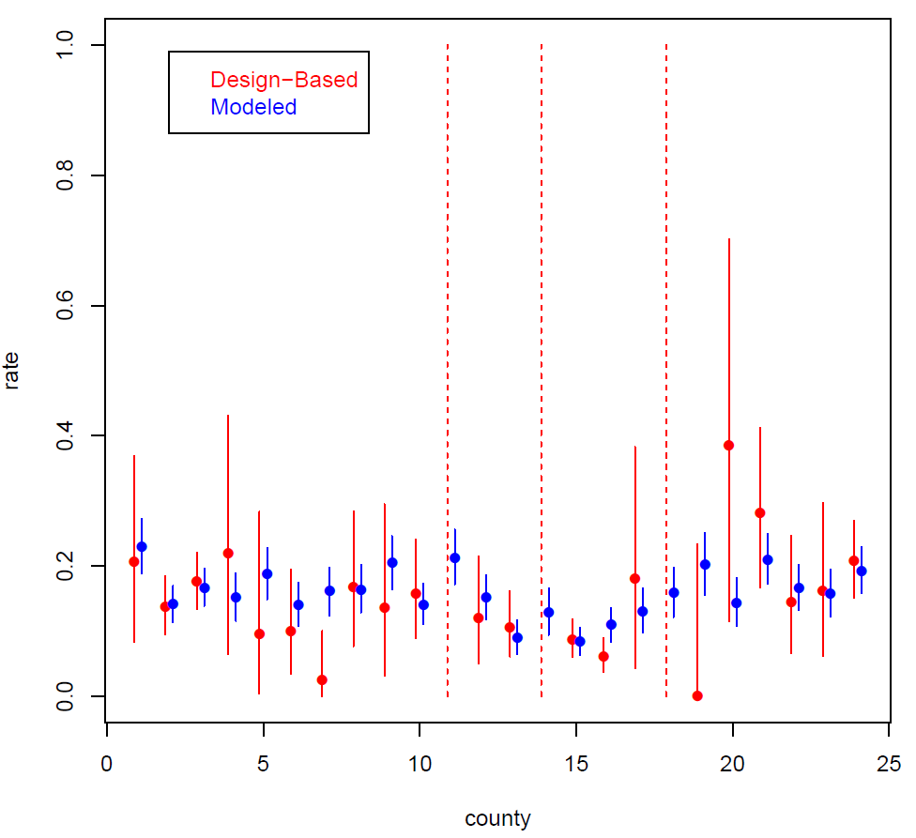
Model-based vs Design-based Estimates for Current Smoking Prevalence –Maryland 2010/11

Slide 17
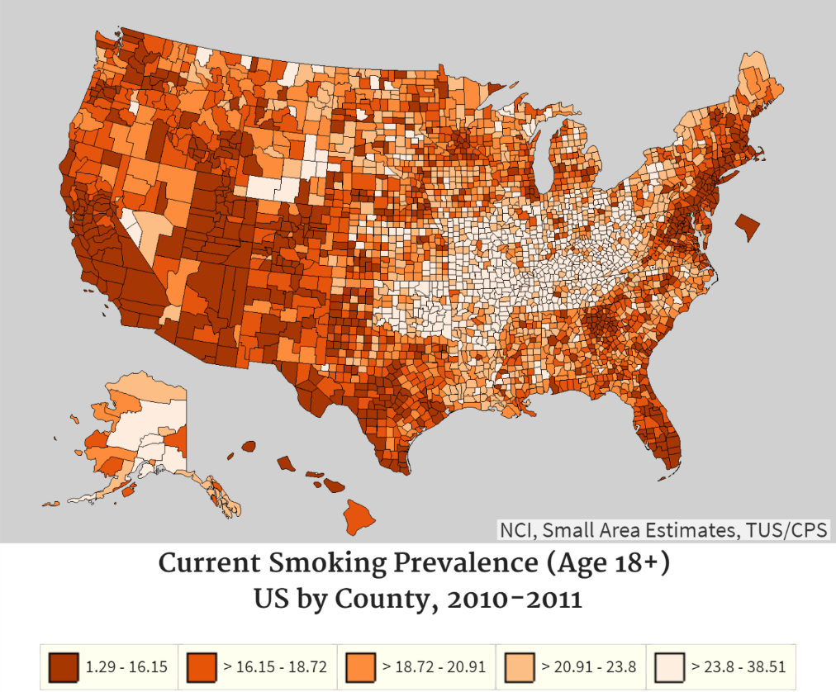
Model-based Estimates for Percent of Population Currently Smoking Among Age 18+: TUS-CPS 10/11

Slide 18
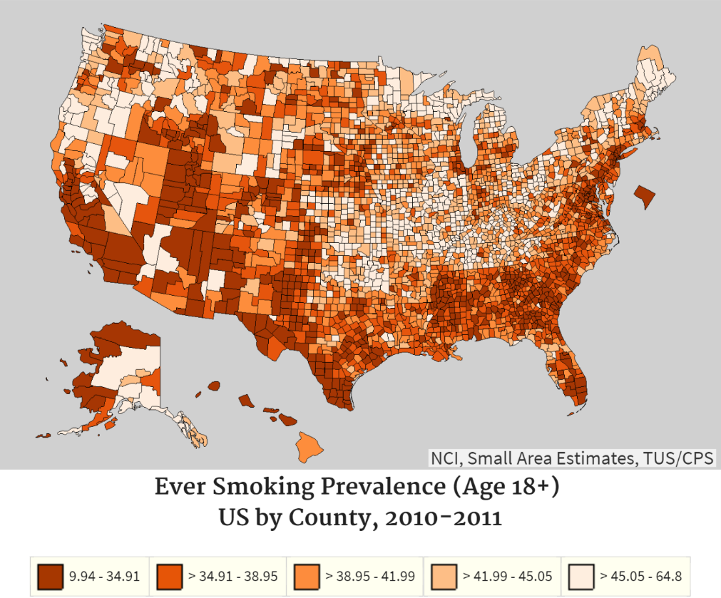
Model-based Estimates for Percent of Population Ever Smoked Among Age 18+: TUS-CPS 10/11

Slide 19
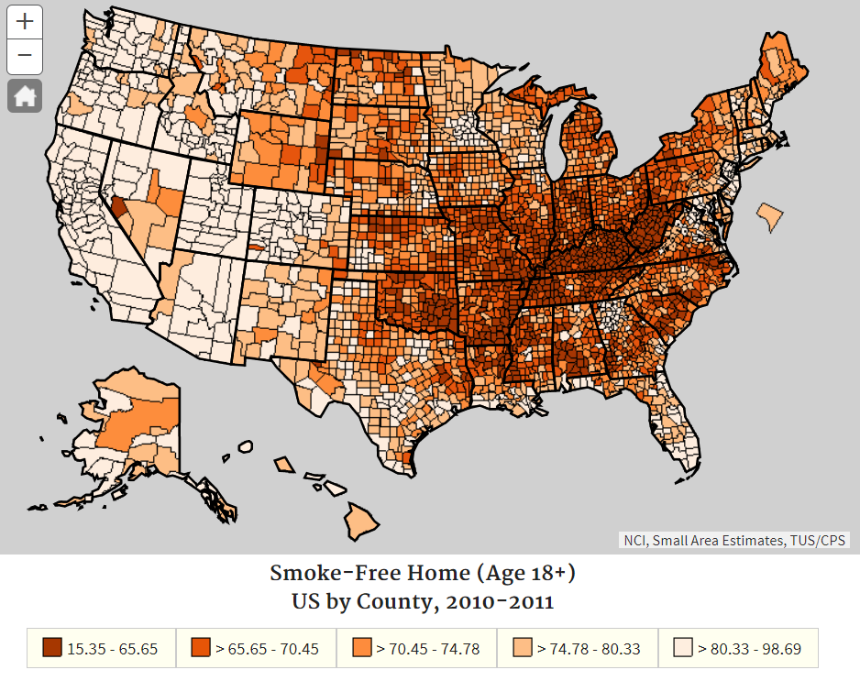
Model-based Estimates for Percent of Population Live in Smoke-Free Home Among Age 18+: TUS-CPS 10/11

Slide 20
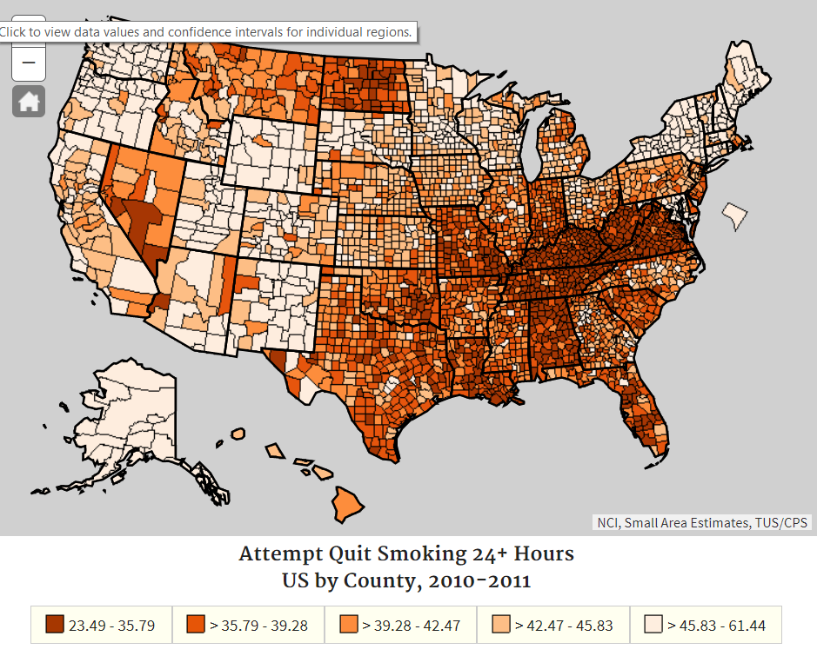
Model-based Estimates for Percent of Population Attempt Quit Smoking for 24+ Hours Among Age 18+: TUS-CPS 10/11

Slide 21
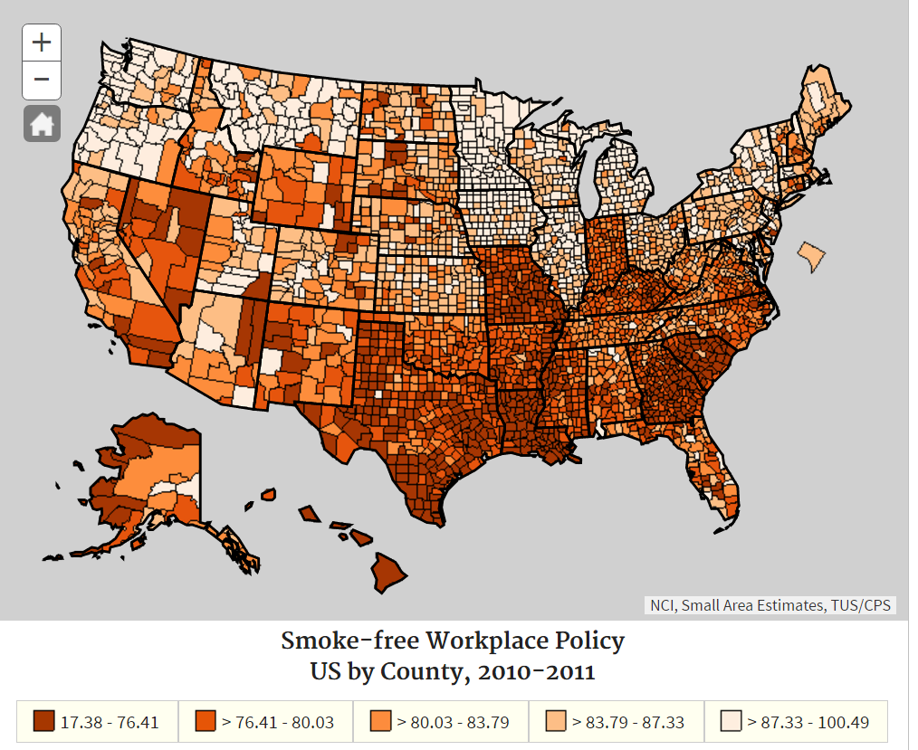
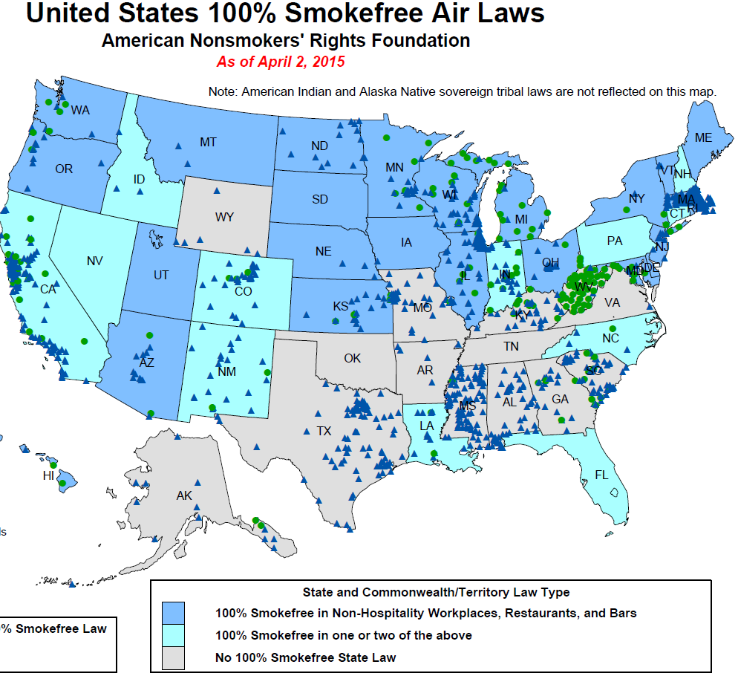
Model-based Estimates for Percent of Population Governed by a Smoke-free Workplace Policy* Among Age 18+: TUS-CPS 10/11
Individual Self-Reported
Law Legislations
*Workplace has an official smoking policy: Smoking Not allowed in ANY public areas and work areas
https://sae.cancer.gov/tus-cps/
Notes:
We can see some general consistency between the self reported modeled estimates with the state smoke free laws. The areas where there are no state laws have lower self-reported smoke-free work policy coverage.

Slide 22
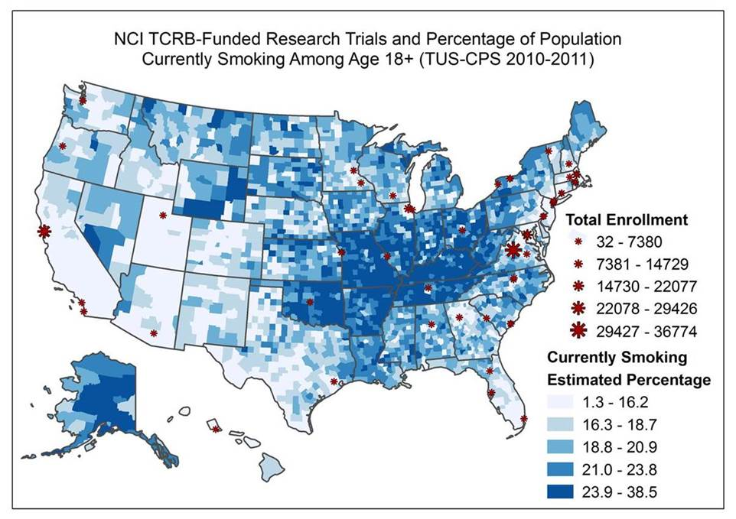
Applications of the SAE estimates and maps

Slide 23
Other Applications of SAE at NCI
Small Area Estimates for Cancer Risk Factors and Screening Behaviors by Combining multiple Surveys
Multiple years of state and county level estimates are produced for 7 variables
Utilize data from both the National Health Interview Survey and the Behavior Risk Factor Surveillance System
Small area estimates using the NCI-sponsored Health Information national Trends Survey (HINTS)
State level estimates are produced for 15 cancer-related knowledge variables
Spatio-temporal Models for Cancer Burden Mapping
To estimate age-standardized mortality rates and incidence rates by US county from a number of cancers and map the estimates to identify patterns and outliers

Slide 24

The SAE website

Slide 25
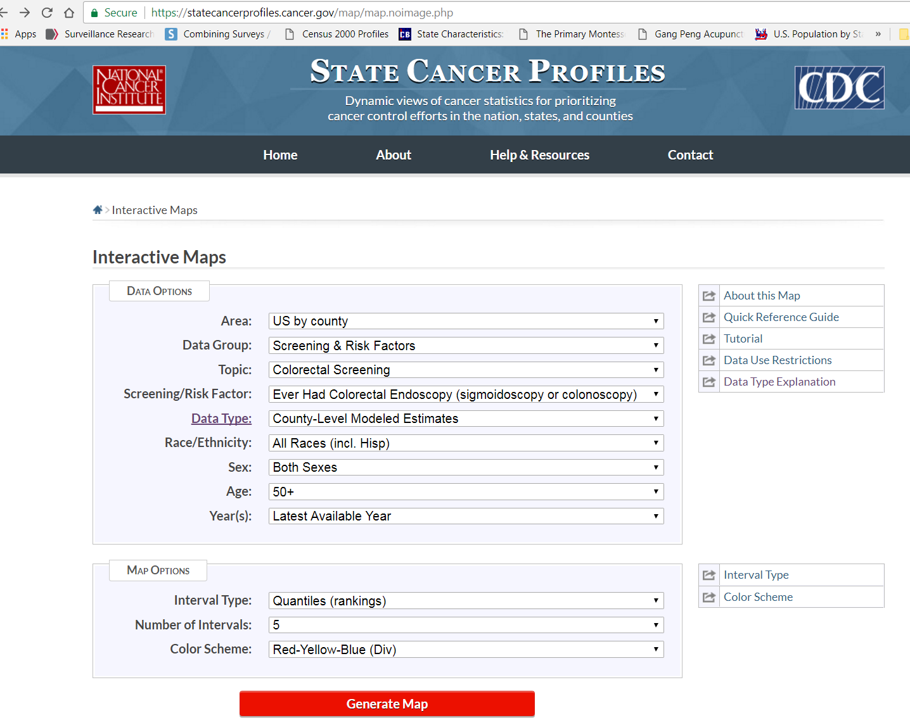
The State Cancer Profiles Website

Slide 26
Summary and Discussion
More details and results are available at https://sae.cancer.gov/tus-cps/.
County level estimates of current and ever smoking prevalence derived from this project are available upon request. Similar estimates were derived from the combining NHIS/BRFSS project and released at https://sae.cancer.gov/nhis-brfss/.
Model-based SAE techniques represent a promising means of generating estimates where there is small (or zero) state or county sample.
The SAE results provide a useful resource for the cancer surveillance, evaluation, and research communities.
We are currently working on the TUS-CPS SAE estimates for the 2014/2015 data cycle.
Future works include model improvements and estimates for county by Race/ethnicity groups
Notes:
County level estimates for current and ever smoking prevalence obtained from another project, combining NHIS and BRFSS, are released at the same SAE website under the topic of Cancer risk factors and Screening Behaviors. To avoid overlap, estimates from this TUS-CPS project for current and ever smoking are not currently released at the same website. But they are available upon request.

Slide 27
Any Questions?
Thank you!
Contact info:
Benmei Liu
liub2@mail.nih.gov

