Slide 1
AI tools that operate over the Genomic Data Commons

Slide 2
Introduction

Slide 3
Goal and Challenges
Goals
Provide natural language interface to the GDC's current functionality
Provide APIs that the community can use for their own AI models, AI tools and related needs
Provide AI assisted data analysis of GDC data to accelerate discovery
Current Constraints
Discoverability across 700+ clinical properties
Currently requires domain knowledge of both interface and data schema
Entry barrier for users without cancer genomic knowledges
Challenges
Operate at GDC scale
Balance pace of new AI models, frameworks & tools with operating an enterprise system at scale
Keep costs as low as possible
Leverage on-premise and cloud computing infrastructure
Maintain FISMA Moderate security & compliance

Slide 4
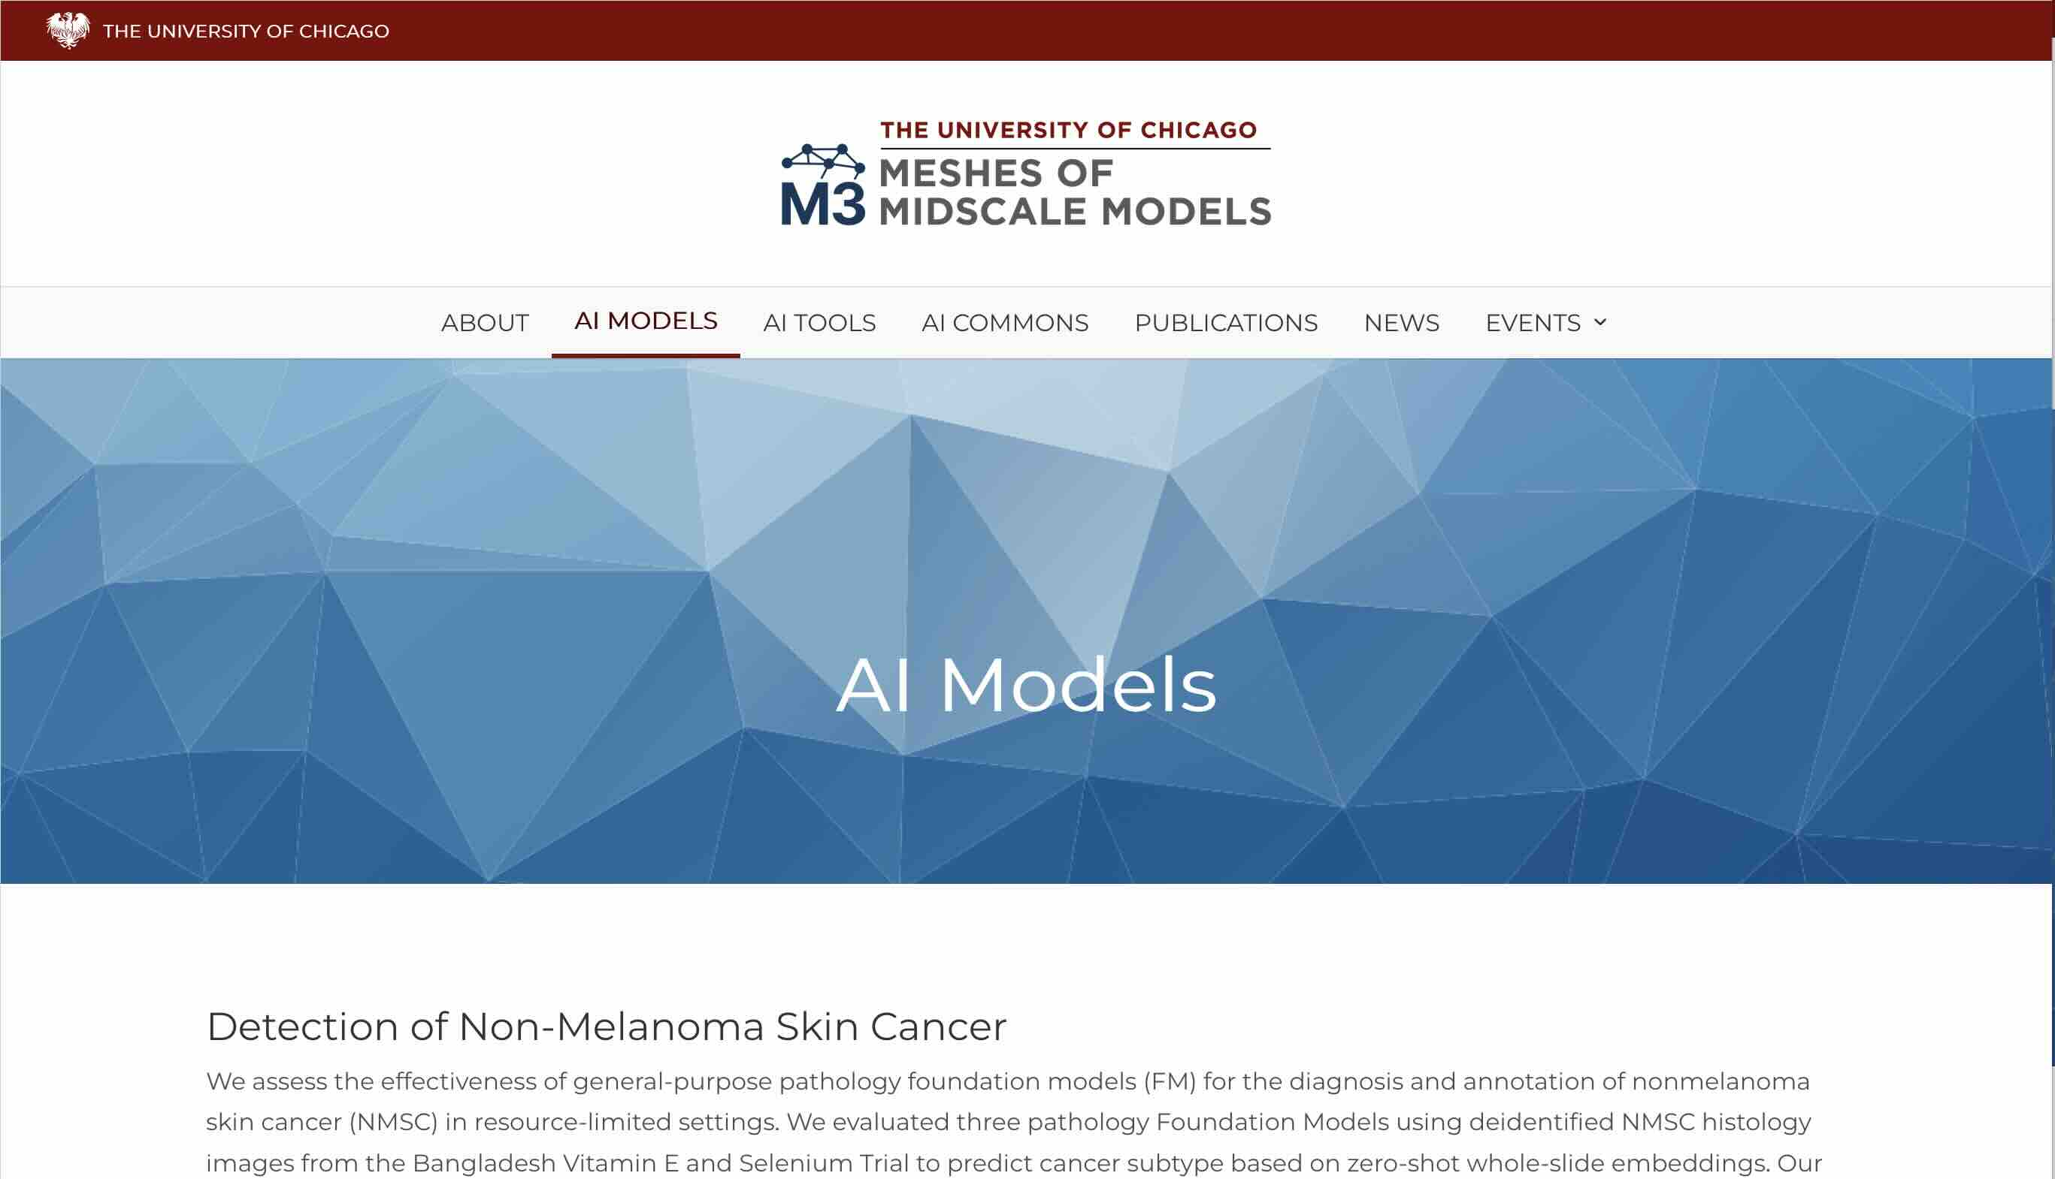
Meshes of Midscale Models Initiative (M3)
M3 AI Models
M3 Software Tools / Agents
M3 AI Commons
M3 Publications
https://m3initiative.uchicago.edu/

Slide 5
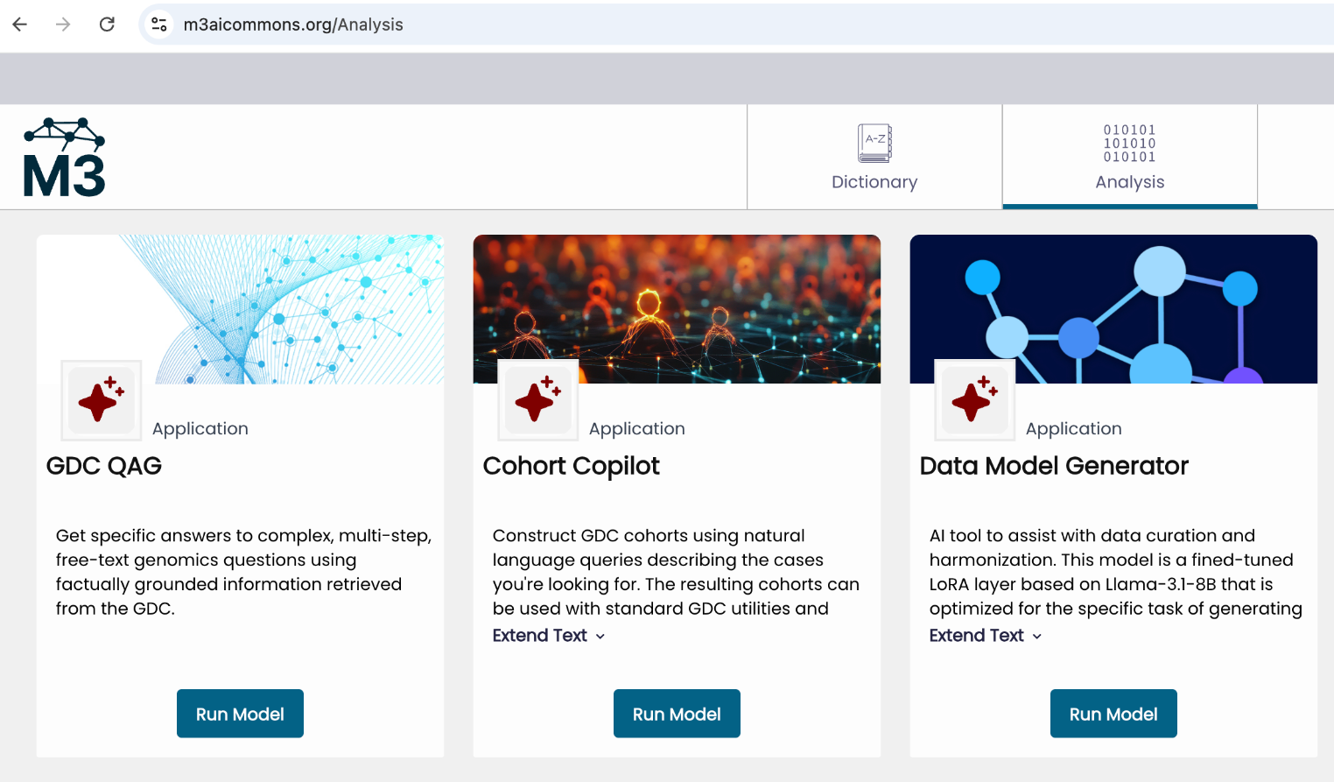
M3 AI tools that operate over GDC Data
The tools are in beta, but we will continue to make available to the public.
The tools / skills get better as the models we call get better and as we add more tools / skills that expose more capabilities of the GDC.
In a broad sense, we are focused on developing AI tools and models that are designed to interoperate with data commons and other sources of biomedical knowledge.

Slide 6
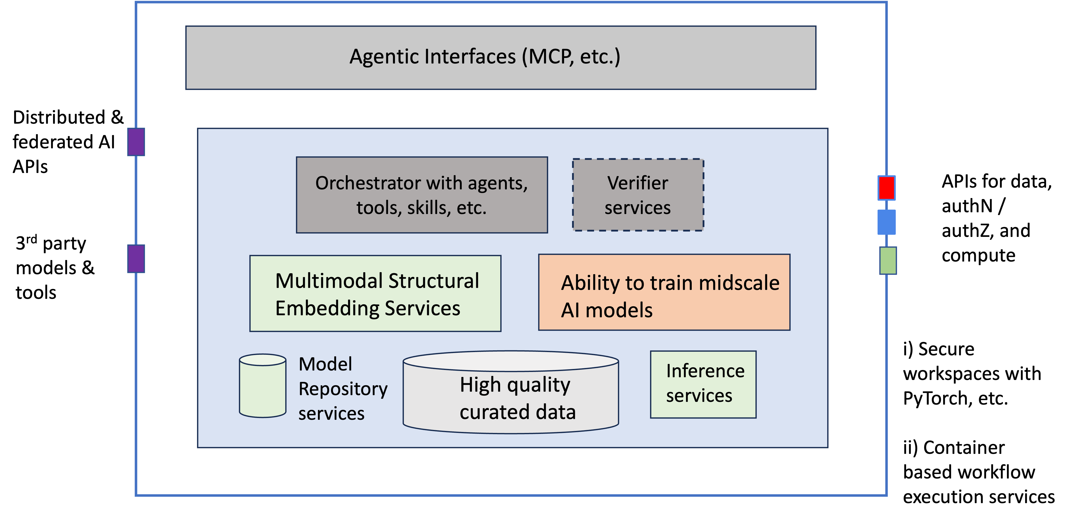
AI Commons
Source: Robert L. Grossman, Towards AI Commons

Slide 7
Two Tools: Cohort Co-Pilot and QAG
QAG (Query augmented generation)
To answer natural language questions about somatic mutation, copy number alternation, MSI and other molecular data
Under review: https://www.biorxiv.org/content/10.1101/2025.09.02.673797v1.full.pdf
Cohort Copilot
To facilitate Cohort-Building with natural language
Published in Bioinformatics Advances https://academic.oup.com/bioinformaticsadvances/article/5/1/vbaf295/8326854
In 2025, we developed v1. Now rolling out v2.
Can either use i) our foundation models running in our systems with our GPUs, ii) our models in the cloud with cloud GPUs, or iii) third party models.
Ongoing iterative updates, including architectural redesign to improve functionality and robustness

Slide 8
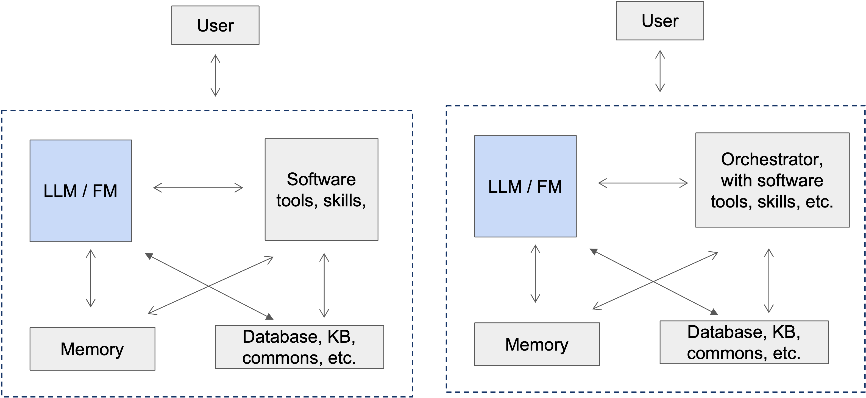
The Many Variants of Agent Architectures
We will show you some of these we built today for the GDC

Slide 9
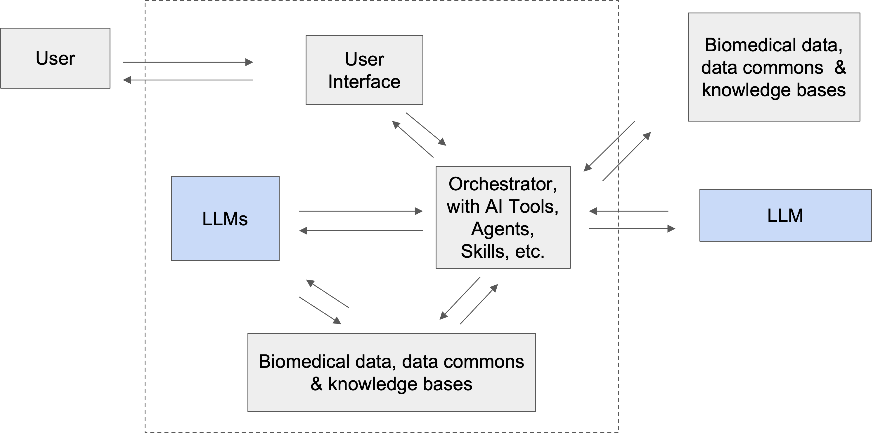
One Design Pattern for Tools / Agents in M3
(or other apps)
(or other apps)

Slide 10
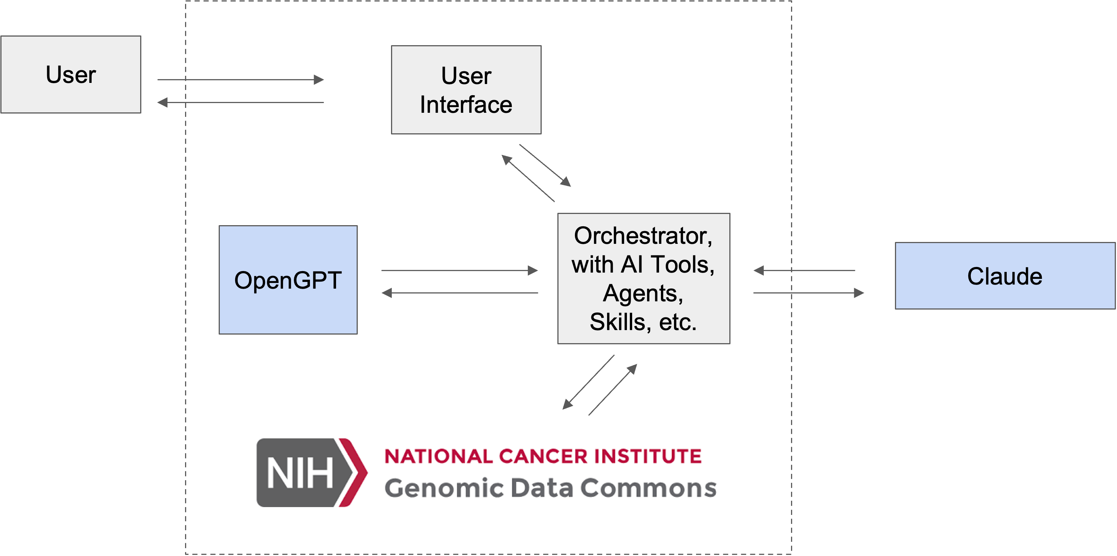
Agentic Design Pattern We Will be UsingToday
Demos below use different sets of tools

Slide 11
2. Query Augmented Generation (QAG) Tool

Slide 12
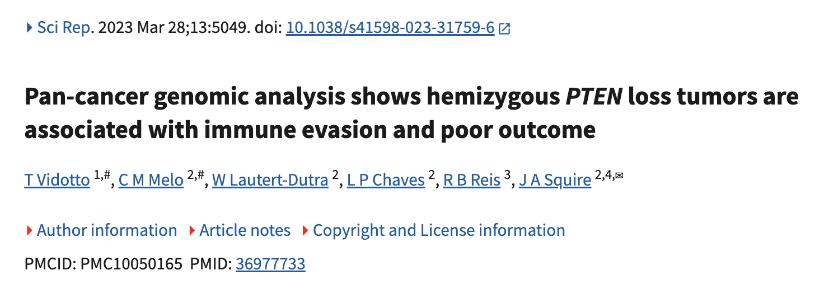
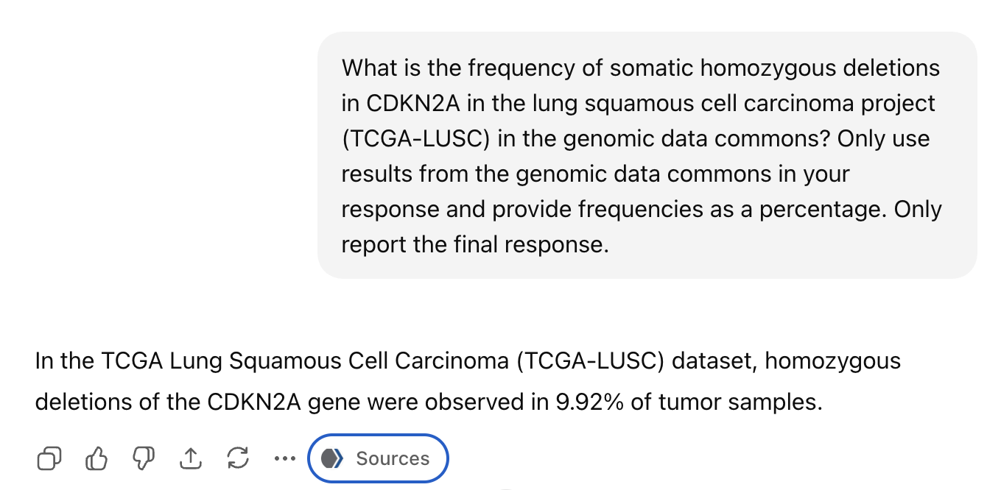
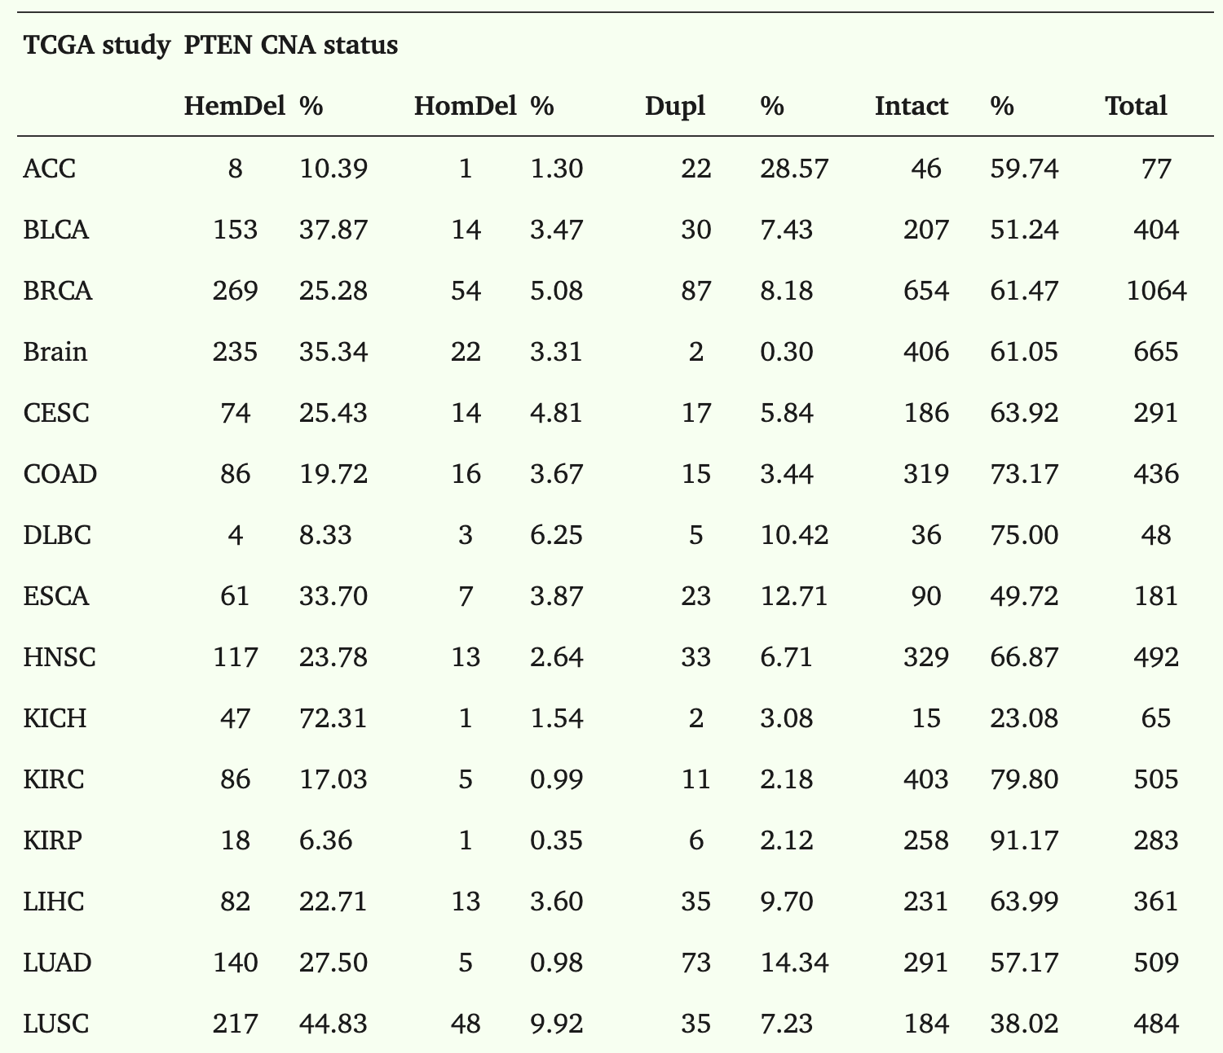
Query Augmented Generation (QAG)
LLMs struggle with factual or numeric queries
Asked GPT-4o (ChatGPT) a simple cancer genomics query about CDKN2A deletion
Note: Frequency in the GDC is 22.51%

Slide 13
GDC-QAG demo Tool is particularly useful for queries requiring multiple API calls that are time consuming in portal
https://qag.m3aicommons.org
Side-by-side comparison in portal

Slide 14
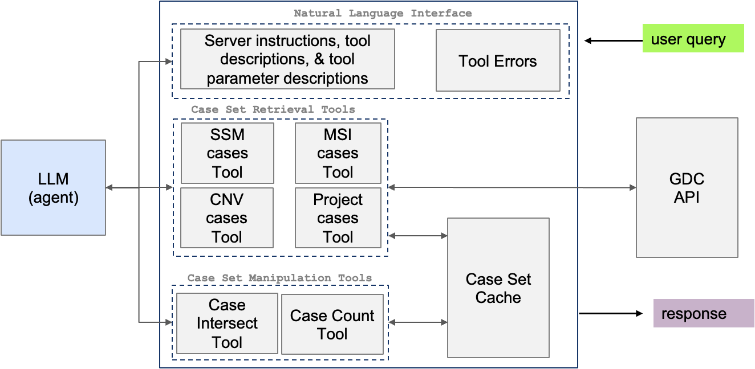
GDC-QAG Architecture v2

Slide 15
3. GDC Cohort Copilot Tool

Slide 16
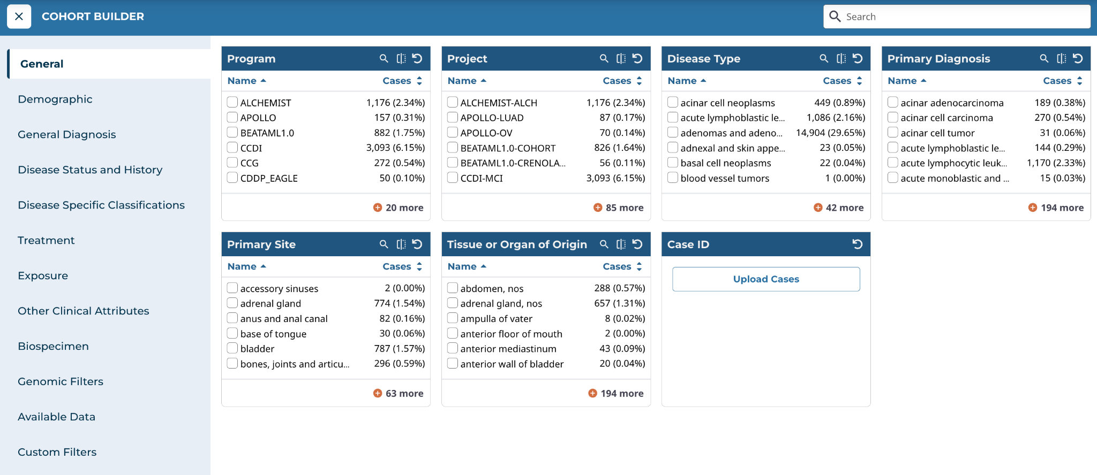
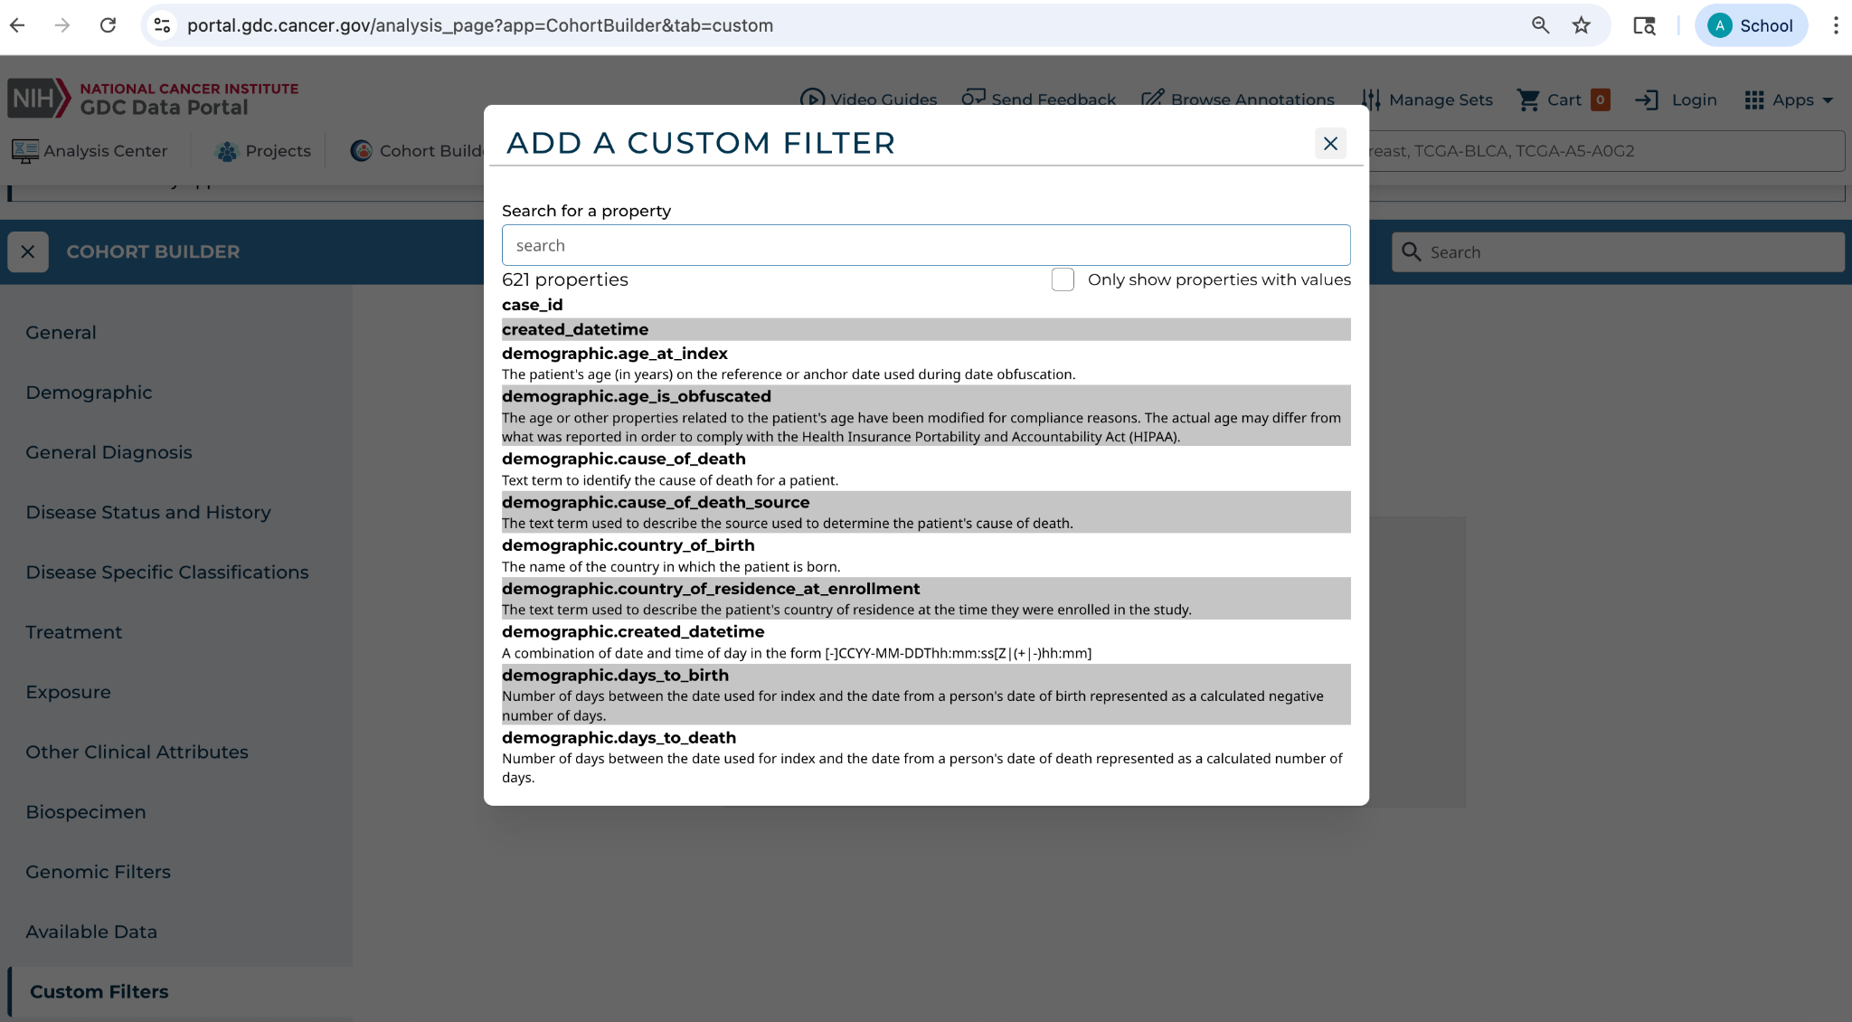
Building Cohorts Via Cohort Builder
2 demos on Cohort Builder
New users could benefit from curation of GDC cohorts using natural language

Slide 17
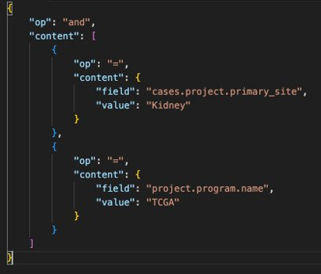
Cohort Filters
GDC cohort filters are described in JSON

Slide 18
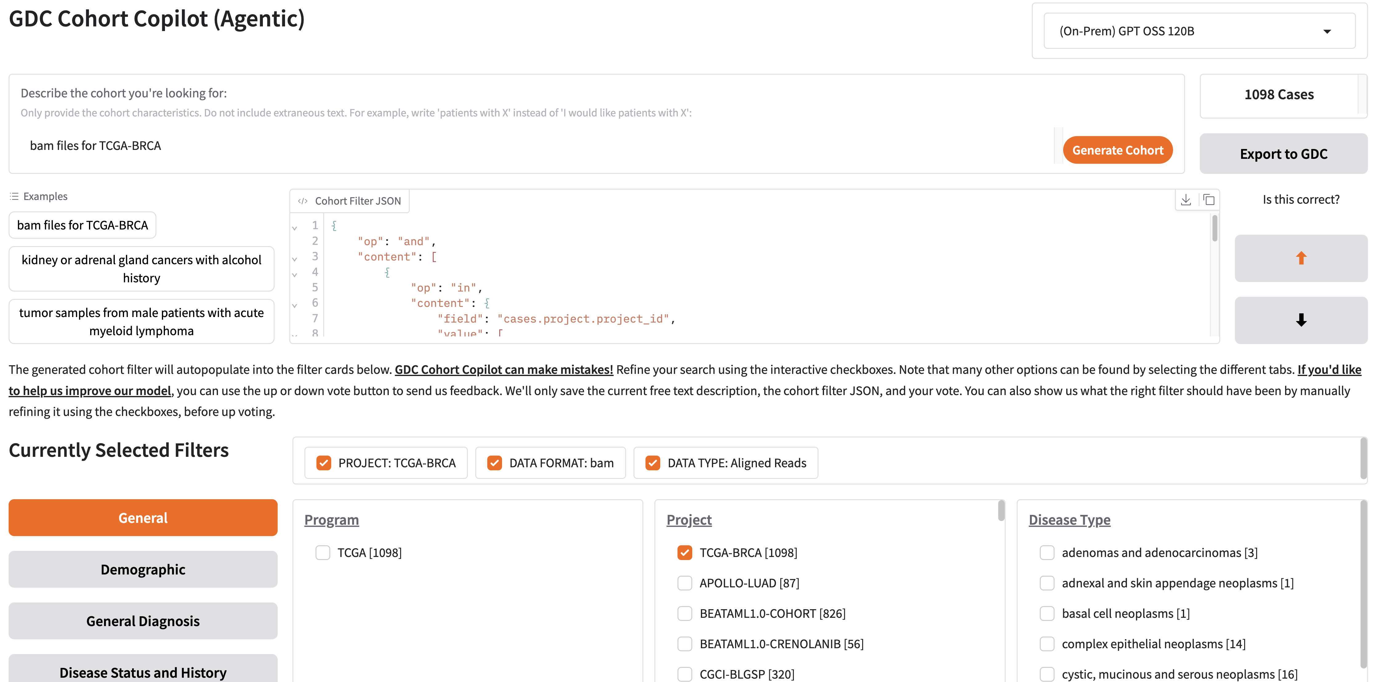
Cohort Copilot Demo
5
1
4
2
3

Slide 19
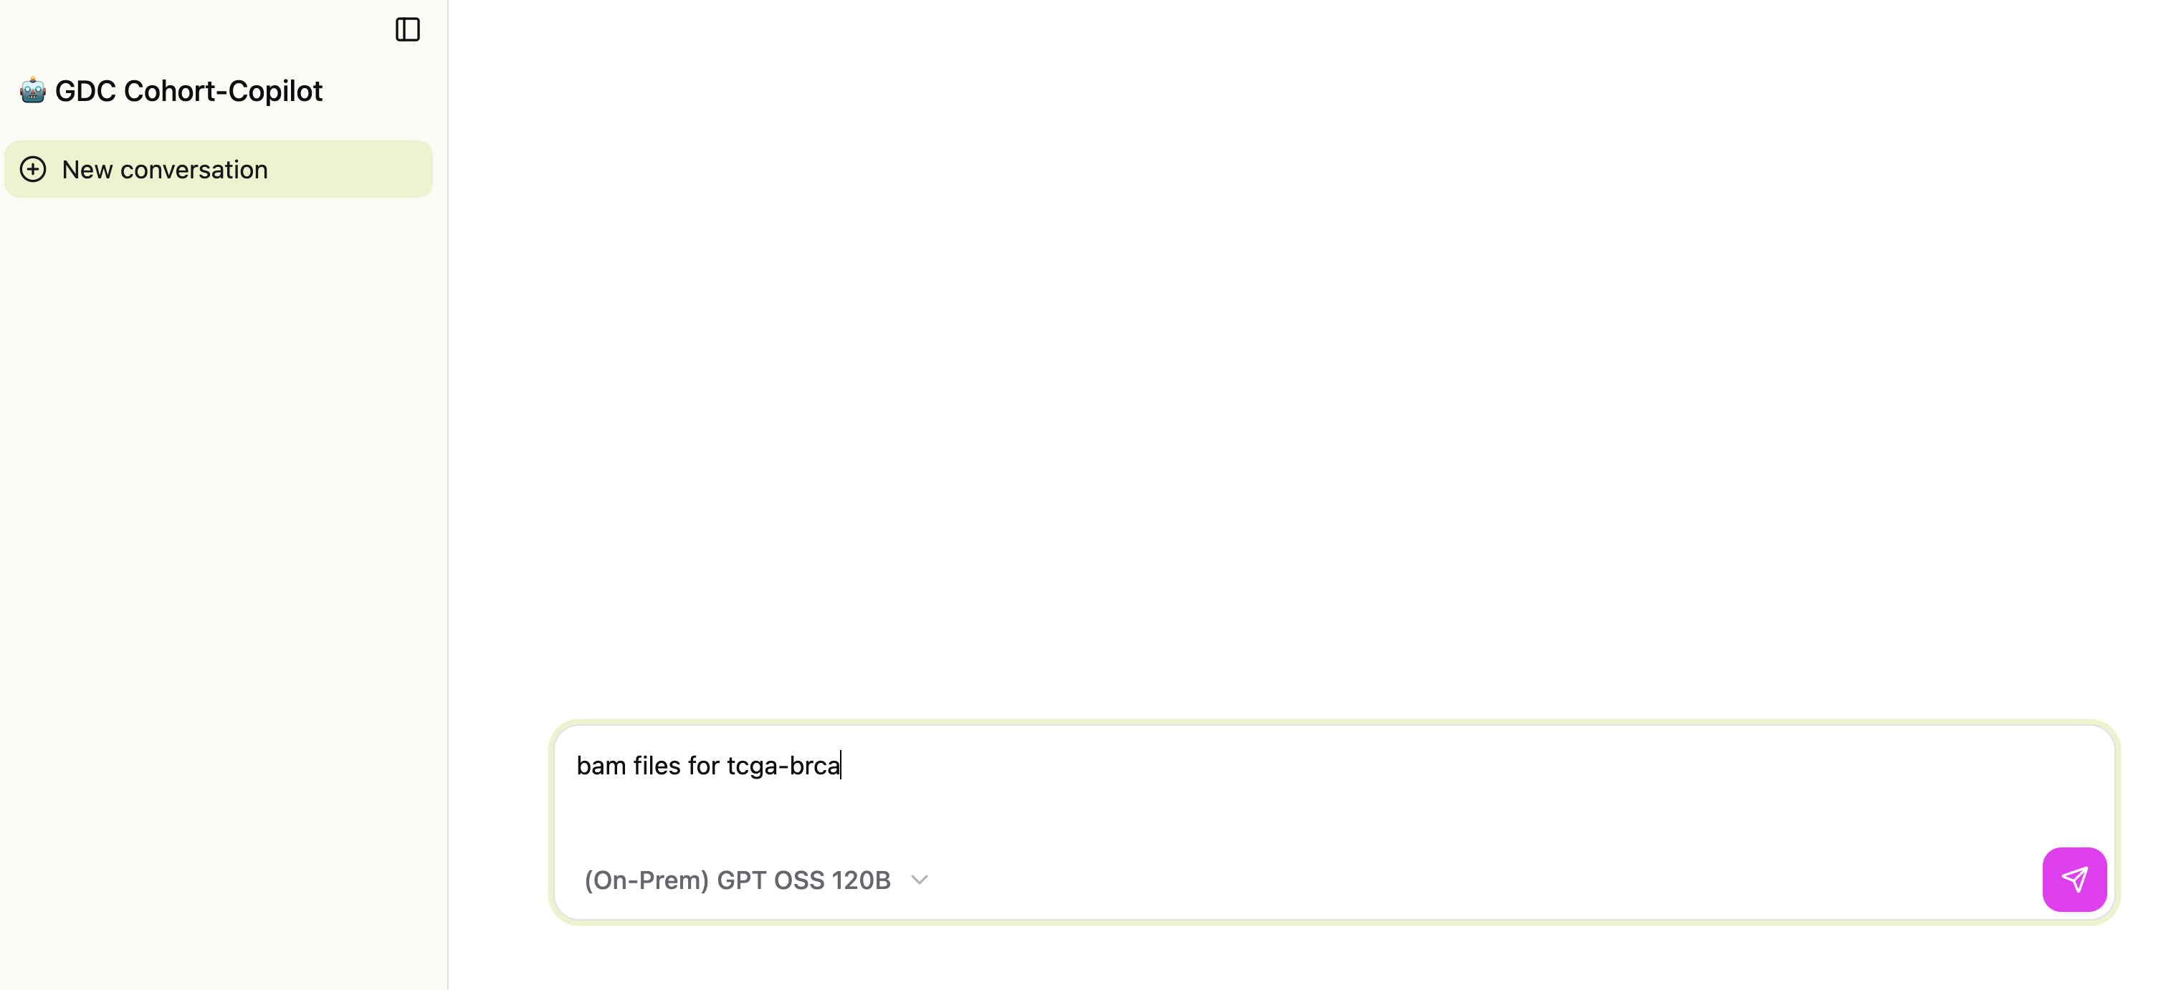
Cohort Copilot Interactive Mode Demo

Slide 20
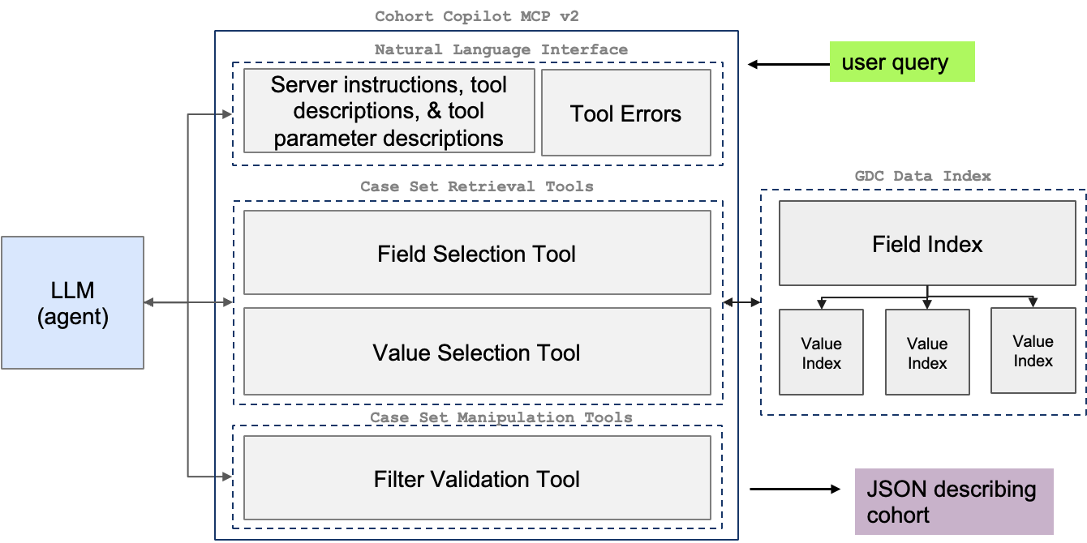
GDC Cohort CoPilot v2 Arch

Slide 21
4. An Additional Demo

Slide 22
5. Roadmap

Slide 23
AI tools next steps
These tools are deployed on M3 commons today
We are conduct more extensive testing on real user queries
We are improving and moving apps to production
GDC-QAG
Add more supported queries, like DNA methylation, gene expression, survival analysis
Support arbitrary cohort analysis by integrating GDC Cohort Copilot
GDC Cohort Copilot
Expand to entire set of ~700 GDC filters

Slide 24
Questions

