Slide 1
TITLE
Subtitle
caBIG Developer Boot Camp
August 18, 2005
National Cancer Institute
Center for Bioinformatics

Slide 2
Learning Objectives
Upon completion of this session, you will be able to:
… objectives here …

Slide 3
Outline
Intro to SDK 1.0.3 (features, capabilities)
Configuration (Ant, properties, control)
DEMO: caCORE 3.0.1
Best practices / tips (inst, mod, config)
Customization
  JBoss, ORM, multiple data sources
  Enabling CSM writable API
Q&A

Slide 4
Outline
Intro to caCORE 3.0.1 (feat., capabilities)
Service layer
  ApplicationService
  Web services
  CSM
Query methods
  Query-by-example
  Hibernate criteria
HANDS-ON: Code for real cases

Slide 5
Intro to SDK 1.0.3

Slide 6
CSM-SDK Adapter
CSM Integration
  Authentication
  Authorization
Session Management
  User Session Management
  Inactive session time-out
  No need to re-authenticate
Writeable APIs
  Simple CRUD operations
  Not domain specific

Slide 7
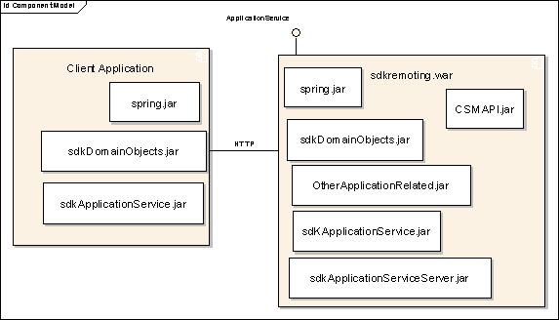
CSM-SDK Adapter - Architecture
  Spring Framework
  HTTP Remoting
  Application Service Interface
  HTTPClient

Slide 8
CSM-SDK Adapter – Architecture
Blocks for Managing User Session and Security
User
Session
Security
&
User
Session
Application
Service
Interface
Application
Service
Interface
Specific
Implementation
Hidden from User

Slide 9
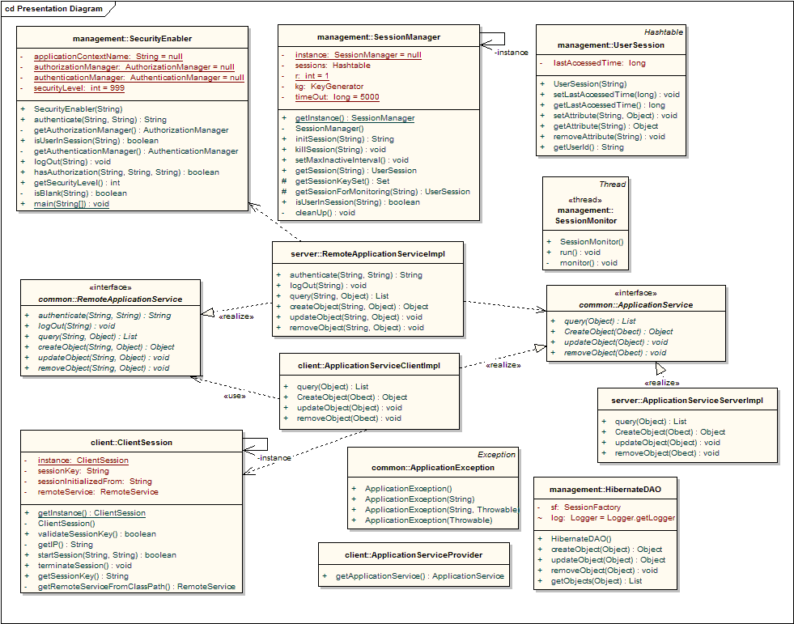
CSM-SDK Adapter - Architecture

Slide 10
Configuration

Slide 11
Configuration - CSM-SDK Adapter
Session Management
  Declare a time out period (session Inactive timeout)
  Properties-service.xml
CSM
  Turn CSM on or off
  Also Properties-service.xml
<attribute name="Properties">
gov.nih.nci.security.configFile=c:/jboss-4.0.1sp1/server/default/csm-config/ApplicationSecurityConfig.xml
gov.nih.nci.sdk.remote.sdk.securityLevel=1
gov.nih.nci.sdk.applications.session.timeout=120000
</attribute>

Slide 12
Configuration - CSM-SDK Adapter
Configuring CSM for the Service
Configuring Authorization Data using UPT
Configuring the Client

Slide 13
Best Practices

Slide 14
Best Practices - CSM-SDK Adapter
  Make sure the domain objects implements serializable interface
  Send proper messages in the exceptions thrown on the server side
  Make sure the methods of the service interface qualify as a service method
  Methods should not return only void. There should be a response code for every service method executed, so that users may know what exactly happened.
  Make sure all parameters of the service methods are serializable

Slide 15
Customization

Slide 16
CSM-SDK Adapter – Workflow
Develop the Application Service Interface and implementation
Build the remoting components
Build the server and client components
Download and install CSM. Use the CSM Guide for Application Developers
Configure the application’s authorization policy using the User Provisioning Tool
Configure the client
Use CSM in your application

Slide 17
CSM-SDK Adapter – Demo

Slide 18
Service Layer

Slide 19
CSM-SDK Adapter
If features like session management, security and writable APIs are needed then the adapter is needed
From the client perspective nothing changes, it will be the same interface
No burden of extra coding on developers.

Slide 20
Questions?

Slide 21
Further Reading
caCORE SDK Programmer’s Guide
  ftp://ftp1.nci.nih.gov/pub/cacore/SDK/caCORE_SDK1.0_Programmers_Guide.pdf
caCORE Technical Guide
  ftp://ftp1.nci.nih.gov/pub/cacore/caCORE2.0_Tech_Guide.pdf
  ftp://ftp1.nci.nih.gov/pub/cacore/caCORE3.0_Tech_Supp.pdf
caCORE Web site
  http://ncicb.nci.nih.gov/core/SDK

