Slide 1
CSM-SDK Adapter for caCORE SDK
caBIG Developer Boot Camp
August, 2005
National Cancer Institute
Center for Bioinformatics

Slide 2
Outline
Overview
  Introduction
  Features
  Changes from Client Application’s Perspective
Architecture
  Overview
  Components
Installation and Usage
  General Workflow
  Demo
Q&A

Slide 3
Overview

Slide 4
Introduction
What is Common Security Module (CSM)?
CSM-SDK Adapter is a wrapper over existing caCORE SDK output
Takes caCORE SDK server & client as input and produces CSM-SDK server & client
Adds the following functionality to caCORE SDK
  Security Integration
  Session Management
  Standard Spring HTTP Remoting
Provide all the functionality provided by the caCORE SDK except the utility methods

Slide 5
Features
Security Integration
  Authentication
  Authorization
  User Provisioning
Session Management
  User Session Management
  Inactive session time-out
  No need to re-authenticate
Standard HTTP Remoting through Spring

Slide 6
From Client Application’s Perspective
None of the method signatures change
None of the method functionality changes
Instead of using ApplicationService from caCORE SDK, clients will use SDKApplicationService from the CSM-SDK Adapter

Slide 7
Architecture

Slide 8
Architecture Overview
Blocks for Managing User Session and Security
User
Session
Security
&
User
Session
Application
Service
Interface
Application
Service
Interface
Specific
Implementation
Hidden from User

Slide 9
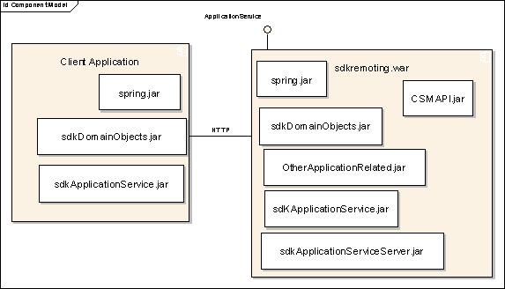
Components
Spring HTTP Remoting
SDKApplicationService Interface
CSM Integration

Slide 10
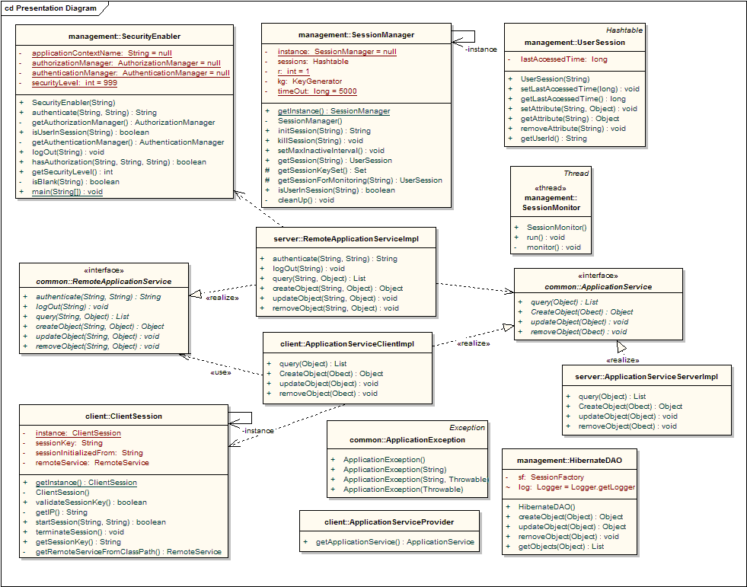
CSM-SDK Adapter - Architecture

Slide 11
Installation and Usage

Slide 12
Workflow
Build the server and client components for the SDK generated war
Configure CSM. Use the CSM Guide for Application Developers
Configure the application’s authorization policy using the User Provisioning Tool (UPT)
Configure the client to point to the server hosting the CSM-SDK Application Service
Use CSM-SDK Adapter Client in your application

Slide 13
DEMO

Slide 14
Building the Components
Obtain the war and client zip file generated by the caCORE SDK process
Place them in the directory where the CSM-SDK Adapter is unzipped
Edit the sdkBuild.xml file
  Change the warFileName value to the war file name which is generated by the caCORE toolkit
  Change the clientFileName value to the name of the client zip file which is generated by the caCORE toolkit
  Update value for arg4 is the web context root name for the HTTPService, for example, sdkremoting or your application name.
  Update value for arg6 is the unique name for the application as configured for CSM
Run sdkBuild.xml file using ant

Slide 15
Building the Components
Output will be generated in release folder
Copy the war file on JBoss Server from the release/server folder
Copy the jars and configuration files for the client application from the release/client folder

Slide 16
Server Configurations
Place the Datasource file generated by caCORE SDK in deploy directory of JBoss
Session Management
  Declare a time out period (session Inactive timeout)
  Modify the properties-service.xml file
CSM
  Turn CSM on or off
  Modify the properties-service.xml file
<attribute name="Properties">
gov.nih.nci.security.configFile=c:/jboss-4.0.1sp1/server/default/csm-config/ApplicationSecurityConfig.xml
gov.nih.nci.sdk.remote.sdk.securityLevel=1
gov.nih.nci.sdk.applications.session.timeout=120000
</attribute>

Slide 17
Configuring CSM
Configure Credential Provider using login-config.xml file of JBoss
Create ApplicationSecurityConfig.xml and add entry for the application
Configure the hibernate & datasource files appropriately to point to the correct Authorization Schema
Configure the Application’s Security Policy through UPT
Refer to CSM’s Documentation for detailed steps

Slide 18
Configuring Client
Add all the jars from the release/client folder into the lib directory of the client application
Copy the remoteService.xml file in the classpath of the application
Edit the remoteService.xml to point to the server hosting the CSM-SDK Application Service
  Replace {Host} with the name of the server hosting the service

Slide 19
Using the Client
Instantiate an object of ClientSession Class and initialize the session by passing the login credentials of a valid User
Instantiate an object of ApplicationServiceProvider Class and obtain implementation of SDKApplicationService Interface
Invoke Business methods to perform the required task
Terminate the client session

Slide 20
Further Reading
caCORE SDK Programmer’s Guide
  ftp://ftp1.nci.nih.gov/pub/cacore/SDK/caCORE_SDK1.0_Programmers_Guide.pdf
caCORE Technical Guide
  ftp://ftp1.nci.nih.gov/pub/cacore/caCORE2.0_Tech_Guide.pdf
  ftp://ftp1.nci.nih.gov/pub/cacore/caCORE3.0_Tech_Supp.pdf
CSM Guide for Application Developers
  ftp://ftp1.nci.nih.gov/pub/cacore/CSM/CSM_Guide_ApplicationDevelopers.pdf
caCORE SDK and CSM Web site
  http://ncicb.nci.nih.gov/core/SDK
  http://ncicb.nci.nih.gov/core/CSM

Slide 21
Questions?
Thank You

