Slide 1
Common Security Module (CSM)
Vijay Parmar
parmarv@mail.nih.gov
Ekagra Software Technologies

Slide 2
Agenda
Introduction
CSM Overall Architecture
Authentication Service
Authorization Service
  Concepts
  Service Types
  Sample code
User Provisioning Tool
  Overview
  Screen shots
Installation and Deployment

Slide 3
Common Security Module v4.1
Open Source Technology – based on standard NCI CBIIT Technology Stack, Java Authentication and Authorization Service (JAAS) based.
Authentication Service
  Authentication of User Credentials against credential providers
  Currently supports RDBMS and LDAP/LDAPS based credential providers for authentication
Authorization Service
  User based, Role/Group based, Attribute level &/or Instance level security
  Provision User security policy and check permission services
CSM API (v4.1)
  Minor coding required to integrate the API services
  Easy integration into existing applications, available as jar file.
User Provisioning Tool (v4.1)
  Management of user’s authorization policy via easy to use Web-based UI.
CSM – GAARDS Migration Module (CGMM v0.6)
  A solution to migrate existing (web or services) applications from CSM based authentication to use caGrid GAARDS based authentication.

Slide 4


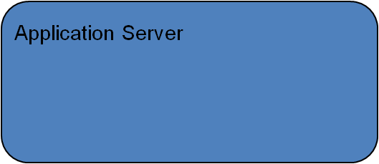
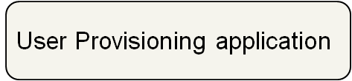
CSM - High Level Architecture
Application server
UPT Web Interface
Application XYZ
Authenticate
JAAS
Authorize
Common Security module
Authenticate
Authorize
Authorize
Credential Providers
CSM Authorization Schema
RDBMS
LDAP

Slide 5
CSM - High Level Architecture
Application server
UPT Web Interface
Application XYZ
Authenticate
JAAS
Authorize
Common Security module
Authenticate
Authorize
Authorize
Application Admin uses UPT to manage Authorization Policy
Credential Providers
CSM Authorization Schema
RDBMS
LDAP

Slide 6
CSM - High Level Architecture
Application server
UPT Web Interface
Application XYZ
Authenticate
JAAS
Authorize
Common Security module
Authenticate
Authorize
Authorize
Authorization Policy stored in CSM Authorization Schema
Credential Providers
CSM Authorization Schema
RDBMS
LDAP

Slide 7
CSM - High Level Architecture
Application server
UPT Web Interface
Application XYZ
Authenticate
JAAS
Authorize
Common Security module
Authenticate
Authorize
Authorize
Application invokes CSM API with User Credentials
Credential Providers
CSM Authorization Schema
RDBMS
LDAP

Slide 8
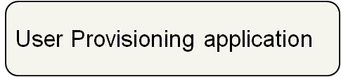
CSM - High Level Architecture
Application server
UPT Web Interface
Application XYZ
Authenticate
JAAS
Authorize
Common Security module
Authenticate
Authorize
Authorize
CSM validates User Credential against Credential Provider(s)
Credential Providers
CSM Authorization Schema
RDBMS
LDAP

Slide 9
CSM - High Level Architecture
Application server
UPT Web Interface
Application XYZ
Authenticate
JAAS
Authorize
Common Security module
Authenticate
Authorize
Authorize
Application invokes CSM API to authorize User
Credential Providers
CSM Authorization Schema
RDBMS
LDAP

Slide 10
CSM - High Level Architecture
Application server
UPT Web Interface
Application XYZ
Authenticate
JAAS
Authorize
Common Security module
Authenticate
Authorize
Authorize
CSM checks User Permission against the Authorization Policy
Credential Providers
CSM Authorization Schema
RDBMS
LDAP

Slide 11
Authentication Service
Verify user credentials against configured credential providers
JAAS based service
Supports RDBMS and LDAP/LDAPS based credential providers for authentication
Also supports NCI e-directory

Slide 12
NCI’s EDIRECTORY
VERIFY CREDENTIALS
CSM API AUTHENTICATION MODULE
CSM’s
JAAS BASED LDAP LOGINMODULE
JAAS’s LOGIN CONFIG
OTHER LDAP
SERVER
LOGIN MODULE CONFIGURATION
LOGIN RESPONSE
INVOKE PASSING USER CREDENTIALS
VERIFY CREDENTIALS
CLIENT APPLICATION
USER CREDENTIALS
AUTHENTICATION MANAGER
INVOKE
JAAS LOGINCONTEXT
LOGIN RESPONSE
LOGIN RESPONSE
INVOKE PASSING USER CREDENTIALS
USER CREDENTIALS
CALLBACK
LOGIN RESPONSE
USER CREDENTIALS
CSM’s CALLBACK HANDLER
CSM’s
JAAS BASED RDBMS LOGINMODULE
DATABASE
VERIFY CREDENTIALS
Based on the LoginModule, the credentials are verified against the credential providers (LDAP or Database)
The response from the LoginModules is returned to the LoginContext
This response is provided back the AuthenticationManager by the LoginContext
Authentication Manager returns the response back to the Client Application. In case of any exceptions or failure of credentials an appropriate CSException is thrown
Pass the User credential to Authentication Manager
Authentication Manager Constructs a CallbackHandler
Authentication Manager invokes JAAS LoginContext
LoginContext reads the LoginModule info.
LoginContext invokes the appropriate configured LoginModule

Slide 13
Authorization Service
What is Authorization
  Check if User has permission to access a resource
Services included as part of authorization
  User Provisioning
    Create Users, Protection Elements etc..
    Associate Users, Protection Elements, Roles..
  Check Permission

Slide 14












Authorization Service – Concepts
Entities
  Application
  User
  Group
  Protection Element
  Protection Group
  Role
  Privilege
User Provisioning Workflow
Notes:
Feedback: - Add Description or Diagram to relate Privilege, Roles, Users, PG, PE etc.

Slide 15
Authorization Service – Security Types
User Based Security
Role/Group Based Security
Object Level Security
Attribute Level Security
Instance Level Security
Notes:
Kalpesh

Slide 16
Authorization Service – Sample Code
API level access to perform Authorization operations
AuthorizationManager authorizationManager = SecurityServiceProvider.getUserProvisioningManager("security");
Example: Provisioning Authorization Policy
ProtectionElement tempProtectionElement = new ProtectionElement();
authorizationManager.createProtectionElement(tempProtectionElement);
Example: Enforce Authorization Policy
authorizationManager.checkPermission(…)

Slide 17
User Provisioning Tool (UPT)
The User Provisioning Tool provides a graphical user interface to create authorization data and provision the user security based on the data.
The UPT functions in two modes
  Super Admin Mode – To register Applications and Admins
  Admin Mode – To administer a registered application’s user authorization policy.

Slide 18
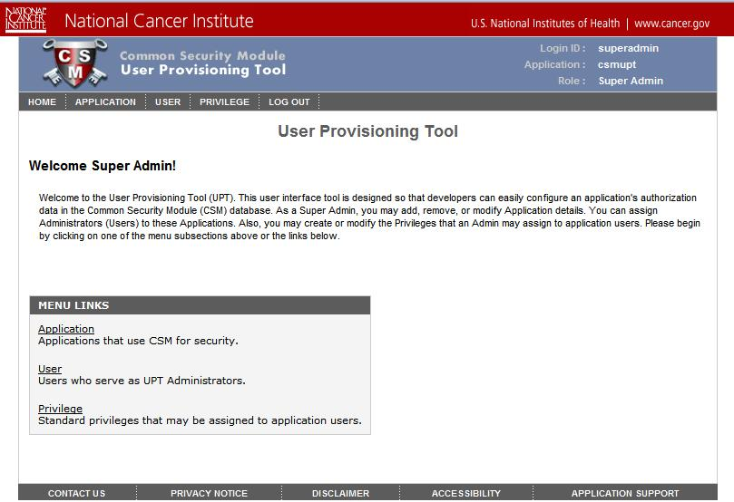
User Provisioning Tool – Super Admin

Slide 19
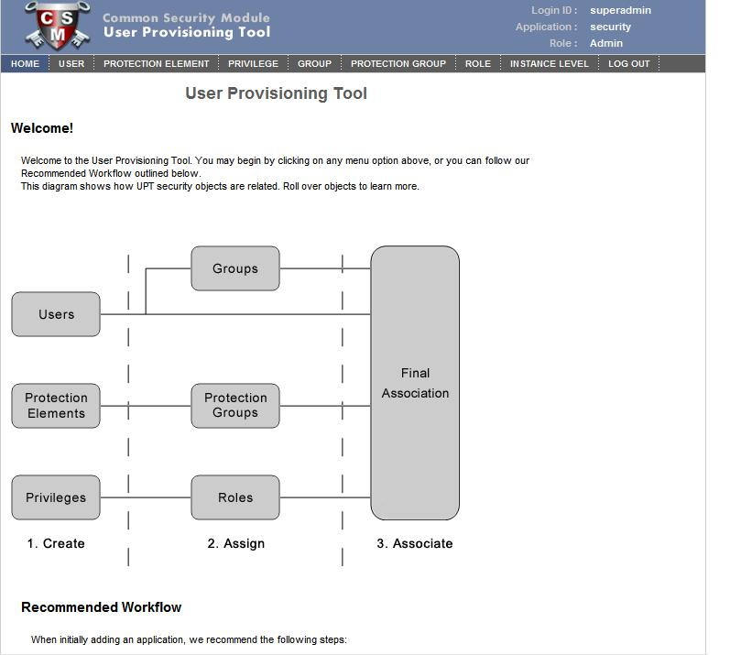
User Provisioning Tool – Admin Screen

Slide 20
Installation and Deployment
UPT was developed as a flexible application that can be deployed in multiple ways depending on the need or scenario. The three primary modes to install the UPT include the following:
  Single Installation, Single Schema
  Single Installation, Multiple Schemas
  Local installation, Local schema

Slide 21
Single Installation, Single Schema
One Instance of UPT hosted on common application server.
One installation used to administer authorization data for all applications.
Therefore an application using UPT does not have to install its own authorization schema.
App 1
UPT
Ap
p 2
Common
Authorization
Database

Slide 22
Single Installation, Multiple Schema
One Instance of UPT hosted on common application server.
One installation used to administer authorization data for all applications.
An application can use its own authorization schema.
App 1
UPT
Authorization database for App 1
Common Authorization
Database
Authorization database for App 2
App 3
App 2

Slide 23
Local Installation, Local Schema
UPT is not shared with other applications.
This installation is used to administer authorization data for particular applications ( or set of related applications)
UPT
App 1
Authorization
Database

Slide 24
Documentation
CSM Guide for application developers
  Multiple deployment models
  Configuration & Integration for Authentication
  Configuration & Integration for Authorization
  Authorization Meta data set up using User Provisioning Tool web interface
  UPT user guide
  CSM – caGrid Integration

Slide 25
CSM GAARDS Migration Module
Vijay Parmar
parmarv@mail.nih.gov
Ekagra Software Technologies

Slide 26
Agenda
Introduction
Requirements
CGMM Components and Overall Architecture
CGMM Workflows
CGMM User Interface
Documentation. Questions?

Slide 27
Introduction
Common Security Module (CSM)
  provides Application security tools that address authentication, authorization and user provisioning.
Grid Authentication and Authorization with Reliably Distributed Services (GAARDS)
  provides services and tools for administration and enforcement of security policy in an enterprise Grid.
CGMM
  A web application tool which allows automated and user-oriented process of migrating CSM user ID to GAARDS user ID and allow an application to use GAARDS based authentication.
Notes:
Common Security Module (CSM) provides Application security tools that address authentication, authorization and user provisioning.
Grid Authentication and Authorization with Reliably Distributed Services (GAARDS) provides services and tools for administration and enforcement of security policy in an enterprise Grid.
CSM GAARDS Migration Module is a web application tool which allows automated and user-oriented process of migrating CSM user’s to GAARDS user’s and allow an application to use GAARDS based authentication.

Slide 28
Requirements
Single Set of Credentials
Migrate CSM based local account to caGrid account.
GAARDS based authentication
Notes:
Single Set of Credentials
The existing web applications having CSM based authentication is required to provide Grid based authentication. Hence users with CSM credentials as well as Grid credentials can access all components of existing web application.
The requirement is to avoid duplication of accounts for existing and new users. The application needs to provide a single set of credentials to access various above mentioned components.
GAARDS based authentication
The requirement is to switch CSM based authentication to caGrid’s GAARDS based authentication. Users should not be allowed to login using CSM credentials once they are migrated.
Migrate Accounts
The Migration module will enable migrating of existing users accounts from CSM accounts to Grid accounts. This will make users authenticated against GAARDS for scalability and federation.
Provisioning of new users with Grid Identities.
New users should be allowed to create Grid accounts and login to existing application using Grid credentials. The existing applications Authorization policy provisioning should be enhanced to allow users Grid Identities instead of CSM credentials.
To use caBIG approved Identity Providers and thus allowing federation of identity
The web application should use a caBIG approved Identity Provider as your credential source. This way any user which is member of those Identity Providers can log onto the application (provided the user has appropriate access permission if any).

Slide 29
CGMM Components
Host Application
  CGMM Filter (Optional)
  caGrid Form Authenticator (Optional)
CGMM
  CGMM Web Application
  CGMM API
caGrid 1.2 services used by CGMM
  Authentication Service
  Dorian
  SyncGTS
Notes:
The following are the minimum set of components involved in the Migration Module Framework. The following section describes the design for CSM GAARDS Migration Module and integration with Host applications.
CGMM Filter
A new HTTP filter (provided as part of the CGMM) is configured to intercept and forward the user requests to the CGMM to either migrate the user account or to login the user into the Host application. Depending on whether the user is an existing application user or not, the control is passed back either to the login workflow or the new user creation workflow respectively.
CSM – GAARDS Migration Module web application (CGMM)
To assist in the migration of local CSM accounts to caGrid, CGMM is provided. CGMM is a separate web application that resides in the same container as the Host web application. CGMM also provides the Servlet Filter that is placed in front of the Host application intercepting and routing each user request for login or migration purpose. Detailed work flow of the migration module and the considered scenarios are provided in the next section.
Authentication Service
The IdPs registered on NCICB Production Grid will be used as the Identity Provider to validate user’s credentials. They will authenticate the user and provide a SAML token
Dorian
The NCICB Production Dorian is used as a Federation Service to generate user’s grid identity. This Dorian instance will also host all the users migrated from individual local host application instances which are not associated to any other IdPs.
SyncGTS
Sync GTS will be installed in CGMM for the Host application. Sync GTS daemon will keep the Host application in sync with the Grid Trust Fabric and update the CRL’s accordingly. Once the CGMM obtains Grid proxy from Dorian it will validate the proxy against the GTS to make sure the certificate is still valid and has not been revoked.

Slide 30

Host Application
Requested Flow
New User Flow
User Info + Grid Proxy
User Request
CGMM Filter
Pass control
User Info + Grid Proxy
Client
Perform Login
Pass control
CSM LOGIN
GRID LOGIN
CGMM Manager
CSM Login Screen
CSM 4.1 Schema
Validate CSM Credentials
Authentication or Migrate
Grid Login Screen
Authentication Grid User
Authentication Service
Validate Grid Credentials
Create New Dorian User account
Dorian
New Grid User
Screen
Create New Grid User
CGMM Web Tool
Validate Proxy
Web Server
SyncGTS

Slide 31
CGMM Web – Behaviors/Modes
Default Behavior
  Original workflows/scenarios as described in following slides.
Alternate Behavior
  The user must have a Local (CSM) account.
  The user may or may not have a caGrid Account.
  The Application wishes to leverage caGrid authentication and account migration features only.
  Based on those criteria there are two different scenarios addressed by the CGMM Tool. The scenarios are as follows
  1. User logs in with CSM account and user has a caGrid account
  2. User logs in with CSM account and user does not have a caGrid account

Slide 32
CGMM Workflows – Default Behavior
The CGMM Tool allows multiple scenarios/workflows based on the User. The user may or may not have CSM account. The user also may or may not have a caGrid Account.
Based on the above there are four different scenarios addressed by the CGMM Tool. The scenarios in default behavior/mode are as following:
  User logs in with CSM account
    User does not have a caGrid account.
    User has a caGrid account
  User logs in with caGrid account
    User does not have a CSM account
    User has a CSM account.
Note: The CGMM tool DOES NOT address the scenario where a User does not have a CSM (local) Account and does not have a caGrid account as well. The host application needs to address this scenario.

Slide 33
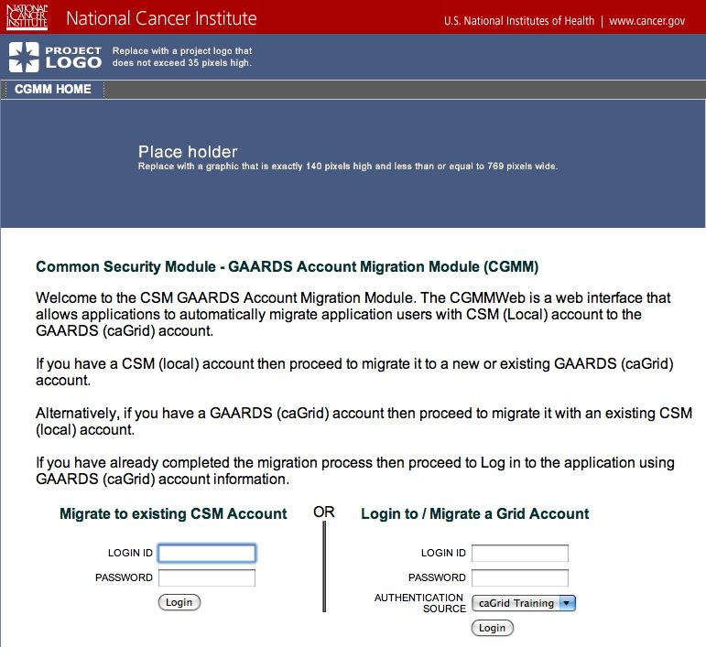
UI – CGMM Home Page

Slide 34
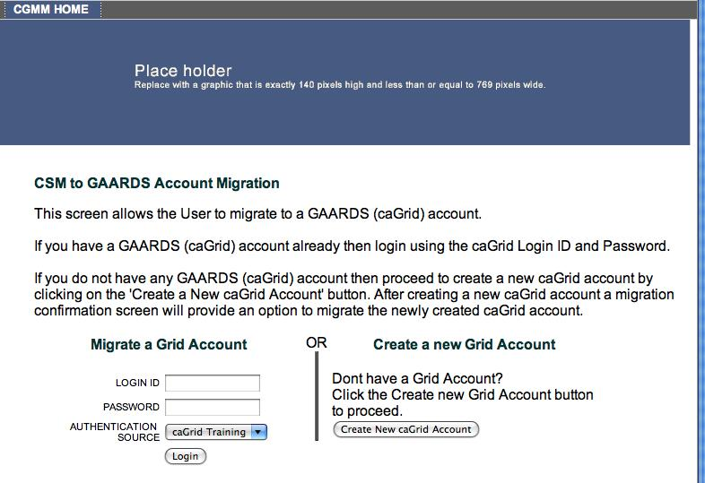
GAARDS Login Page
User is already authenticated with valid CSM login ID and password.

Slide 35
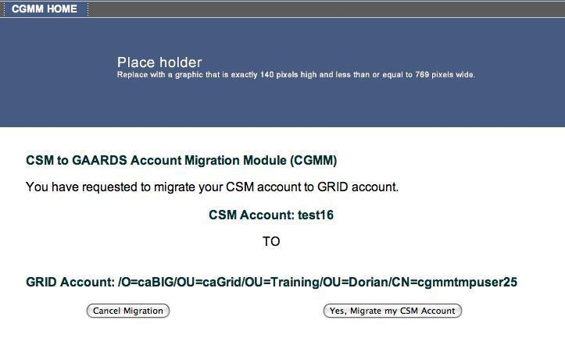
Migration Confirmation Page
- User is already authenticated with valid CSM login ID and password.
User is also authenticated with valid GAARDS (caGrid) based Login ID,
Password against Authentication Source (service).

Slide 36
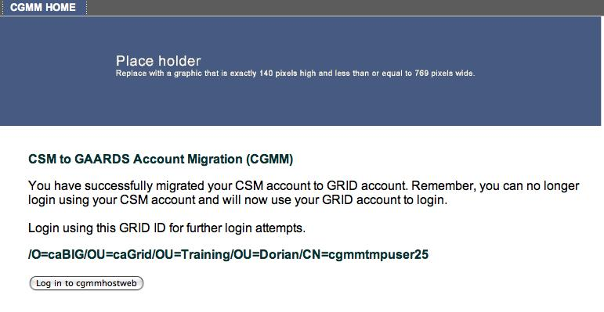
Migration Success page

Slide 37
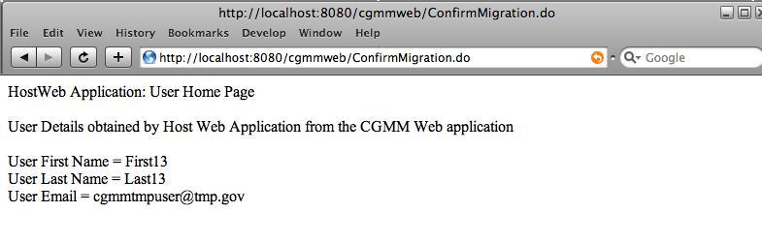
Host application page

Slide 38
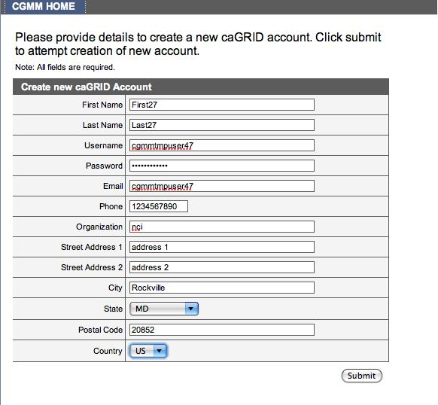
New Grid account page

Slide 39
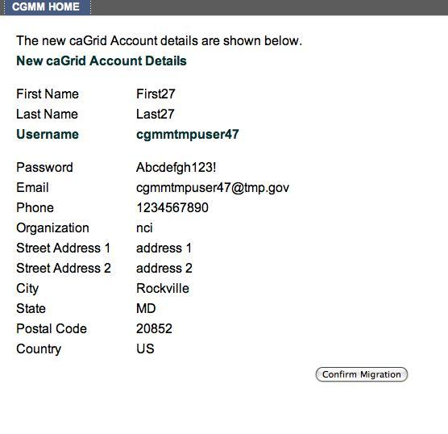
New Grid account confirm page

Slide 40
Technical Environment
CSM V4.1 / CSM UPT v4.1
caGrid Release v1.2

Slide 41
Documentation/More info
CSM GAARDS Migration Module Guide
  http://gforge.nci.nih.gov/docman/view.php/12/15148/CSM41_GAARDSMigrationModuleGuide.pdf
CSM
  http://ncicb.nci.nih.gov/NCICB/infrastructure/cacore_overview/csm
GAARDS
  http://www.cagrid.org/wiki/GAARDS:Main

Slide 42
QUESTIONS?

