Slide 1
NCICB Common Security Module
Security Working Group Meeting
Next Phase Requirements
05/12/2005

Slide 2
Agenda
Current Release
  caCORE 3.0 Release Features
  Integration with C3PR
Future Release
  caCORE 3.0.1 Release Details
  Next Phase Proposed Requirements
  Team Specific Requirements
Notes:
Kalpesh

Slide 3
caCORE 3.0 Release Features
Pluggable JAAS based Authentication Supporting RDBMS and LDAP
Programmatic Granular Authorization
User Provisioning Tool aiding in authoring of the authorization data
Reference Implementation
Notes:
Kalpesh

Slide 4
Integration with C3PR
C3PR uses only the Authorization Service provided by CSM
UPT tool to input the C3PR authorization data in the common database
Integration of C3PR with CSM was smooth
  Took total 1 hour of configuration to integrate
  Total took 1 day due to access issues
  C3PR has completed implementing CSM authorization APIs in their code without any issues
Notes:
Mention time

Slide 5
3.0.1 Release Main Features
Cross Browser Compatibility for UPT
Cross Database Compatibility for Authorization Schema
Reporting Functionality for UPT
Other Enhancements and Bug fixes in APIs and UPT
Open Source Initiative
Notes:
Kalpesh

Slide 6
Next Phase Requirements
HIPPA Compliance
Single Sign-On
Integration with Digital Certificates
Web Services Security
Authentication as Web Service
Notes:
Mention that all the slides following this are based on this limited scope as decided in SWG meetings for caCore 3.0 release

Slide 7
Next Phase Requirements contd.
Policy Adapters
Authorization Policy Caching
Encryption with Authentication
AOP Integration
UPT Enhancements
Logging and Audit Trail
Notes:
Mention that all the slides following this are based on this limited scope as decided in SWG meetings for caCore 3.0 release

Slide 8
Team Specific Requirements
Current Release
  Any Issues, Bugs, Enhancements ?
Next Release
  Any Specific Requirement
  Suggestions

Slide 9
Questions ?....

Slide 10
NCICB Common Security Module
Security Working Group Meeting
CSM Demonstration
05/12/2005

Slide 11
Agenda
CSM Overview
  Authentication Overview
  Authorization Overview
UPT Overview
Reference Implementation
  Business Scenarios
  Authorization Data Authoring using UPT
  CSM API’s Usage
Best Practices
Documentation Details
Notes:
Kalpesh

Slide 12
CSM Overview
Authorization Schema
CSM API jar (java archive)
  Integration
  Authentication
  Authorization
User Provisioning Tool (web application)
  Provisioning of Authorization Data
Reference Implementation
Notes:
Kalpesh

Slide 13
High Level Architecture for Phase I
Credential Providers
Application server
RDBMS
LDAP
Application XYZ
Authenticate
Common
Authorization
schema
JAAS
Authenticate
Authorize
Security module
Authorize
User
Provisioning
Web
interface
Web server
Application
server
User
Provisioning
application
Notes:
Vinay

Slide 14
CSM API Integration
Distributed in form of jar files
Minor coding required to integrate the API services
Easily configurable to be able to connect to the authorization database and authentication credential providers
Notes:
Kalpesh

Slide 15
Authentication Service
Verify user credentials against configured credential providers
JAAS based service
Currently supports RDBMS and LDAP/LDAPS based credential providers for authentication
Supports NCI e-directory
Notes:
Kalpesh

Slide 16
Authorization Service
Provides programmatic authorization schema
Runtime Java API to control access based on the authorization metadata
Notes:
Kalpesh

Slide 17
Authorization Service – Concepts
Entities
  Application
  User
  Group
  Protection Element
  Protection Group
  Role
  Privilege
Notes:
Kalpesh

Slide 18












Authorization Model
JBoss
Csmapi.jar
Notes:
Kalpesh

Slide 19
UPT - Authorization Data Provisioning
Web based tool to provision the authorization metadata for an application
Notes:
Kalpesh

Slide 20
UPT - Authorization Data Provisioning
UPT Deployment Modes
  Single Installation Single Schema used by multiple applications
  Single Installation – but each application has its own Schema
  Local Installation Local Schema for each application
App 1
UPT
App 1
UPT
UPT
App 1
Authorization database for APP 1
Common authorization
Database
Authorization
Database
App 2
Common authorization
Database
App 2
Notes:
Kalpesh

Slide 21
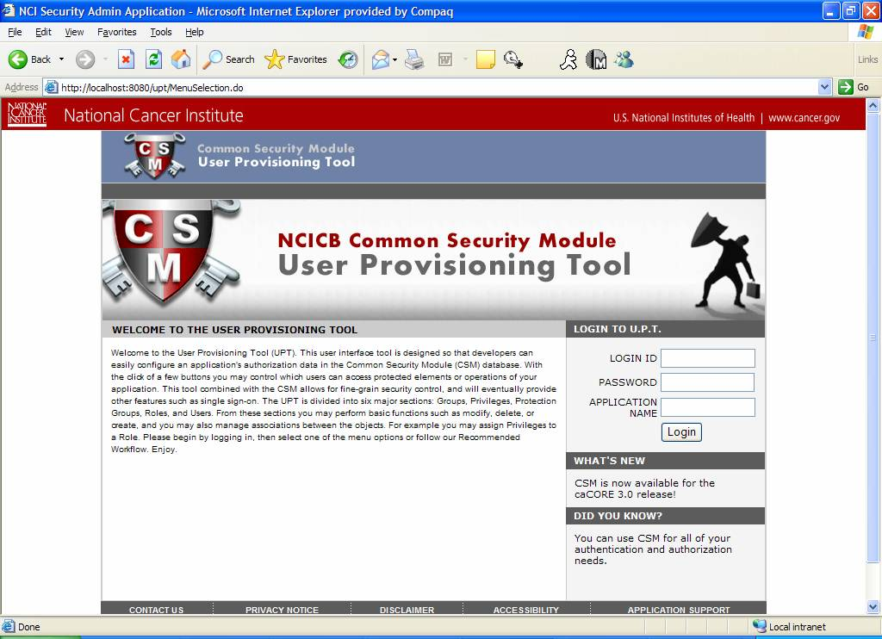
UPT DEMO
Notes:
Kalpesh

Slide 22
Reference Implementation
HR management web application
Shows how CSM enables security
Highlights the following:
  Integration of security API
  Usage of security API
  Configuration of security API
Notes:
Kalpesh

Slide 23
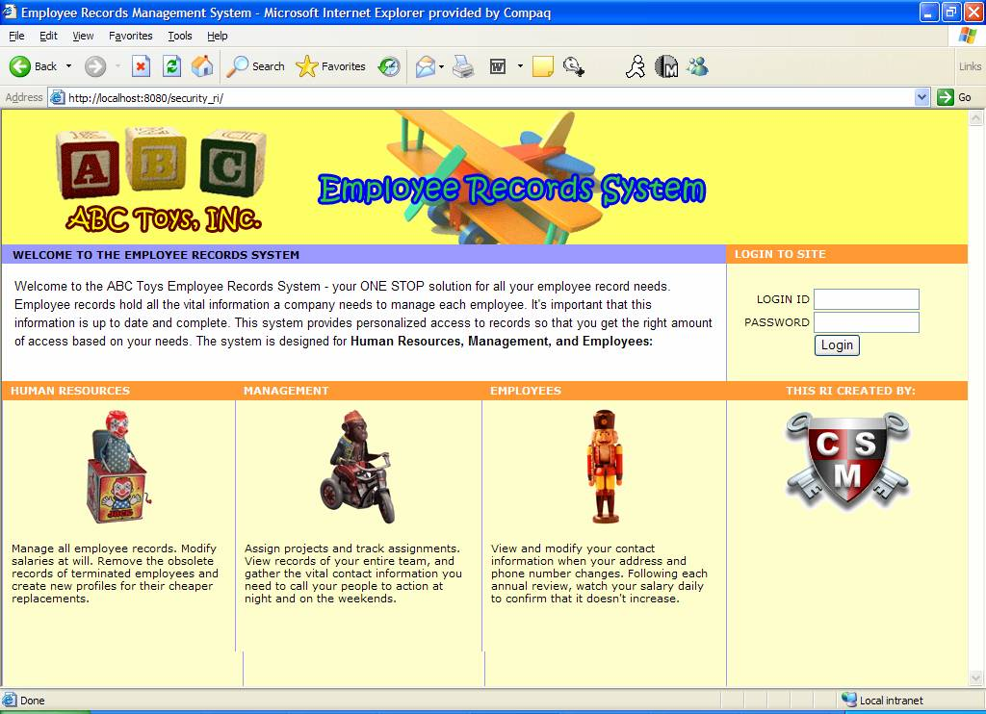
RI DEMO

Slide 24
Business Scenario Implementation
All Employees
  Login
  Search, View, Modify Records
    Depending on access rights
HR Manager
  Create an Employee Record
  Modify sensitive data
Technical/Biz. Dev. Managers
  Create and Assign a Project

Slide 25
CSM Best Practices
Use Data Source for connection pooling
Instantiate Authorization Manager once per application (singleton)
Use Standard Privileges
Do not instantiate or call CSM methods in loop

Slide 26
Project Documentation
Requirements and Design in EA
Test plans in EA
CSM Guide for application developers
  Multiple deployment models
  Configuration & Integration for Authentication and Authorization
  Authorization Meta data set up using web interface
Reference Implementation (RI)
  Full and working application that demonstrates how to use CSM functionality
    Documented business scenario (HR system)
    Demonstration of the implementation of these requirements using CSM
    Reference Implementation Guide
      With example code snippets
    Documented best practices for CSM
UPT user guide

Slide 27
Questions ?....

