Slide 1
CSM/UPT CLM/LLT
Build and Deployment Automation Training
June 2008

Slide 2
Build and Deployment Story
DEV Writes Code
QA Tests Code
Systems Promotes Tested Code
Systems/QA/Dev Verify STAGE/PROD
All Build Code
  Build every time from source
  Ability to build from a Subversion tag

Slide 3
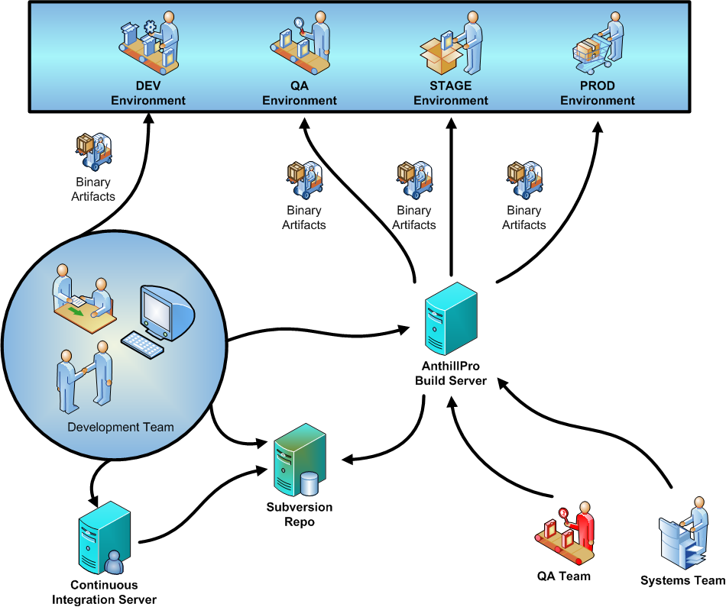

Slide 4
Build and Deployment Contexts
Local Install (Developer Workstation/CI)
Local Upgrade (Developer Workstation/CI)
Remote Install (NCI/AnthillPro)
Remote Upgrade (NCI/AnthillPro)
Installer Install (…sounds off) (Cancer Centers)
Installer Upgrade (Cancer Centers)

Slide 5
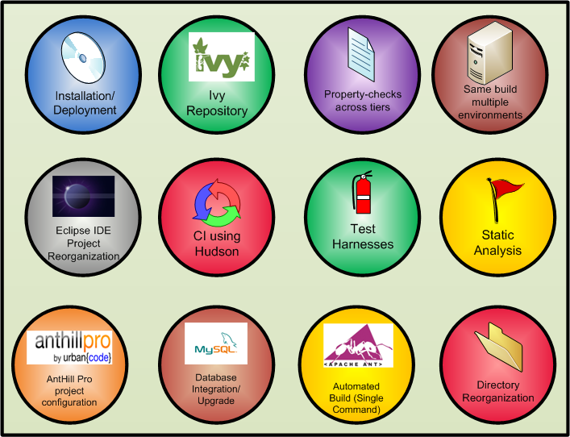
Features

Slide 6
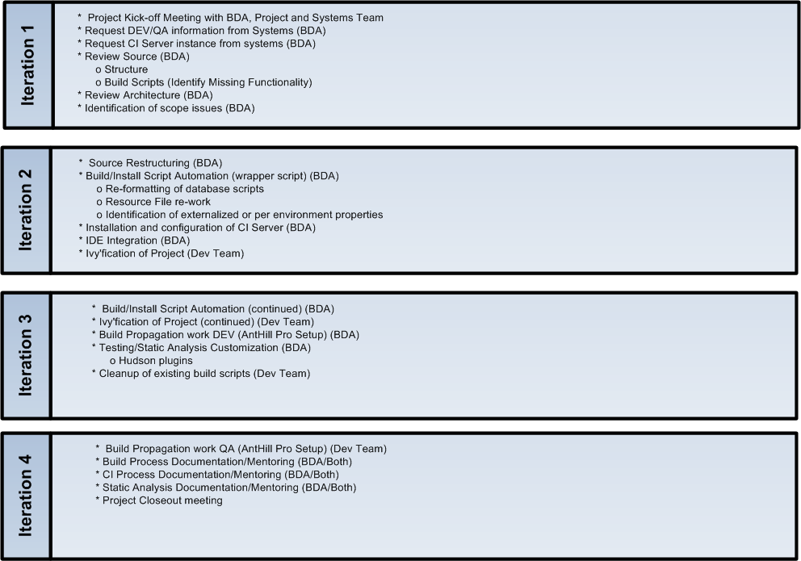


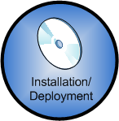

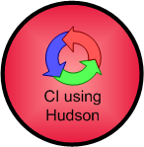
Iteration Plan

Slide 7
Project Details
Start – 6/17/2008
End – 7/11/2008
Wiki - https://wiki.nci.nih.gov/display/BuildandDeploymentAutomation/BDA+caIntegrator2+Project+Page

