Slide 1
Requirements For
CSM/CLM/CSM-SDK
Kunal Modi
Ekagra Software Technologies Ltd.
Notes:
Kalpesh

Slide 2
Agenda
GRID Requirements
  Overview
  New Grid Security Framework
  Authentication Requirements
    Problems Faced
    How CSM Can Help
    Authentication Architecture Diagram
    Advantages
  Authorization Requirements
    Problems Faced
    How CSM Can Help
    Authentication Architecture Diagram
    Advantages
Other CSM Requirements
  Authentication Web Service
  Accepting X.509 Certificate as credentails
  CSM SDK Requirements
  CLM Requirements
Notes:
Kalpesh

Slide 3
Overview
Requirements developed based on discussion with the OSU’s caGRID Team
Authentication Use Case based on the discussions held in the IMF Working Group and with caGRID Team
Authorization Requirements are provided by the caGRID Team
caGRID Team requested these changes if approved to be made available in line with caGRID 1.0 release
Notes:
Kalpesh

Slide 4
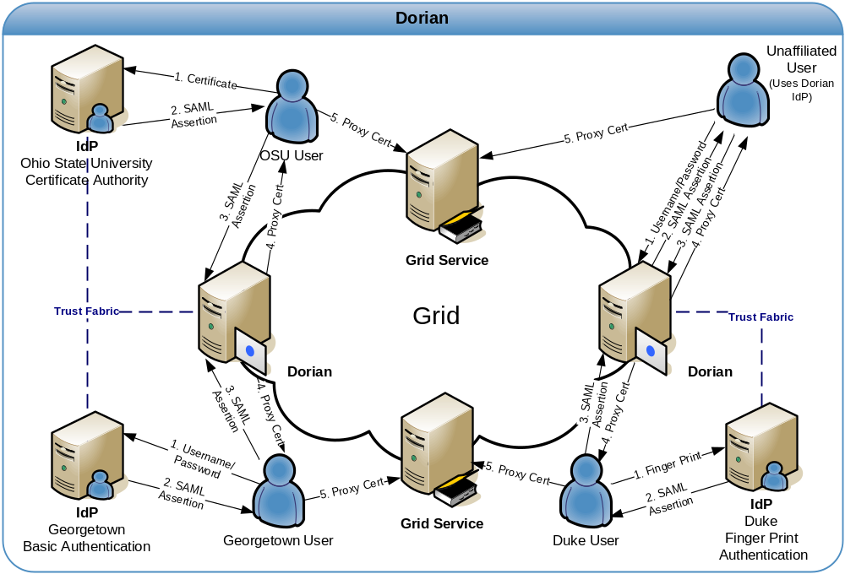
New GRID Authentication Framework
Notes:
Kalpesh

Slide 5
Authentication : Problems Faced
Applications have Existing Local Credential Providers (CPs)
  LDAP Based
    Non advanced to support SAML assertions
  RDBMS Based (majority)
    User Name and Password exists in tables
Applications hard wired to use the above
Additional Effort and Expertise needed to change
  To upgrade the CP to be SAML enabled
  To migrate the user info from old CPs to the new ones
  Formation of new Policy like password limitation
  Reprogramming all the applications to use new CP
Notes:
Kalpesh

Slide 6
Authentication: How CSM Can Help
CSM continues to provide Local Authentication
Act as a bridge between existing Authentication components and new GRID Authentication Framework
Following is the flow of event in the new proposed solution
  CSM Authentication Module can be used to authenticate against Local CPs like RDMBS, LDAP etc.
  Once authenticated, CSM can retrieve the attributes from a CP and form a JAAS Subject for the user based on mapping of CP attributes to Principals of the Subject
  Using another Mapping CSM can now generate a SAML message from this Subject
  CSM connects to Dorian on behalf of the application and perform the SAML assertion
  CSM obtains the Grid Proxy Certificate back and can return the same to the users
Notes:
Kalpesh

Slide 7

Authentication: Architecture Diag.
IdP
CSM Authentication
DORIAN
Proxy Certificate
DORIAN GRID Client
CP Interface
Username / Password
SAML
SAML
JAAS - SAML Mapping
Proxy Certificate
Existing Credential Provider
Subject
Username / Password
Attributes - JAAS Mapping
User Attributes

Slide 8
Authentication: Advantages of the Proposed Solution
Applications can continue to use their existing CPs. No Need to upgrade
No major code change required for developers or sys admins
Agnostic to the underlying caBIG Authentication technologies
Combination of existing CP and CSM would act as a trusted IDP on Grid
Avoids duplication of effort by using CSM to handle various CPs and be able to generate SAML Assertions
Only need to certify one standard solution to verify it is secured. Same solution can be used by all the applications
Fully configurable solution to be able to connect to various CPs, having different schema for storage of user attributes & credentials
Notes:
Kalpesh

Slide 9
Authorization: Problems Faced
Grid has no major component to support Authorization
Major effort will be required to develop authorization components like
  Authorization Storage System
  Authorization Provisioning System
  Authorization Runtime Decision System
Notes:
Kalpesh

Slide 10
Authorization: How CSM Can Help
Following two use cases have been provided by the caGRID Team
Use Case1: CSM to develop Custom PDP (Globus Component)
  This component is a part of the grid node
  It accepts a grid id for a user which is derived from the proxy grid certificate
  It uses this id to perform the local authorization for that grid node
  If the authorized, the user is granted access to perform the operation at that grid node
Use Case 2: To upgrade the caCORE generated systems to accept grid user id as user id’s for the purpose of Authentication and Authorization
  It accepts a grid id for a user which is derived from the proxy grid certificate
  It uses this id to perform the automated authorization for the caCORE like system
  If the authorized, the user is granted access to perform the operation at that grid node
Notes:
Vinay

Slide 11
Authorization: Use Case One Architecture Diagram
Proxy Cert.
User Provisioning Tool
OGSA-DAI Security
User Grid Id
Business Logic
Custom PDP
Common Authorization Scheme
CSM Auth. APIs
Grid Node

Slide 12
Authorization: Use Case Two Architecture Diagram
Proxy Cert.
User Provisioning Tool
OGSA-DAI Security
User Grid Id
Custom PDP
Common Authorization Scheme
caCORE SDK Generated System
Grid Node

Slide 13
Authorization: Advantages of the Proposed Solution
No need to develop separate authorization component for grid
Reuse of CSM’s Authorization Service
Provision of fine grained security through Authorization APIs
Web based Authorization schema authoring tool (UPT)
Fully automated components, doesn’t require any additional coding by the developers of individual grid node
Standard security framework which can be easily upgraded and modified
Notes:
Kalpesh

