Slide 1
CSM caGrid Integration
Kunal Modi
Ekagra Software Technologies Ltd.
Notes:
Kalpesh

Slide 2
Agenda
Overview
New Grid Security Framework
Authentication Requirements
  Problems Faced
  How CSM Can Help
  Authentication Architecture Diagram
  Advantages
Notes:
Kalpesh

Slide 3
Overview
Requirements developed based on discussion with the OSU’s caGrid Team
Authentication Use Case based on the discussions held in the IMF Working Group and with caGrid Team
caGrid Team requested these changes if approved to be made available in line with caGrid 1.0 release
Notes:
Kalpesh

Slide 4
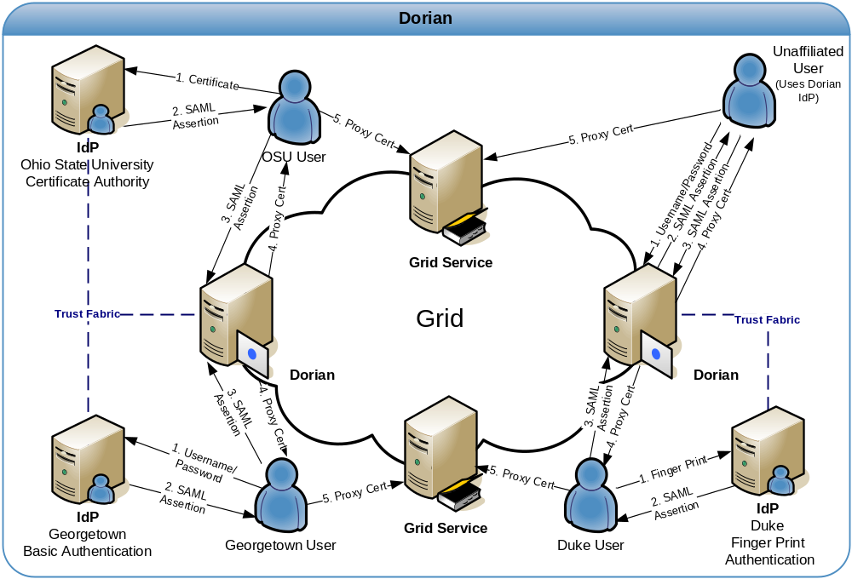
New GRID Authentication Framework
Notes:
Kalpesh

Slide 5
Authentication : Problems Faced
Applications have Existing Local Credential Providers (CPs)
  LDAP Based
    Non advanced to support SAML assertions
  RDBMS Based (majority)
    User Name and Password exists in tables
Applications hard wired to use the above
Additional Effort and Expertise needed to change
  To upgrade the CP to be SAML enabled
  To migrate the user info from old CPs to the new ones
  Formation of new Policy like password limitation
  Reprogramming all the applications to use new CP
Notes:
Kalpesh

Slide 6
How CSM Can Help
CSM continues to provide Local Authentication
Act as a bridge between existing Authentication components and new GRID Authentication Framework
Following is the flow of event in the new proposed solution
  CSM Authentication Module can be used to authenticate against Local CPs like RDMBS, LDAP etc.
  Once authenticated, CSM can retrieve the attributes from a CP and form a JAAS Subject for the user based on mapping of CP attributes to Principals of the Subject
  Using another Mapping CSM can now generate a SAML message from this Subject
  CSM connects to Dorian on behalf of the application and perform the SAML assertion
  CSM obtains the Grid Proxy Certificate back and can return the same to the users
Notes:
Kalpesh

Slide 7

Authentication: Architecture Diag.
IdP
CSM Based
Authentication
DORIAN
Proxy Certificate
DORIAN GRID Client
CSM API
CP Interface
Username / Password
SAML
SAML
JAAS - SAML Mapping
Proxy Certificate
Existing Credential Provider
Subject
Username/
Password
Attributes - JAAS Mapping
User Attributes

Slide 8
Advantages
Applications can continue to use their existing CPs. No Need to upgrade
No major code change required for developers or sys admins
Agnostic to the underlying caBIG Authentication technologies
Combination of existing CP and CSM would act as a trusted IDP on Grid
Avoids duplication of effort by using CSM to handle various CPs and be able to generate SAML Assertions
Only need to certify one standard solution to verify it is secured. Same solution can be used by all the applications
Fully configurable solution to be able to connect to various CPs, having different schema for storage of user attributes & credentials
Notes:
Kalpesh

Slide 9
Question & Answers
Thank You

