Slide 1
NCICB Common Security Module
CSM Overview Presentation

Slide 2
Agenda
Project Overview
Services Offered
Overall Architecture
Authentication
Authorization
User Provisioning Tool
Documentation Available
Notes:
Kalpesh

Slide 3
Project Overview – Motivation
Eliminate duplication of effort and resources
Standardized mechanism for common security needs
Compliance with emerging industry-wide security standards
Notes:
Kalpesh

Slide 4
Project Overview - Vision
Common Security Module (CSM) was perceived to provide a common infrastructure and mechanism to cater to security needs for all NCICB applications
To provide a easy to adapt and integrate module
To provide a module complying to latest industry security standards and technologies
Notes:
Kalpesh

Slide 5
Project Overview - Scope
Scope for CSM caCORE 3.1 release was decided in consensus with the SWG
CSM API jar (java archive)
  Authentication
  Authorization
User Provisioning Tool (web application)
  Provisioning of Authorization Data
Reference Implementation
Total 38 use cases!
Notes:
Mention that all the slides following this are based on this limited scope as decided in SWG meetings for caCore 3.0 release

Slide 6
CSM Approach
Open Source Technology – based on standard caCORE stack
Java Authentication and Authorization Service (JAAS)
  Standard Java APIs
Authentication
  Authentication against existing credential providers
  Easy integration with existing applications
Authorization
  Configurable granularity for protection
    Coarse or Fine-grained security
  Management of authorization meta model via UI
Reference Implementation

Slide 7
High Level Architecture for Phase I
Credential Providers
Application server
RDBMS
LDAP
Application XYZ
Authenticate
Common
Authorization
schema
JAAS
Authenticate
Authorize
Security module
Authorize
User
Provisioning
Web
interface
Web server
Application
server
User
Provisioning
application
Notes:
Vinay

Slide 8
CSM API Integration
Distributed in form of jar files
Minor coding required to integrate the API services
Easily configurable to be able to connect to the authorization database and authentication credential providers
Notes:
Kalpesh

Slide 9
Authentication Service
Verify user credentials against configured credential providers
JAAS based service
Currently supports RDBMS and LDAP/LDAPS based credential providers for authentication
Supports NCI e-directory
Notes:
Kalpesh

Slide 10
Authorization Service
What is Authorization?
Provides programmatic access to authorization schema
Web based tool to provision authorization metadata
Runtime Java API to control access based on the authorization metadata
Notes:
Kalpesh

Slide 11
Authorization Service – Concepts
Entities
  Application
  User
  Group
  Protection Element
  Protection Group
  Role
  Privilege
Notes:
Kalpesh

Slide 12












Authorization Model
JBoss
Csmapi.jar
Notes:
Kalpesh

Slide 13
Authorization Service – Security Types
User Based Security
Role/Group Based Security
Object Level Security
Attribute Level Security
Notes:
Kalpesh

Slide 14
Authorization Service Provided
Create Protection Elements
Assign Protection Elements to Protection Group
Assigning Owners to Protection Elements
Checking Access Permissions
Notes:
For further details refer to Javadocs

Slide 15
UPT - Authorization Data Provisioning
Web based tool to provision the authorization metadata for an application
Notes:
Kalpesh

Slide 16
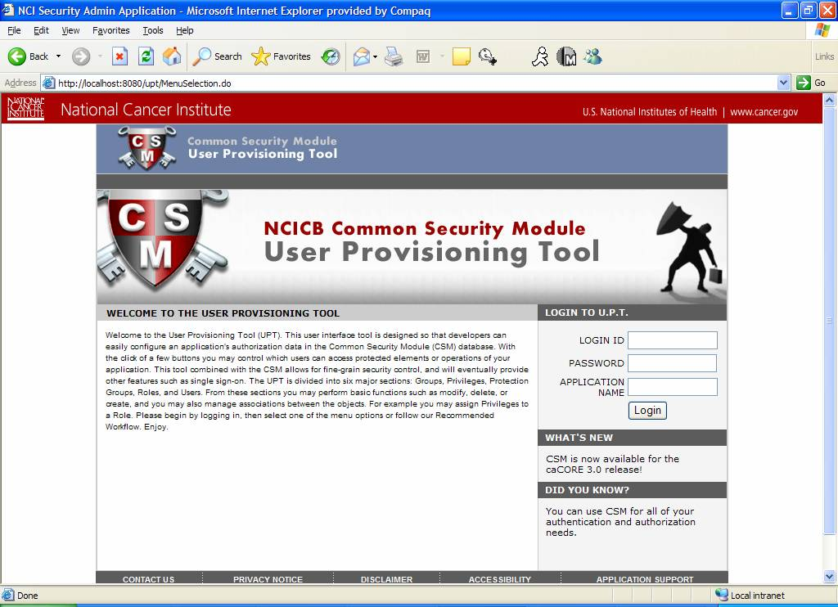
UPT Screen Shot
Notes:
Kalpesh

Slide 17
Project Documentation
Requirements and Design in EA
Test plans in EA
CSM Guide for application developers
  Multiple deployment models
  Configuration & Integration for Authentication
  Configuration & Integration for Authorization
  Authorization Meta data set up using web interface
UPT user guide

Slide 18
Questions ?....

