Slide 1
NCICB Common Security Module
3.2 Changes Presentation

Slide 2
CSM API 3.2 Enhancements
Core Authentication and Authorization Services Exposes as Web Services
Provisioning of Checking Authorization Permission at Group Level
Caching of Authorization Policy for User and Group to save database trip at the time of checking permission

Slide 3
CSM API 3.2 Enhancements
Securing Web Services and HTTP Interface (getHTML & getXML) using the existing CSM SDK Security
Integration with caGRID project, provided methods to retrieve attributes of a user from the Credential Providers

Slide 4
CSM API 3.2 Out of Scope
Linking of the User to Application

Slide 5
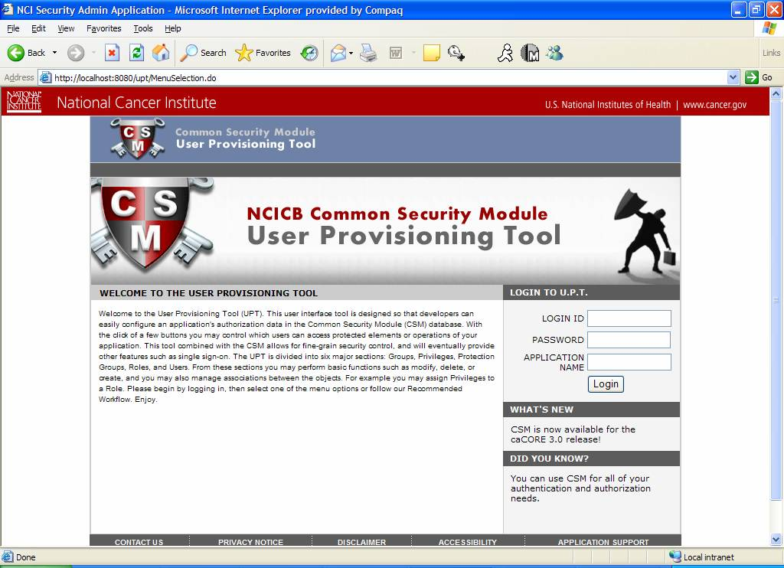
UPT Demo

Slide 6
UPT 3.2 Enhancements
Easy installation of UPT
  Needs a DataSource Entry
  Needs a JAAS Entry
Ability to specify database parameters for new application
    Before adding a new application needs config files changes to be performed by system
    Now UPT Admin can add new application on the fly and connect to its Authorization Database

Slide 7
UPT 3.2 Enhancements contd…
Search Results are sorted
Password are stored encrypted whenever added or modified from UPT
PE Type is provided to help organize PE’s of same type

Slide 8
UPT 3.2 Enhancements contd…
All the association screens now come equipped with intermediate search screens
Added new ability to associate multiple Users to a Group

Slide 9
UPT 3.2 Enhancements contd…
Other minor items like…
  Enter key works on all the pages
  Focus is set on appropriate field on load
  Bug fixes

Slide 10
Questions ?....

