Slide 1
NCICB Common Security Module
UPT Presentation
06/15/2005

Slide 2
Modes
Two Modes
  Super Admin
  Admin
Notes:
Super Admin –can add applications and assign application administrators
Admin. – where application admins perform user provisioning for a particular entity

Slide 3
Super Admin Functionality
Register a new Application
Create a new User
Associate a User as an Admin for that particular Application

Slide 4
Admin Functionality
Perform CRUD operations on entities
Search for and retrieve a particular entity
Group entities
Associate various entities to form an authorization relationship
Notes:
Group the entities – assign users to groups, roles to privileges, etc.

Slide 5
Login
Data needed for Login
  NCICB User Name
  Password
  Application Name

Slide 6
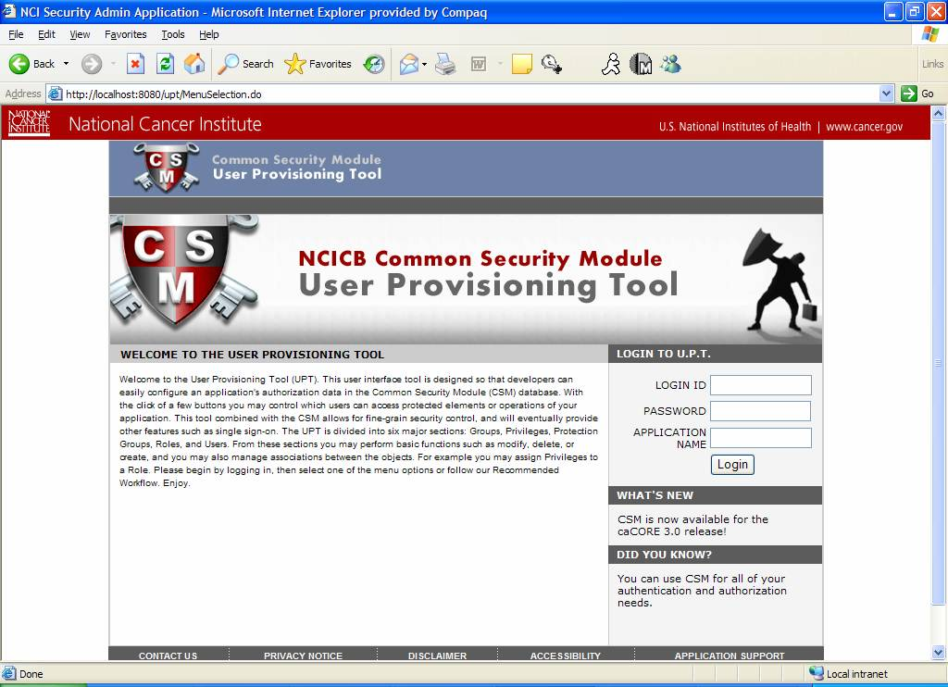
UPT Demo

Slide 7
3.0.1 Changes
Standard Privileges
Privilege functions moved to Super Admin mode
Reporting
  Protection Elements
  Privileges

Slide 8
Questions ?....

