Slide 1
CSM-SDK Adapter
Architecture Overview
caBIG Architecture Meeting
August, 2005
National Cancer Institute
Center for Bioinformatics

Slide 2
Outline
Motivation
Architectural Solution
  Remoting
  Security
  Session Management
  Writeable APIs
The Big Picture
Class Diagram
Components
A Different Outlook
Further Reading

Slide 3
Motivation
Provide more features to SDK users
  Authentication
  Access control for domain objects (authorization)
  User Provisioning
  Session management and tracking users on the server
  Writable APIs for the domain objects
Promote common security practices
Leverage existing NCICB CSM solution

Slide 4
Architectural Solution

Slide 5
Components
Remoting
Security
Session Management
Writeable APIs

Slide 6
Remoting
Spring Framework
HTTPClient
Proven Solution
Open Source

Slide 7
Security
Leverage NCI’s existing CSM
  Authentication
  Authorization
  User Provisioning

Slide 8
Session Management
Session Management on Server
Avoid repeated authentication for every call

Slide 9
Writeable APIs
Writeable APIs used to perform CRUD operations on domain objects
APIs neutral to domain specifics

Slide 10
The BIG Picture
Blocks for Managing User Session and Security
User
Session
Security
&
User
Session
Application
Service
Interface
Application
Service
Interface
Specific
Implementation
Hidden from User

Slide 11
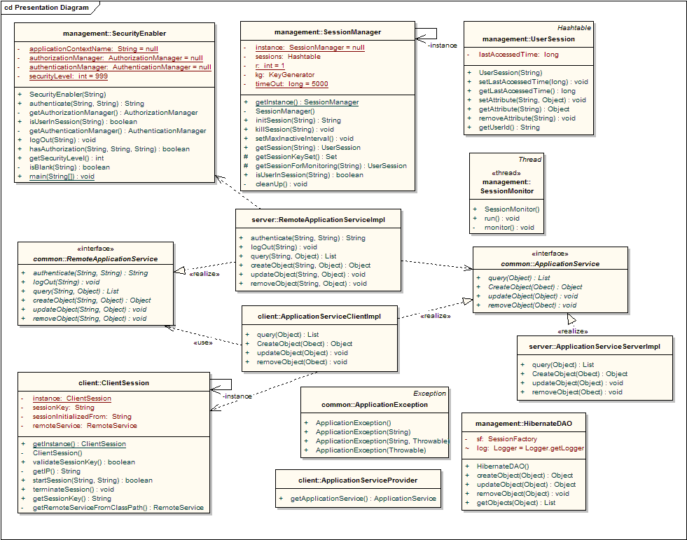
CSM-SDK Adapter - Architecture

Slide 12
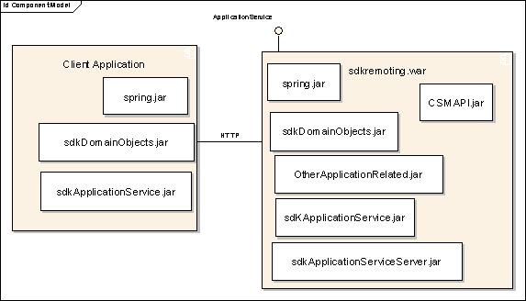
Components

Slide 13
A Different Outlook
Not specific to SDK-generated applications
Can be used with any application service

Slide 14
Questions?

Slide 15
Further Reading
caCORE SDK Programmer’s Guide
  ftp://ftp1.nci.nih.gov/pub/cacore/SDK/caCORE_SDK1.0_Programmers_Guide.pdf
caCORE Technical Guide
  ftp://ftp1.nci.nih.gov/pub/cacore/caCORE2.0_Tech_Guide.pdf
  ftp://ftp1.nci.nih.gov/pub/cacore/caCORE3.0_Tech_Supp.pdf
caCORE SDK and CSM Web site
  http://ncicb.nci.nih.gov/core/SDK
  http://ncicb.nci.nih.gov/core/CSM

