Slide 1
caLIMS2: a caBIG™ compliant laboratory information management system
Bob Clifford, Jenny Kelley & Sashi Thangaraj
October 08, 2007

Slide 2
Outline
Why caLIMS2?
Design principles
Core modules
caLIMS2 version 0.5 milestone 1
Ongoing work
caLIMS2 consortium

Slide 3





Open Source
Notes:
caLIMS2: An Overview
caLIMS2v2.4_28May08.ppt

Slide 4




Integration with caBIGTM
caLIMS2 fills the gap between specimen repositories and analytical tools in the caGRID.
Clinical Trial Services
CT Bundle
Analytical Services
GenePattern, geWorkbench
DB
caGRID
DB
LIMS Services
caLIMS2
Data Repository Services
caArray, caGWAS
Sample Repository
caTissue Suite
DB
DB
DB
File System
Notes:
caLIMS2: An Overview
caLIMS2v2.4_28May08.ppt

Slide 5
Customization
caLIMS2 has a modular design that allows the addition of custom objects to provide expanded, lab-specific functionality.
Examples:
new equipment interfaces
new sample types
Notes:
caLIMS2: An Overview
caLIMS2v2.4_28May08.ppt

Slide 6
Advanced Features
Fine-grained security management (CSM)
FileTransporter tool
Workflow management – import standard workflows
Customizable UI
Metadata management
Notes:
caLIMS2: An Overview
caLIMS2v2.4_28May08.ppt

Slide 7

FileTransporter Based on caAdapter
Major Steps involved to convert Format1 to Format2.
Design Source Specification of Format 1 (from format)
Design Target Specification of Format 2 (to format)
Map Format1 elements to Format2 elements
Execute
SOURCE
TARGET
FORMAT 1
FORMAT 2
Target
Specification
Source Specification
Data Base Tables
Notes:
caLIMS2: An Overview
caLIMS2v2.4_28May08.ppt

Slide 8

Cost
Notes:
caLIMS2: An Overview
caLIMS2v2.4_28May08.ppt

Slide 9
Targeted Users
Laboratories seeking a reliable, cost effective caBIGTM compliant LIMS that does not require a large IT resource to implement and maintain:
  Basic research laboratory
  Core facility
  Clinical research laboratory
  Public health laboratory
  BIG-Health disease research laboratory
Notes:
caLIMS2: An Overview
caLIMS2v2.4_28May08.ppt

Slide 10
Design Principles
Model Driven Architecture (roundtrip UML artifacts)
Service Oriented Architecture
caBIGTM compliant (silver/gold)
Semantically (caDSR/EVS), syntactically interoperable with well defined APIs
Security - caBIGTM CSM/UPT
Reuse of existing caBIGTM tools / functionalities / components
Workflow management – import standard workflows
Platform independence
Ease of installation and customization
Usability standards based UIs
Notes:
caLIMS2: An Overview
caLIMS2v2.4_28May08.ppt

Slide 11
caLIMS2 - Major Components
caLIMS2 System
Administration
Workflow
Analysis
LogIn
Lab
Personnel
Equipment
Project
Assay
Analytical Assay
Message
NC
Barcode
CR/Billing
Lab Procedure
Analytical Tool
Analytical Tool
Unit
File Transporter
Metadata
Run
Reaction
Workflow
Analytical Assay
Schedule Analysis
Inventory
Containers
Reagents
Process
Lab Supplies
Schedule Analysis
Aliquots
Working Stocks
Activity
Approval
Orders
Specimens
Transition
Report
Approval
Query
Search
Report
Summary
Common classes: Audit (dateCreated, dateModified, createdBy, modifiedBy), Status, Type, Document, File, FileExtension, FileFormatSpecification, Notes, SOP, EnvironmentalCondition, Task, Criterion, Parameter, ExternalIdentifier, NamingConvention, Word, Safety.
Notes:
caLIMS2: An Overview
caLIMS2v2.4_28May08.ppt

Slide 12
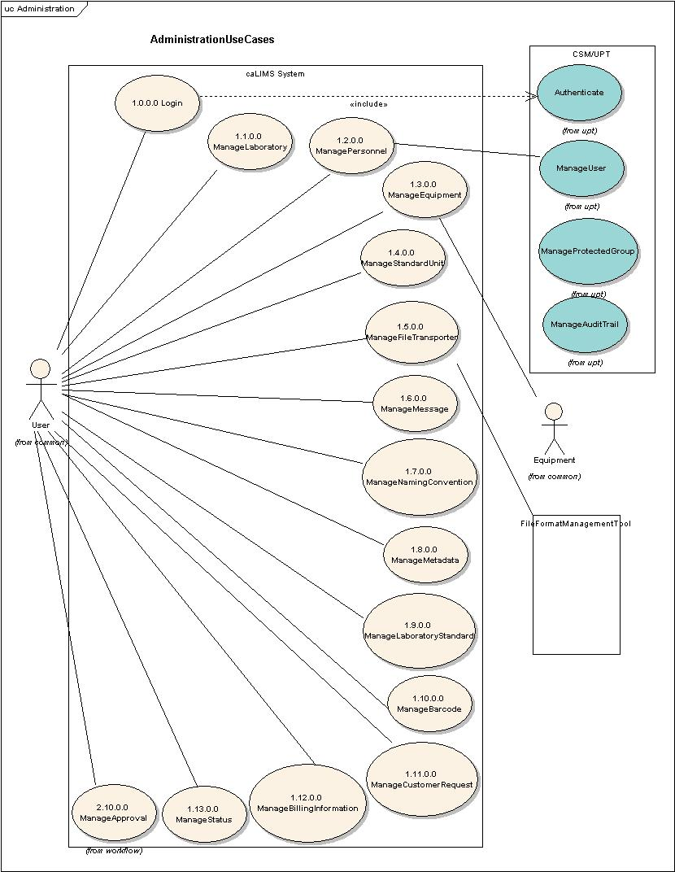
Administration Module
Administration:
*Login
*Lab
*Equipment
*Personnel
*Units
Message
*FileTransporter
*MetaData
*Naming Convention
Barcodes
Billing
Customer Request
*Status
*included in beta 0.5 release
Notes:
caLIMS2: An Overview
caLIMS2v2.4_28May08.ppt

Slide 13
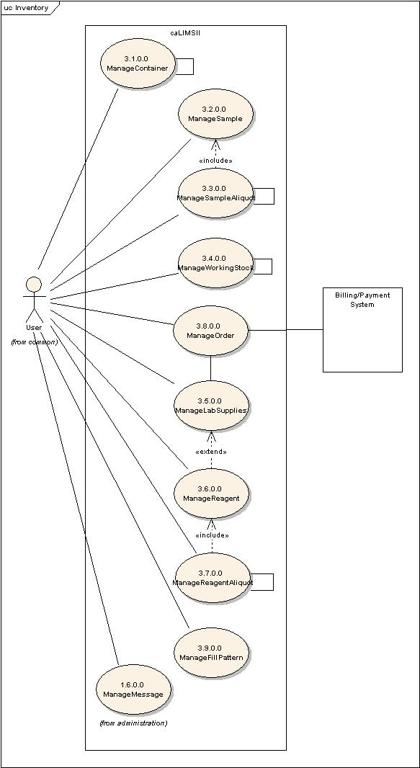
Inventory Module
Inventory:
*Container
*Specimen (sample)
*SampleAliquot
*FillPattern
*Working Stock Reagent
ReagentAliquot
Lab Supplies
Orders
*included in beta 0.5 release
Notes:
caLIMS2: An Overview
caLIMS2v2.4_28May08.ppt

Slide 14
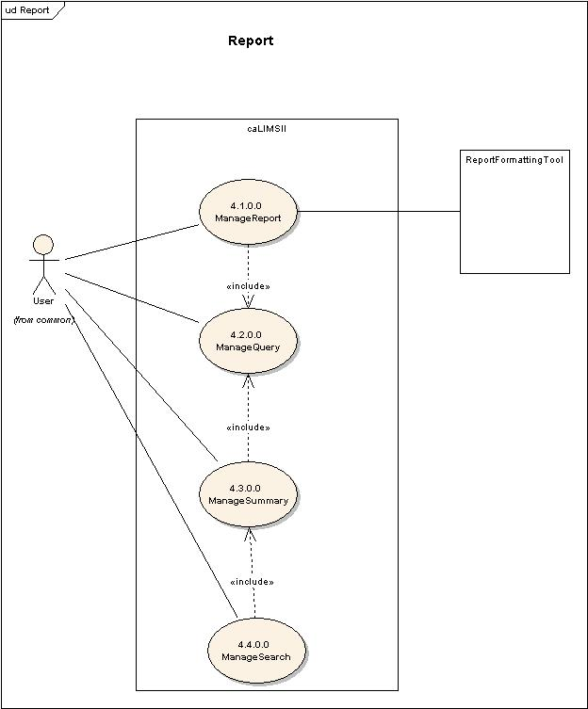
Report Module
Report:
*Report
*Query
*Search
*Summary
*included in beta 0.5 release
Notes:
caLIMS2: An Overview
caLIMS2v2.4_28May08.ppt

Slide 15
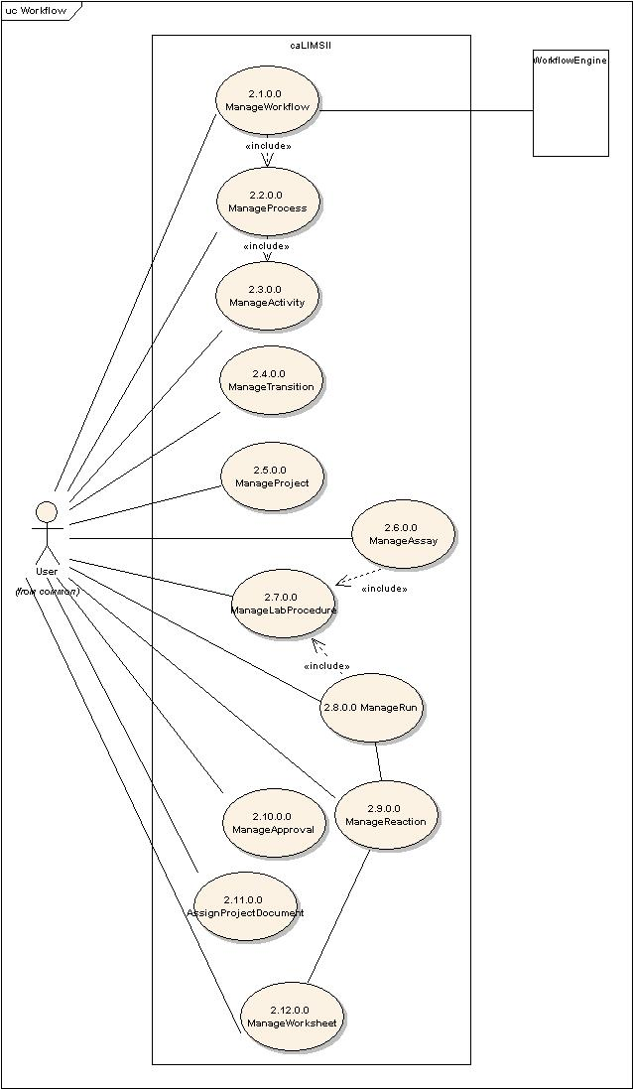
Workflow Module
Workflow:
Workflow
Process
Activity
Transition
Project
Assay
Lab Procedure
Run
Reaction
Project Document
Approval
Worksheet
Not included in beta 0.5 release
Notes:
caLIMS2: An Overview
caLIMS2v2.4_28May08.ppt

Slide 16
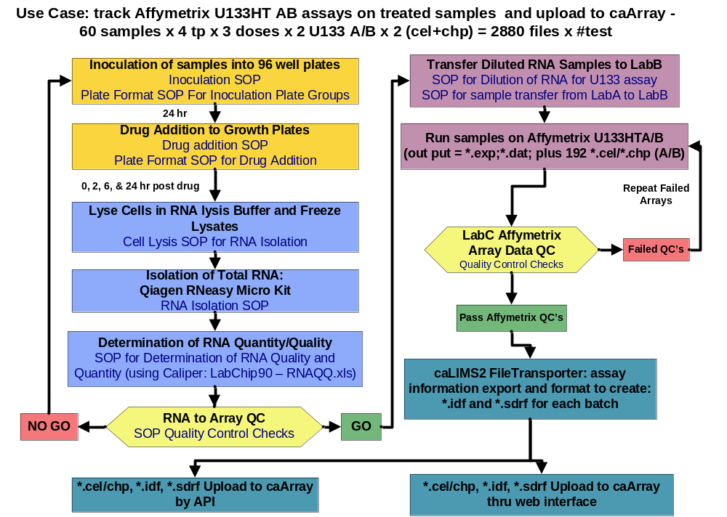
Workflow Example Involving caArray
Notes:
caLIMS2: An Overview
caLIMS2v2.4_28May08.ppt

Slide 17
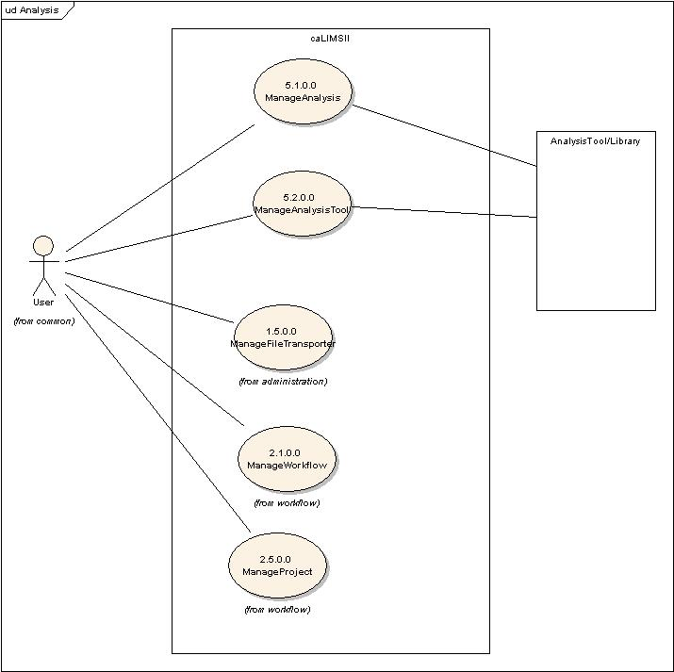
Analysis Module
Analysis:
Analysis
Analysis Tools
(Workflow)
(Project)
(File Transporter)
(Approval)
Not included in beta 0.5 release
Notes:
caLIMS2: An Overview
caLIMS2v2.4_28May08.ppt

Slide 18
Current caLIMS2 Status
Use Case design phase completed
OM or Class design for beta 0.5 release completed and registered in caDSR
Data Model for beta 0.5 release completed
Coding for beta 0.5 release (includes core system and specimen management) completed
Beta 0.5 milestone 1 release with Java APIs/web services and a very basic web UI available in October
Notes:
caLIMS2: An Overview
caLIMS2v2.4_28May08.ppt

Slide 19
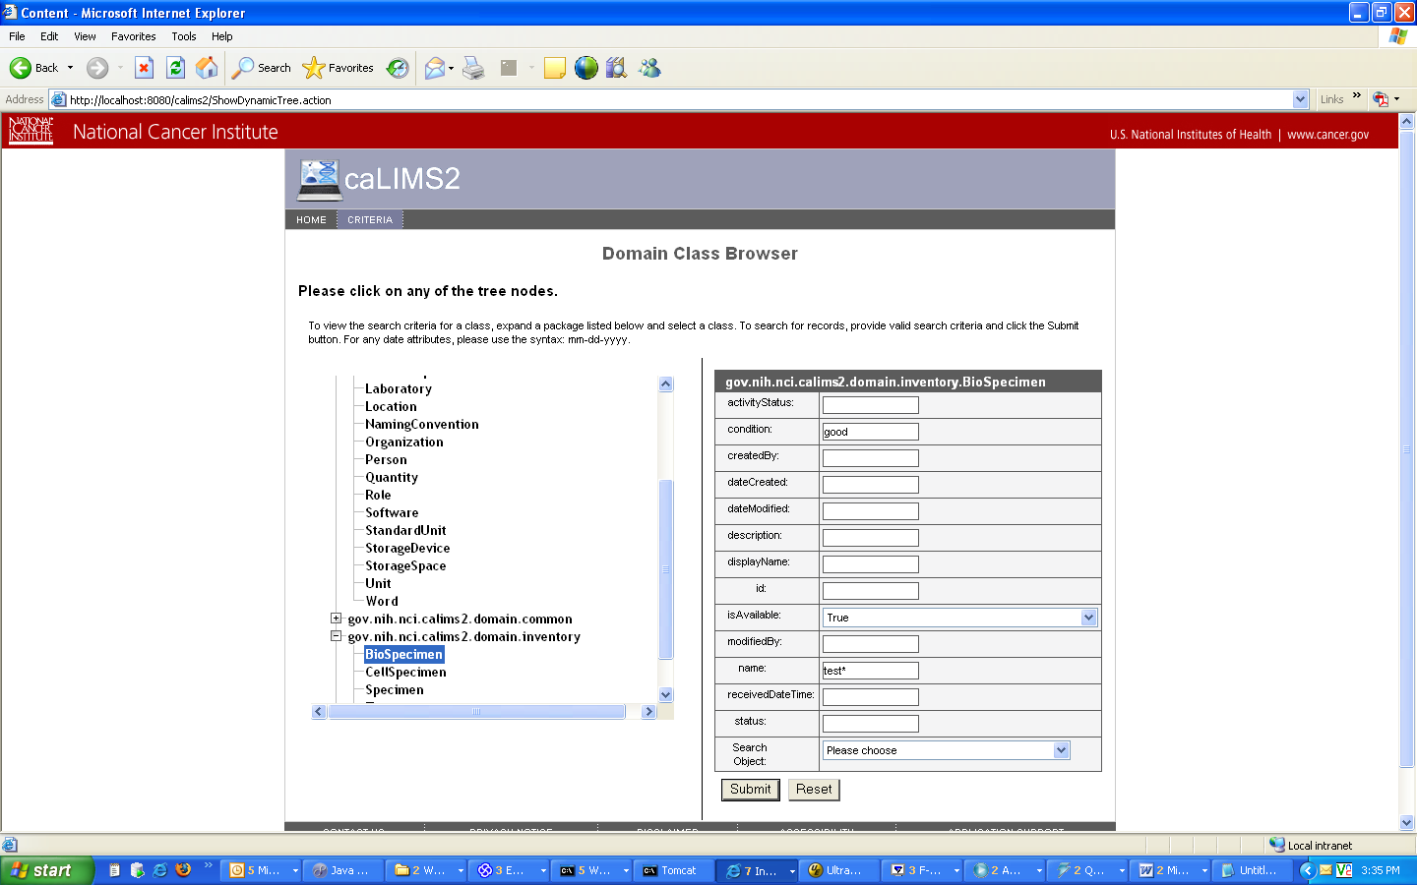
caLIMS2 Application
Notes:
caLIMS2: An Overview
caLIMS2v2.4_28May08.ppt

Slide 20
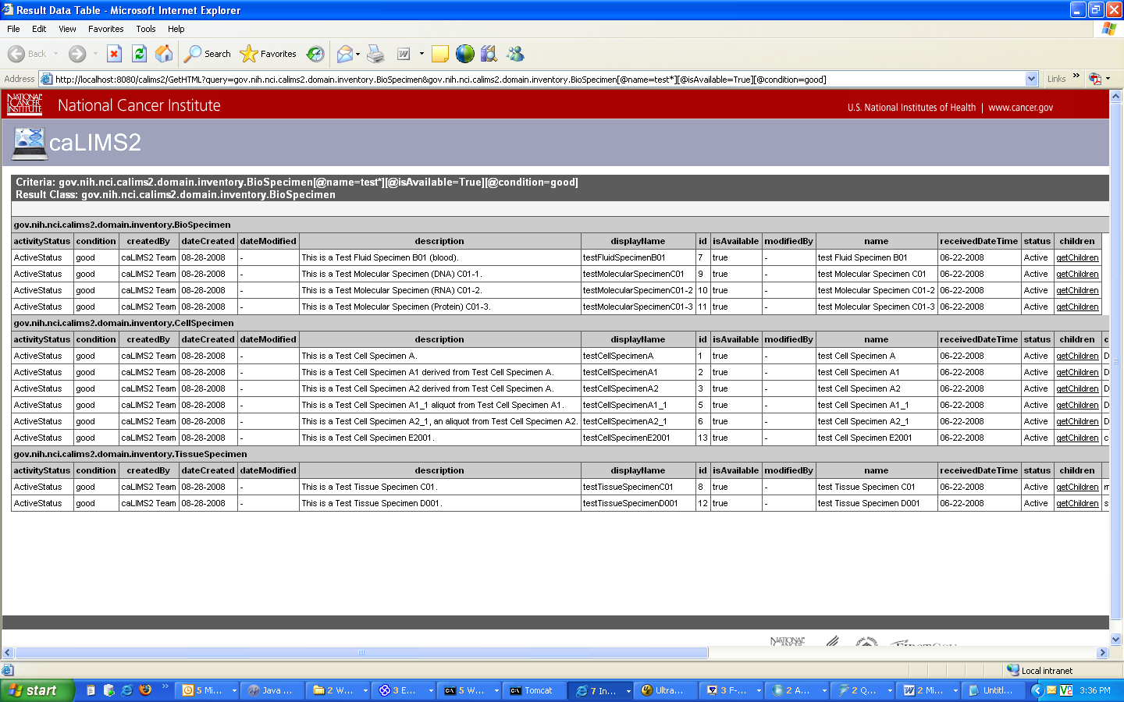
Search Result
Notes:
caLIMS2: An Overview
caLIMS2v2.4_28May08.ppt

Slide 21
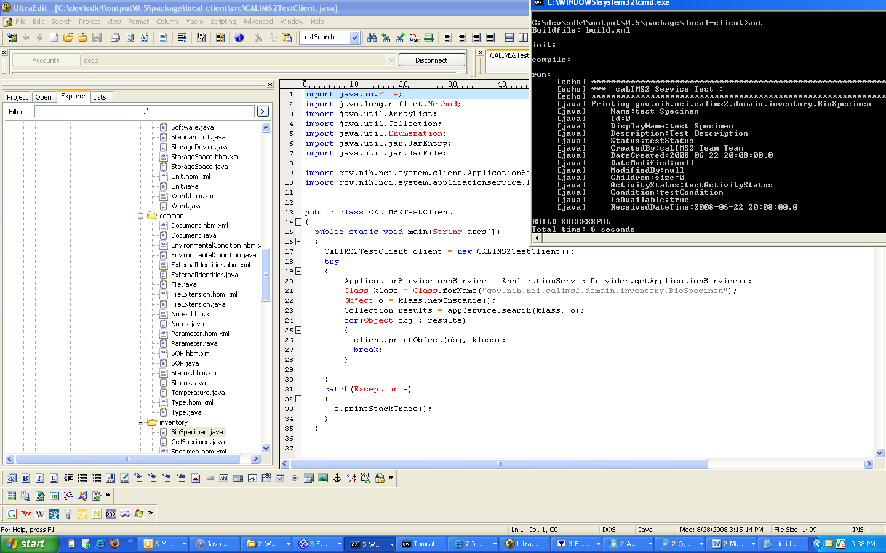
Service Test Client (Java)
Notes:
caLIMS2: An Overview
caLIMS2v2.4_28May08.ppt

Slide 22
Ongoing Work
Class design of remaining classes for the version 1.0 application
Optimization and normalization of the Data Model for the beta 0.5 milestone 1 release as the application is tested
Business logic coding
UI logic coding
UI coding
Notes:
caLIMS2: An Overview
caLIMS2v2.4_28May08.ppt

Slide 23
caLIMS2 Consortium
Laboratory of Population Genetics
CBIIT
Arizona Research Laboratories
Minnesota Public Health Laboratory (APHL/PHL)
Laboratory of Molecular Technology (NCI-Frederick)
Dana Farber Cancer Institute
caNanoLab (NCL/SAIC)
NCI / TMEN
Minnesota Supercomputing Institute
Notes:
caLIMS2: An Overview
caLIMS2v2.4_28May08.ppt

Slide 24
Communication
caLIMS2 project site:
http://gforge.nci.nih.gov/projects/calims2
https://wiki.nci.nih.gov/display/ICR/caLIMS2
NCICB LIMS Consortium LISTSERV:
https://list.nih.gov/archives/nci-lims-consortium.html
Web based design artifacts
http://lpgws.nci.nih.gov/calims2/index.htm
Contacts:
  Bob Clifford: clifforr@mail.nih.gov
  Jenny Kelley: kelleyj@mail.nih.gov
Notes:
caLIMS2: An Overview
caLIMS2v2.4_28May08.ppt

Slide 25
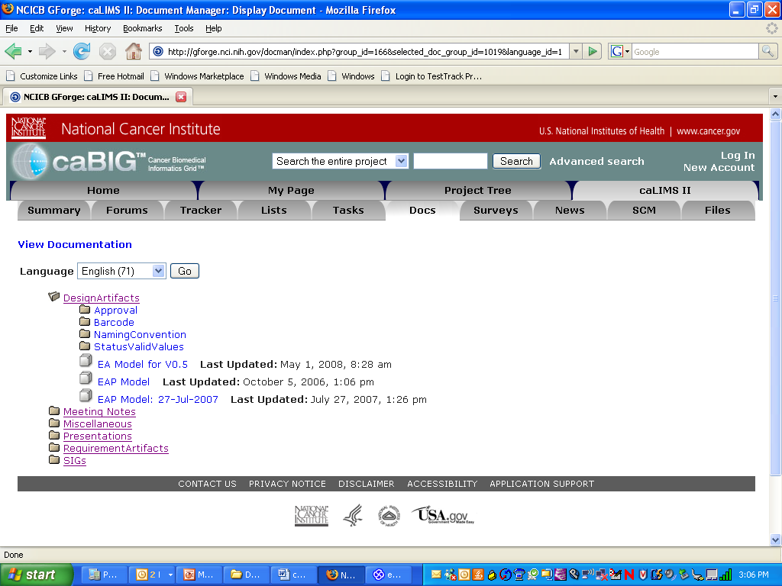
caLIMS2 gForge site
Notes:
caLIMS2: An Overview
caLIMS2v2.4_28May08.ppt

Slide 26
Questions?
Notes:
caLIMS2: An Overview
caLIMS2v2.4_28May08.ppt

