Slide 1
CTB app trigger
User apply an account
New record in auth_user
account_emailaddress and verified =0
Email user of validation link
User click URL to verify
accounts_passwordexpiration
account_emailaddress.verified=1
Cron trigger
Admin trigger
Cronjob run hourly
Check password expiration day =
current date + 14: first warn
current date + 2: second warn
current date: expiration notice
Compare last-login to current date:
=2 second warn
=10 first warn;
=60: inactive notice
check pending account: If verified=1 but auth_user_groups does not have this user id
trigger notification email
Dear xiaozheng.yao@nih.gov, Your CTB account password will expire on 2024-08-09 (14 days from today). Please visit our website to change your password before it expires, to ensure uninterrupted access. To access this webpage you must know your username and current password. Your new password will expire in 120 days after you change it. If you need assistance with your login then please email us at ctbWebAdmin@mail.nih.gov. Sincerely, Chernobyl Tissue Bank Team
Dear xiaozheng.yao@nih.gov, Your CTB account shows that you had no activity for a long time, and will expire on 2024-07-26 (1 days from today). Please visit our website and login to your account before it expires, to ensure uninterrupted access. Any account that has not been logged in for 60 days or longer will become deactivated, but any stored information with the account will not be lost. Once the account is deactivated, you will need to contact us to re-atviate your account. If you need assistance with your login then please email us at ctbWebAdmin@mail.nih.gov. Sincerely, Chernobyl Tissue Bank Team
This is an email to inform you that there is 1 new CTB account which is in pending status: User account email: xiaoz.yao@gmail.com Please evaluate the account above and inform the CTB Web team whether to approve or disapprove it. A user will not be able to access the biorepository until the account is approved. A disapproved account will be deactivated, and cannot be reused again without an admin's assistance. CTB Web Team
Dear xiaozheng.yao@nih.gov, Your CTB account password has been expired. Please visit our website to change your password in order to access the Biosample Search Facility. To access this webpage you must know your username and current password. If you need assistance, please email us at ctbWebAdmin@mail.nih.gov. Sincerely, Chernobyl Tissue Bank Team
Dear xiaozheng.yao@nih.gov, Your CTB account has been deactivated due to 60 days of inactivity. Please contact ctbWebAdmin@mail.nih.gov in order to reactivate your account. If you would like more information regarding CTB policies on account deactivation, please contact ctbWebAdmin@mail.nih.gov. Sincerely, Chernobyl Tissue Bank Team
Admin call account approval_stat to approve or not
auth_user_groups will be updated
Send email about approve or not

Slide 2
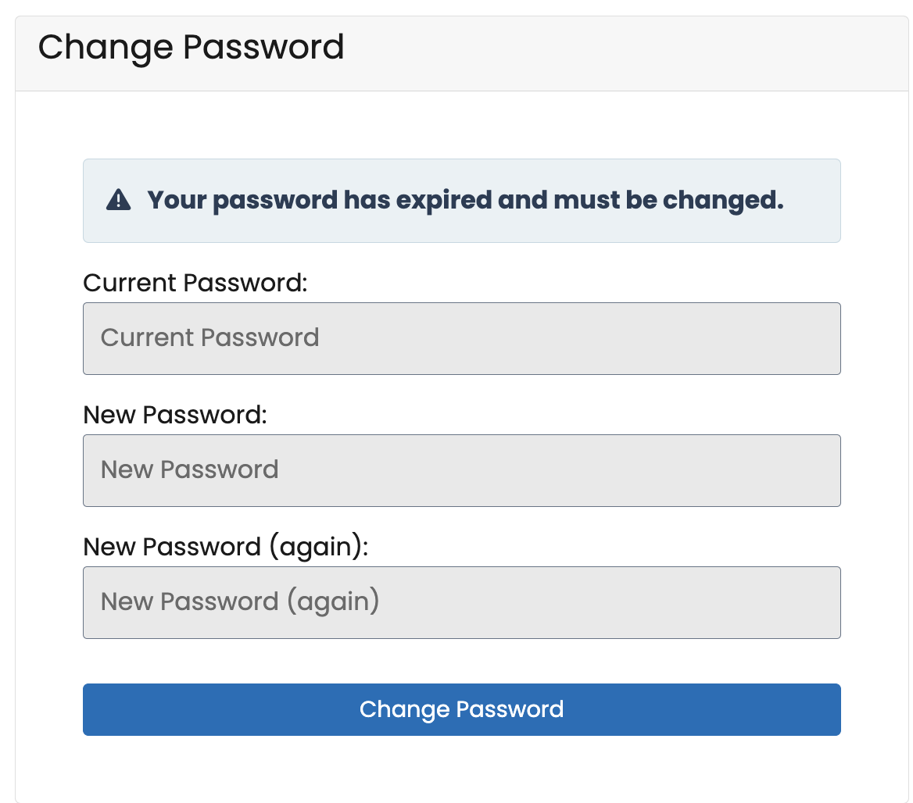
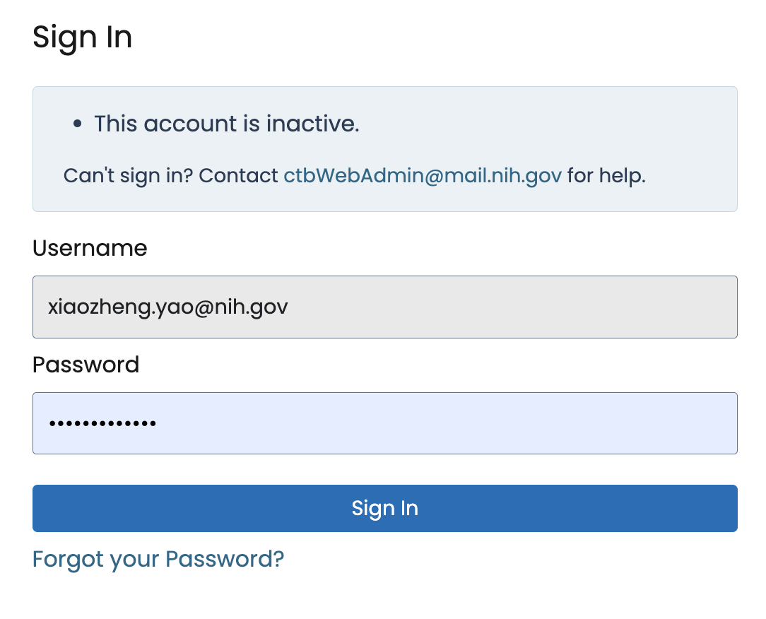
If password expire, when user login with old password:
If account inactivated, when user login with password:
Admin need to run this command to activate account.
After activated user can use previous password to login
UPDATE auth_user SET last_login = CURRENT_TIMESTAMP(6), is_active = 1 WHERE username = ”xiaozheng.yao";

