Slide 1

caIntegrator:
Building a robust translational research framework for cancer clinical studies

Slide 2
Agenda
What is this about
Architecture
webGenome Integration
Analytic Server
Information models
  Domain Model
  APIs
  Data Model

Slide 3
What is it about: Background
Rembrandt
  REpository of Molecular BRAin Neoplasia DaTa
  Glioma molecular diagnostic Initiative
  Enable biologically-meaningful histopathological classification of tumors (based on patient’s genomic profiles)
  Facilitate cross platform validation of markers
I-SPY
  Investigation of Serial Studies to Predict Your Therapeutic Response with Imaging And moLecular analysis
  Stage III Breast Carcinoma therapeutic trial
  Capture the biomarkers that predict response to therapy throughout the course of the cancer treatment cycle
  Accelerate our ability to find meaningful robust biomarkers

Slide 4
What is this about: Project vision
Generic biomedical integrative informatics platform
  To build a caBIG-compatible generic framework that allows retrieval and transformation of data from a variety of heterogeneous data sources that house microarray, genomic, tissue array, imaging and clinical data
User-centric, high-performance search, retrieval and analysis platform for translational data:
  To build an analytical tool that allows Clinician /Scientists/Biostatisticians to conduct translational analysis of study specific data in a user friendly manner.
  caIntegrator-derived applications: Rembrandt, ISPY, CGEMS, DCEG/EAGLE, (Future: ALL CTEP/OCG study)

Slide 5
caIntegrator usage scenarios
An investigator is interested in looking at a Heatmap of gene expression in normal vs. tumor tissue samples annotated with corresponding survival rates from adenocarcinoma male cases, age 50 or younger, who have a mutation in the EGFR gene, ubiquitin level higher than median in serum, and had smoked more than 20 cigarettes per day for >10 years and have low depression scores?
Find the top differentially expressing genes between good vs poor survival outcome groups from Brain tumor clinical study
Show a PCA graph for DCIS breast cancer samples and annotate the samples by the change in longest diameter from correlative MR imaging study
Select [pre-computed] genotype summaries from the Illumina HumanHapMap bead array, CGEMS SNP id, dbSNP id, genomic locus, and any gene features that include the locus for genotype summaries that show a significant difference [user-supplied P-value] between two populations [for example, normal and advanced disease] for a given study [for example, prostate cancer study]. A genotype summary for a probed locus contains the frequency for each genotype (AA/Aa/aa) in the population and a measure of significance.

Slide 6
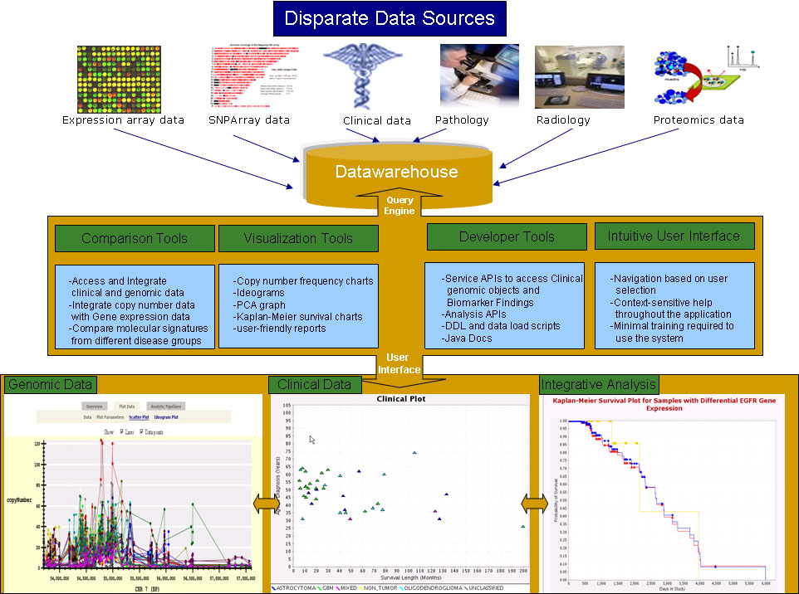
Data Integration via caIntegrator

Slide 7
caIntegrator Architecture
Build a framework with the infrastructural components needed to develop enterprise level translational applications such as Rembrandt and I-SPY
Guiding principles :
  Driven by user requirements
  User-friendly for a wide range of audience (physician scientists, programmers, statisticians)
  Standards-based and pattern-driven
  Extensible and scalable
  Reuse/extend existing open-source technologies
  Goal: caBIG silver-level compatibility

Slide 8
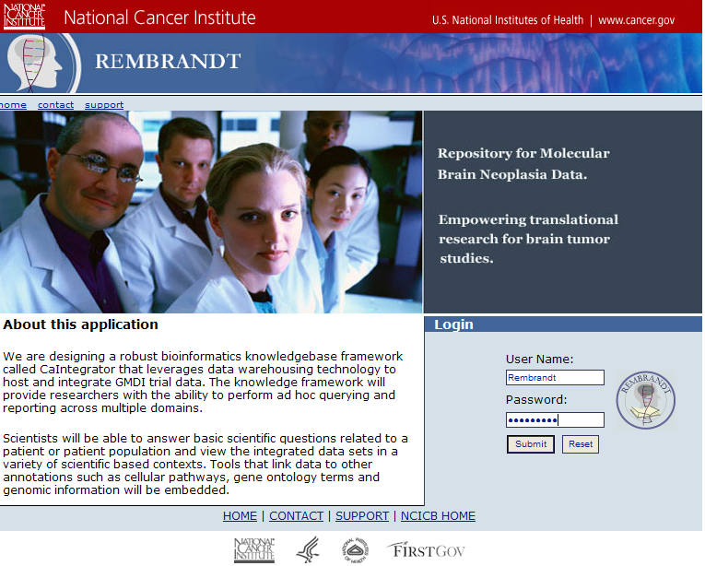
DEMO

Slide 9
Groundwork for a robust translational research framework: Evolution of caIntegrator
Challenge: Lay the foundation for a clinical genomic framework that…
  Integrates Clinical data with Experimental data
  Provide researchers with the ability to perform complex ad hoc querying, real time analysis and reporting across multiple domains.
  Generic enough to support other similar clinical genomic studies

Slide 10

caIntegrator Architecture – release 1.0
PRESENTATION
TIER
BUSINESS TIER
DATABASE/
ANALYSIS
TIER
WEB
SERVER
(JBoss /Tomcat)
Service Layer
BROWSER
Query Builder
(Struts)
Findings Factory
Analysis server
DTOs
Report Generation
(XML/XSL)
Business Cache (ECHACHE)
JMS
(Asynchronous)
R
INTERNET
Security Manager (CSM)
R-Binary
Asynchronous Updates
(AJAX)
DOs
Analysis Server Client Manager
(JMS Node)
Presentation Cache (ECHACHE)
Multi-Threaded Query Service (OJB)
WebGemone
App state
caIntegrator dB
BioAssay DTOs
BIOAssay Service
EJB Container

Slide 11
caIntegrator Architecture Highlights– release 1.0
N – tiered Architecture (J2EE)
Rich user friendly web tier (Struts, XML/XSL, AJAX)
Clinical-Genomics Service layer that handles both fine and coarse grained, strong typed objects
Scalable Run Time Analysis Service (JMS/R-Server/ R-Binary)
High Performance Query Service (Multi-threaded Query processing/ Hybrid Star Schema)
Remote interface with WebGenome (EJB)

Slide 12
WebGenome Integration
Visualize complex query results in graphical plots
Allows co-visualization of different datatypes (expression, copy number, LOH)
Zoom-in, Zoom out functionality across the genome
Frequency Plots, Ideograms (this phase)

Slide 13
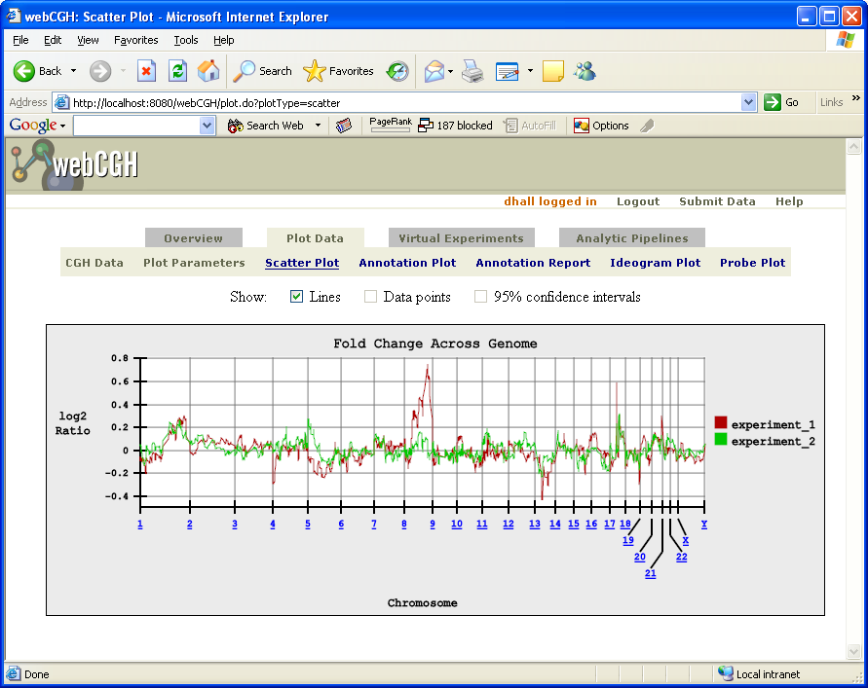
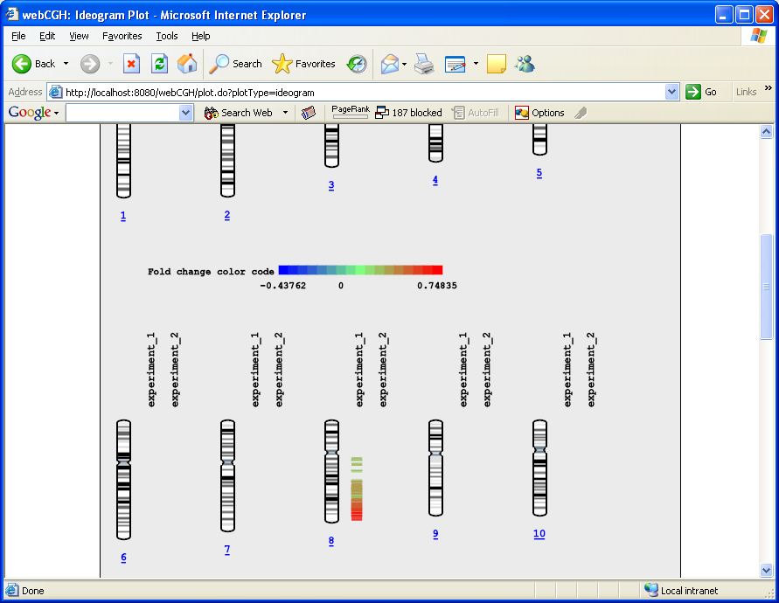
webGenome functionality
Whole Genome View
Ideograms

Slide 14
JVM1
Rembrandt web Application
3.URL request
webGenome web Application
JVM3
(client ID)
Query Service
App State/
2. Client ID
4. BioAssay
Request
6. BioAssay
DTOs
1.Publishes
Jboss App Server
JNDI
caIntegrator
Data system
EJB Container
Application State Service
BioAssayService
Copy Number
LOH
Gene Expression
…
JVM2
BioAssayService
5. BioAssay
Query
Query Service (Multi-thread)
OR mapping Layer
<<Infrastructure>>

Slide 15
Analytical Server Architecture
Analysis Node
JBoss App Server
JBossMQ
(JMS implementation)
Analysis Node
Analysis Request Queue
Analysis Server
Client Manager
Analysis Node
Analysis Result Queue
Rembrandt
Front End
Middle Tier

Slide 16
Analysis Node Architecture
Analysis Node
JMS Message Handler
Thread Pool Executor
Compute Thread(s)
JMS Message Handler: receives analysis requests from the
AnalysisRequestQueue and sends analysis results to the
AnalysisResultQueue.
ThreadPoolExecutor: uses the Java 1.5 ThreadPoolExecutor class to handle
thread execution and job queuing. (See:java.util.concurrent.ThreadPoolExecutor)
Compute Thread: Responsible for performing the actual statistical
computation. Receives an analysis request as input and produces an
analysis response.

Slide 17
Goals of CG-OM
Represent clinical genomics data from a clinical trial and findings in a queriable and comprehensive manner
Extensible model for Findings (specimen based Findings, group based Findings and HOA Findings)
Models study, study participant, events and results from tests (such as pathology, MR analysis etc.)
Annotation Objects provide context for the Findings
Use controlled vocabulary and common data elements to enable standard representation of the data for efficient access and exchange between data sources
Interoperability with other models in caBIG (caBIO, CT-OM, caTissue, MAGE-OM)

Slide 18
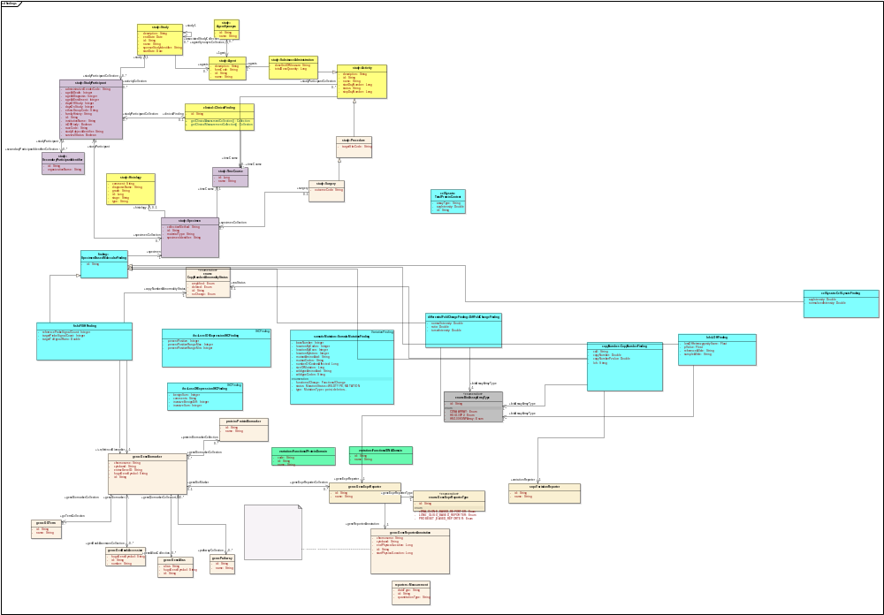
caIntegrator – CG-OM v2.0
Study
Findings
Annotations

Slide 19
CG-OM Findings
Study:
Study
StudyParticipant
Specimen
Agent
Histology
TimeCourse
Activity
SubstanceAdminstration
Findings:
Clinical Finding
Copy Number
  Copy Number
  LOH
  FISH
Gene Expression
  DifferentialFoldChange
Protein
  Cell Lycate
  IHC
Variation
  Somatic Mutation
  Germ line Mutation
Analysis
  Class Comparison
  PCA
  SNP
Annotation:
GeneBiomarker
ProteinBiomarker
GeneReporterAnnotation
Histology
SNPAnnotation
BioAssayArrayType
SNPPanel

Slide 20
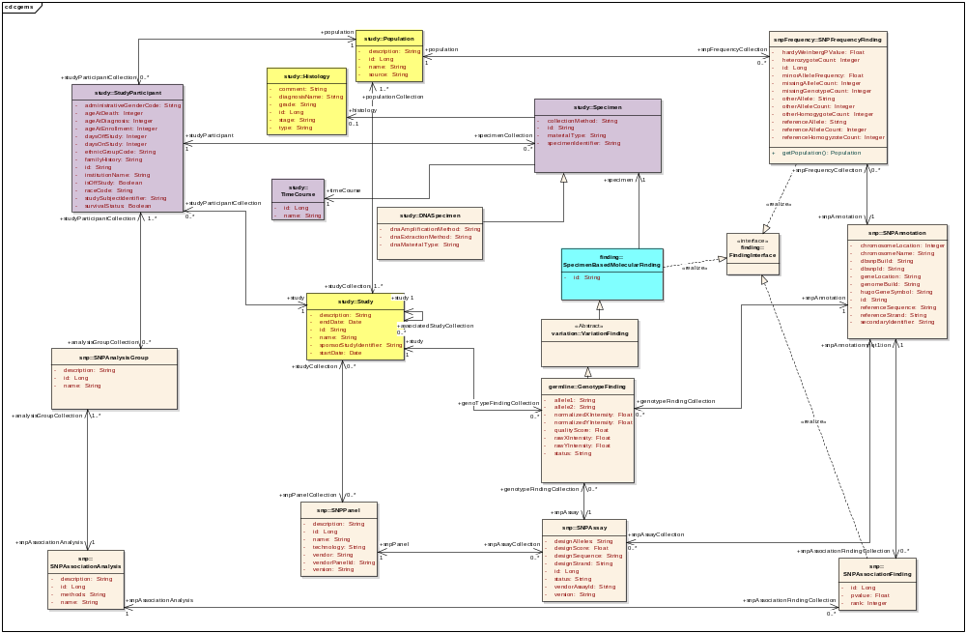
CGEMS Findings

Slide 21
caIntegrator Data Access Challenges
Framework should allow both Fine Grained and Coarse Grained access
Objects may be Transient
  Requires Runtime Analysis in many cases
Performance of Large Result Sets is High Priority
  Data is stored is in Warehouse Snow Flake schema.
  Relatively few tables/views with very large amount of data
  Query Processing tuned for performance

Slide 22
caIntegrator Solution
Provide support both Fine and Coarse grained API
  Use the caCORE SDK to generate the fine grain API
  Create a new Study Service Layer that handles coarse gain API that utilizes Data Transfer Objects (DTOs)
  Study service layer uses HQL to assemble request
  Both Domain Objects (DOs) and DTOs map to same Hibernate mappings
Supports Transient Objects via Analysis Service layer
Semantic interconnection of metadata via caDSR

Slide 23
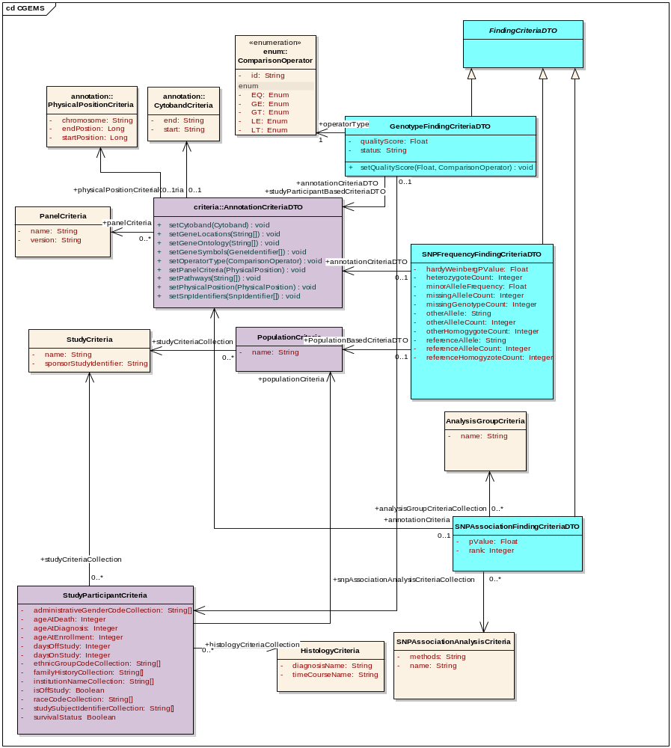
CGEMS DTO

Slide 24
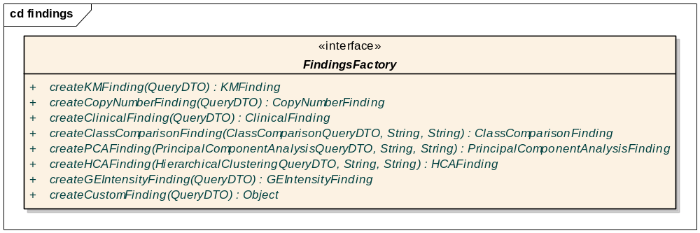
API: caIntegrator Findings Service
Translational Service API serves “Findings” based on clinical genomic (CG) criteria (queryDTO)
Consumes Genomic and clinical DTOs and returns Finding DTO’s that encapsulate DO’s
DTO’s comprise of data from CG-OM objects

Slide 25
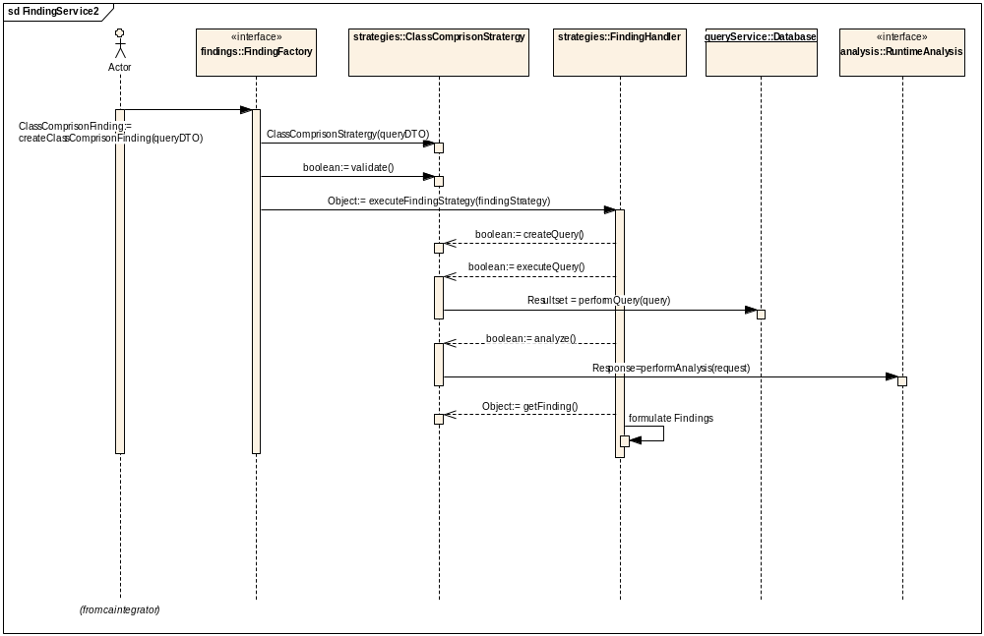
Class Comparison Analysis Example

Slide 26
Data Model
Original Star Schema
Modified Snowflake and Relational Schema
Additional Fact tables for gene based data
CSM related tables and institutional based access
New clinical data tables

Slide 27
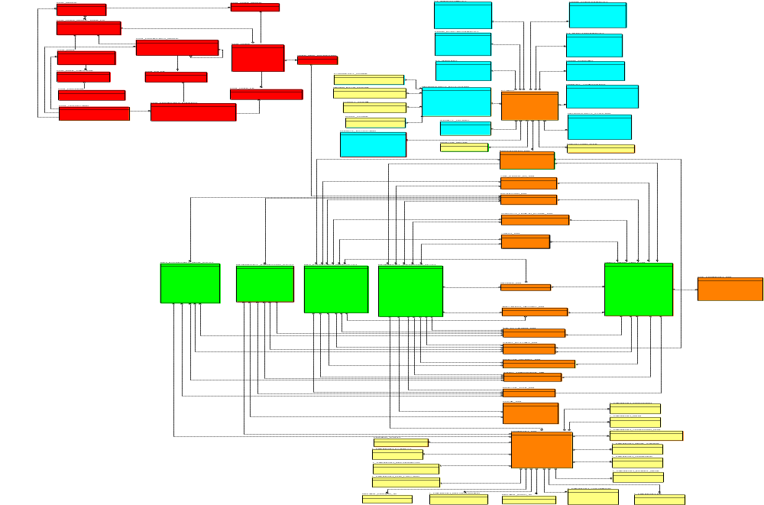
caIntegrator data model (caIntegrator)
CSM
Clinical
Genomic Fact
CN:~35 M
GE:~20M
Dimensions

Slide 28
caIntegrator User Access
Use Case: Provide role based read only access (Super, Institution Level, Public (default))
Utilize CSM 3.0.1 for
  Authentication via LDAP
  User Provisioning Tool (UPT) for assigning groups and roles to users
Authorization:
  Current CSM authorization design applies access control measures after each query has been executed.
  Therefore, caIntegrator data processing tier will add applicable datasets constrains to each query as we have high data thru-put and high performance needs.

Slide 29
Questions?

