Slide 1
Business Case: Real-Time Electricity Data
Daoudi Soufiane
Cheikh B. Ndoye
Xudong Liu

Slide 2
Role of Real-Time Electricity Data
Monitor electricity demand and supply
Gathering statistical data about communities electrical consumption
Providing data about sources of electricity for environmental purposes
Alert stakeholders to upgrade the infrastracture when supply is not enough

Slide 3
Description of the project
Scraping Data (Beautifulsoup library) from website
-Analyzing HTML code to find relevant data
-Extract data
-Generate csv files
Displaying formatted Data (Mathplotlib and Pandas)
-Read csv files
Generate table / Graphs
Recommendations

Slide 4
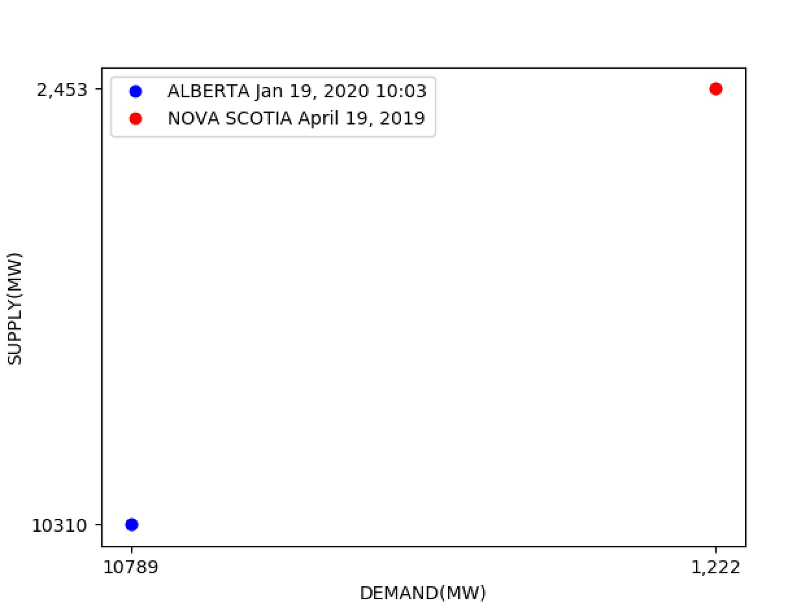
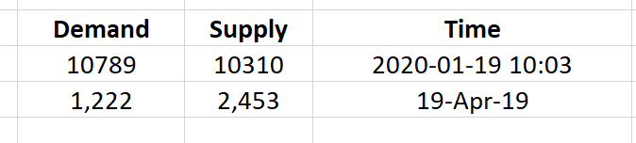
Results

Slide 5
Recommendations
Implement a real-time system that does the following:
Generate warning messages in case of emergencies (generator failure etc…)
Turn on the required number of backup generators in the case where the demand exceeds supply

Slide 6
Thank you!

