Slide 1

Business Case:
Real-Time Electricity Data

Slide 2

Statement
“As a data analyst, I would like to be able to automatically collect, process and disseminate real-time electricity data at the provincial and national level. This would improve data quality and timeliness for policy making and analysis, modelling scenarios, as well as market trading and system balancing decisions.”

Slide 3
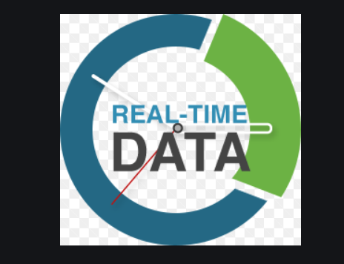
What is Real-time Data ?
The basic definition of real-time data is that it is data that is not kept or stored, but is passed along to the end user as quickly as it is gathered. It is important to note that real-time data does not mean that the data gets to the end user instantly. There may be any number of bottlenecks related to the data collection infrastructure, the bandwidth between various parties, or even just the slowness of the end user's computer. Real-time data does not promise data within a certain number of microseconds. It just means that the data is not designed to be kept back from its eventual use after it is collected.

Slide 4

Importance of real-time data
Real-time Data provides insights into your operations, help you make decisions about those operations, and then act accordingly.
It makes the data you are working with is accurate .
Real-time analytics are important for operating your workflows as efficiently as possible.

Slide 5
https://www.techopedia.com/definition/31256/real-time-data
https://www.power-grid.com/2016/03/22/real-time-data-analytics/
https://www.truthinit.com/index.php/p/118/streamlio-for-real-time-data-streaming/
https://techcrunch.com/2017/09/19/real-time-data-analytics-startup-incorta-raises-15m-series-b-led-by-kleiner-perkins/
https://www.insightdata.co.uk/news/what-is-real-time-data/
https://www.sfgnetwork.com/blog/data-services/the-importance-of-real-time-data/

