Slide 1
Sample Request Feature

Slide 2
Web Client Requirements
Research groups: Web-client-only users, organized into groups with one or more principal investigators per group. Research groups possess a default address, but may specify a different one per request.
  Who creates these groups/users? Web-client or java client?
Researchers make requests and one of the designated PIs must approve the request.
Begin by uploading a CSV file containing patient numbers. The researcher can then drill down to the specific samples
Both java client and web client will be able to view request status. Research groups will receive an email notification when a request has been shipped.

Slide 3
Non-PI Researcher Sample Request
Each researcher will require his / her own login and password and will have to be associated with his / her studies
Start
Researcher creates a sample order
Researcher opens web client and connects to CBSR server and logs in
User returned to researcher home page
Display researcher home page: report showing studies, patients and aliquots
Researcher selects logout link
Researcher selects link to create a sample order
Display sample order form
End

Slide 4
Research PI Oder Approval
Start
PI opens web client and
connects to CBSR server
And logs in
Display PI Home Page:
Report showing studies, patients, and aliquots, and requests pending approval
PI can place order himself
as a researcher, or approve
requests
Confirmation email is sent and CBSR is informed via email of the order
PI selects logout link
End

Slide 5
Create a Sample Order
Start
The table shows a pull down for each sample type, when sample type is selected, then the pull down for patient visit is populated, when patient visit is selected the total number of samples for that visit is displayed
Display shipping address form
Upload patient numbers using CSV?
NO
Researcher fills in form and submits
Present table showing patient numbers and all samples for those patients
Upload CSV file
NO
Checks that all patients belong to researcher's study (or chosen one)
Researcher selects aliquots from table
Researcher assoc with more than 1 study?
Researcher selects study
Researcher presses submit order button
  Once the patient number is entered the date drawn selection is populated with a list of valid values
  Once the sample type is selected the number of aliquots range is enforced
End
Researchers can save form and come back later at any time

Slide 6
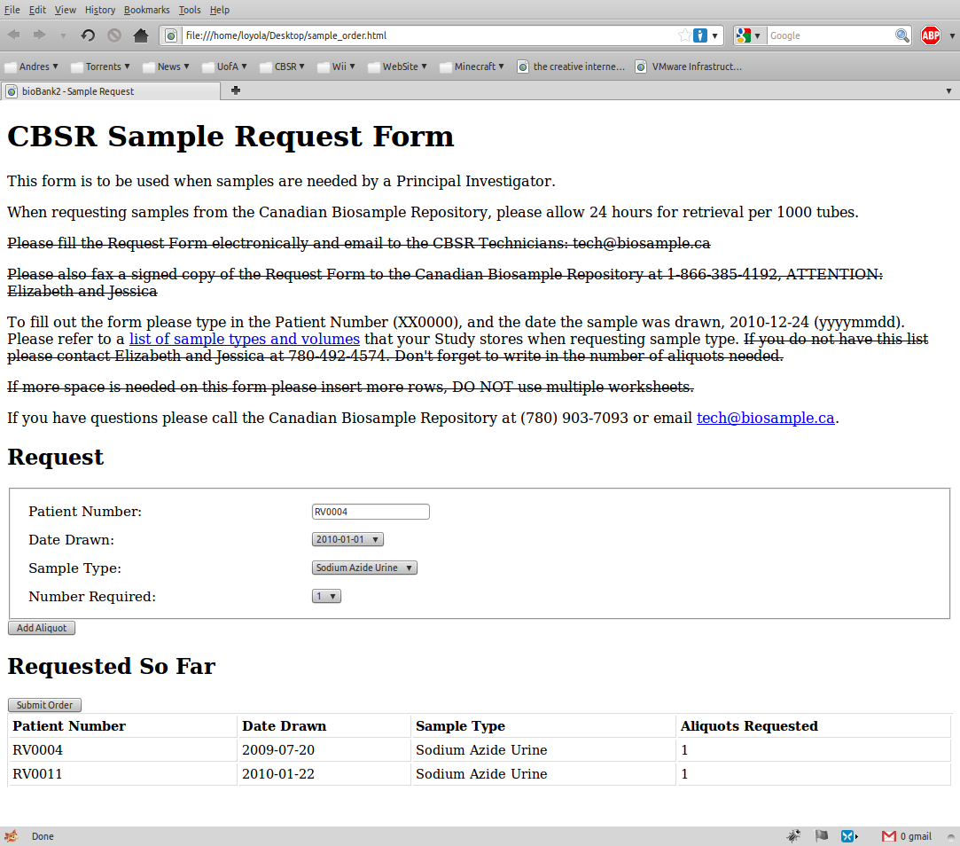
Sample Request Form Mock Up

Slide 7
Java Client Requirements
New view in Java Client showing pending sample orders
Requested aliquots can be claimed by techs. This is to avoid confusion when multiple techs pull samples at the same time. Features include being able to claim by container.
If an aliquot is unavailable, it is possible to flag the aliquot.
A request cannot be completed until all of the requested aliquots are flagged as processed or unavailable.
A repository site needs an “receive email” account. Sample order emails will be sent to this account to when submitted.
Requests have an id number that may be searched at any time

Slide 8
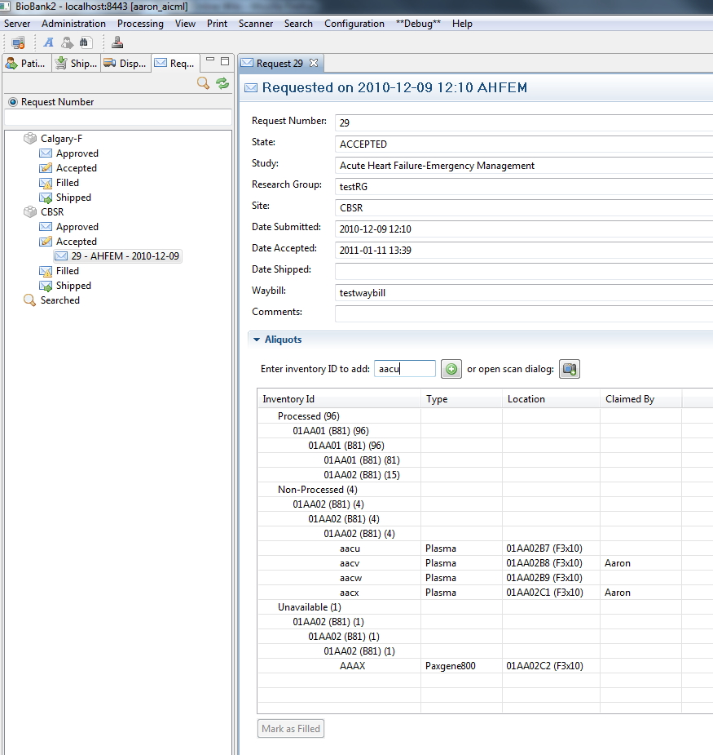
Java Client:
Processing a Sample Order
New Request tab in the patient processing view
A Request form shows the status for each sample
By selecting items in the table and the right click context menu, the user can claim them
Once all aliquots are processed, the order can be filled
The tree represents various states of the request

Slide 9
Java Client: Manipulating a Request
The tree view shows all non closed orders and the state they are in
The next state in order processing can be assigned by pressing a button in the order's form or clicking on the tree icon
When an order is given a new state a form is displayed to the user where he / she can enter the required information

Slide 10
Model Changes
New Object: Request. Associated with researcher and study. Requires a status: new, submitted, approved, accepted, filled, shipped, closed. Associated with one or more techs who worked on the request.
  Creation occurs from new-approved. Processing occurs from approved-shipped. Upon receipt, someone (who?) marks as closed. Which state/client combinations are visible?
Add email attribute to repository site object.
New Object: RequestAliquot. Associated with a request and an aliquot. Contains a state (processed, non-processed, unavailable).

Slide 11
Model Changes cont.
New Object: Researcher. Belong to a research group. Have the capability to log in with a username/password
  Are these users with specific permissions? Or are they separate entirely from csm_user?
Users who are researchers need to be associated with one or more research groups. A researcher can be designated a PI in a research group.
New Object: Research Group. Have research members, and PIs. Associated to at most one study.
To place a request, you must be a member of the research group for the study.

Slide 12
Request States
State | Description | Associated Information
New | The researcher is creating the request | Research group, aliquots, address, creation date
Submitted | The researcher has completed creating the request and submitted it to the system | Submitted date and time, request number
Approved | The principal investigator has approved the request | Approved by: ____
Accepted | The request has been received and techs at the repository site is working on filling it | Someone (admin?) accepts the request. Aliquots can be claimed and processed.
Filled | The repository site has filled the request and is ready to be shipped, picked up, or dropped off | The completion date and time
Shipped | The request is in transit | Pickup date and time, waybill number Do we allow multiple waybills for multiple shipments?
Closed | The request has been received by the researcher and no further work on the order is required | Received date and time

