Slide 1
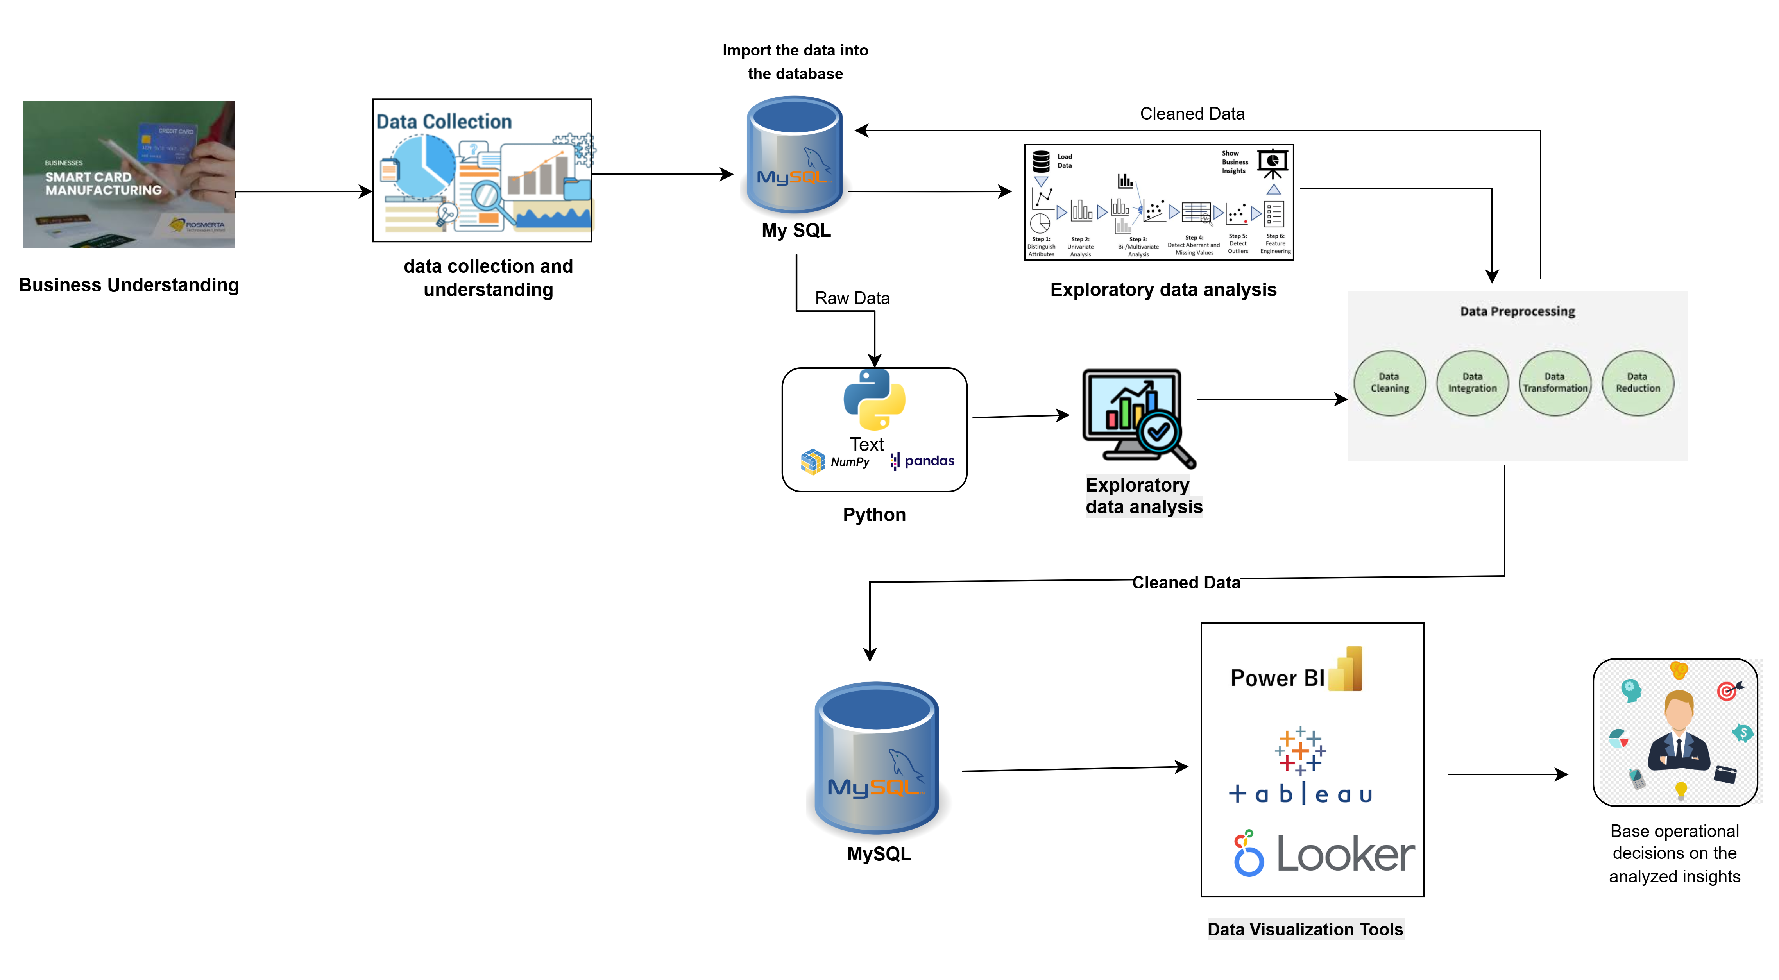
Architecture Diagram

