Slide 1
RPI Grade Tracker

Slide 2
What it is
Java Applet
Tracks past grades
Calculates current grade
Predicts worth of current work
Variety of calculations
Handles the cornucopia of syllabi curveballs
Helps students make informed decisions
Notes:
Rpi students. . . Good a math and science/ classes. . .however are ‘blissfully’ unaware and unorganized.

Slide 3
Progress
Simple user interface is key
Played with different configurations
Have framework implemented

Slide 4
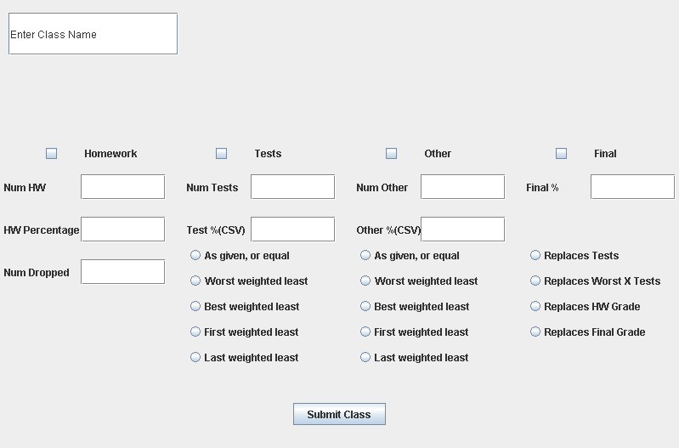
Screen Shot

Slide 5
Questions/Input
Notes:
Name?

