Slide 1

Conversion Gallery

Slide 2


Slide 3

DANDI Example Notebooks

Slide 4

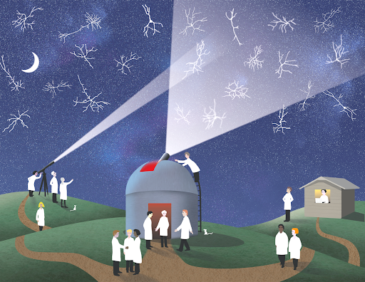
OpenScope Databook

Slide 5

IBL Brainwide Map Dataset Tutorial

