Slide 1

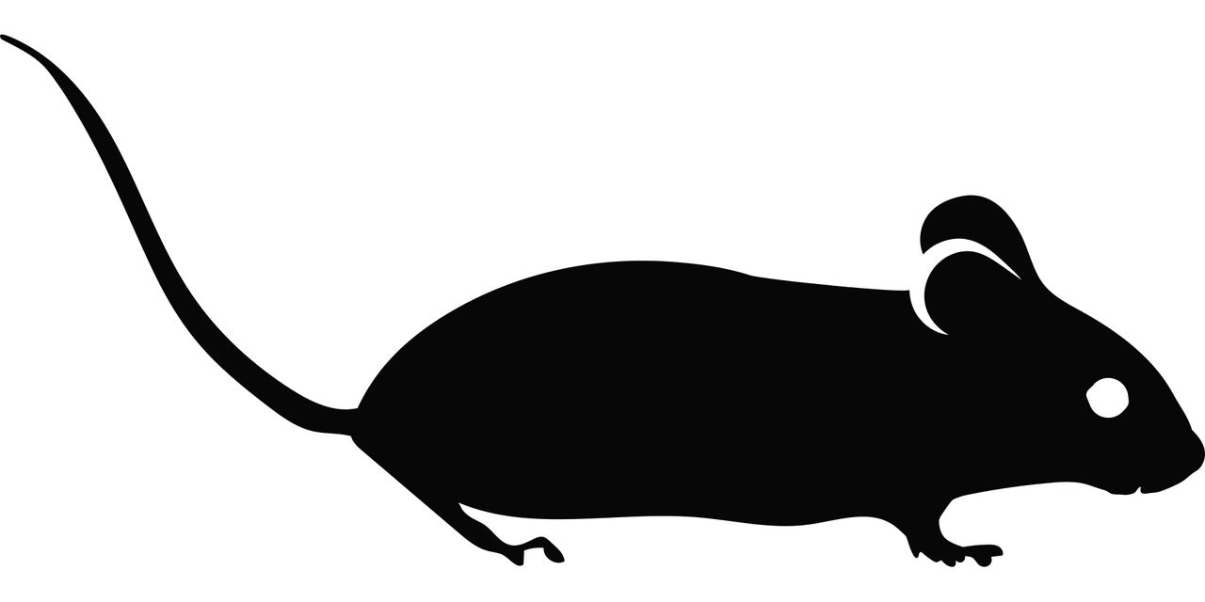




Experimental Design
?
Stimuli
Environment
Trial structure
Optogenetics
Experimental
Subjects
Data Acquisition
Device settings
Filtering parameters
Sampling rate
Recording/imaging area
Species
Genotype
Age
Weight
Behavior
Neural Activity
Task accuracy
Task response time
Video and motion tracking
Audio
Extracellular electrophysiology
Intracellular electrophysiology
Two-photon imaging
Extensions
New data types and modalities
Acquisition, processing, analysis, and experiment specific metadata

Slide 2
Previous Versions

Slide 3
Experimental Design
?
Stimuli
Environment
Trial structure
Optogenetics
Experimental
Subjects
Data Acquisition
Device settings
Filtering parameters
Sampling rate
Recording/imaging area
Species
Genotype
Age
Weight
Neural Activity
Behavior
Extracellular electrophysiology
Intracellular electrophysiology
Two-photon imaging
Functional ultrasound imaging
Task accuracy
Task response time
Video and motion tracking
Audio

Slide 4
Experimental Design
?
Stimuli
Environment
Trial structure
Optogenetics
Experimental
Subjects
Data Acquisition
Device settings
Filtering parameters
Sampling rate
Recording/imaging area
Species
Genotype
Age
Weight
Neural Activity
Behavior
Extracellular electrophysiology
Intracellular electrophysiology
Two-photon imaging
Functional ultrasound imaging
Task accuracy
Task response time
Video and motion tracking
Audio
Extensions
New data types and modalities
Acquisition, processing, analysis, and experiment specific metadata

