Slide 1



Introduction to Git/Github

Slide 2
Git vs Github
Git is a version-control management and collaboration software (since 2005)
Git tracks file changes, letting multiple people work together and merge updates easily.
Click here to Install.
GitHub (since 2008) is an online application that provides:
A visual interface for git.
Free cloud storage for all your projects’ code/files

Slide 3
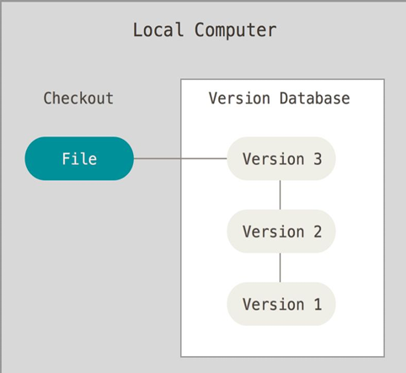
Version Control System
Version control is a system that records changes to a file or set of files over time so that you can recall specific versions later.

Slide 4
Basic Terminology
Working Tree- is a single checkout of one version of the project. These files are pulled out of the compressed database in the Git directory and placed on disk for you to use or modify.
Committed means that the data is safely stored in your local database. ○ Modified means that you have changed the file but have not committed it to your database yet.
Staged means that you have marked a modified file in its current version to go into your next commit snapshot. The staging area(Index) is a file, generally contained in your Git directory, that stores information about what will go into your next commit.

Slide 5
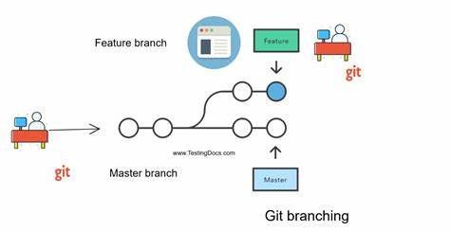
Basic Terminology (contd.)
Commit- Commit holds the current state of the repository. A commit is also named by SHA1 hash. It is the snapshot of a repository at a particular instance.
Branch- Branches are used to create another line of development.

Slide 6
Git Configuration with Github
Configuring user information used across all local repositories.
Open Git bash and run following commands
git config --global user.name “[your-username]”
git config --global user.email “[your-email]”

Slide 7
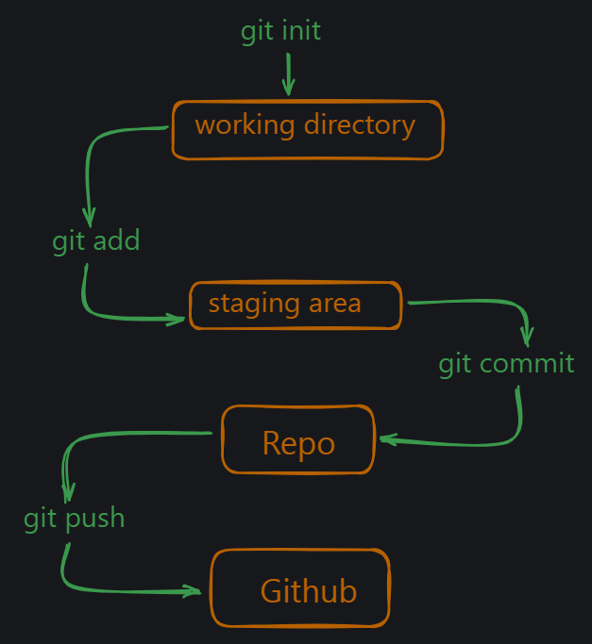
Complete Git flow
When you want to track a new folder, you first use init command to create a new repository. Then you can use add command to add the folder to the repository. After that you can use commit command to save the changes. Finally you can use push command to push the changes to github. Of course there is more to it but this is the basic flow.

Slide 8

Git Staging Area
The Git staging area lets you prepare specific changes before saving them in Git’s history, giving you control over what gets included in your next commit.
git add . - adds all the
files that have been
changed to the stage
git status - show modified files in working directory,
staged for your next commit.
git add [file] - add a file as it looks now to your next commit (stage).

Slide 9
Git Staging Area
git reset [file] - unstage a file while retaining the changes in working directory.
git diff - diff of what is changed but not staged.
git diff --staged - diff of what is staged but not yet committed.
git commit -m “[descriptive message]” - commit your staged content as a new commit snapshot

Slide 10
Branch And Merge
git branch - list your branches. a * will appear next to the currently active branch.
git branch [branch-name] - create a new branch at the current commit.
git checkout [branch-name]- it changes your current working branch to the one you specify
git checkout [file-name] - it reverts that file back to its last committed state
git merge [branch] - merge the specified branch’s history into the current one

Slide 11
SHARE & UPDATE
git remote add [alias] [url] - This command is used to connect your local Git repository to a remote repository (hosted on platforms like GitHub, GitLab, etc.).
git fetch [alias] - fetch down all the branches from that Git remote
git merge [alias]/[branch] - merge a remote branch into your current branch to bring it up to date
git pull - it is equivalent to git fetch + git merge.
git merge [alias]/[branch] - merge a remote branch into your current branch to bring it up to date
git push [alias] [branch] - Transmit local branch commits to the remote repository branch

Slide 12

Finally!!
git push [alias] [branch] -Transmit local branch commits to the remote repository branch.
Go and watch your changes on Github!!

Slide 13
Git Hard Reset
A hard reset in Git undoes changes in the working directory and index (staging area), forcing your branch to match a specific commit.
git reset --hard HEAD~1 - Reset to the Previous Commit
git reset --hard <commit-hash> - Reset to a Specific Commit (Replace <commit-hash> with the commit ID you want to reset to. You can find the commit ID by running git log.)
1-> git fetch origin
2-> git reset --hard origin/<branch-name> - If you want to discard all local
changes and reset to match the remote branch.

Slide 14
How to use Github for Open Source?
Lets go through a recommended set of steps for the same:
Fork the Repository - Go to the repository’s GitHub page and click Fork to make a copy of it under your account.
Clone the forked repo to your local machine - ( run git clone [url] )
Create a New Branch - (run git checkout -b feature-branch-name)
Commit your changes and push to your Forked Remote Repository.

Slide 15
How to use Github for Open Source?
6. Open a Pull Request (PR)
Go to the original repository, navigate to Pull Requests, and click New Pull Request.
Select your branch and submit the PR with a clear title and description of your changes.
7. Respond to Reviews
Address any feedback or requested changes from maintainers by updating your branch and pushing commits.

Slide 16
How to use Github for Open Source?
8. Stay Updated
Sync your fork with the original repo’s updates:
run git remote add upstream https://github.com/original-owner/repo-name.git
git fetch upstream
git merge upstream/main
9. Once your PR is approved and merged, your contribution is part of the project!

Slide 17

Any
DOUBTS ??

Slide 18
Thank You ! See you in next session!!

