Slide 2
_________________________________________________________________
Layer (type) Output Shape Param #
=================================================================
conv2d_1 (Conv2D) (None, 254, 254, 32) 896
_________________________________________________________________
conv2d_2 (Conv2D) (None, 252, 252, 32) 9248
_________________________________________________________________
max_pooling2d_1 (MaxPooling2 (None, 126, 126, 32) 0
_________________________________________________________________
conv2d_3 (Conv2D) (None, 124, 124, 64) 18496
_________________________________________________________________
conv2d_4 (Conv2D) (None, 122, 122, 64) 36928
_________________________________________________________________
conv2d_5 (Conv2D) (None, 120, 120, 64) 36928
_________________________________________________________________
max_pooling2d_2 (MaxPooling2 (None, 60, 60, 64) 0
_________________________________________________________________
dropout_1 (Dropout) (None, 60, 60, 64) 0
_________________________________________________________________
conv2d_6 (Conv2D) (None, 58, 58, 128) 73856
_________________________________________________________________
conv2d_7 (Conv2D) (None, 56, 56, 128) 147584
_________________________________________________________________
dropout_2 (Dropout) (None, 56, 56, 128) 0
_________________________________________________________________
flatten_1 (Flatten) (None, 401408) 0
_________________________________________________________________
dense_1 (Dense) (None, 128) 51380352
_________________________________________________________________
dense_2 (Dense) (None, 172) 22188
_________________________________________________________________
dropout_3 (Dropout) (None, 172) 0
_________________________________________________________________
dense_3 (Dense) (None, 2) 346
=================================================================
Total params: 51,726,822
Trainable params: 51,726,822
Non-trainable params: 0
_________________________________________________________________
Gender model structure

Slide 3
_________________________________________________________________
Layer (type) Output Shape Param #
=================================================================
zero_padding2d_1_input (Inpu (None, 224, 224, 3) 0
_________________________________________________________________
zero_padding2d_1 (ZeroPaddin (None, 226, 226, 3) 0
_________________________________________________________________
conv2d_1 (Conv2D) (None, 224, 224, 64) 1792
_________________________________________________________________
zero_padding2d_2 (ZeroPaddin (None, 226, 226, 64) 0
_________________________________________________________________
conv2d_2 (Conv2D) (None, 224, 224, 64) 36928
_________________________________________________________________
max_pooling2d_1 (MaxPooling2 (None, 112, 112, 64) 0
_________________________________________________________________
zero_padding2d_3 (ZeroPaddin (None, 114, 114, 64) 0
_________________________________________________________________
conv2d_3 (Conv2D) (None, 112, 112, 128) 73856
_________________________________________________________________
zero_padding2d_4 (ZeroPaddin (None, 114, 114, 128) 0
_________________________________________________________________
conv2d_4 (Conv2D) (None, 112, 112, 128) 147584
_________________________________________________________________
max_pooling2d_2 (MaxPooling2 (None, 56, 56, 128) 0
_________________________________________________________________
zero_padding2d_5 (ZeroPaddin (None, 58, 58, 128) 0
_________________________________________________________________
conv2d_5 (Conv2D) (None, 56, 56, 256) 295168
_________________________________________________________________
zero_padding2d_6 (ZeroPaddin (None, 58, 58, 256) 0
_________________________________________________________________
conv2d_6 (Conv2D) (None, 56, 56, 256) 590080
_________________________________________________________________
zero_padding2d_7 (ZeroPaddin (None, 58, 58, 256) 0
_________________________________________________________________
conv2d_7 (Conv2D) (None, 56, 56, 256) 590080
_________________________________________________________________
max_pooling2d_3 (MaxPooling2 (None, 28, 28, 256) 0
_________________________________________________________________
zero_padding2d_8 (ZeroPaddin (None, 30, 30, 256) 0
_________________________________________________________________
conv2d_8 (Conv2D) (None, 28, 28, 512) 1180160
_________________________________________________________________
zero_padding2d_9 (ZeroPaddin (None, 30, 30, 512) 0
_________________________________________________________________
conv2d_9 (Conv2D) (None, 28, 28, 512) 2359808
_________________________________________________________________
zero_padding2d_10 (ZeroPaddi (None, 30, 30, 512) 0
_________________________________________________________________
conv2d_10 (Conv2D) (None, 28, 28, 512) 2359808
_________________________________________________________________
max_pooling2d_4 (MaxPooling2 (None, 14, 14, 512) 0
_________________________________________________________________
zero_padding2d_11 (ZeroPaddi (None, 16, 16, 512) 0
_________________________________________________________________
conv2d_11 (Conv2D) (None, 14, 14, 512) 2359808
_________________________________________________________________
zero_padding2d_12 (ZeroPaddi (None, 16, 16, 512) 0
_________________________________________________________________
conv2d_12 (Conv2D) (None, 14, 14, 512) 2359808
_________________________________________________________________
zero_padding2d_13 (ZeroPaddi (None, 16, 16, 512) 0
_________________________________________________________________
conv2d_13 (Conv2D) (None, 14, 14, 512) 2359808
_________________________________________________________________
max_pooling2d_5 (MaxPooling2 (None, 7, 7, 512) 0
_________________________________________________________________
conv2d_14 (Conv2D) (None, 1, 1, 4096) 102764544
_________________________________________________________________
dropout_1 (Dropout) (None, 1, 1, 4096) 0
_________________________________________________________________
conv2d_15 (Conv2D) (None, 1, 1, 4096) 16781312
_________________________________________________________________
dropout_2 (Dropout) (None, 1, 1, 4096) 0
_________________________________________________________________
predictions (Conv2D) (None, 1, 1, 101) 413797
_________________________________________________________________
flatten_2 (Flatten) (None, 101) 0
_________________________________________________________________
activation_2 (Activation) (None, 101) 0
=================================================================
Total params: 134,674,341
Trainable params: 17,195,109
Non-trainable params: 117,479,232
_________________________________________________________________
Structure of age model

Slide 4
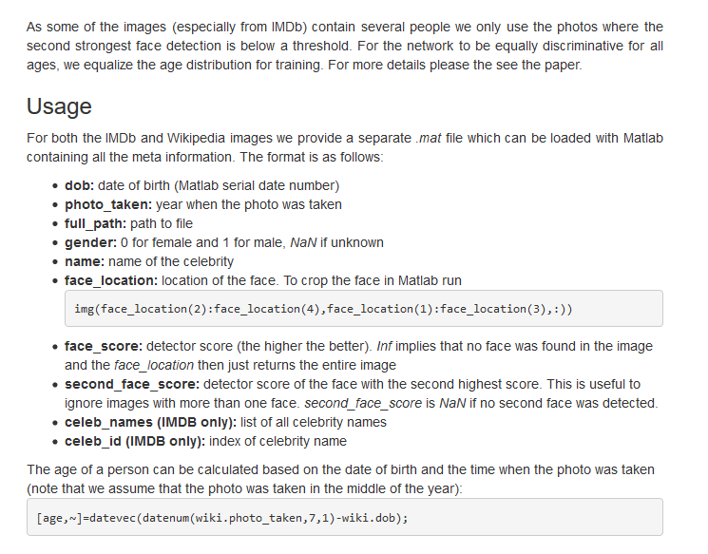

Slide 5
