Slide 1




AI Research
CCChat Demo
`
© Conestoga College. All rights reserved.
Notes:
!!!
Hello, I will begin the Sprint 2 Demo Meeting. My name is Eunie from the AI Team

Slide 2

Team
Supervisor | Member
Sean Yo | Arsh Chauhan
 | Jongeon Lee
 | Wei-Hsiang Chen
 | Eunie Jo
Notes:
Our team members are Sean, Arsh, Jong-eon, Wei and myself
.

Slide 3
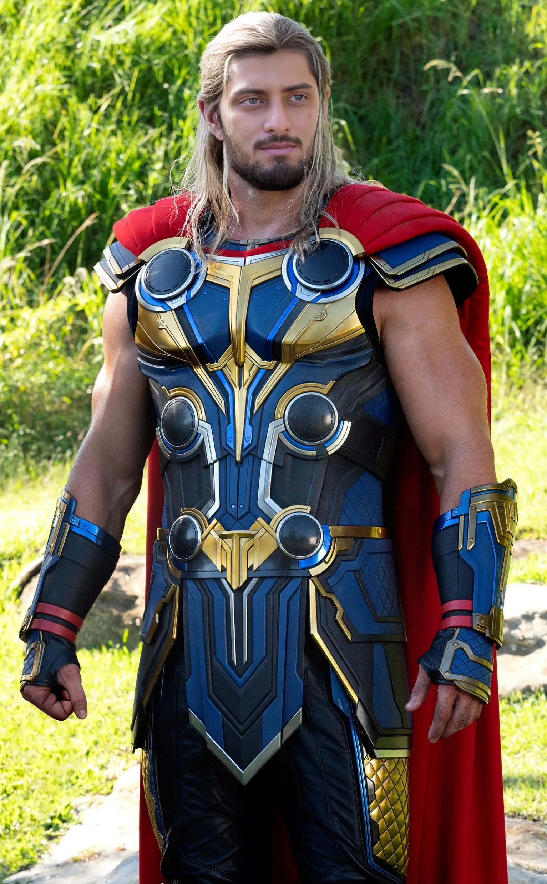
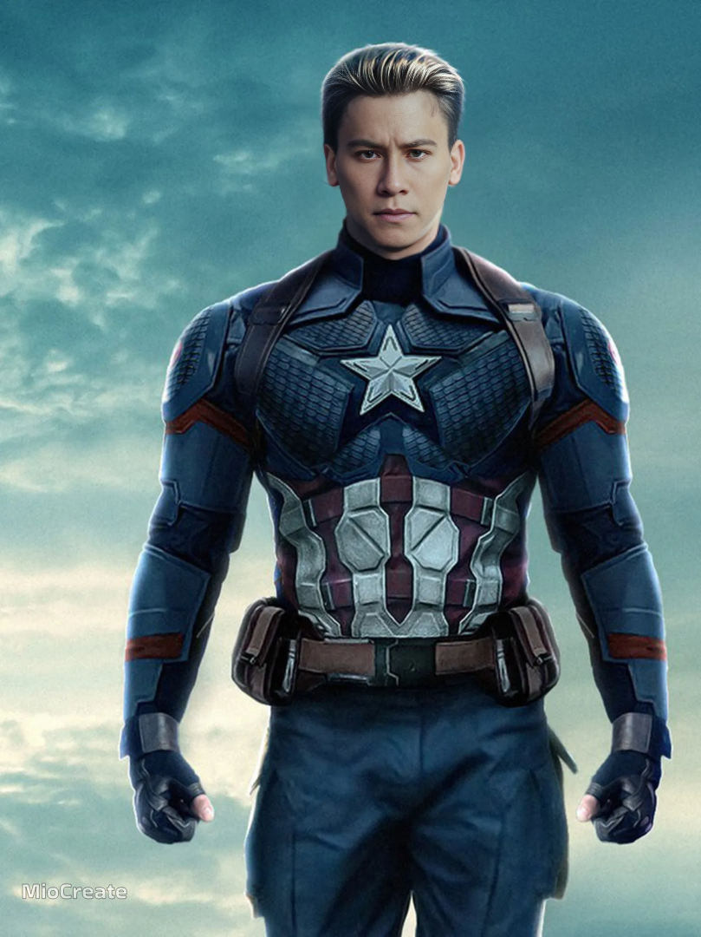
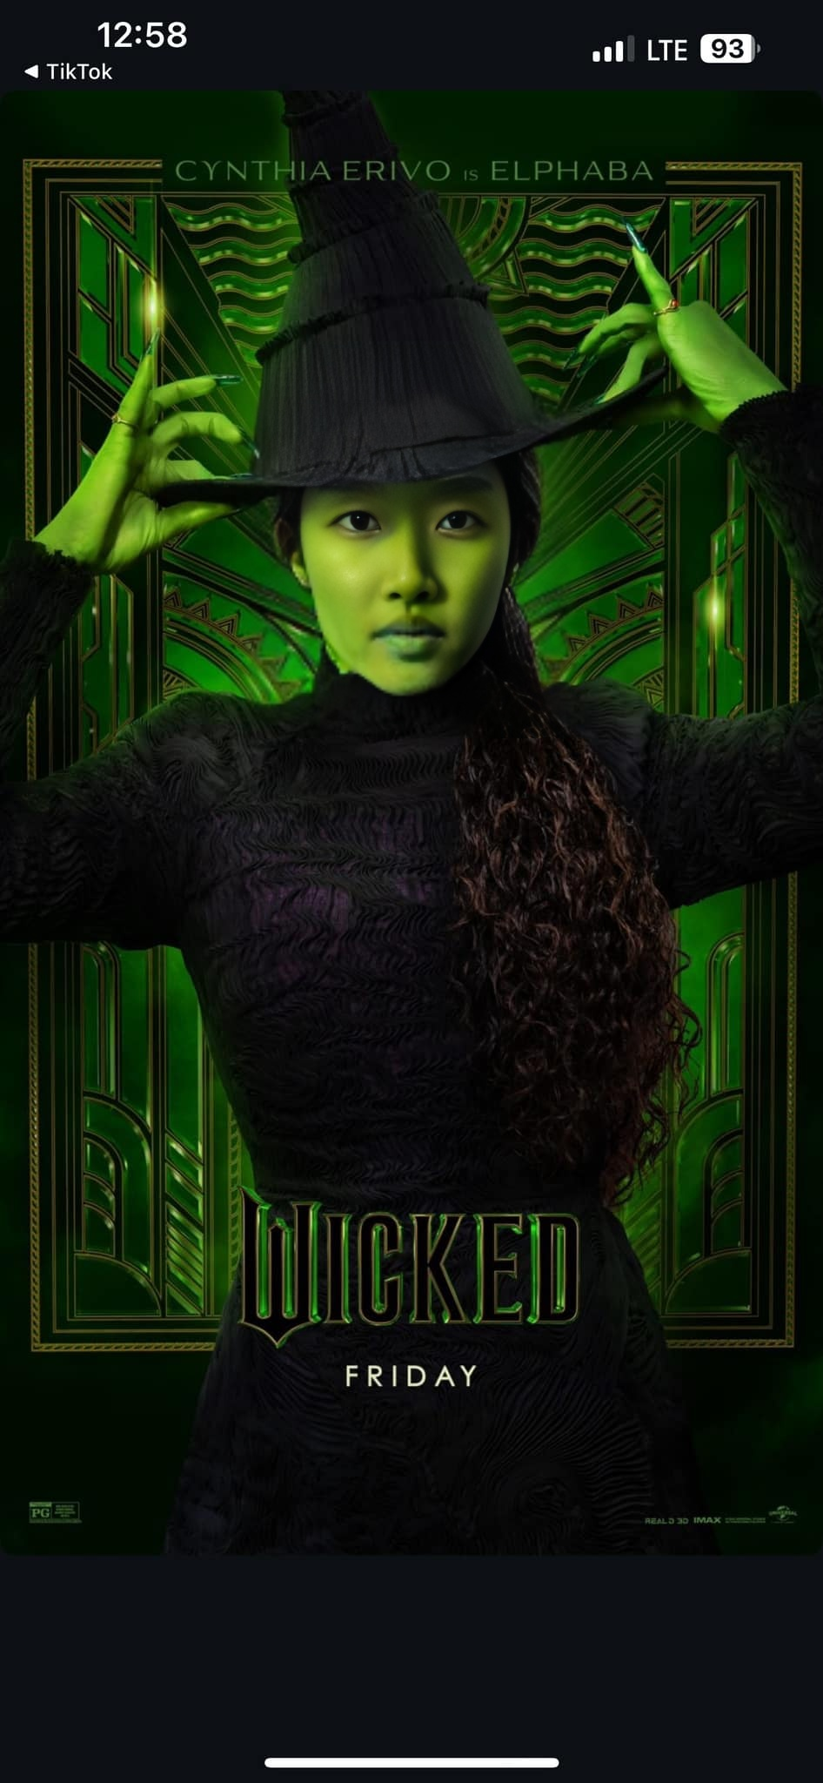
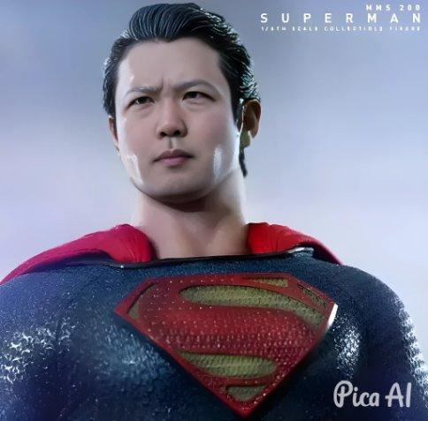
AI Team
Arsh
Wei
Eunie
Jongeon
Notes:
Here are my team members

Slide 4

Project Overview
The goal of this project is to create a Digital Teaching Assistant(DTA) that enhances student learning by summarizing class materials, answering questions, and providing personalized academic guidance.
Key Value
Always available 24/7 support for learners
Reduce questions for the instructor which are answered in the course shell
Current Scope
Provides accurate summaries and reliable Q&A to help students review and understand class content effectively.
Currently supports one subject (PMP course)
Notes:
Since this is our team’s first sprint presentation, I would like to start with a brief introduction to our project.
Our goal is to develop a Digital Teaching Assistant (DTA). Last semester, we implemented a feature that allows the assistant to answer user questions based on course materials.
For example, students can request PMP course content (e.g., “Please summarize Unit 5”), and the DTA will generate a relevant response based on the course materials.

Slide 5
Project Overview
Future Scope
Personalized Learning:
Leverage advanced analytics to identify individual student learning patterns and preferences.
Expand the assistant's capability to guide students by providing curriculum suggestions tailored to their academic level and progress.
Multi-Subject Support
Broaden the assistant's support to multiple subjects, allowing students from different academic areas to benefit from its features.
Notes:
“This semester, we are focusing on two key points: personalized learning and multi-subject support.”
Personalized Learning
• The assistant will evaluate students’ academic proficiency and provide customized learning guidance.
• It will also provied personalized suggestions and feedback reflecting the student’s improvement
.
Multi-Subject Support
• We plan to extend DTA’s capabilities to upport additional courses

Slide 6
Sprint Goal
Frontend Development
Implement subject selection page and subject detail page aligned with DTA usage scenarios.
Infrastructure Deployment
Establish server architecture and deploy frontend and backend services.
Tool Reassessment (LLM)
Conduct a comparative analysis of state-of-the-art LLMs :DeepSeek-R1, Phi-4, and Mistral
Multi-Subject Support Expansion
Request and collect subject-specific datasets.
Notes:
During this sprint, we worked on the following tasks:
• First, We improved the user interface for better usability in DTA scenarios.
• Next, We deployed both the frontend and backend on Azure Virtual Machines (VMs) to ensure seamless updates and improve the testing process
• Then, We compared models , Mistral, Phi-4, and DeepSeek-R1 to determine the best model for this semester:
• Mistral is A strong, free model that we have been using.
• Phi-4 is Released by Microsoft last year, promising but requires high-end hardware for using it in local.
• DeepSeek-R1 – A recently released model that is Lightweight, powerful, and cost-effective.
(I can share the report comparing the models on Confluence.)
After evaluating these models, we decided to work with both Mistral and DeepSeek-R1 moving forward.
• Finally, To expand DTA beyond a single course, we are collaborating withCorey and Kristina through weekly meetings to integrate additional course data.
“Now, let’s move on to the demo.”

Slide 7
Demo time
Frontend Development & Infrastructure Deployment
https://ai.cvri.ca
Demo Scenarios
Retrieving information through the DTA (chatbot).
Tool Reassessment (LLM)
Local version : deepseek-r1:1.5b on Azure vm server
Notes:
First, I will demonstrate our deployed system and then showcase DeepSeek-R1 in action.
Deployed System
• The service is accessible via the ai.cvri.ca domain.
• Upon accessing the domain, users see a login screen. By using an existing account , such as 7111111, they can log in and access the main course page.
• Currently, only the PMP course is available, but additional courses will be added.
• Selecting PMP takes user to the course details page, this will be familiar to Conestoga College students. From here, they can interact with the DTA.
“Now, let’s ask DTA a PMP-related question: ‘Please explain Unit 5.’”
• (Pause for AI response)
• As you can see, the assistant provides relevant answers based on course materials.
Local Model Testing: DeepSeek-R1
“Next, I will demonstrate a locally hosted version of DeepSeek-R1.”
This is our Azure VM. This environment does not have a GPU.
• Once the model is initialized, I ask reasoning-related questions and observe its responses.
Reasoning is the process of thinking logically to reach conclusions or make decisions
DeepSeek is known for its strong reasoning abilities.
• DeepSeek-R1 provides logical step-by-step reasoning( I think it is useful for our project)
• It is particularly impressive that such a powerful model runs on a local machine without a high-end GPU.
• Other models typically require high-end GPUs. I think it make DeepSeek-R1 a game-changer in terms of accessibility and cost efficiency.
• Even when using the cloud version, DeepSeek-R1 is more affordable than other models.
“For this semester, our team plans to work with both DeepSeek-R1 and Mistral, exploring their differences, (particularly in prompt engineering.)
“This concludes the demo. Now, let’s go over our next sprint goals.”

Slide 8
Next Sprint Planning
Model Optimization & Enhancements
Transition to an embedding model for more efficient knowledge representation.
Prompt Engineering for Adaptive Learning
Design and refine prompting strategies to evaluate user proficiency levels and enhance AI-driven tutoring.
Making DTA Scenarios
Making a questions which are evaluating the user's level
Notes:
“In the next sprint, we will focus on the following tasks:”
• First, we plan to update the embedding model to enhance performance.
• And we will begin developing prompt engineering techniques to assess user proficiency
Lastly I will make specific Scenarios for evaluating the user's level
This is the end of our presentation.

Slide 9
Q & A
Notes:
“Thank you for your attention. If you have any questions or feedback, we would love to hear them.”
(Pause for Q&A. If no questions, conclude with: )
“If there are no further questions, we will conclude the presentation here. Thank you!”

