Slide 1




AI Research
`
© Conestoga College. All rights reserved.

Slide 2

Team
Supervisor | Member
Jonathan Bezeau | Jongeon Lee
 | Wei-Hsiang Chen
 | Eunie Jo
 | Arsh Chauhan

Slide 3

Sprint Goal
Data Preparation and Database Setup for System Integration​
Course Data Cleansing & Organizing​
PostgreSQL Database Setup
DTA System Enhancement
Apply DTA Logic to the existing chat environment.
Provide questions based on the selected course.
Dynamically change the input box according to the question type.​

Slide 4
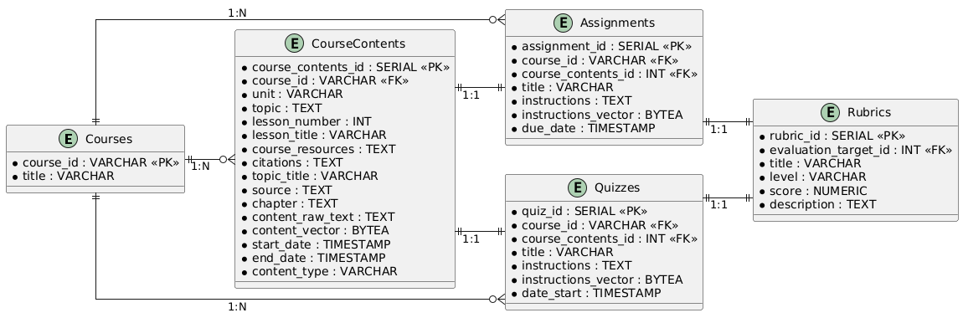
Course Data Cleansing & Organizing
Data Cleansing: PROG73010, CSCN72010
Extract essential data from XML, JSON, DOCX, PPTX.
Categorize into Lessons, Assignments, Quizzes, Rubrics
Remove duplicates and standardize formats
Database Schema Design

Slide 5
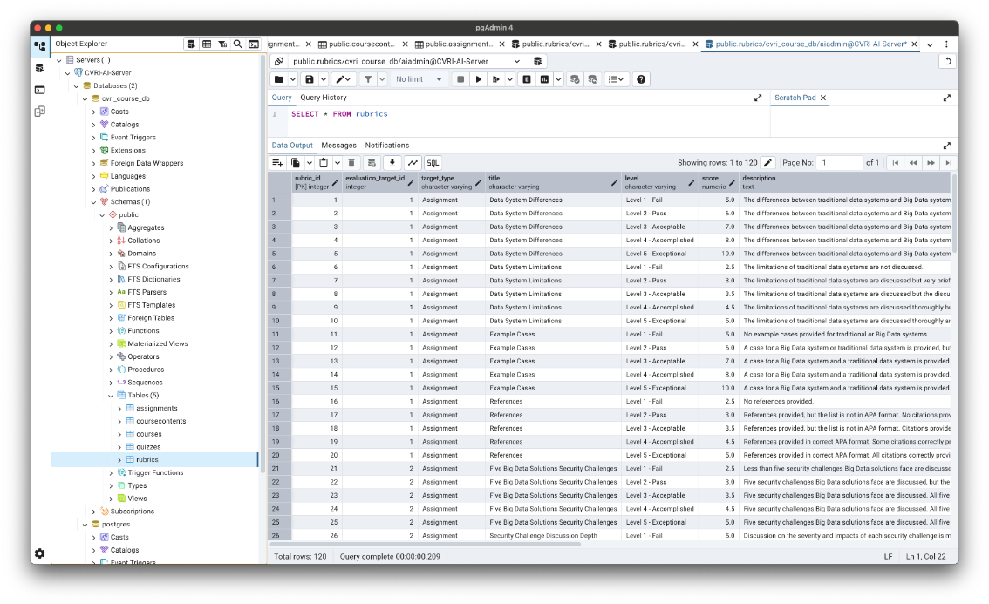
PostgreSQL Database Setup
Environment:
OS: Ubuntu 22.04
PostgreSQL Version: 15
Connection test: Verified using pgAdmin

Slide 6
DTA Live demo
Demo scenarios
Provide different questions for the selected course
Change the input field based on the question type
Demonstrate DTA functionality

Slide 7
Next Plan
DTA system
Release the DTA logic to the server.
Documentation Tasks
Organize all technical documents.
Create operation and user guide manuals.

Slide 8
Q & A

