Slide 1
Ecological Mental Functioning Ontology (EMFO) Graph
2024-03-08

Slide 2
is_a
Upper Levels/Categories
part_of
White Bold
Social Environments
Physical Environments
is_a & part_of
Attribute and
Property Classes
part_of
has
(some) have
White Bold
Environment
has
Environmental Factors
provides
Lower Levels/Classes
External Factors
influences
Black
Black Italics
part_of
Distal Contexts
integrates
Categories, Concepts Legend
Internal Feedback
part_of
uses
part_of
is_a
dependent on integrity of
Feedback
provides
Input
Context
has
Contextual Factors
part_of
relationship Legend
part_of
External Feedback
part_of
Proximal Contexts
part_of
Ecological Mental Functioning Ontology
part_of
uses
provides
Learning & Applying Knowledge
part_of
Health Condition Factors
part_of
Psychological
Communication Activities
Physical Functioning
Output
uses
Throughput
part_of
is_a
is_a
part_of
is_a
Personal Background Factors
Biographical
Mobility Activities
part_of
is_a
Person
has
Person Factors
part_of
is_a
Self_Care Activities
part_of
Demographic
part_of
Impairments
(some) have
Body Structures
General Tasks and Demands
Domestic Life Activities
(some) have
integrates
dependent on integrity of
is_a
Observable
Behavior
part_of
uses
Mental Functions
part_of
is_a
Body Functions
part_of
is_a
Interpersonal Interactions and Relationships
is_a
Mental Functioning
Brain
Influences
Mental Activity Limitations
part_of
is_a
Major Life Areas Activities
is_a
has
modifier
uses
is_a non
anatomical phenomenon within
Communication Functions
Feedback Appraisal
Mind
(some)
have
part_of
is_a
Cognitive Functions
part_of
is_a
Community, Social and Civic Life Activities
Activities
Level of Performance
Experiences
Participation

Slide 3
Feedback
provides
Input
part_of
part_of
Ecological Mental Functioning Ontology
uses
provides
part_of
part_of
Output
uses
Throughput

Slide 4
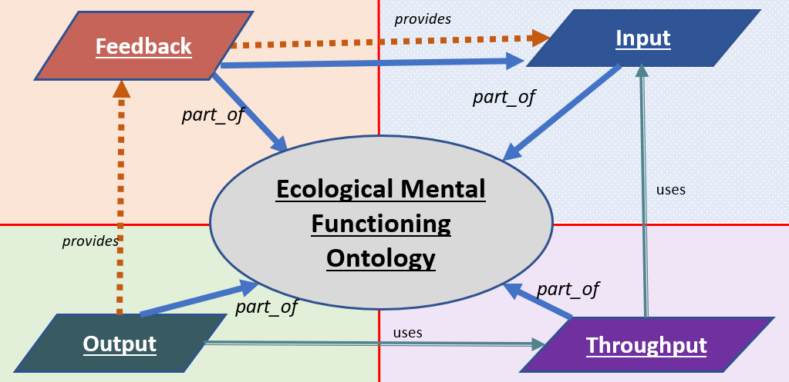

Slide 5
Context
Environment
External
Factors
Environmental Factors
Social Environments
Physical Environments

Slide 6
Context
Environment
External
Factors
Environmental Factors
Social Environments
Physical Environments

