Slide 1
Ecological Mental Functioning Ontology (EMFO) Graph
2024-06-14
2024-09-27
2024-11-01
2024-12-04
Revised
2025-02-03
2025-02-13
2025-05-09
2025-05-12
2025-05-16
Revised

Slide 2

is_a
Human-being
part_of
Top Level Class
Person
Social Environment
is_a & part_of
has-qualifier
Attribute and
Property Classes
Body Functions
Facilitators
Social Environments factors
Physical Environments factors
Physical Environment
provides
Class
Barriers
Class Shape Legend
provides
is_a &
part_of
bearer of
External Factor
Metrics
integrates
External Feedback
Internal Feedback
Environmental Factors
Environment
uses
has -qualifier
realizes
Is_a part_of
processed_by
provides
provides
Distal Contextual Factors
FEEDBACK
INPUT
External Factors
experience
observes
Contextual Factors
Context
relation legend
Observer
processed_by
Proximal Contextual factors
provides
part_of
Ecological Mental Functioning Ontology
is_a &
part_of
Rehabilitation Medicine Department
2025-05
observes
part_of
part_of
k
Learning & Applying Knowledge
part_of
Person-of-focus
Health Condition Factors
OUTPUT
uses
THROUGHPUT
Psychological
Communication Activities
Functioning Observed By Others
process
realizes
function
part_of
Is_a & part_of
is_a
is_a & part_of
Personal Background Factors
Biographical
part_of
Mobility Activities
Activities
Function-ing
Person Factors
is_a & part_of
Observed
Behavior
has agent
Self_Care Activities
Participation
Mental Functioning
bearer of
Impairments
bearer of
Demographic
General Tasks and Demands
Mental Activity Limitations
Body Structures
Domestic Life Activities
Self Reported Functioning
part of
Physical Functioning
bearer of
is_a & part_of
Disability Status
Functioning Performance
Performance Metrics
realizes
Mental Functions
is_a & part_of
Body Functions
Brain
Interpersonal Interactions and Relationships
has
qualifier
bearer of
has
qualifier
Internal Feedback
integrates
is_a & part_of
is_a non
anatomical phenomenon within
Major Life Areas Activities
Level of Performance
Communication Functions
Feedback Appraisal
Person Metric
Mind
Capacity
experience
bearer of
Community, Social and Civic Life Activities
Independence
Assistance
is_a & part of
Cognitive Functions
Impairment
Cognitive Level
difficulty
Limitation
Lived-experience
Of
Participation
bearer of
Notes:
Black and blue lines on bottom overlap and hard to tell where going.
Person Factors is part of the Person. Person has a role as patient.
I would remove “functioning observed by others” as it is not an activity of the person. Have the relationship in opposite direction as Observer > observes > observed behavior.
Functioning performance is a realization of mental functioning. Would remove “realization of” from Mental functioning to mental functions. Uses is enough.
Uses and realizes is not the same. Can you separate them in the legend?
Maybe drop the word “activities” after Communication, Mobility, self-care, domestic life since they have a relationship of is a Activities
Person factors is a p

Slide 3
Occurrents
Continuants
process
Functioning Observed By Others
Is-a
Function-ing
realizes
Function
Is-a
Activities
Observed
Behavior
Participation
part_of
Is-a
part_of
Mental Functioning
is_a & part_of
Self Reported Functioning
Functioning Performance
is_a & part_of
Mental Functions
Body Functions
realizes

Slide 4
Guy Divita, Maryanne Sacco, Kathleen Coale, Rebecca Parks and Elizabeth Rasch
Rehabilitation Medicine Department, National Institutes of Health, Bethesda, MD USA
2024-11
Feedback
provides
Input
part_of
part_of
Ecological Mental Functioning Ontology
uses
provides
part_of
part_of
Output
uses
Throughput

Slide 5
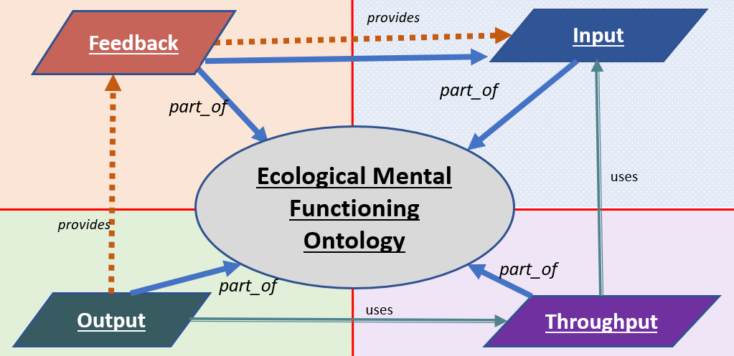
Guy Divita, Maryanne Sacco, Kathleen Coale, Rebecca Parks and Elizabeth Rasch
Rehabilitation Medicine Department, National Institutes of Health, Bethesda, MD USA
2024-11

Slide 6
Context
Environment
External
Factors
Environmental Factors
Social Environments
Physical Environments

Slide 7
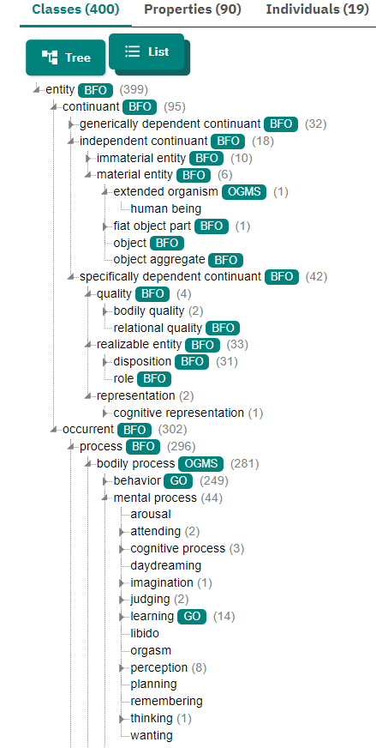
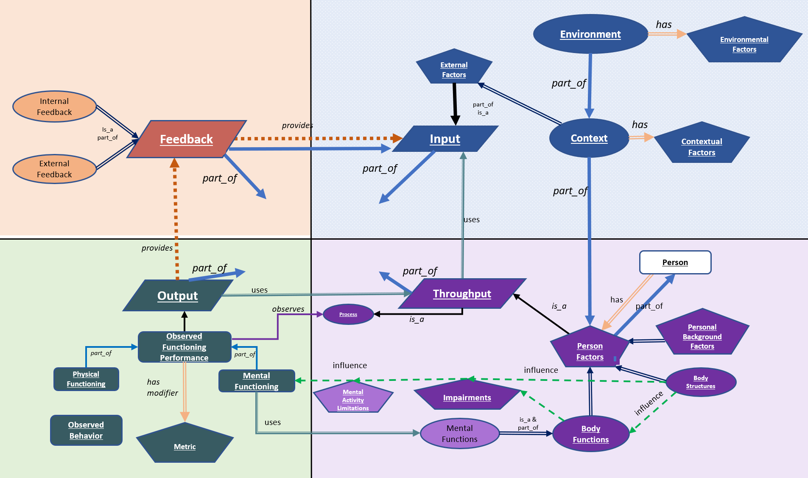
MF Ontology Mappings
Continuants
Move
Continuants
Occurrents

Slide 8
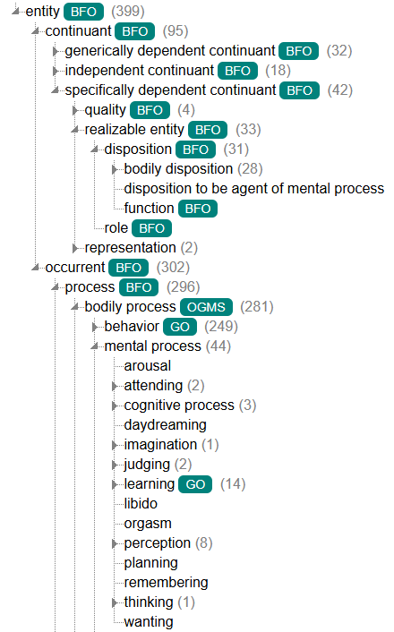
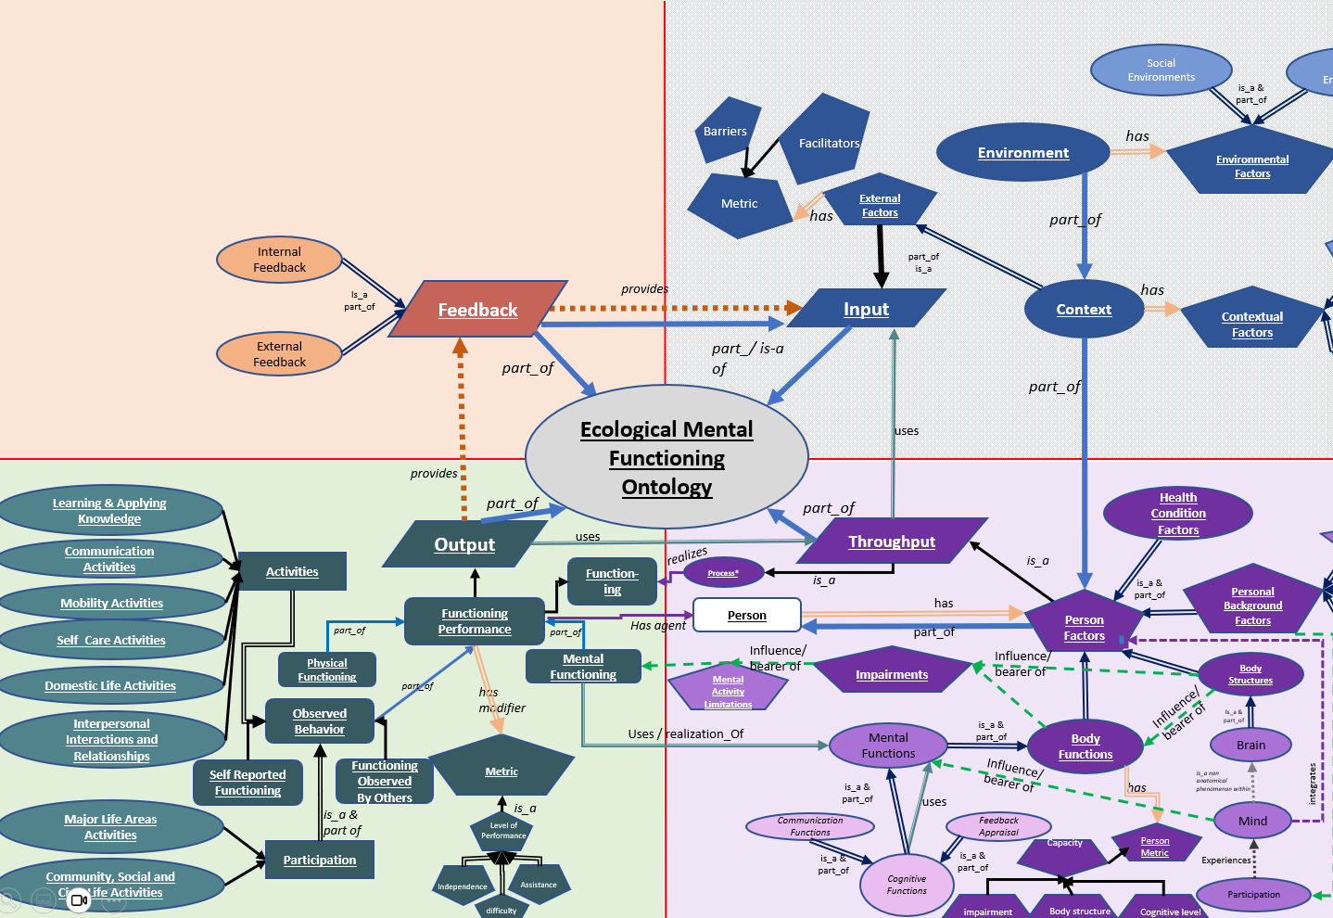
MF Ontology Mappings

Slide 9

External Factors: Contextual and Environmental
ICF Adapted
EXTERNAL FACTORS
Contextual Factors
Environmental
INPUT
Receives sensory information (including sensory feedback)
INPUT
Body Structures: Eye
THROUGHPUT
Perceives sensory and Feedback information and
Processes using neurocognitive functions
Feedback Appraisal (outcomes Adaptive? Effective?)
Organizes and Interprets information
Decides upon a response
THROUGHPUT
Body Structure: Brain
Body Functions: Mental
Health Condition
Person Factors
External Factors: Contextual and Environmental
External Factors: Contextual and Environmental
FEEDBACK
Results of one’s actions
OUTPUT
Observable behavior
OUTPUT
Functioning
Mental Functioning
Physical Functioning
Activities & Participation
External Factors: Contextual and Environmental
Notes:
This conceptualization represents functioning from the perspective of the individual
Orientation to the Model of Mental Functioning and how it aligns with the ICF. We put Personal Factors as Input and Throughput.

Slide 10
realizes
Processes
is_a
Person
Function-ings
Functioning Performance
part_of
part_of
influence
Physical Functioning
Mental Functioning
Mental Activity Limitations
Functioning Observed By Others
part_of
has
modifier
Observed
Behavior
Metric
uses
Self Reported Functioning
is_a
is_a
Level of Performance
Polarity
Quality
Activities
Independence
difficulty

Slide 11
Observed
Behavior
Activity Metric
is_a
is_a
Polarity
Quality
Activities
Environment Metric
difficulty
Performance problem
restriction
Level of Assistance
Level of Helper Assistance
Level of Supervision
Level of Performance
Possible Values
Complete
Moderate
No
N/A
Slight
Minimal
Total
Maximal
Mild
Severe
Not Specified
Low
Independent
Not Testable
Person Metric
capacity
limitation
impairment
Possible Values
Complete
Moderate
No
N/A
Slight
Minimal
Total
Maximal
Mild
Severe
Not Specified
Low
Not Testable

Slide 12
is_a
Upper Levels/Categories
Guy Divita, Maryanne Sacco, Kathleen Coale, Rebecca Parks and Elizabeth Rasch
Rehabilitation Medicine Department, National Institutes of Health, Bethesda, MD USA
2024-11
part_of
White Bold
Social Environments
Physical Environments
is_a & part_of
Attribute and
Property Classes
is_a &
part_of
has
Barriers
provides
White Bold
Environment
has
Environmental Factors
influence
Lower Levels/Classes
Metric
Facilitators
Black
External Factors
integrates
Black Italics
part_of
uses
Categories, Concepts Legend
Internal Feedback
Distal Contexts
Somewhat dependent on
part_of
is_a
observes
Is_a part_of
Feedback
provides
Input
Context
has
Contextual Factors
is_a &
part_of
relation Legend
External Feedback
Proximal Contexts
part_of
part_of
Ecological Mental Functioning Ontology
part_of
uses
provides
k
Learning & Applying Knowledge
part_of
part_of
Health Condition Factors
Output
uses
Throughput
Psychological
Communication Activities
realizes
Process
is_a
is_a & part_of
is_a
is_a & part_of
Personal Background Factors
Biographical
Mobility Activities
Observed Functioning Performance
Person
has
Person Factors
is_a & part_of
Self_Care Activities
part_of
part_of
influence
part_of
Demographic
part_of
Physical Functioning
Mental Functioning
Impairments
influence
Body Structures
General Tasks and Demands
Domestic Life Activities
part_of
has
modifier
Mental Activity Limitations
is_a
influence
Is_a & part_of
Disability Status
Interpersonal Interactions and Relationships
Observed
Behavior
uses
Mental Functions
is_a & part_of
Body Functions
Brain
Metric
Major Life Areas Activities
is_a
is_a & part_of
uses
has
is_a non
anatomical phenomenon within
integrates
is_a
uses
Level of Performance
Communication Functions
Feedback Appraisal
Mind
Community, Social and Civic Life Activities
Polarity
Quality
is_a & part_of
is_a & part_of
Person Metric
Experiences
influence
Activities
Cognitive Functions
Capacity
Independence
difficulty
Participation

Slide 13
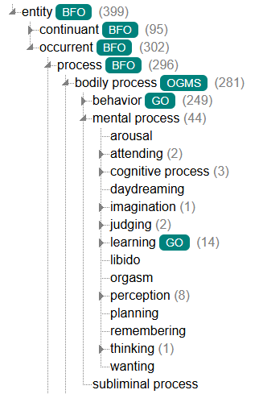
Legend
Mental Function

Slide 14
